Slide 2


Disclaimer
This presentation has been prepared by KT Corp. This presentation contains forward-looking statements, which are subject to risks, uncertainties, and assumptions. This presentation is being presented solely for your information and is subject to change without notice. No representation or warranty, expressed or implied, is made and no reliance should be placed on the accuracy, actuality, fairness, or completeness of the information presented. The Company, its affiliates or representatives accept no liability whatsoever for any losses arising from any information contained in the presentation.
This presentation does not constitute an offer or invitation to purchase or subscribe for any shares of the Company, and no part of this presentation shall form the Basis of or be relied upon in connection with any contract or commitment. Any decision to purchase shares of the Company should be made solely on the Basis of information, which has been publicly filed with the Securities and Exchange Commission or the Korea Stock Exchange and distributed to all investors.
The contents of this presentation may not be reproduced, redistributed or passed on, directly or indirectly, to any other person or published, in whole or in part, for any purpose.
Notes:
For all pages, please make sure that the format is set to print properly on A4 paper.
The client says that the KT logo at the bottom gets cut off.

Slide 3


Table of Contents
I
Company Status
II
“We say, they say”
III
Shareholder Return

Slide 4
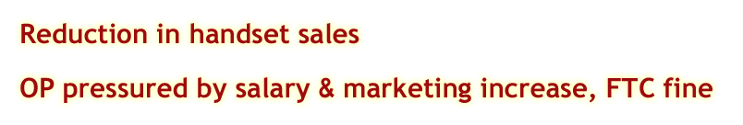


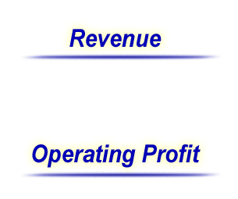




Flat Revenue
Handset sales
(KRW Trillion)
6.05
-1.3%
5.97
3.03
0.34
0.25
3.02
2.98
2.99
0.19
0.15
0.16
0.10
2.83
2.88
5.71
2.83
2.89
5.72
’04 1Q
’04 2Q
’04 1H
’05 1Q
’05 2Q
’05 1H
FTC fine
(KRW Trillion)
1.33
-18%
1.09
0.75
0.14
0.58
0.61
0.48
0.14
0.34
0.95
’04 1Q
’04 2Q
’04 1H
’05 1Q
’05 2Q
’05 1H

Slide 5

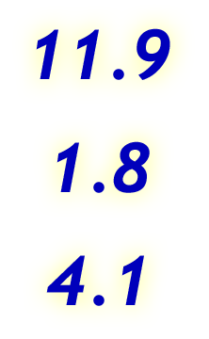




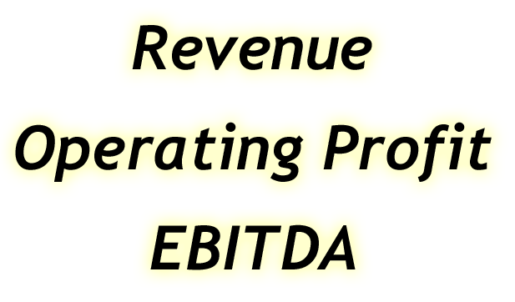
FY 05 Targets
(KRW Trillion)
53%
50%
47%
2005. 1H performance
Notes:
Targets revised
OP
- 70bn salary increase for 1Q, 140 bn FTC fine all gone
- marketing expense control

Slide 6

Table of Contents
I
Company Status
II
“We say, they say”
III
Shareholder Return

Slide 7

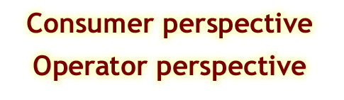

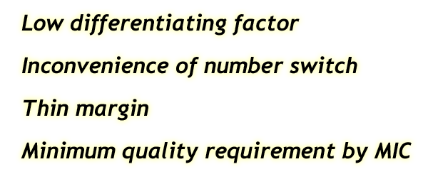



VoIP
(KRW / 3min)
(KRW / 3min)
KT Telephone
A VoIP
A VoIP
Tariff
Interconnection cost paid to KT
Monthly fee
5,200
2,000
Monthly fee
2,000
1,500
Local /
DLD < 30Km
39
45
Local
45
Telephone: 54.4 / 62.5
VoIP: 16.5
DLD > 30Km
261
DLD
Notes:
Monthly fee difference - $3 per month
Saving in DLD
Telephone # switch, emergency call not offered, disfunction when power out
VoIP economics is not viable for mass market. Current VoIP will target corporate users.

Slide 8
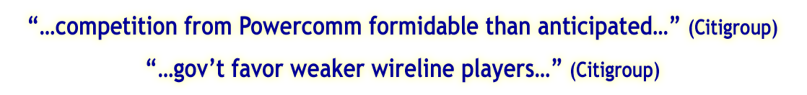


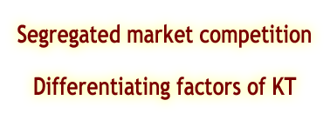



Broadband competition
Net addition in Sep
High quality of service
44,000
35%
LAN
xDSL technology superiority
Prompt & excellent customer service
18,581
17%
LAN
65%
Cable
Effective marketing
83%
xDSL
KT
Powercomm
Extensive sales distribution
Source: KT Company data
Powercomm – Hanwha Sec Report
Notes:
1st month, Powercomm – 44,000, KT 18,581 (as of Sep 25th)
Due to network coverage, 65% cable based subs (Hanaro+ Thrunet cable accounts 64% of total subs)
Differentiating factors of KT
- inform xDSL technology superiority
- promptly provide excellent installation & A/S guys
- establish image of 명품
Effective marketing
- extensive sales distribution including internal sales force -> marketing expense controlled
- 3rd party sales commission capped
Keep stable net addition at a reasonable cost

Slide 9

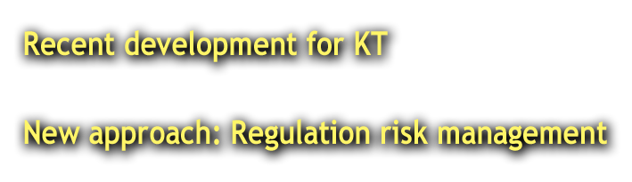


Regulation
Designated as dominant broadband player
Received FTC fine
KT already announced to maintain 6.2% wireless M/S cap by 2007
not to overheat market competition
Pursue fair competition
Notes:
Dominant broadband player , FTC fines(140bn)
Different perspective of FTC fine – do not need to follow MIC advice
KT cannot getaway, deal with regulation is key
New approach
- set up regulation risk management system
- Examples are no FTC fine on broadband and
PCS resale market cap announcement – No more related investigation

Slide 10
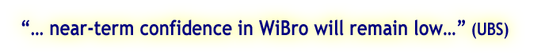
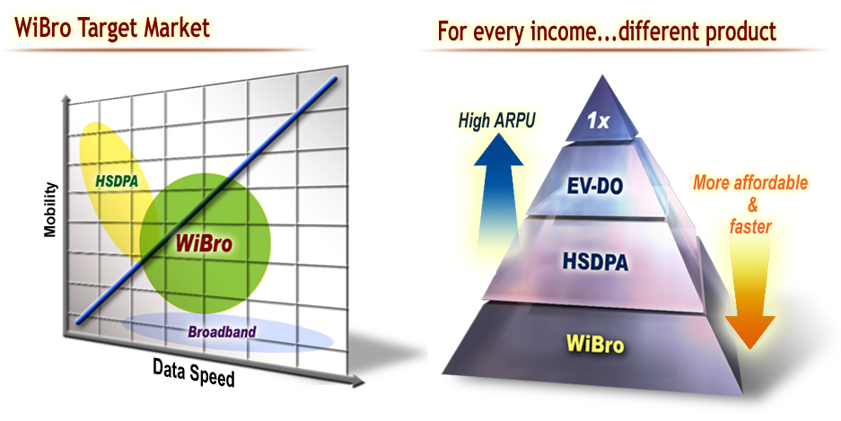
WiBro
WiBro Business Principle
- Verification of technology & equipment feasibility and reliability
- Gradual network expansion with caution
WiBro preparation as planned
Notes:
WiBro Target Market : medium high speed with mobility
- WiBro demands : 3~6m
- business man, students
For every income.. Different product
- Faster speed up to 4M, affordable price at 15,000 won
KT group – fixed-line and mobile network

Slide 11
Table of Contents
I
Company Status
II
“We say, they say”
III
Shareholder Return

Slide 12
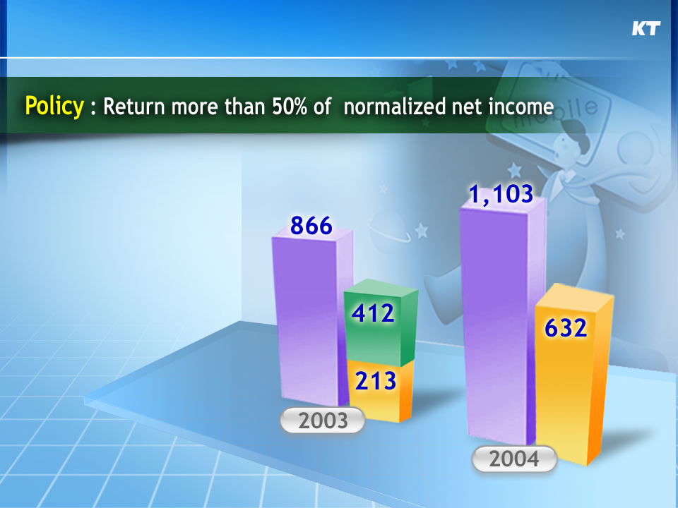
Shareholder Return
Dividend
Normalized Net Income
Share buyback & cancellation
(KRW billion)
Notes:
Normalized net income
Normalized net income
2003 Payout ratio: Total 72%, dividend only 25%
2004 Payout ratio: 57%
After BOD, 2006 biz review 06 dividend determined
But mgmt intention to maintain shareholder return
2005 2Q net debt: 5,229 bn

