Slide 1

Investor Presentation
“The Value Networking Company”
June 2005

Slide 2
Disclaimer
This presentation has been prepared by KT Corp. This presentation contains forward-looking statements, which are subject to risks, uncertainties, and assumptions. This presentation is being presented solely for your information and is subject to change without notice. No representation or warranty, expressed or implied, is made and no reliance should be placed on the accuracy, actuality, fairness, or completeness of the information presented. The Company, its affiliates or representatives accept no liability whatsoever for any losses arising from any information contained in the presentation.
This presentation does not constitute an offer or invitation to purchase or subscribe for any shares of the Company, and no part of this presentation shall form the Basis of or be relied upon in connection with any contract or commitment. Any decision to purchase shares of the Company should be made solely on the Basis of information, which has been publicly filed with the Securities and Exchange Commission or the Korea Stock Exchange and distributed to all investors.
The contents of this presentation may not be reproduced, redistributed or passed on, directly or indirectly, to any other person or published, in whole or in part, for any purpose.
Notes:
For all pages, please make sure that the format is set to print properly on A4 paper.
The client says that the KT logo at the bottom gets cut off.

Slide 3
Table of Contents
I. Highlights of 1Q 2005
II. Shareholder initiatives
III. Growth Strategy – WiBro Service

Slide 4
I. Highlights of 1Q 2005
(KRW trillion)
1Q 2005
1Q 2004
2005(E)
Revenue
2.98
3.02
11.9
Operating expense
2.36
2.27
-
Operating profit
0.62
0.75
Over 2.1
EBITDA
1.10
1.31
Over 4.4

Slide 5
I-1. 1Q 2005 revenue performance
1Q 2004
1Q 2005
(KRW billion)
1,133.9
1,100.8
705.7
634.2
493.4
427.7
339.2
354.3
330.0
328.6
Internet
Data
Telephone
LM
PCS resale
11.3%
2.8%
2.9%
13.3%
7.3%

Slide 6
I-2. Broadband & PCS – Continued growth
Broadband subscribers (000s)
KT PCS subscribers (000s)
5,589
6,078
6,133
6,600
1,555
2,230
2,473
2,540
2003
2004
1Q-2005
2005 target
2003
2004
1Q-2005
2005 target

Slide 7
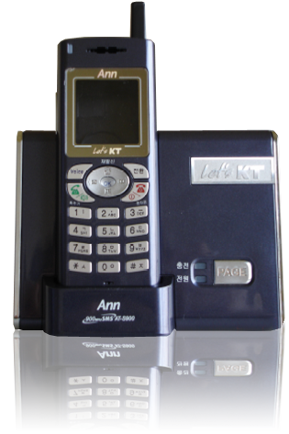

I-3. Minimized fixed-line revenue decline
Adopt mobile VAS to fixed voice service
Fixed-line subs(000s)
  Mobile handset functions added to cordless phone
  - Launch “Ann” in Nov. 2004 / 390,838 subs (Mar.2005)
21,091
21,107
  Customized ring-back tone service
♪
  - Launch “Ringo” in Apr. 2004 / 2.85 million subs (Mar.2005)
♪
♪
♪
♪
Successful response to FNP
  Successful defense in 1Q 2005 : 0% M/S loss
  Maintain 21 million fixed-line subscribers
4Q-2004
1Q-2005

Slide 8
I-4. 1Q 2005 cost structure
(KRW : billion)
492.8
Depreciation
11.6%
557.4
16.3
Provision for doubtful accounts
39.2
58.3%
631.4
Cost of goods & service
614.4
2.8%
Sales related cost increased
137.3
40.6%
193.1
Marketing Expense
37.9
26.5%
47.9
Repairs & Maintenance
578.8
631.3
9.1%
Labor
1Q-2004
1Q-2005

Slide 9
I-5. Focus on cash flow management
Operating profit
(KRW : billion)
751.3
609.4
578.0
510.6
287.2
1Q-04
2Q-04
3Q-04
4Q-04
1Q-05
EBITDA
1,308.7
1,093.2
1,102.3
1,088.4
915.9
1Q-04
2Q-04
3Q-04
4Q-04
1Q-05

Slide 10
II. Shareholder initiatives
Regular Dividend
Buyback & Cancellation
Interim Dividend
(KRW billion)
625
634
630
212
Interim
dividend
FTC – one time charge
- Cool down market competition
No impact on dividend
412
422
422
213
2003
2004
2005 (E)
Maintain same level of returns as 2004
Notes:
어떠한 기업이 기존 사업의 전망은 불투명하고, 향후 성장동인이 불투명한 상황이라면, 전략적 방향을 다시 조명할 필요가 있으며, 이것이 바로 현재의 KT가 직면한 상황임
향후 기존 사업의 paradigm으로는 지속적 성장 momentum의 확보가 불가능
새로운 성장 모멘텀의 확보가 필요
‘Chasm’의 극복은 양적인 변화만이 아니라 질적인 변화를 함께 요구한다는 의미
새로운 성장 모멘텀은 사업내용은 물론, 사업추진 방식 및 요구되는 내부역량의 측면에서도 변화를 요구
사업추진을 위한 역량의 확보를 위하여는, 기존 역량의 단순한 연장이 아닌, 차별적 역량의 독립적 확보라는 시각도 필요
바로 이러한 인식에 의거하여 중장기 전략적 지향점은 ‘Global Best Growing Company’로 설정하였음

Slide 11
III. Growth strategy
Overviews of KT’s WiBro Strategy
Notes:
어떠한 기업이 기존 사업의 전망은 불투명하고, 향후 성장동인이 불투명한 상황이라면, 전략적 방향을 다시 조명할 필요가 있으며, 이것이 바로 현재의 KT가 직면한 상황임
향후 기존 사업의 paradigm으로는 지속적 성장 momentum의 확보가 불가능
새로운 성장 모멘텀의 확보가 필요
‘Chasm’의 극복은 양적인 변화만이 아니라 질적인 변화를 함께 요구한다는 의미
새로운 성장 모멘텀은 사업내용은 물론, 사업추진 방식 및 요구되는 내부역량의 측면에서도 변화를 요구
사업추진을 위한 역량의 확보를 위하여는, 기존 역량의 단순한 연장이 아닌, 차별적 역량의 독립적 확보라는 시각도 필요
바로 이러한 인식에 의거하여 중장기 전략적 지향점은 ‘Global Best Growing Company’로 설정하였음

Slide 12
III-1 Market Forecast for Data Communication
Fixed Line
Wireless
saturated market
high growth rate is expected
up to 2008
CAGR = 4.77%
CAGR = 20.20%
Data
6.7
8.5
6.43
3.08
2004
CAGR = -6.23%
2008
2004
2008
CAGR = -3.08%
Voice
6.5
13.1
11.6
5.0
2004
2008
2004
2008
diminishing demand due to the
demand shift to mobile
communication
revenue began to decrease
Source : KISDI, Unit : KRW trillion

Slide 13

III-2 Market Position of WiBro
portability & mobility
inter-activity
portability & mobility
low tariff
EV-DO
D M B
limited data speed
high tariff
WiBro
one-way communication
not available for
additional service
portability & mobility
nation-wide coverage
high speed
inter-activity
price competitiveness
high speed
portability & mobility
high speed & QoS
convenient for use
limited coverage
poor QoS
W-LAN
Broadband
non-portability
service for household

Slide 14
III-3 What WiBro means to KT?
Future Growth
Engine
WiBro service will be cemented as a future growth engine for KT
- year 2010 target : 3 million subscribers and 1.2 trillion revenue
KT Group Synergy
Cost effective service using existing infrastructure
- KT’s fixed-line infra and distribution channel
- KTF’s wireless network
- contents sourcing from KTH & KDB
Leader in
Ubiquitous Market
Lead a ubiquitous market as a No.1 telecommunication service provider
- make the utmost use of broadband M/S
- prominent position in wireless TPS
※ TPS : Triple Play Service (voice + data + media)

Slide 15
III-4 Technical Progress in Ubiquitous Networking
Past
Present
Near Future
Fixed
PSTN Modem
ADSL
VDSL
FTTH
ISDN
1-8Mbps
20~50Mbps
100+ Mbps
IEEE802.11
IEEE802.11b
IEEE802.11a
(5GHz)
WLAN
1+ Mbps
11Mbps
per AP
IEEE802.11g
(2.4GHz)
WiBro
(2.3GHz)
54Mbps
per AP
~1Mbps
per device
PCS
(IS-95A)
IS-95B
CDMA2000
1X
1X EV-DO
1X EV-DV
Mobile
14.4 kbps
64 kbps
144 kbps
2.4 Mbps
shared
3.1Mbps
shared
GSM
GPRS
WCDMA
HSDPA
9.6 kbps
115 kbps
2 Mbps
shared
14 Mbps
shared

Slide 16

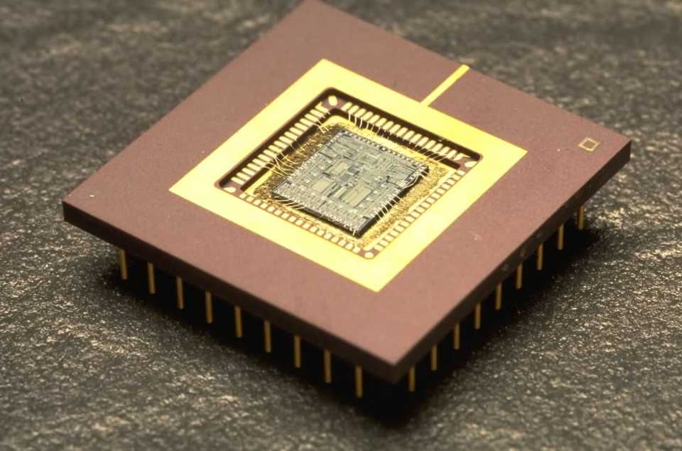
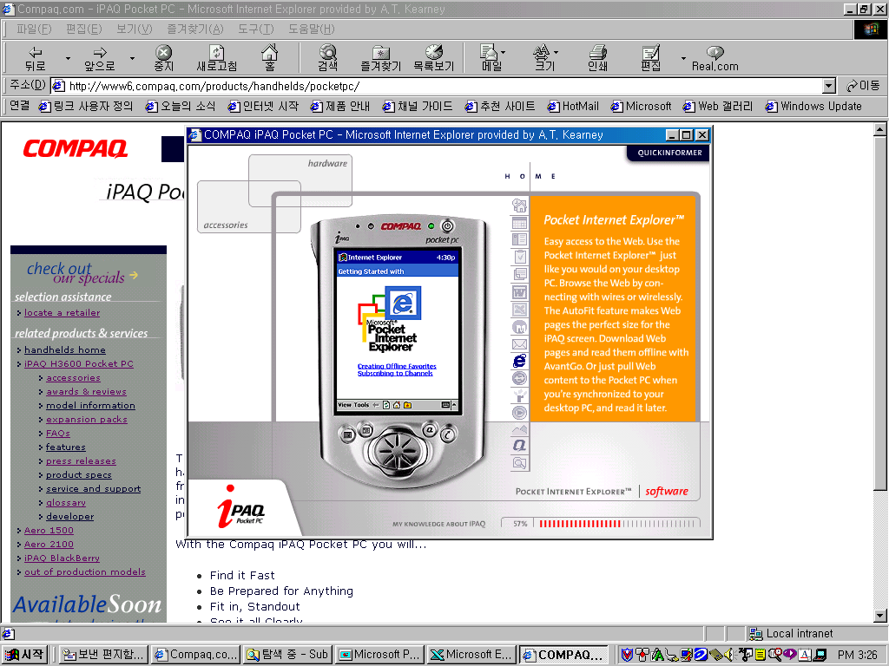
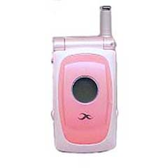


III-5 Terminal Development Plan
Form of terminal
Development Roadmap
Beginning period
High growth period
Mature period
WiBro chip
built in laptop
PCMCIA card &
chip built in laptop
Multi-mode terminal
WiBro + CDMA + GPS
One Chip
Laptop
customized terminals
for individual / enterprise use
for specific service
for converged service
Portable terminals
for WiBro Service
Dual mode terminal
WiBro + CDMA
Dual mode terminal
WiBro + WLAN
WiBro + DMB
Triple mode terminal
WiBro + WLAN + CDMA
WiBro + CDMA+ DMB
PDA
Smart Phone

Slide 17
III-6 Service Promotion Plan
Schedule of KT’s WiBro Service
Key Target for year 2010
equipment test 2Q, 2005
equipment purchasing 2Q ~ 3Q, 2005
- platform & base station (Jul.), relay stations (Aug.)
pilot service during APEC(Busan region) Nov., 2005
trial service 1Q, 2006
commercial service launching 2Q, 2006
Total subscribers
3.1 million
WiBro revenue
1.2 trillion KRW
Cumulative Capex
1 trillion KRW

