Slide 1
Task difficulty affects the dimensionality of neural population activity
By: Sydney Dimmock, Pui-Shee Lee, Daniel-Cosmin Marcu, Joram van Rheede, Heng Wei Zhu
Pod: Quixotic Swan TA: Roman Pogodin Mentor: Mehdi Adibi

Slide 2
Project outline
Brief scientific background:
Decision uncertainty is the degree of confidence on whether a choice is correct
Challenging decisions are associated with higher uncertainty and more errors
How this is reflected in neural population activity in the brain remains unclear
The dimensionality of frontal areas decreases when animals perform incorrectly in tasks
Scientific question:
How does the dimensionality of neural population activity in the Steinmetz data set change when the animal is presented with easy and hard tasks?
Does task difficulty predict how well neurons encode choice?

Slide 3
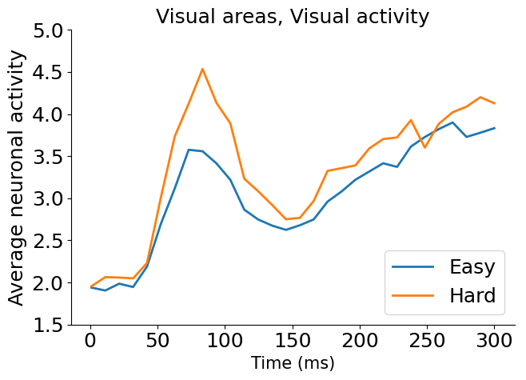
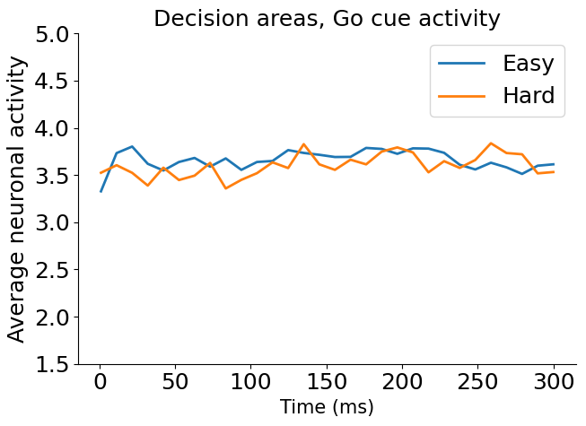
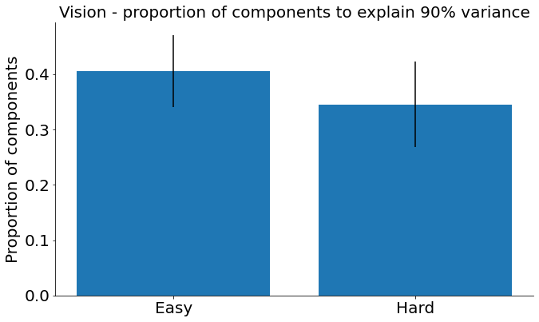
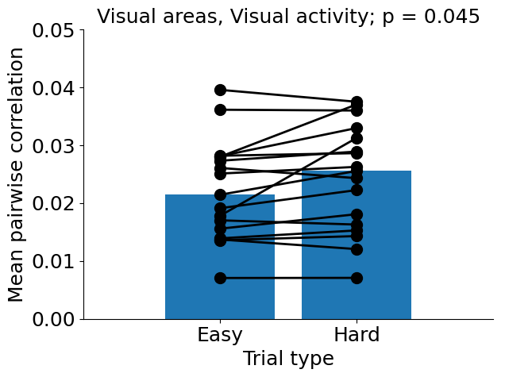
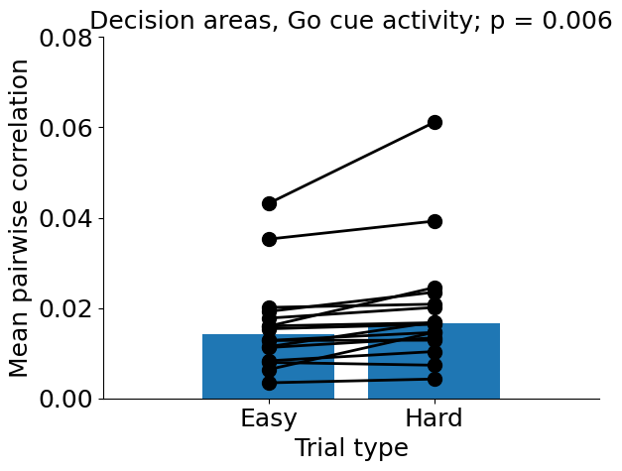
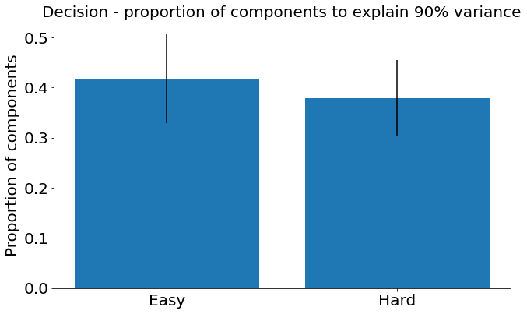
Pairwise correlations between neurons and PCA of neural population activity reveal more redundancy and lower dimensionality in hard trials

Slide 4
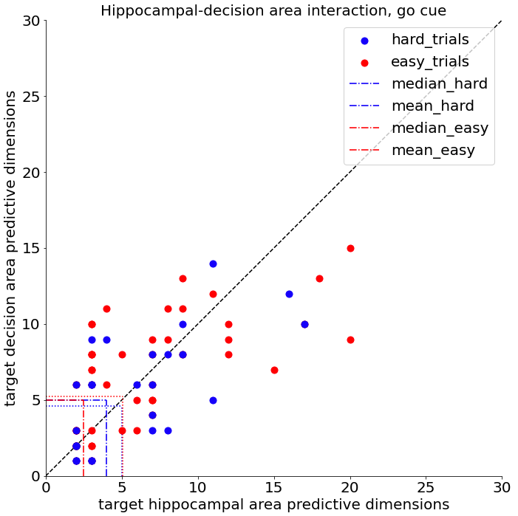
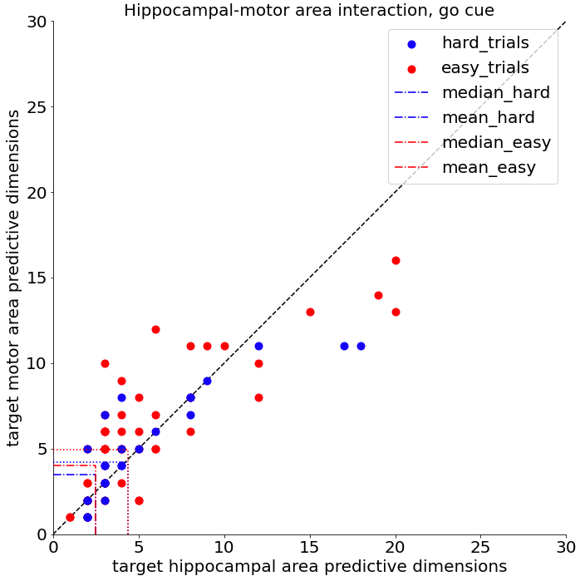
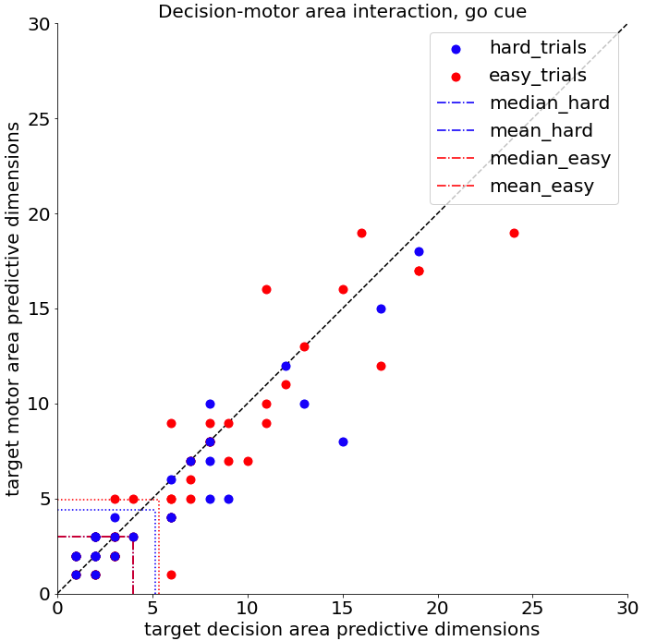
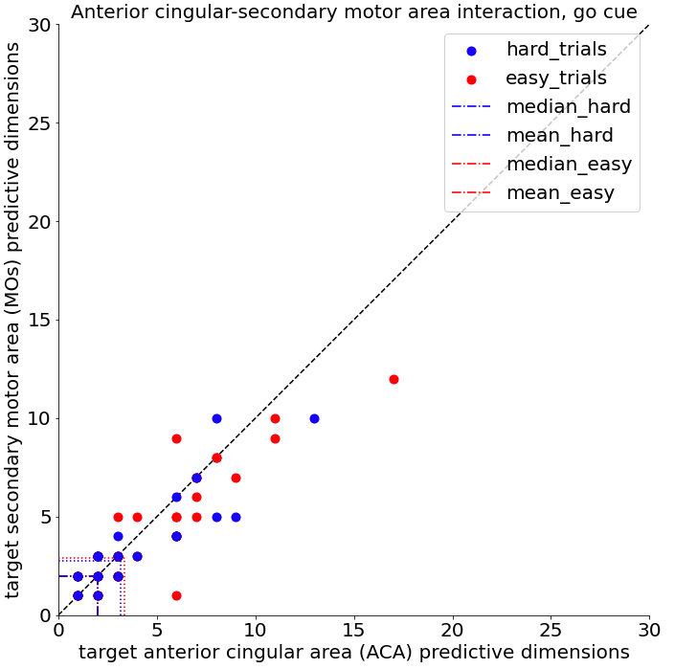
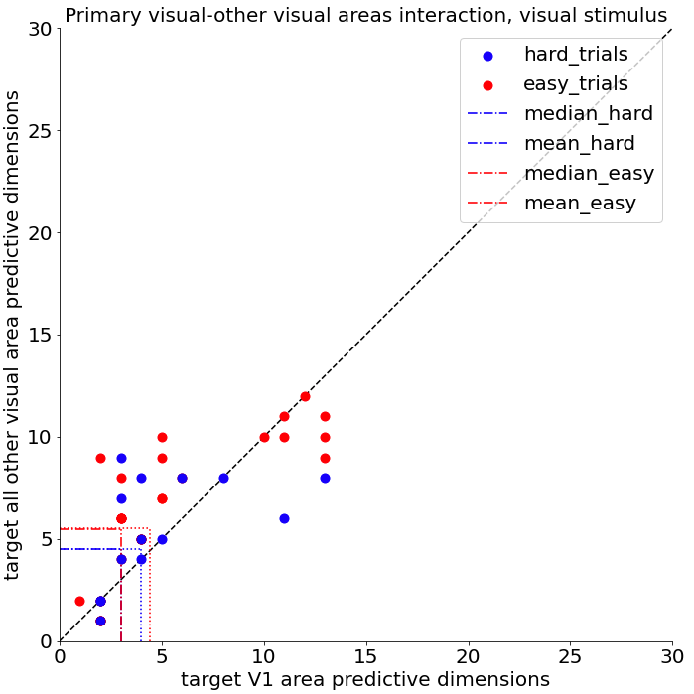
Communication subspace between within cortical area and inter-area are lower dimensional in hards trials compared to easy trials
Techniques: ridge regression,
reduced rank regression

Slide 5
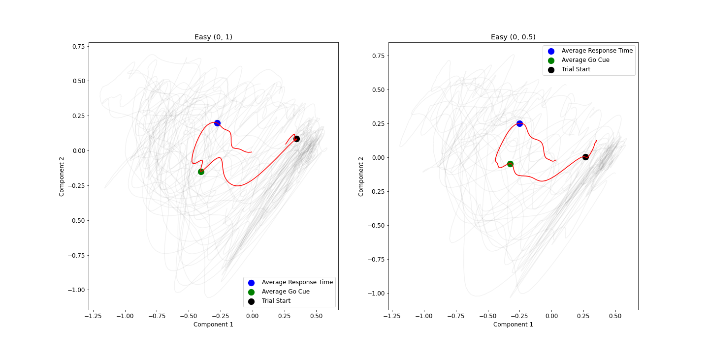
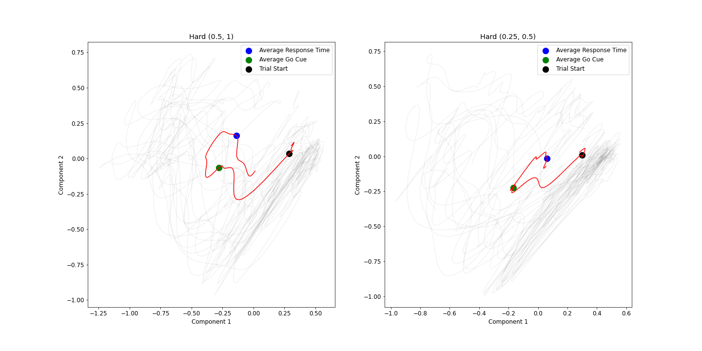
Gaussian Process Factor Analysis
Gaussian process factor analysis was used to visualise the latent trajectories of easy and hard trials. Example trajectories from recording session four are given on the left.
Whilst providing a visual insight into how neural activity evolved through the trial of interest, this was not a quantitative result.
Significance tests were computed for extracted trajectory lengths over sessions, however a statistically significant conclusion was not reached.

Slide 6
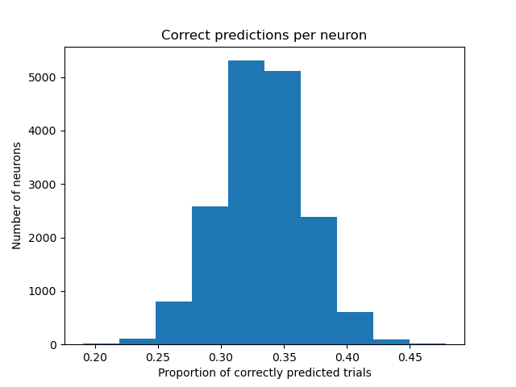
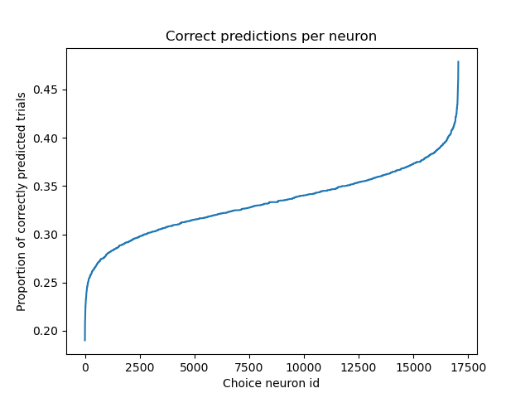
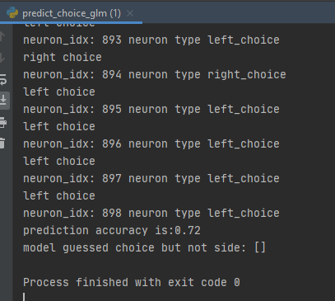
Choice can be decoded from neuronal spiking patterns using GLMs

Slide 7
Conclusions & Lessons learnt
Conclusions - Increased task difficulty resulted in lower-dimensional neural population activity as captured in pairwise correlations and PCA of within-area activity as well as inter-area correlations. Lower-dimensional population dynamics did not appear quantitatively different for easy vs. hard trials. GLMs could be used to predict choice but we ran out of time for doing a trial difficulty comparison…
Lower dimensionality of the neural population response could reflect increased ambiguity about course of action (which we were hoping the GLM approach might address) or perhaps the effect of attention on neural synchrony.
Lessons learnt - Diving into a complex data set under time pressure with high-level dimensionality reduction methods is pretty ambitious; you realise there many basic elements of an experiment that may introduce confounds and need serious thought to be controlled for (e.g. unequal numbers of neurons between sessions; unequal numbers of easy / hard trials, more incorrect responses in the hard trial group).
A lot of groundwork needs to be done before doing all the fancy methods you want to do.
Making (causal) interpretations about lower-dimensional neural population activity that generate predictions for further experiments is not straightforward - we are still debating what is going on...
Task distribution in a remote project is an art; and so is merging individual contributions into a single project narrative!

Slide 8
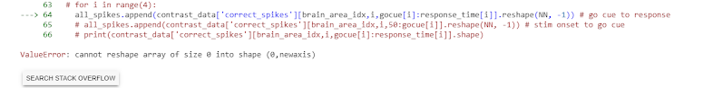
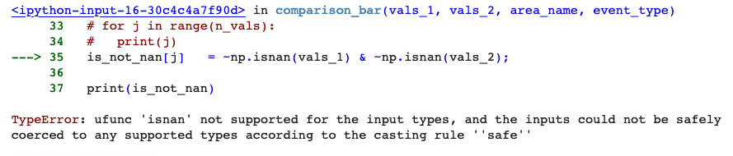
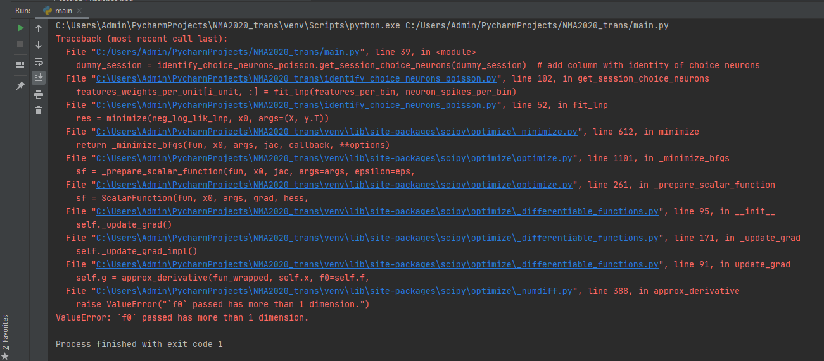
Appendix A: Python error hall of fame

Slide 9
Project outline
Brief scientific background: Decision uncertainty is the degree of confidence on whether a choice is correct. Challenging decisions are associated with higher uncertainty and more errors. However, how this is reflected in neural population activity in the brain remains unclear. It has been observed in rodents and primates that the dimensionality of frontal areas decreases when they perform incorrectly in tasks suggesting the importance of high dimensionality representations in executing the correct response. Are these changes in dimensionality directly reflected in the level of difficulty in the task?
Scientific question: How does the dimensionality of neural population activity in the Steinmetz data set change when the animal is presented with easy and hard tasks? Does task difficulty predict how well neurons encode choice?
Approach: Compute pairwise correlations between neurons to establish redundancy; Run PCA to investigate dimensionality; Explore GPFA to investigate lower-dimensional dynamics; Ridge & reduced rank regression to establish dimensionality of inter-area communication; GLM & logistic regression to investigate how well neural population predicts behavioural response.

