Slide 1
Puja Maharana
Final Project
3/21/2024 Annual Review

Slide 2
PROJECT TITLE:
Key Logger & Security
3/21/2024 Annual Review

Slide 3


AGENDA
Problem Statement
Project overview
Who are the end users?
Your solution and its value preposition
The wow in your solution
Modeling
Results
Project link
3/21/2024 Annual Review

Slide 4

PROBLEM STATEMENT
Keyloggers silently capture all keystrokes on devices, including passwords and sensitive data, posing a significant cybersecurity threat. Despite advancements, they often evade detection by antivirus software. This project aims to develop robust methods to detect and prevent keyloggers, safeguarding users from unauthorized data theft and privacy breaches.
3/21/2024 Annual Review

Slide 5

PROJECT OVERVIEW
This project focuses on the serious threat of keyloggers, which secretly record everything you type on your devices, including passwords and other sensitive info. These sneaky programs can avoid detection by regular security software, putting users at risk of data breaches and identity theft. Our goals are to create better ways to find and stop keyloggers, educate people about these dangers, and do research to improve cybersecurity. By working together and testing our methods thoroughly, we aim to make it harder for keyloggers to steal personal information and help everyone use digital devices more safely.
3/21/2024 Annual Review

Slide 6

WHO ARE THE END USERS?
Cybersecurity measures, including those aimed at detecting and preventing keyloggers, are typically used by individuals and organizations who rely on computers, smartphones, and other digital devices. These include:
Individual User
Businesses and Organizations
Educational Institutions
Government Agencies
Healthcare Providers
Financial Institutions
3/21/2024 Annual Review

Slide 7

YOUR SOLUTION AND ITS VALUE PROPOSITION
My solution:
Our project involves developing a user-friendly Python-based keylogger with start and stop functionality, allowing users to easily control the keylogging process. It captures all keystrokes and saves them to an encrypted text document for secure review. The application also includes notifications to indicate when keylogging is active, ensuring transparency and control.
Value Proposition:
Ease of Use
Comprehensive Logging
Enhanced Security
User Control
3/21/2024 Annual Review

Slide 8

THE WOW IN YOUR SOLUTION
The "wow" factor of our keylogger and security project lies in its blend of advanced features and user-friendly design. With one-click start and stop functionality, even non-technical users can easily control the keylogging process. Real-time notifications keep users informed about the keylogger's status, ensuring transparency. Additionally, all logged data is encrypted, providing robust security against unauthorized access. This solution not only protects sensitive information but also serves as an educational tool, raising awareness about the risks of keyloggers and the importance of cybersecurity.
3/21/2024 Annual Review
‹#›

Slide 9
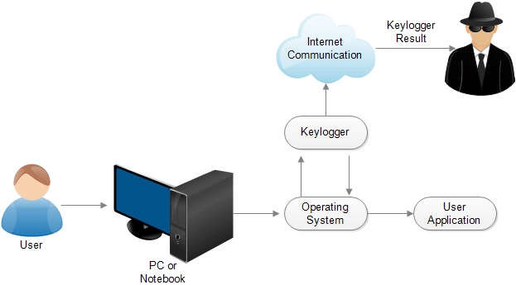
MODELLING
3/21/2024 Annual Review
‹#›

Slide 10
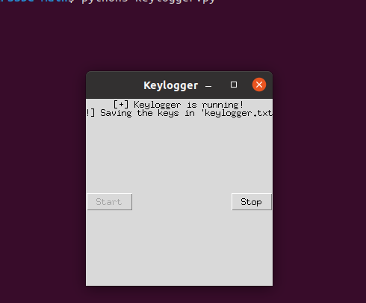
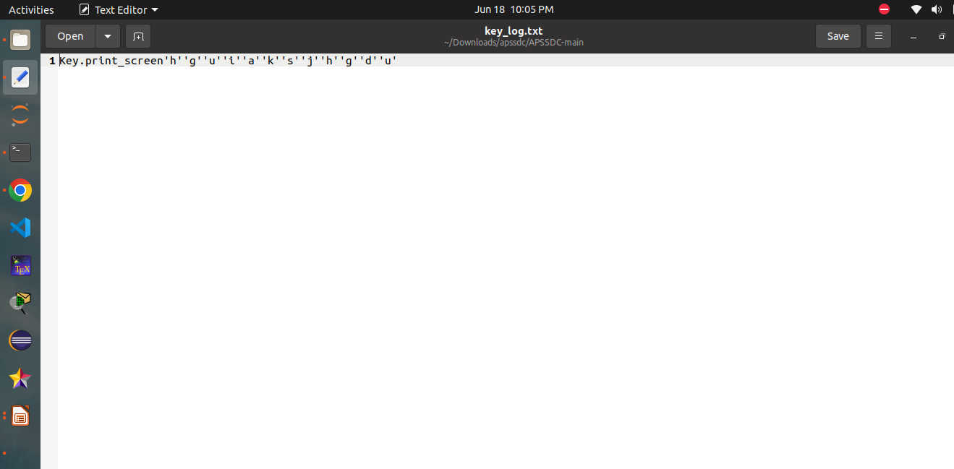
RESULTS
3/21/2024 Annual Review
‹#›

Slide 11
Project link
https://github.com/puja279/apssdcpuja/
3/21/2024 Annual Review
‹#›

