Slide 2
Introduction to Bootstrap
Bootstrap is a widely used front-end framework for web development.
It provides a collection of CSS and JavaScript components that help build responsive and visually appealing websites.
By using Bootstrap, developers can save time and effort by leveraging pre-built components and responsive grid system.
Bootstrap is compatible with modern web browsers and offers cross-browser consistency.

Slide 3
Key Features of Bootstrap
Browser Compatibility: Bootstrap is designed to work across modern web browsers, ensuring consistent behavior and appearance.
Documentation and Community Support: Bootstrap has comprehensive documentation and an active community, making it easy for developers to learn, troubleshoot, and seek assistance when needed.
Continuous Development: Bootstrap has evolved through multiple versions, with each release introducing new features, improvements, and bug fixes.
Extensibility: Developers can customize Bootstrap's components and styles to match their project requirements. Additionally, Bootstrap can be extended with third-party plugins and themes.

Slide 4
Key Features of Bootstrap
Responsive Design: Bootstrap is known for its responsive grid system, allowing websites to adapt and display well on different screen sizes and devices.
Mobile-First Approach: Bootstrap follows a mobile-first approach, prioritizing design and development for mobile devices and then scaling up for larger screens.
Pre-styled Components: Bootstrap provides a wide range of pre-styled components such as navigation bars, buttons, forms, and alerts, enabling developers to quickly incorporate them into their projects.

Slide 5
Bootstrap's Grid System
The grid system is a fundamental feature of Bootstrap, providing a flexible and responsive layout structure for web pages.
The grid system is based on a 12-column layout, allowing content to be divided and organized into columns.
Bootstrap uses container, row, and column classes to create a grid layout.
The container class is used to wrap the entire content and provides a responsive fixed-width container.
Rows are created using the row class and serve as horizontal containers for columns.
Columns are defined using col-X classes, where X represents the number of columns the element should span.
The grid system is responsive by default, automatically adjusting the column layout based on the screen size.

Slide 6
Using Bootstrap Components for Responsive Design
Bootstrap offers a wide range of pre-styled components that can be easily incorporated into web designs.
Navigation Bars: Bootstrap provides customizable navigation bars that adapt to different screen sizes, ensuring a consistent and user-friendly navigation experience.
Buttons: Bootstrap includes a variety of button styles and sizes that can be used to create interactive and visually appealing elements.
Forms: Bootstrap simplifies the creation of responsive forms with its form components, making it easy to collect user input.
Cards: Bootstrap's card component allows for the creation of flexible and visually appealing content containers, suitable for displaying various types of information.
Modals: Modal dialogs can be easily implemented using Bootstrap, enabling the display of interactive pop-up windows for user interactions.
Carousel: Bootstrap provides a carousel component for creating image sliders and interactive content carousels.

Slide 7
Customizing Bootstrap Components
Bootstrap components can be easily customized to match specific design requirements.
CSS Classes: Bootstrap provides a wide range of CSS classes that can be used to modify the appearance and behavior of components.
Styles: Developers can override default styles by adding custom CSS styles to components, allowing for personalized design choices.
Customizing Components: Developers can modify individual components by adjusting their CSS classes, styles, or overriding specific properties.

Slide 8
Color Schemes, Typography, and Layout
Color Schemes: Choose a harmonious color palette that aligns with the website's brand and purpose. Consider color psychology and contrast to create a visually pleasing and legible design.
Typography: Select fonts that are legible, appropriate for the content, and consistent with the brand. Consider font pairing, font sizes, line spacing, and hierarchy to enhance readability and visual appeal.
Layout: Design a well-structured layout that organizes content effectively. Consider grid systems, spacing, and alignment to create a visually balanced and intuitive interface. Use whitespace strategically to improve readability and focus.

Slide 9
Introduction to JavaScript
JavaScript is a versatile programming language primarily used for web development.
It adds interactivity and dynamic functionality to web pages.
JavaScript is a client-side scripting language, executed by the web browser.
It can also be used on the server-side with technologies like Node.js.
JavaScript is widely supported by modern web browsers and has a large community and ecosystem.

Slide 10
Variables, Data Types, and Operators
Variables: In JavaScript, variables are used to store and manipulate data. They are declared using the var, let, or const keywords.
Data Types: JavaScript has several built-in data types, including numbers, strings, booleans, arrays, objects, and more.
Operators: JavaScript provides a range of operators for performing mathematical calculations, string concatenation, logical operations, and comparisons.

Slide 11
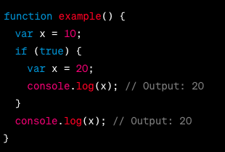

Variables, Data Types, and Operators

Slide 12
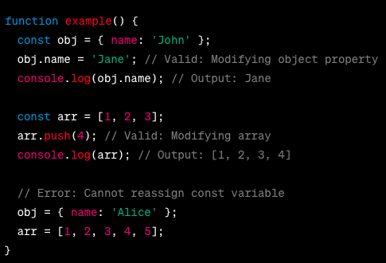
Variables, Data Types, and Operators

Slide 13
Basic Control Flow with Conditional Statements
Conditional Statements: JavaScript offers conditional statements such as if, else if, and else to perform different actions based on different conditions.
Comparison Operators: JavaScript's comparison operators (==, ===, !=, !==, <, >, <=, >=) are used to compare values and make decisions in conditional statements.
Logical Operators: Logical operators (&&, ||, !) are used to combine multiple conditions or negate a condition.

Slide 14
Basic Control Flow with Loops
Loops: JavaScript provides different types of loops to iterate over a set of data or perform repetitive actions.
for Loop: The for loop is used to iterate over a block of code for a specified number of times.
while Loop: The while loop repeatedly executes a block of code as long as a given condition is true.
do...while Loop: The do...while loop executes a block of code at least once and then repeats as long as a given condition is true.

Slide 15
Understanding the Document Object Model (DOM)
The Document Object Model (DOM) is a programming interface for web documents.
It represents the structure of an HTML or XML document as a tree-like structure, where each element is a node.
The DOM provides a way to interact with and manipulate the elements and content of a web page.
It allows JavaScript to access, modify, add, or remove HTML elements dynamically.

Slide 16
Manipulating HTML Elements using JavaScript
JavaScript provides several methods to manipulate HTML elements through the DOM.
Common DOM manipulation tasks include:
Accessing elements: Use methods like getElementById, getElementsByClassName, or querySelector to select elements from the DOM.
Modifying content: Change the content of an element using properties like innerHTML or textContent.
Modifying attributes: Update attributes of elements using properties like setAttribute or getAttribute.
Adding and removing elements: Dynamically create new elements using createElement and insert them into the DOM with methods like appendChild or insertBefore. Remove elements with removeChild or remove.

Slide 17
Handling Events with DOM
Events are actions or occurrences that happen in the browser, such as clicking a button or submitting a form.
JavaScript can handle these events and execute code in response.
Event handling involves:
Selecting an element: Use DOM methods to select the element you want to attach an event handler to.

Slide 18
Handling Events with DOM
Registering event listeners: Use methods like addEventListener to attach event handlers to elements.
Defining event handler functions: Write functions that will be executed when the event is triggered.
Handling events: The event handler function will be called when the event occurs, allowing you to respond to the event with custom code.
Event propagation: Events can propagate up or down the DOM tree. Understand and control event propagation using methods like stopPropagation or preventDefault.

