Slide 1
C2M-App Release
Android Release
By - Rezwan

Slide 2
AGENDA
Launch Checklist
Publishing Process
What after release?

Slide 3
LAUNCH CHECKLIST
Understand the Developer Program Policies.
Target a recent API level.
Run internal tests.
App’s overall size.
Plan your App’s play store listing.
Determine your App’s content rating.

Slide 4
CONTINUES…
Set up your app’s price and countries of distribution.
Browse and reply to user reviews.
Check your vitals.

Slide 5
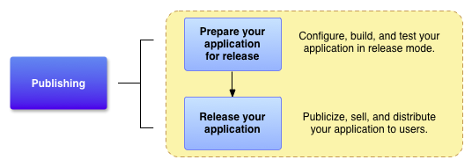
PUBLISHING PROCESS

Slide 6
PREPARE FOR RELEASE
Prepare EULA. get Cryptographic keys, create application Icon
Build Application for Release & sign Application.
Remove debugging & logging settings, configure manifest, setting, clean up project.
Prepare remote servers & services for production, update resources for release
Test the signed application for release & distribution
Gather Materials for Release
Configure App for Release
Build App for Release
Prepare Remote Sensors
Test App for Release

Slide 7
SIGN YOUR APP
Certificates and keystores

Slide 8
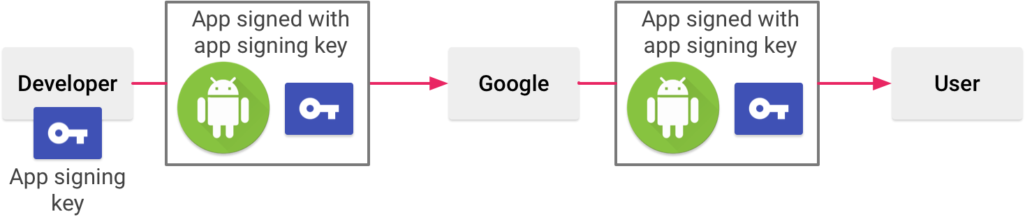
MANAGE YOUR OWN KEY & KEYSTORE

Slide 9
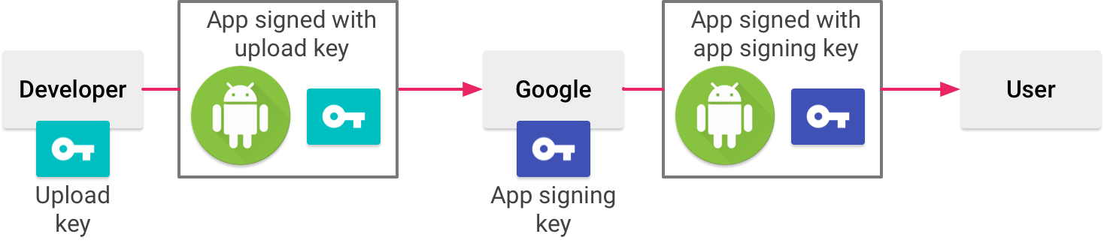
APP SIGNING BY GOOGLE PLAY

Slide 10
Use gradle for your benefits
Signing info in gradle
Build types signing configuration
CI/CD using gradle task

Slide 11

Keystore.properties

Slide 12
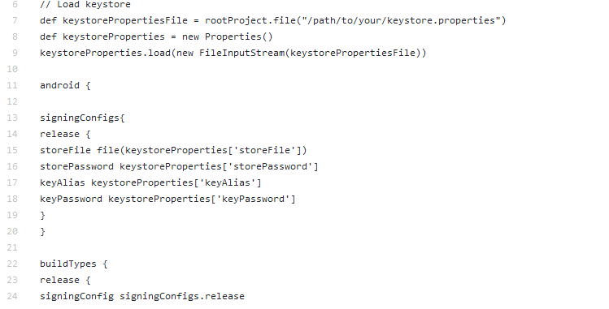
Gradle signing config

Slide 13
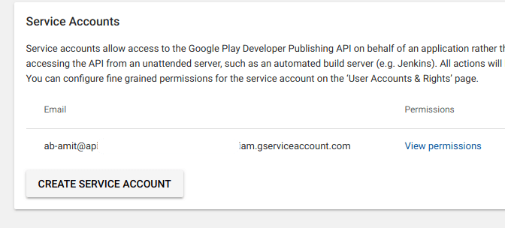
Setup a service account

Slide 14
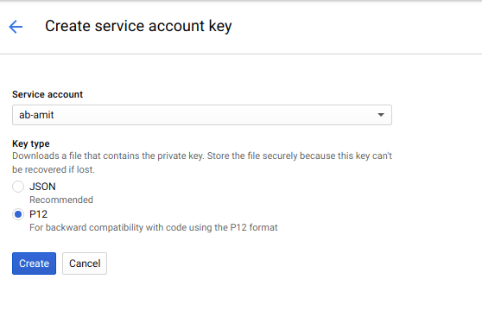
Create service account key

Slide 15
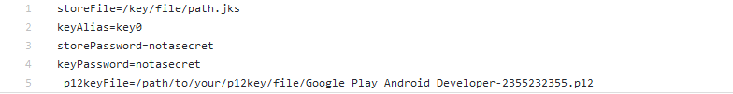
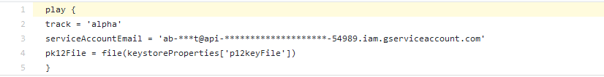
Keystore.properties
Gradle task

Slide 16
AFTER RELEASE
Increasing engagement and retention.
Growing your audience.
Earning more revenue.

Slide 17
THANK YOU

