Slide 1
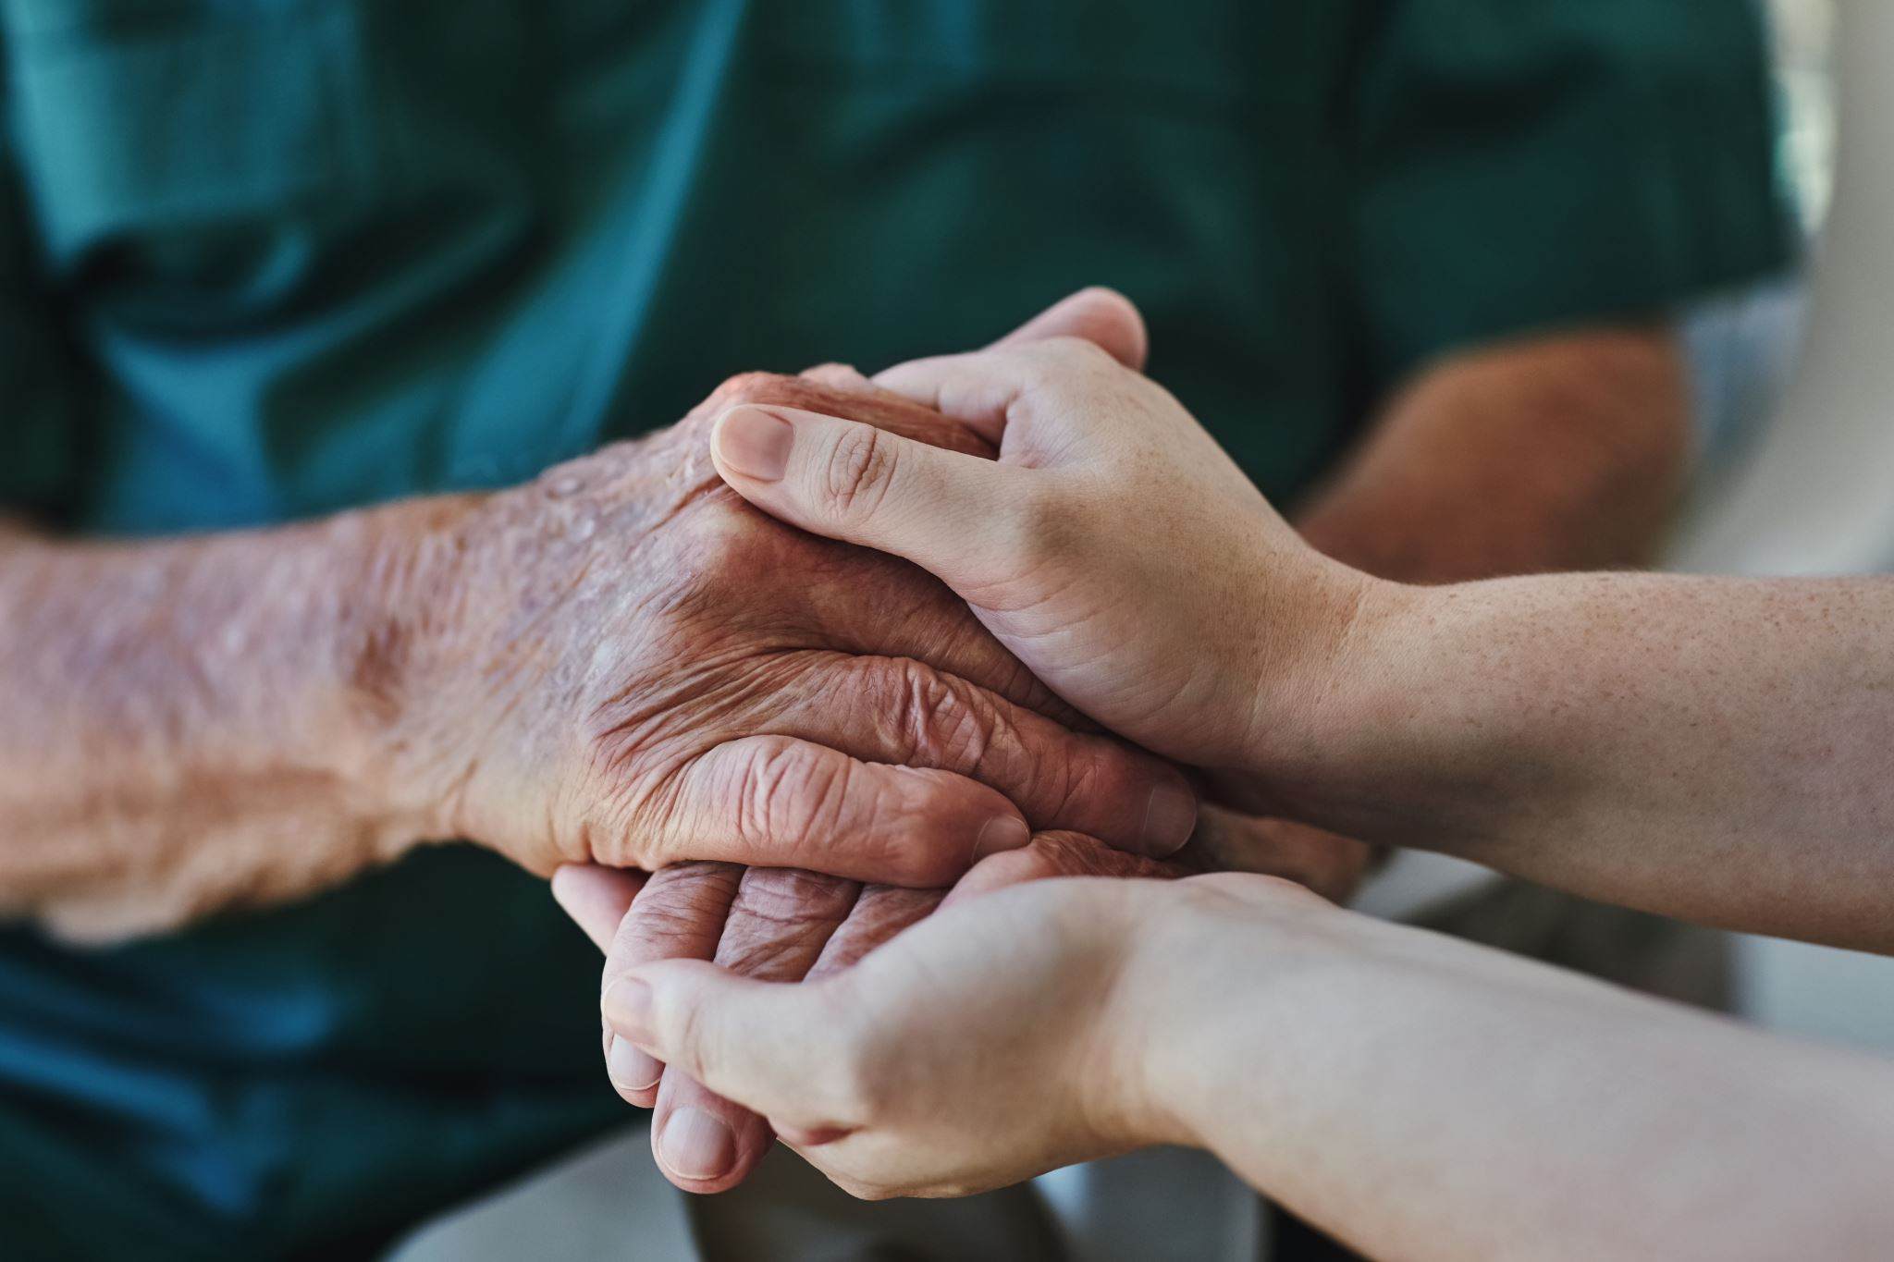

-- Empowering Elders with ElderlyCare --
Group Members:
Pankhuri Gupta
Dhruv Parmar
Kartik Taneja
Puja Bharathi Nagarajan

Slide 2

PURPOSE
To address the global issue of an aging population, a web-based solution is developed to help older people maintain their health, well-being, and active participation in society.
This projects helps elderly people to book doctor appointments based on their requirements.

Slide 3















TECH STACK

Slide 4
Features
Elder and Doctor User Register/Login
EC-Buddy for Elders.
Elder can book Appointment with doctor for consultation.
Payment Gateway for Appointments.
Doctor Can view the appointments scheduled.

Slide 5
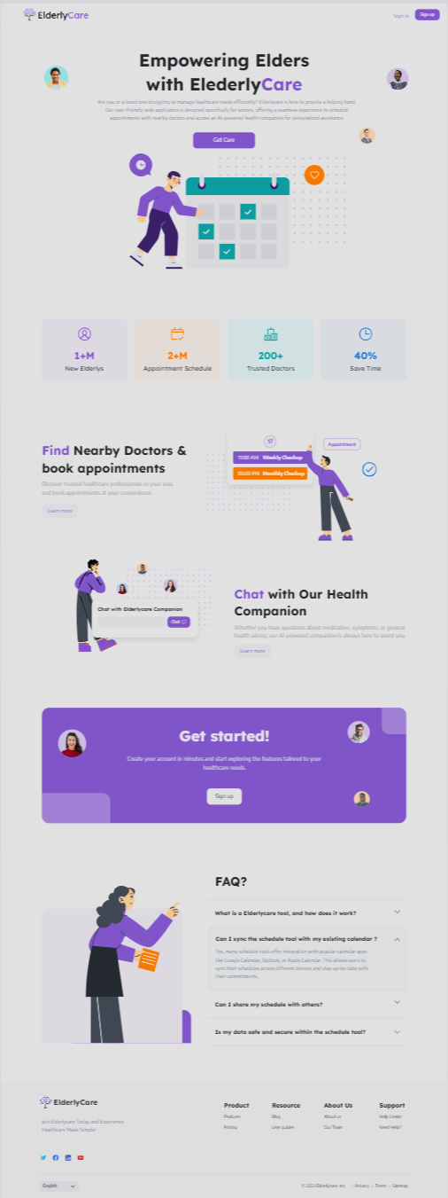
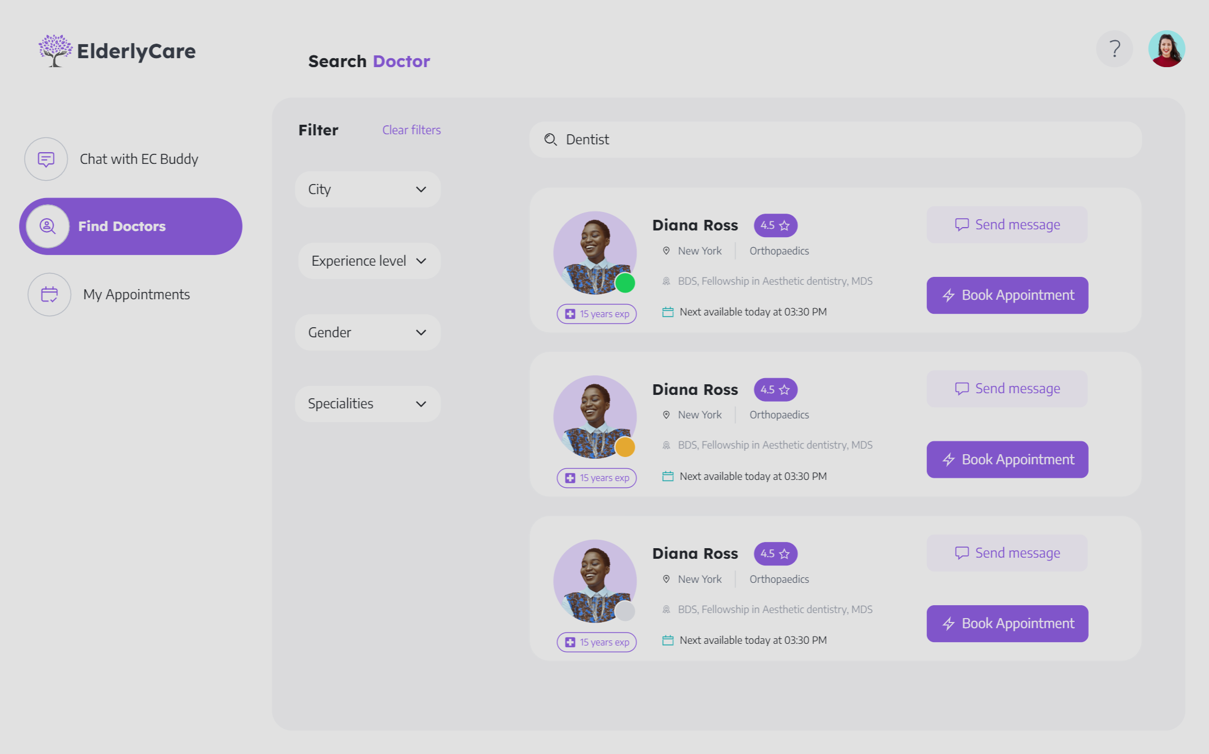
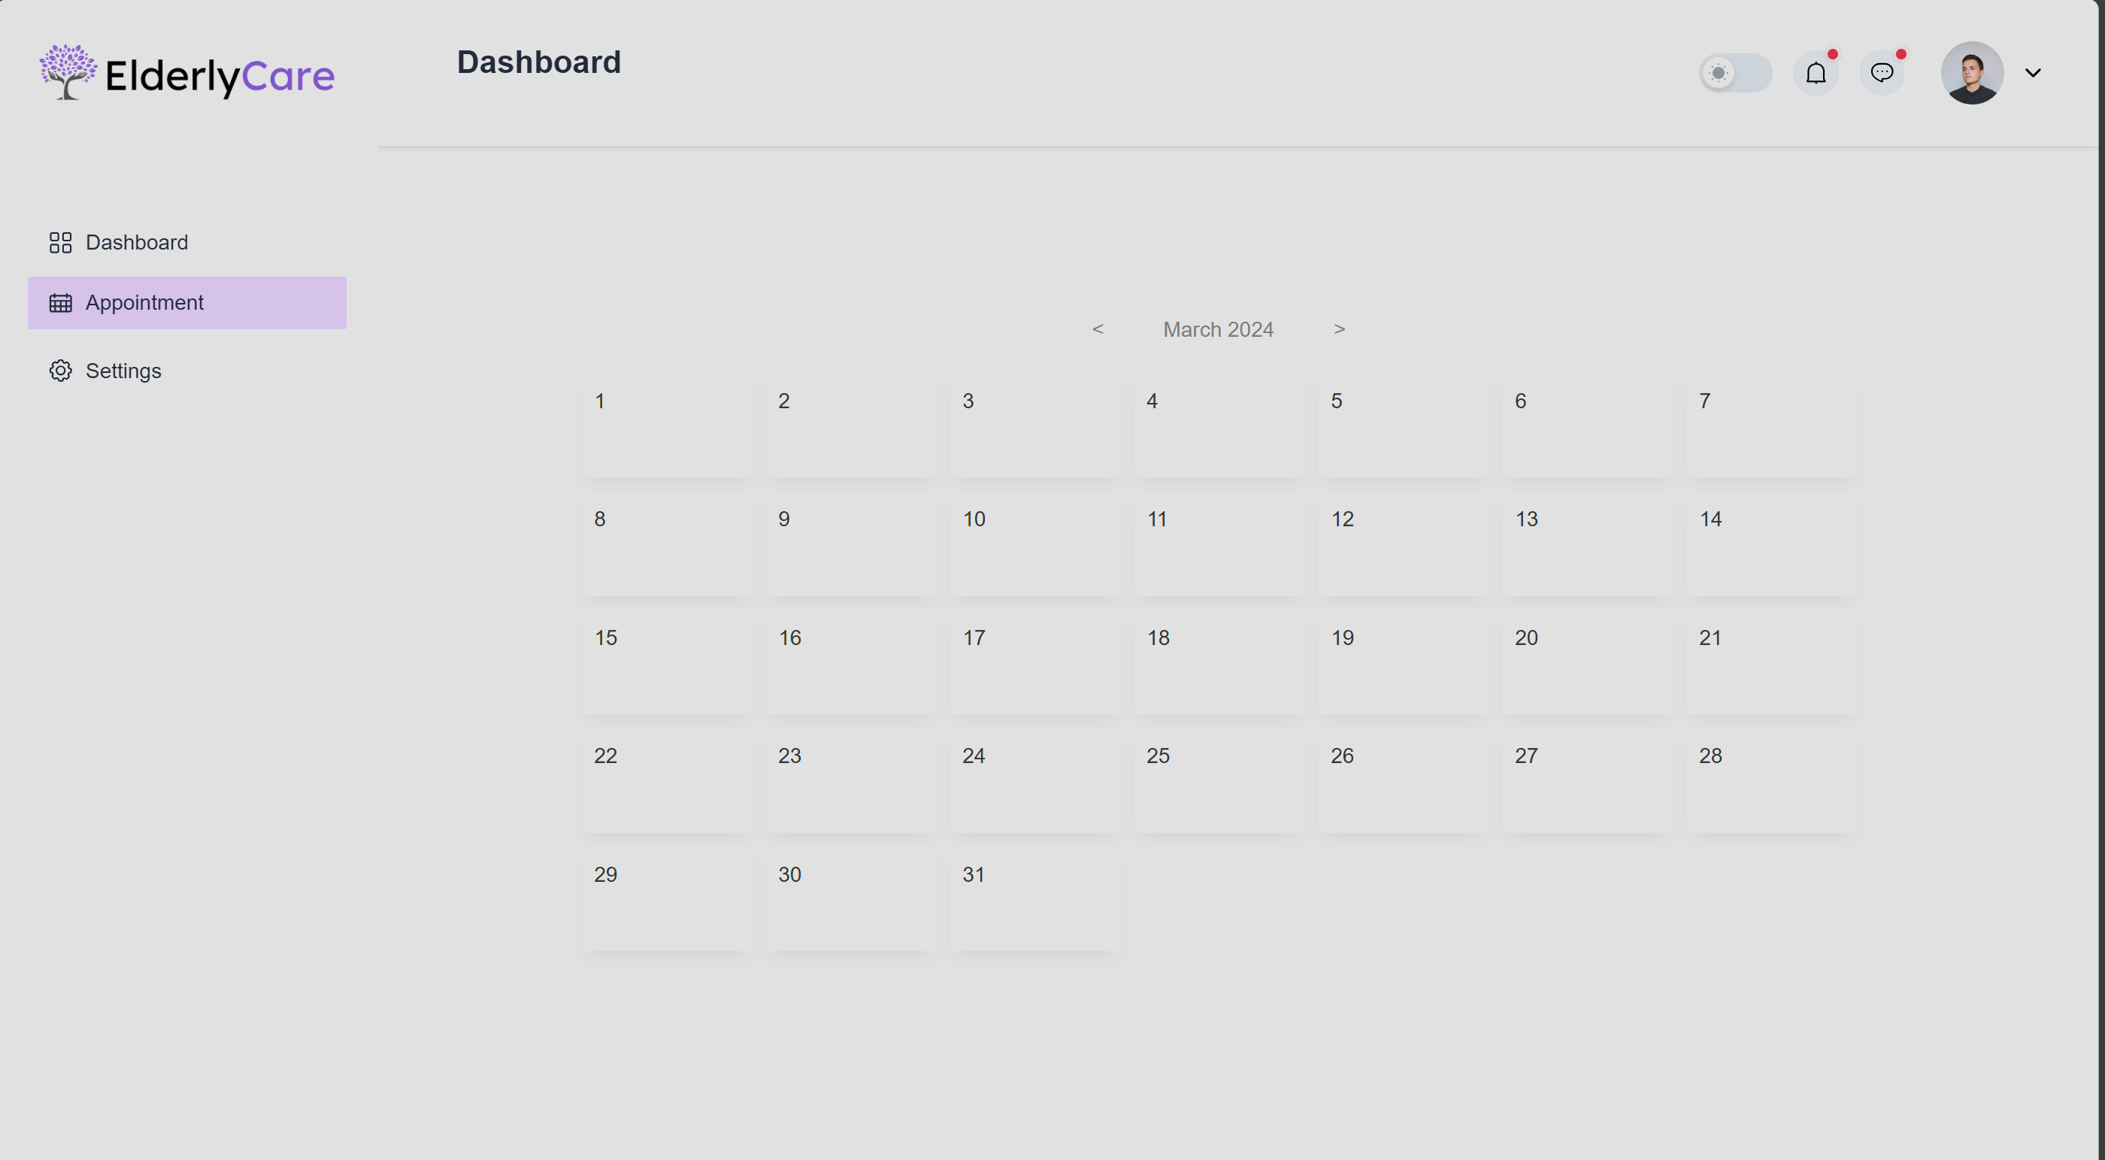
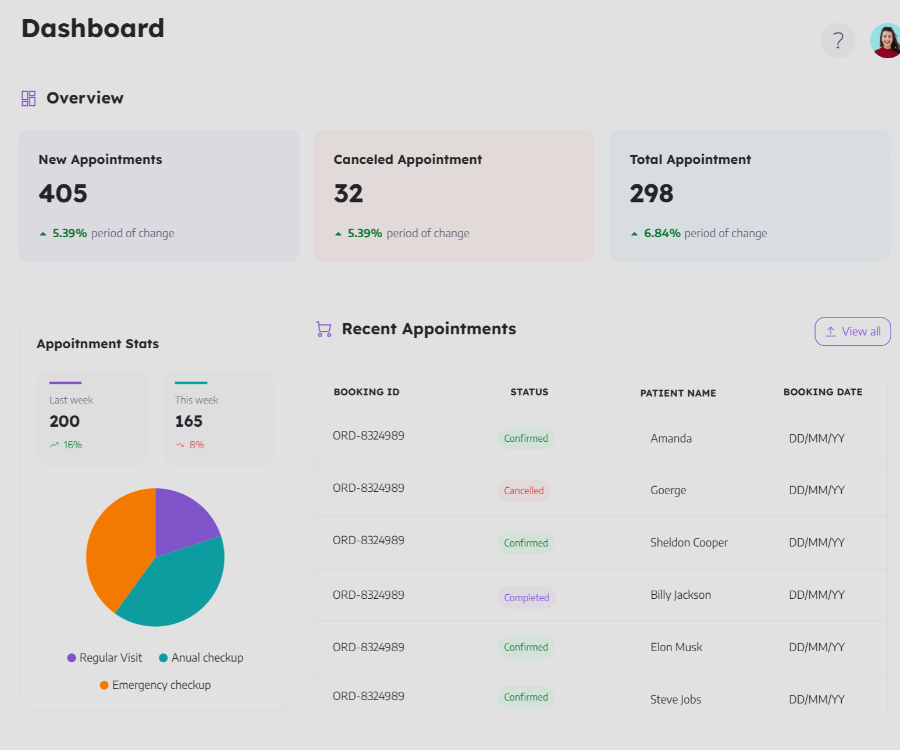
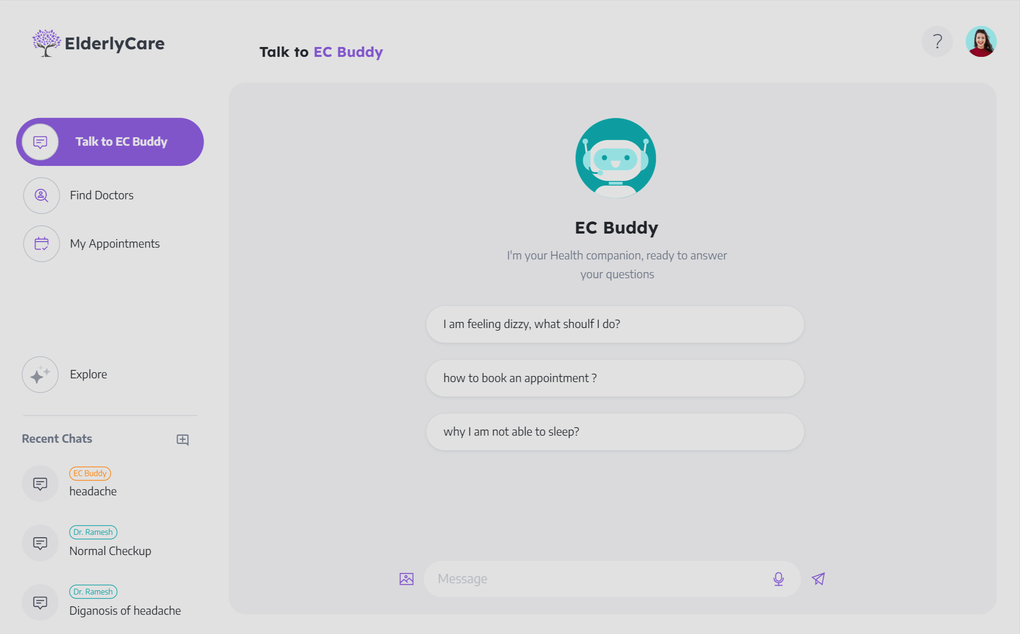
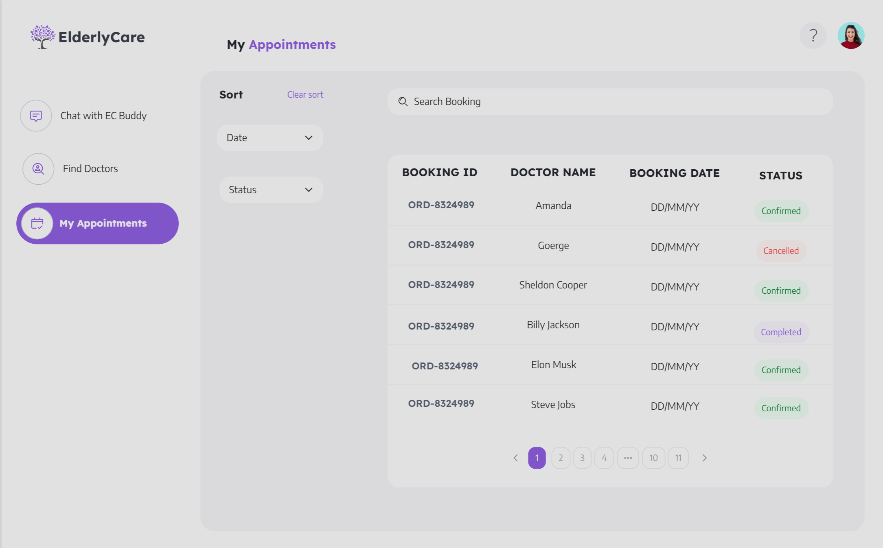
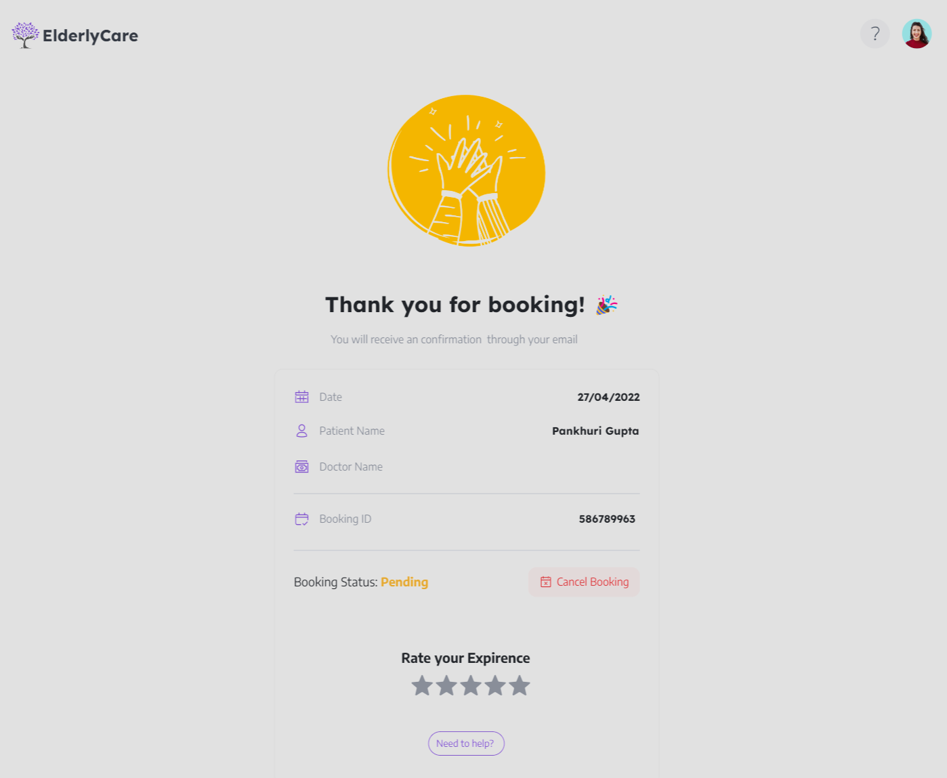
Snapshots

