Slide 1
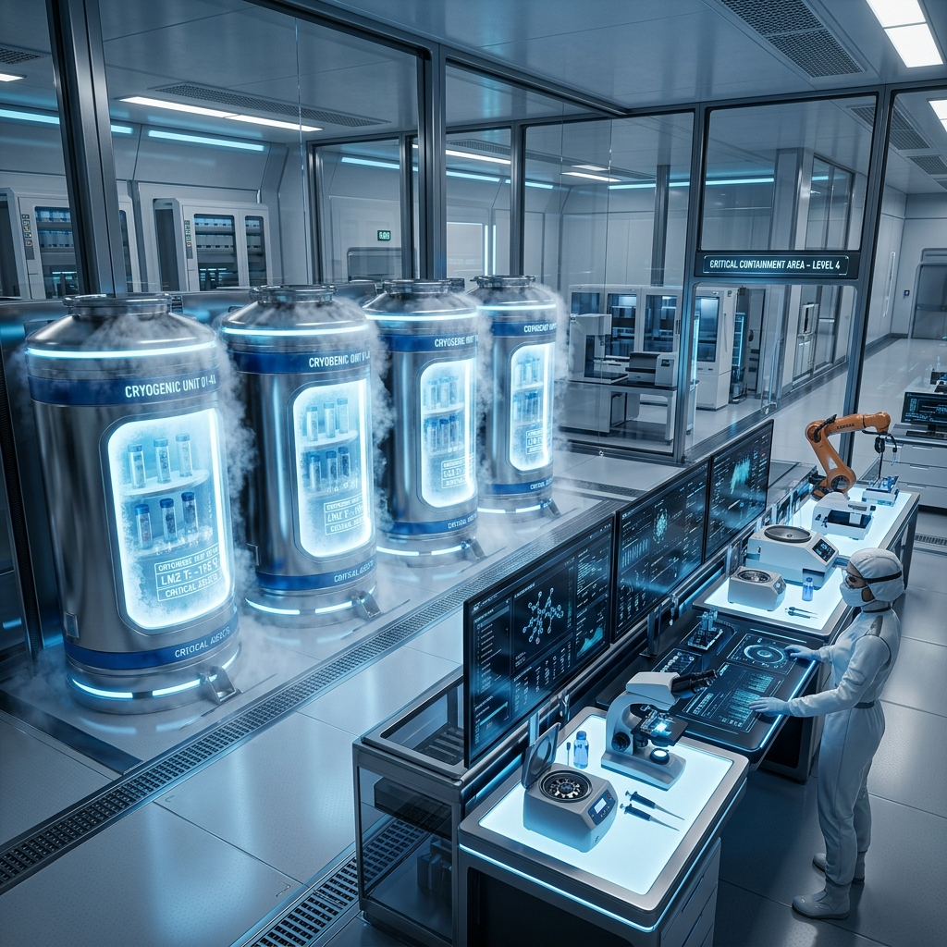
AURA BIOMEDICAL BANK
Widescreen LIMS Operations & Security Portal Review
Next-Generation Cryogenic Storage Mapping, Ethical Patient Consent Guardrails, and Cryptographic Security Controls.
Prepared for: Executive Leadership & Biosafety Board
Presented by: LIMS Development Team

Slide 2
Executive Summary
• Platform Mission & Objectives: Deliver an enterprise-grade LIMS that maintains absolute cold-chain integrity and compliant research access workflows.
• Dynamic Spatial Cold Storage: Eliminate manual inventory spreadsheets with real-time graphical microplate rack mapping and unit temperature constraints.
• Ethically Compliant Governance: Enforce consent restrictions (Academic, Genomic, Commercial) across all biological specimen distribution requests.
• Recent Upgrades Summary: Successfully deployed collapsible panels for full-screen data visibility, secure checkout form resets, and type-specific freezer routing.

Slide 3
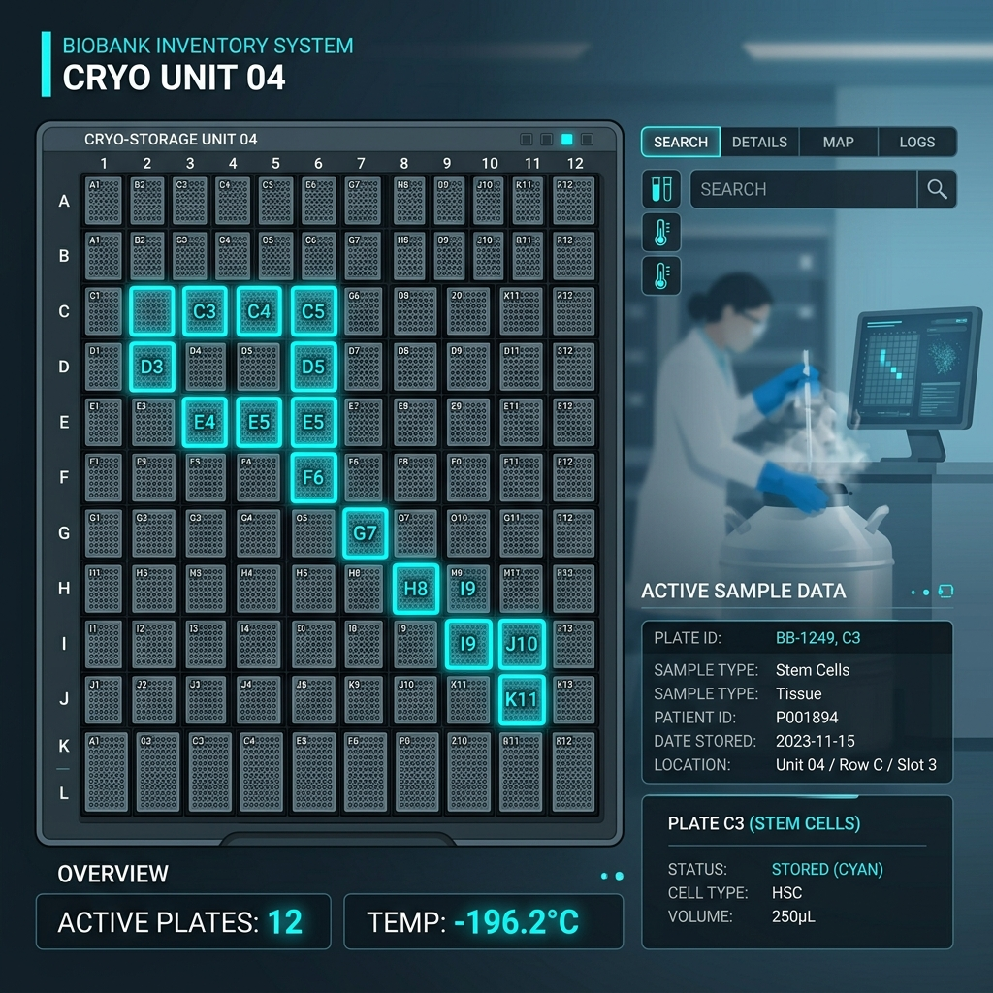
Active Storage Unit & Spatial Grid Matrix
• ULT Freezer 03 (-80.4°C)
Reserved exclusively for Blood and Serum specimens. Protects fluid-based cellular structures and protein stability from crystallization damage.
• Liquid Nitrogen (LN2) Tank 01 (-196.2°C)
Reserved for DNA and Tissue specimens. Vapor-phase cryogenic storage halts all molecular and chemical degradation to preserve genomic structures.
• Dynamic Inventory Restricting
LIMS automatically filters empty well deposits. For example, DNA/Tissue options are locked out during ULT-03 deposits, preventing dangerous storage errors.
• Prefix Coordinates in Logs
Depositing or relocating samples automatically prepends unit names (e.g. 'ULT Freezer 03 > ...') to trace inventory accurately.

Slide 4
Consent Governance & Cryptographic Ledger
• Granular Consent Settings
Every enrolled donor registry profile has toggles for Academic, Genomic, and Commercial consent.
• Automatic Checkout Blockers
LIMS cross-references donor consent toggles during access checkouts. Specimens are programmatically blocked if research purpose conflicts with consent.
• Immutable Blockchain Ledger
All consent edits are instantly sealed as blocks on an internal ledger timeline, featuring SHA-256 links for absolute data integrity.
• Cryptographic Signatures
Audit trails preserve original hash keys and verification signatures, allowing independent bioethics compliance reviews.

Slide 5
Role-Based Access Controls & Session Security
• Role Boundaries (RBAC)
LIMS differentiates between Operator roles: Lead Researchers (Admins), Lab Technicians, and Guest Researchers.
• Locked Administrative Panels
Administration menus, Access Control lists, and Audit Trails are fully hidden and blocked from non-admin roles.
• Automatic Route Protection
Session interceptors redirect unauthenticated or unauthorized users instantly to the Core Operations Dashboard.
• Passcode Verification
All mutations require secure authentication, logging the operator's identity and timestamp in real-time.

Slide 6
Specimen Access Checkout Workflow
• Interactive Selection
Users add specimens directly to their Request Cart while filtering by diagnosis, quality metrics, or freezer position.
• IRB Compliance Validation
Checkout requires entering Researcher Name, Institution, and a valid IRB (Institutional Review Board) Code.
• Checkout Form Safety Resets
The LIMS checkout form automatically resets on modal open, modal cancel, and successful request. This prevents previous operator information or project details from leaking.
• Shipment Order & Cryo-Labeling
Approved checkouts lock specimens and generate cryogenic barcodes ready for packaging and dispatch.

Slide 7
Operational Auditing & Premium Reporting
• Comprehensive Audit Logs
Every action—operator login, specimen deposit, relocation, consent update, and cart checkout—is logged in real-time.
• Interactive Data Filtering
LIMS provides live filters inside tabular reports for search-on-type lookups and checkbox selections.
• Custom CSV Exports
Compliance officers can select specific rows or export targeted datasets for off-platform analytical reviews.
• Spreadsheet-Style Printing
Print styles strip out all colors, sidebars, and dashboard components, rendering high-contrast grid lines for physical lab documentation.

