Slide 1
HTML5
Associate Name:Puja Pandey
Associate Id:784462

Slide 2
HTML
The concept first appeared in the early 1940s, and was named and demonstrated in the 1960s.
Specification is managed by World Wide Web Consortium and Web Hypertext Application Technology Working Group.
Hyper Text Markup language(HTML) is a standard markup language for document design to be displayed in a web browser.

Slide 3
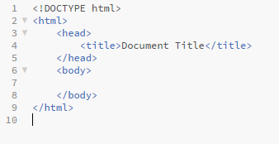
A simple HTML Document

Slide 4
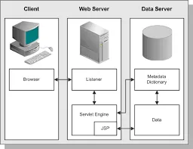
Architecture of HTML

Slide 5
Type of HTML tags
HTML tags have two main types:
Block-level tags : Block-level elements take up the full available space and always start a new line in the document. Headings and paragraphs are a great example of block tags.
Inline tags : Inline elements only take up as much space as they need and don’t start a new line on the page. They usually serve to format the inner contents of block-level elements. Links and emphasized strings are good examples of inline tags.

Slide 6
HTML 5
HTML5 is the latest specification of the HTML language, and represented a major break with previous markup practices.
Most of the individual changes are a result of larger objectives in the design of the language. These objectives primarily include:
Encouraging semantic (meaningful) markup
Separating design from content
Promoting accessibility and design responsiveness
Reducing the overlap between HTML, CSS, and JavaScript
Supporting rich media experiences while eliminating the need for plugins such as Flash or Java
Read more: https://html.com/html5/#ixzz6OlqZ9DnY

Slide 7
Encouraging Semantic Markup
In HTML, there are a host of new semantic elements intended to indicate the basic structure of a page:
<header>
<nav>
<main>
<article>
<aside>
<section>
<footer>
New text-level (inline) elements have also been introduced, such as <address> and <time>

Slide 8
Separating design from content
It is easier to maintain and redesign a site if the style declarations are confined to CSS.
Users view web content in a lot of different contexts — desktops, laptops, tablets, mobile phones, RSS readers, and many others. Styles and design decisions that make sense in one environment don’t always make sense in another. So it is much better to provide semantic information and let the content be adapted to the context.

Slide 9
Why should I use HTML5
Easier to write
Easier to maintain
Easier to redesign
Better for Search Engine Optimization
Better for the blind and visually impaired
Better for content aggregators and feed readers
Better for users on mobile devices
Better for users on slower internet connections
Fewer chances of design breaks
Easier to add media
Easier to create interactive applications
Deprecated features will likely stop being supported at some point, breaking your page

Slide 10
New Features of HTML5
New Semantic Elements
Forms 2.0
Persistent Local Storage
Server-Sent Events
Canvas
Audio & Video
Geolocation
Microdata
Drag and drop

Slide 11
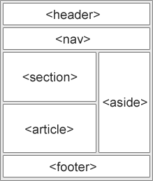
Tags Introduced in HTML5
<article>
<aside >
<audio>
<canvas>
<datalist>
<details>
<embed>
<figure>
<footer>
<header>

Slide 12
Contd:
<hgroup>
<mark>
<meter>
<nav>
<output>
<progress>
<ruby>
<section>
<time>
<video>
<wbr>-Word break oppurnity

Slide 13
New types of input tag
Color
Date
datetime-local
Datetime
Email
Month
Number
Range
Search
Tel
Time
url
week

Slide 14
HTML Web Storage Api
It is a client side database that allow users to persist data in the form of key-value pair.
HTML web storage provides two objects for storing data on the client:
window.localStorage - stores data with no expiration date
window.sessionStorage - stores data for one session(data is lost when the browser tab is closed)

Slide 15
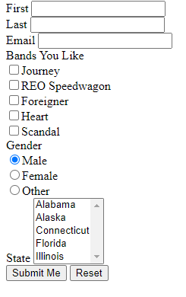
HTML Form
An HTML form is used to collect user input. The user input can then be sent to a server for processing.

Slide 16
Html Form method attribute
GET:
1.Appends form-data into the URL in name/value pairs
2.The length of a URL is limited (about 3000 characters)
3.Never use GET to send sensitive data! (will be visible in the URL)
4.Useful for form submissions where a user wants to bookmark the result
5.GET is better for non-secure data, like query strings in Google
POST:
1.Appends form-data inside the body of the HTTP request (data is not shown in URL)
2.Has no size limitations
3.Form submissions with POST cannot be bookmarked

Slide 17
Html form Validation
required: Specifies whether a form field needs to be filled in before the form can be submitted.
minlength and maxlength: Specifies the minimum and maximum length of textual data (strings)
min and max: Specifies the minimum and maximum values of numerical input types
type: Specifies whether the data needs to be a number, an email address, or some other specific preset type.
pattern: Specifies a regular expression that defines a pattern the entered data needs to follow.

Slide 18
Thank You

