Slide 1
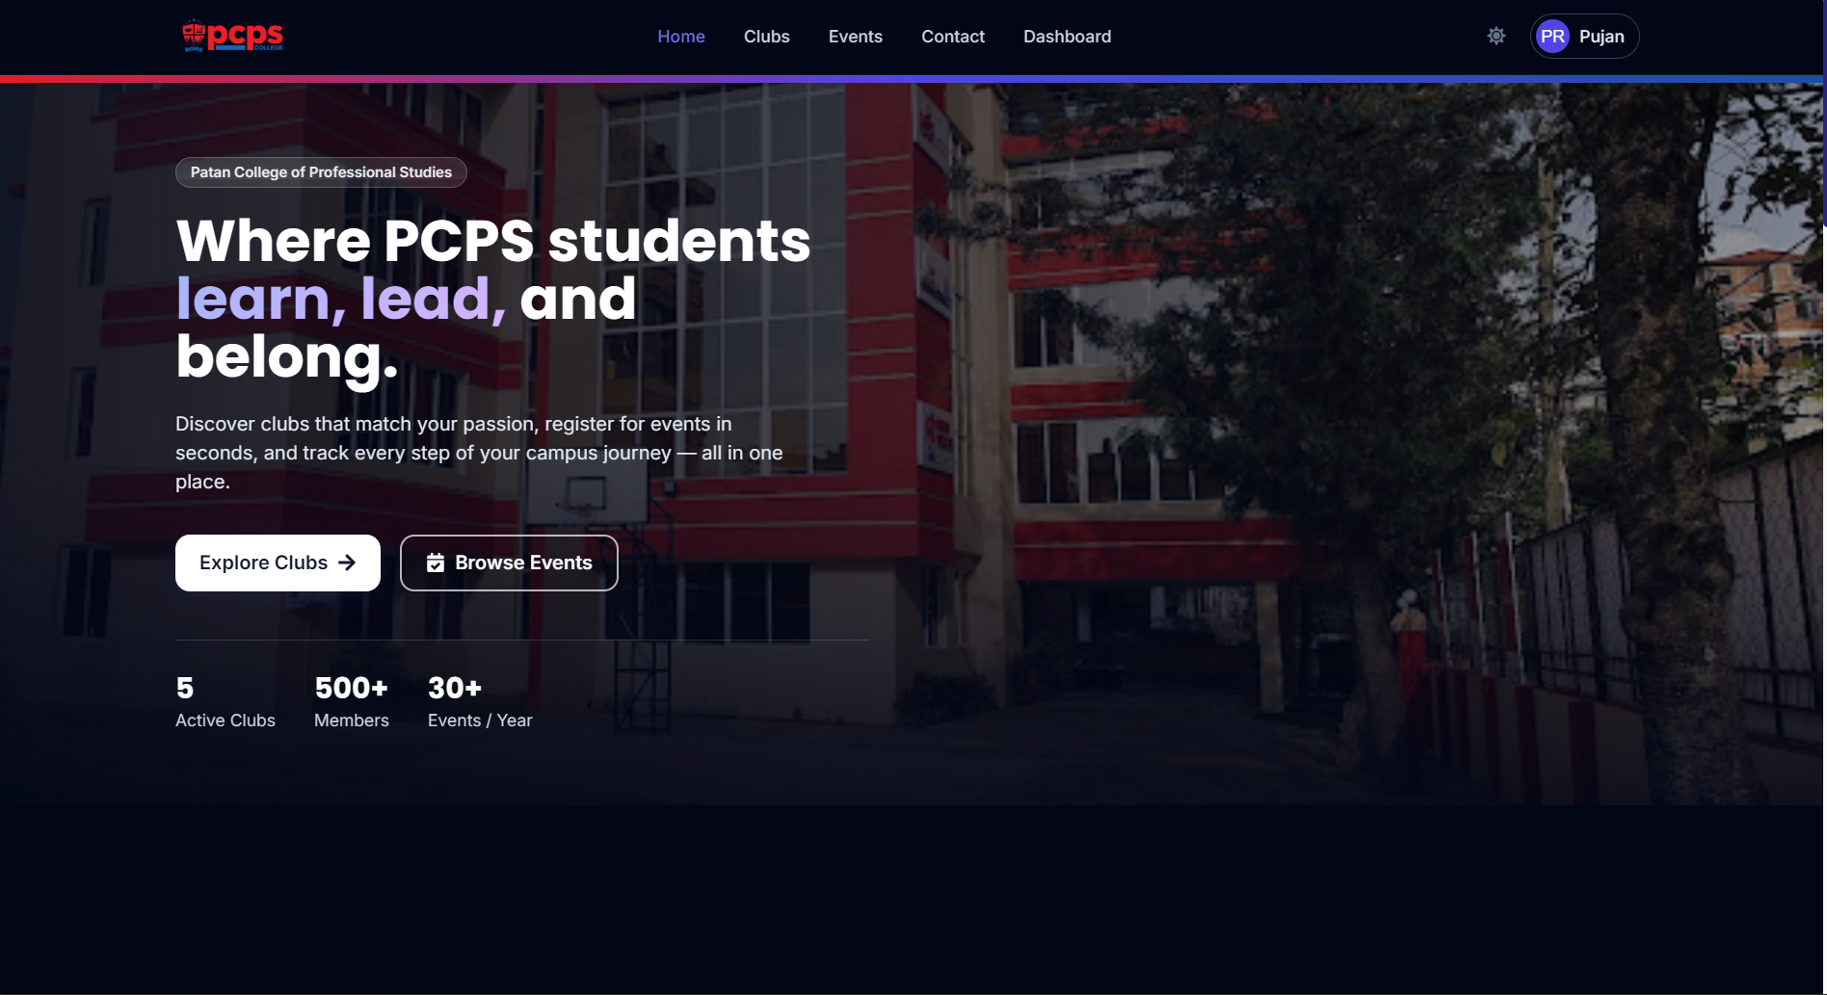
PCPS Connect
Club & Event Management System
MERN Stack Individual Assignment
Patan College of Professional Studies
Presented by Pujan Rasaili
01

Slide 2
Project Overview
One platform for PCPS students to discover, join and participate.
• Centralized platform for college clubs and events
• Students can discover clubs and join based on interests
• Browse, search and register for upcoming events
• Personal dashboard to track participation
• Secure authentication with student/admin roles
HOME PAGE
02

Slide 3
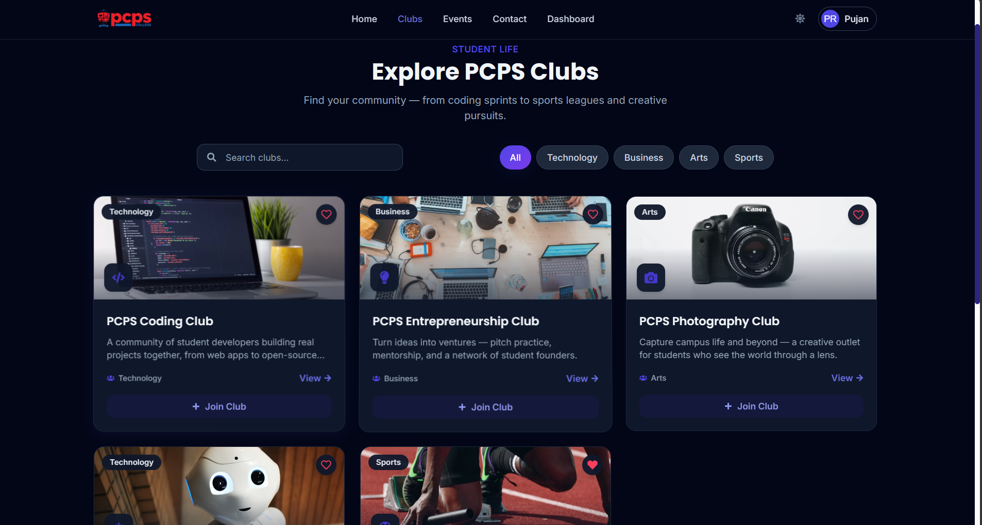
Club Directory
Explore communities across Technology, Business, Arts and Sports.
• Search clubs by name
• Filter by category
• Join or leave a club
• Favorite clubs
• View club details
CLUBS
03

Slide 4
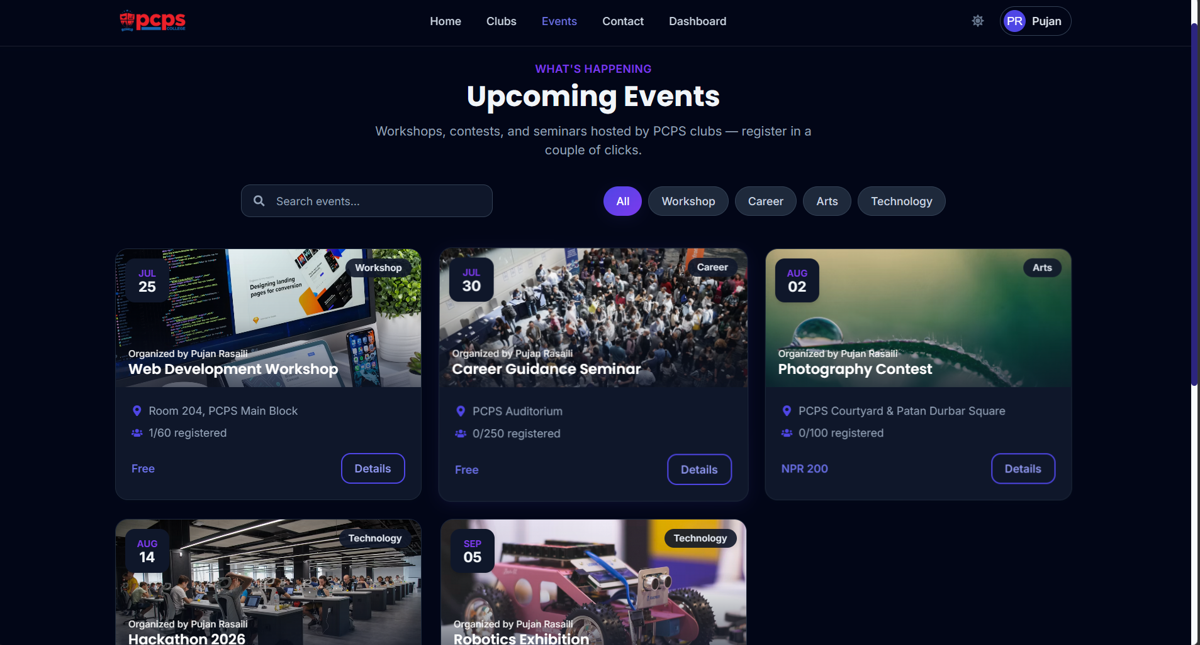
Event Management
Find workshops, seminars, contests and other PCPS activities.
• Search and category filters
• Event date and location
• Live registration capacity
• Free and paid events
• Register / unregister through event details
EVENTS
04

Slide 5
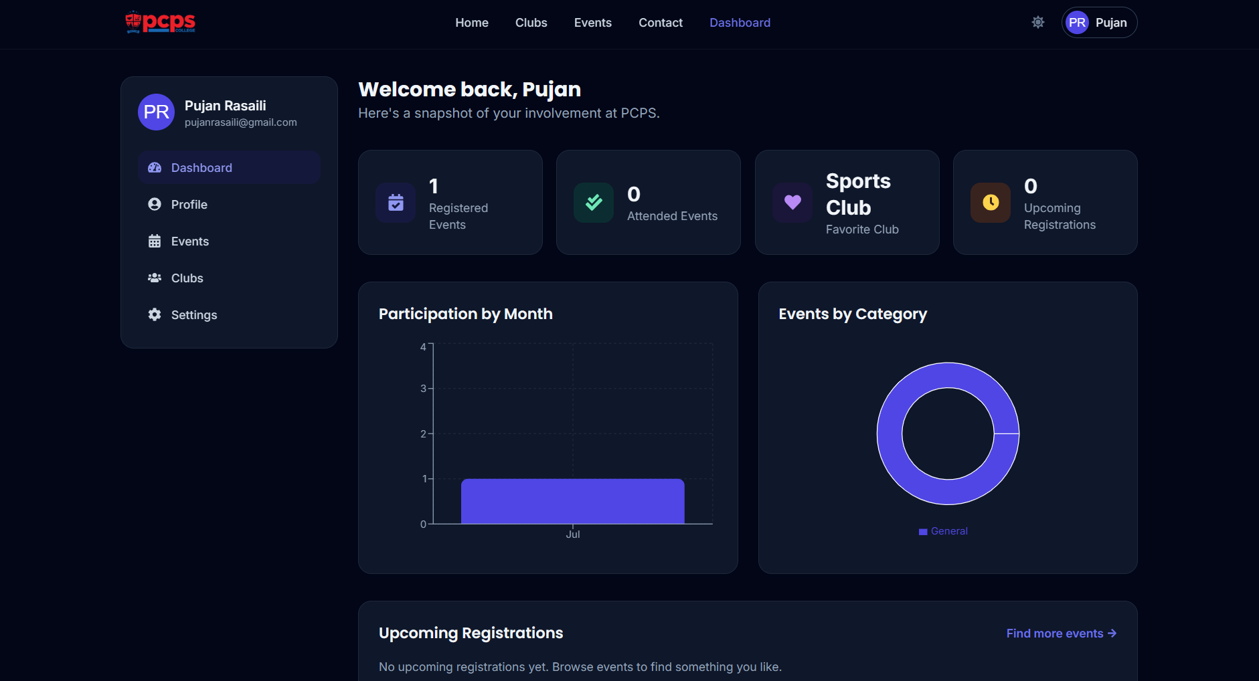
Student Dashboard
A personal overview of each student's involvement at PCPS.
• Registered and attended events
• Favorite club
• Upcoming registrations
• Participation-by-month chart
• Events-by-category chart
DASHBOARD
05

Slide 6
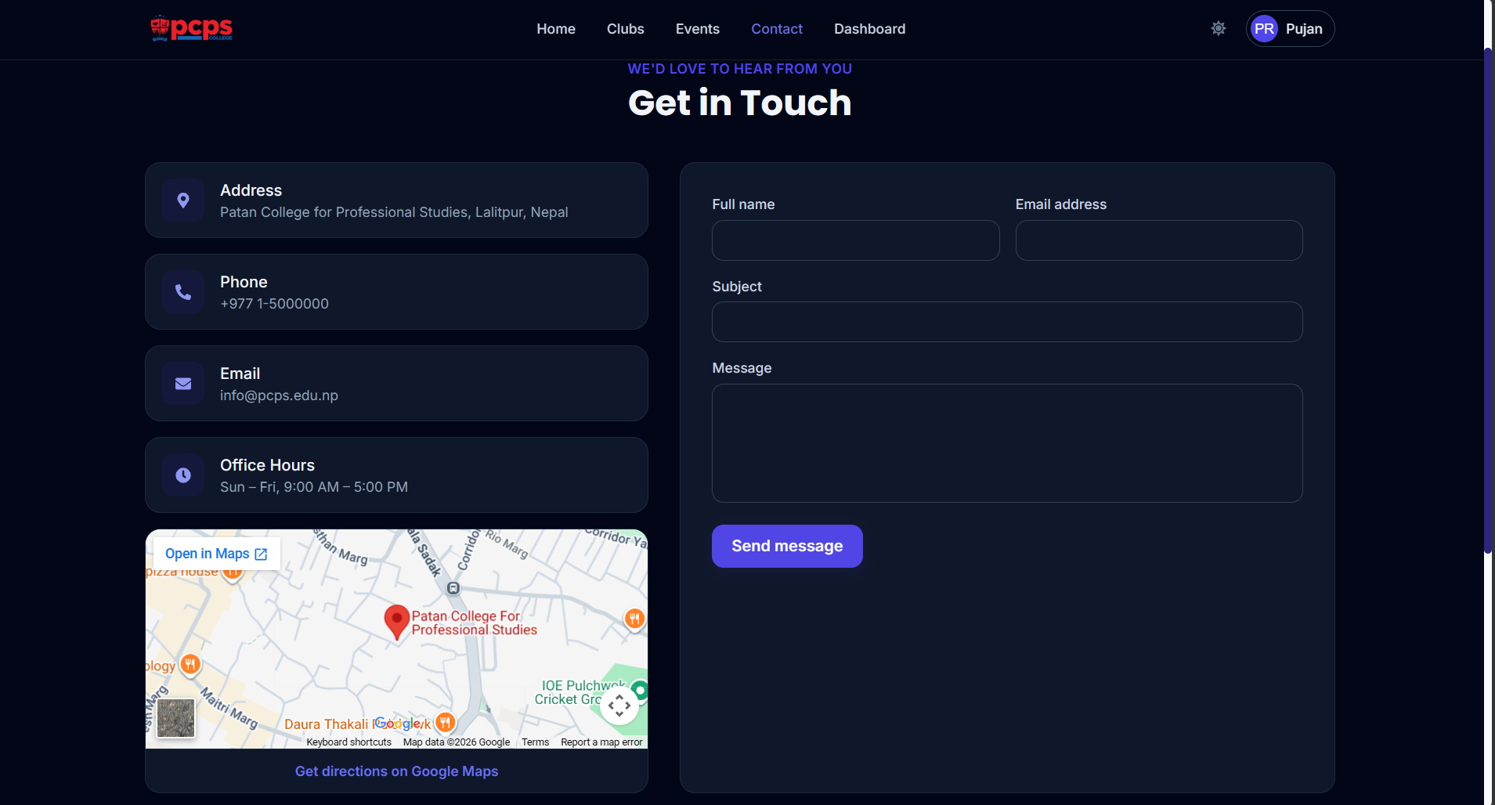
Contact & User Experience
A complete student-facing experience beyond clubs and events.
• College address and contact details
• Office hours
• Contact form
• Integrated map and directions
• Responsive dark-mode interface
CONTACT
06

Slide 7
Technology & Architecture
Built as a full-stack MERN application.
FRONTEND
• React 18
• React Router
• Tailwind CSS
• Axios
• Recharts
• React Icons
BACKEND
• Node.js + Express
• MongoDB + Mongoose
• JWT authentication
• HTTP-only cookies
• bcrypt password hashing
• Multer file uploads
07

Slide 8
Key Features & Security
Core functionality implemented across the application.
AUTHENTICATION
Register, login, logout and session persistence using JWT +
HTTP-only cookies.
AUTHORIZATION
Protected API routes with student and admin roles.
DATA MANAGEMENT
MongoDB stores users, clubs, events and participation data.
RESPONSIVE UI
Tailwind CSS interface with dark mode and responsive layouts.
Future: Admin dashboard UI • Pagination • Email event reminders
08

Slide 9
Thank You
PCPS Connect — Club & Event Management System
• Full-stack MERN application
• Designed for PCPS student engagement
• Clubs • Events • Registration • Dashboard • Authentication
09

