Slide 1
A Core Problem with Forecasting Inflation: Evidence for Adding Food and Beverage Prices to Core CPI
By: John Macke, Pujan Thakrar, Mark Vandre

Slide 2
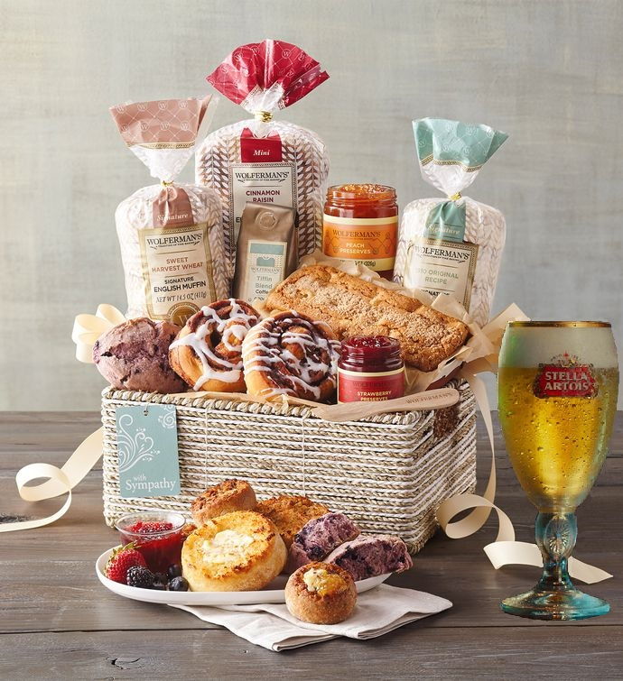
What is CPI?
CPI stand for consumer price index
Represents a measure of prices using a representative basket of goods in some base year
Rather than using full CPI, official CPI inflation forecasts use Core CPI, which excludes food and energy prices

Slide 3
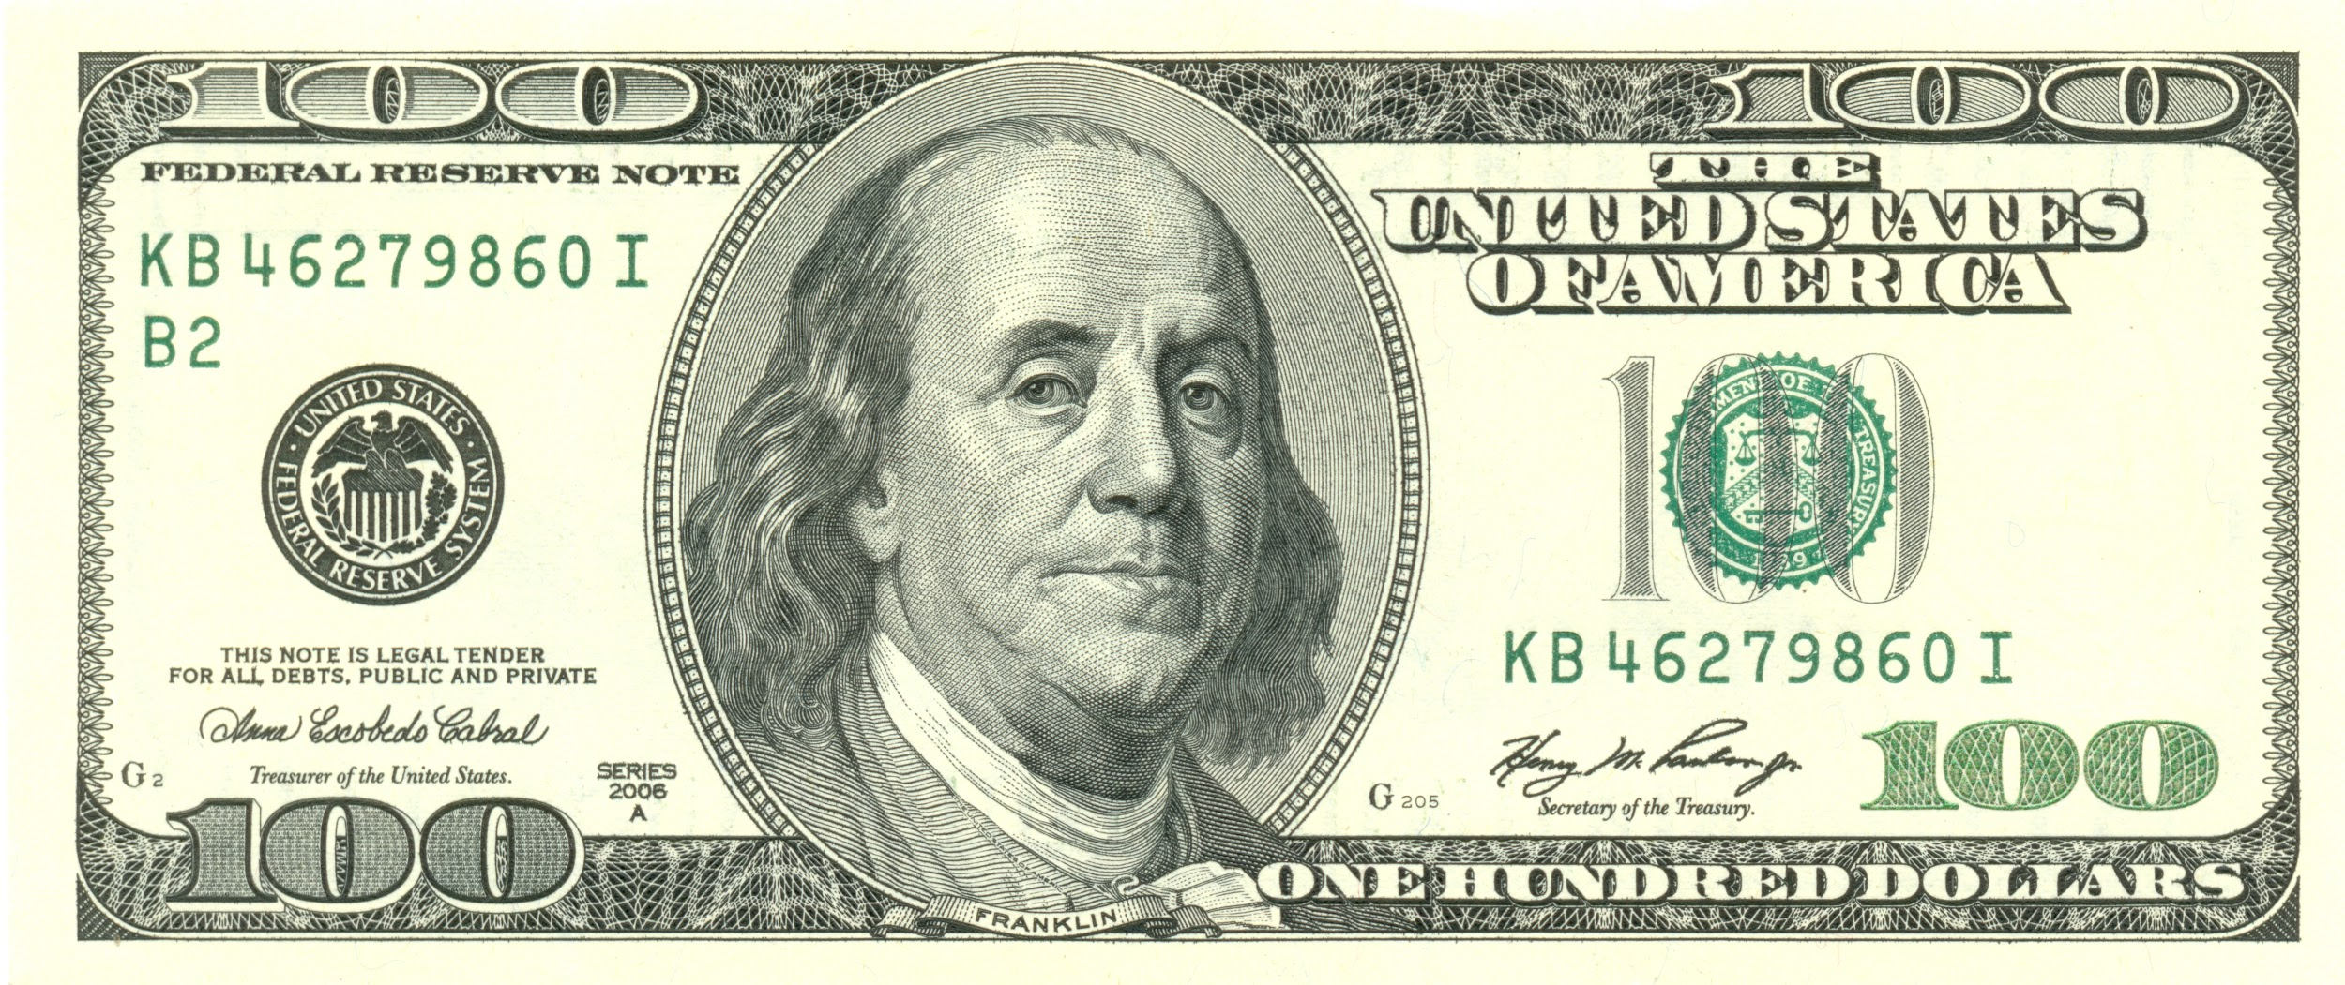

How is the Basket Filled?
$14.31 | Food & Beverages
$42.20 | Housing
$2.96 | Apparel
$16.35 | Transportation
$8.68 | Healthcare
$5.69 | Recreation
$6.60 | Education
$3.20 | Other G&S

Slide 4
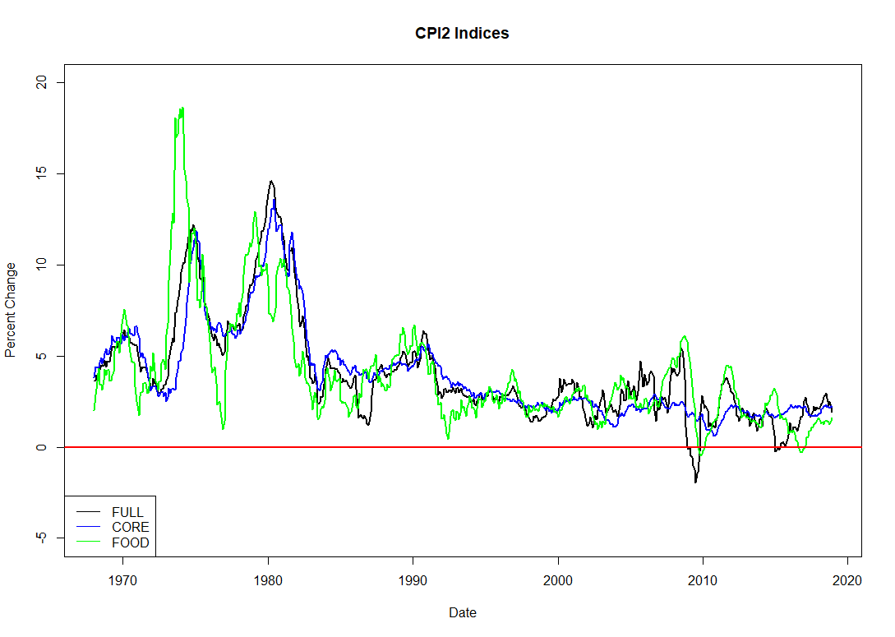
Why Exclude Food and Energy Prices?

Slide 5
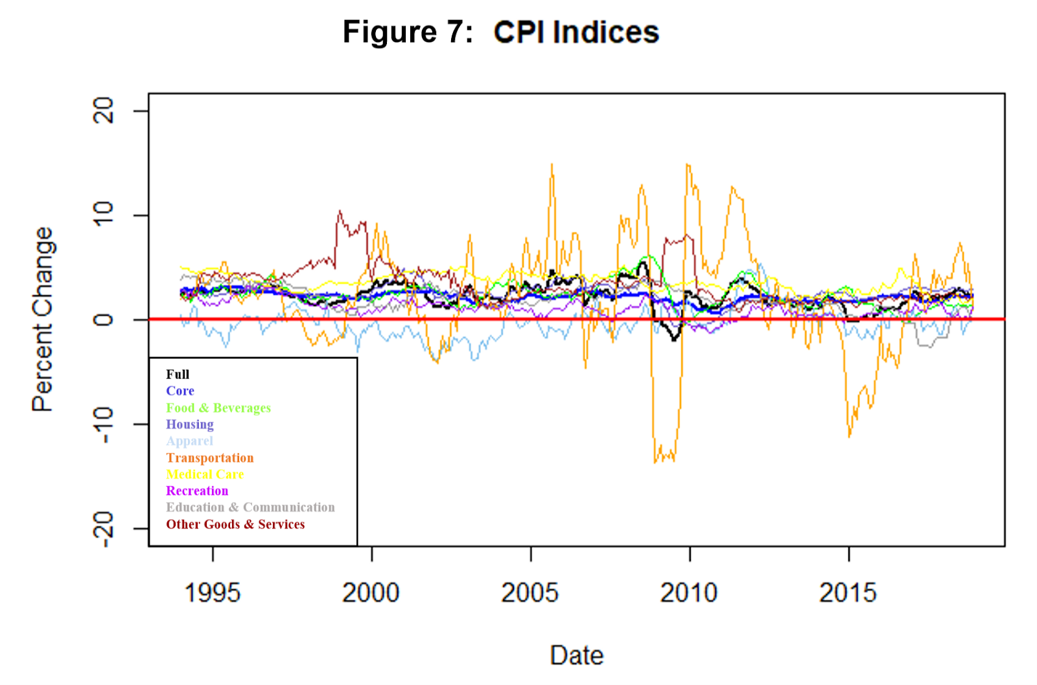
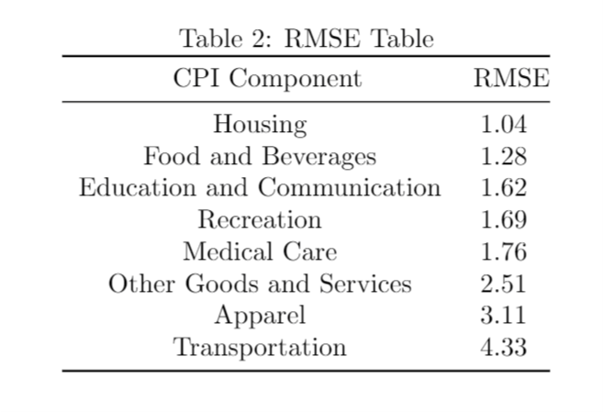
Full CPI Components
Core CPI Forecast
RMSE: 0.57
MAPE: 0.20

Slide 6

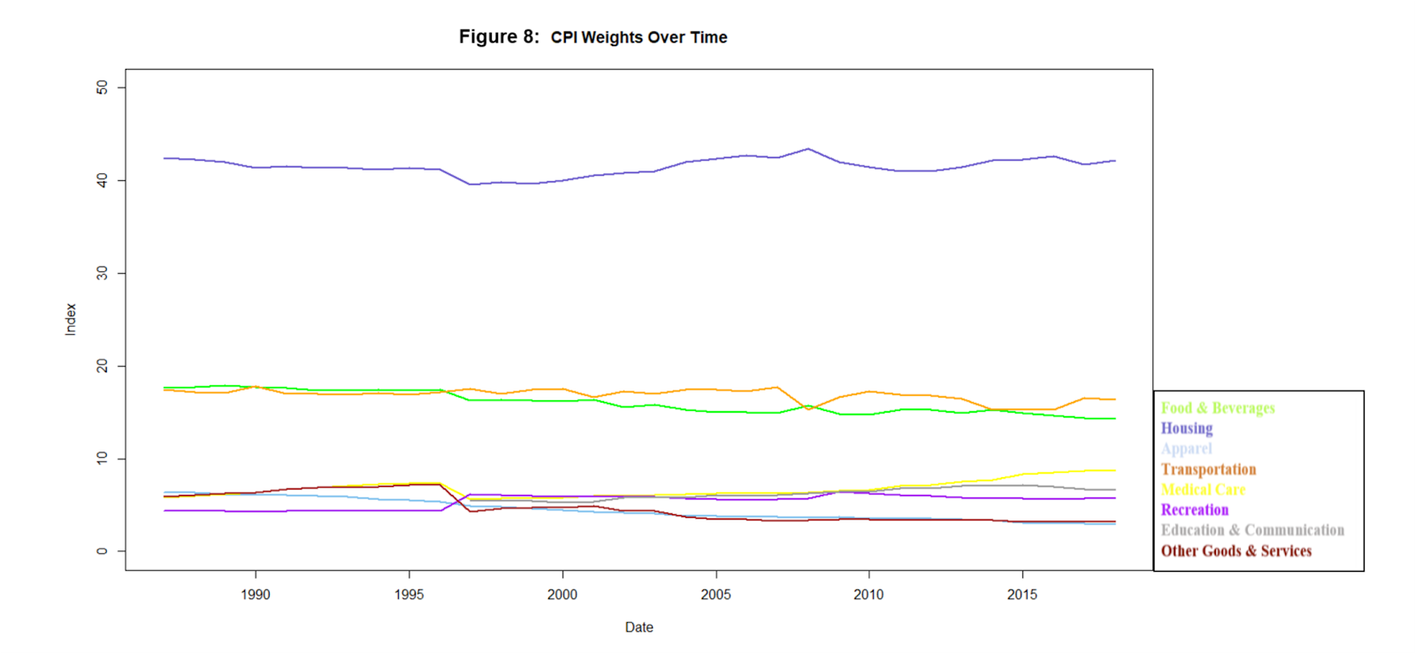

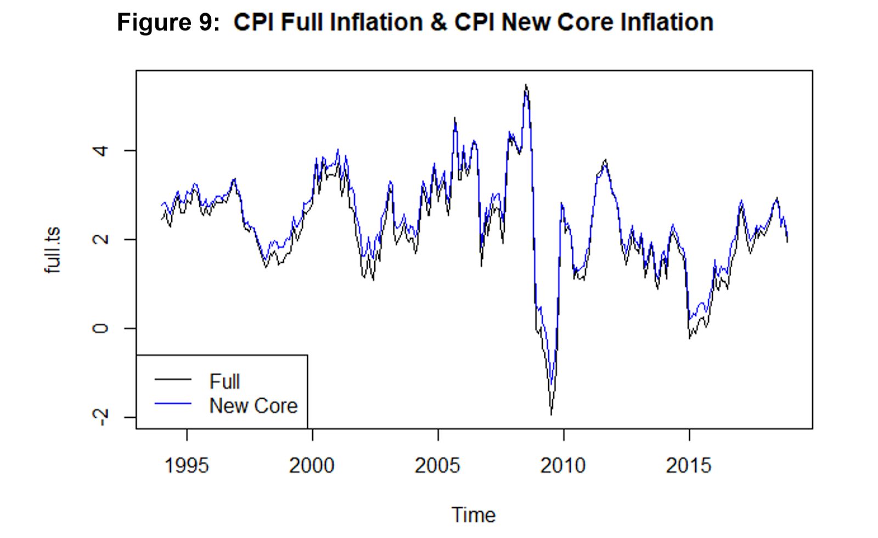
Calculation of New Core CPI

Slide 7
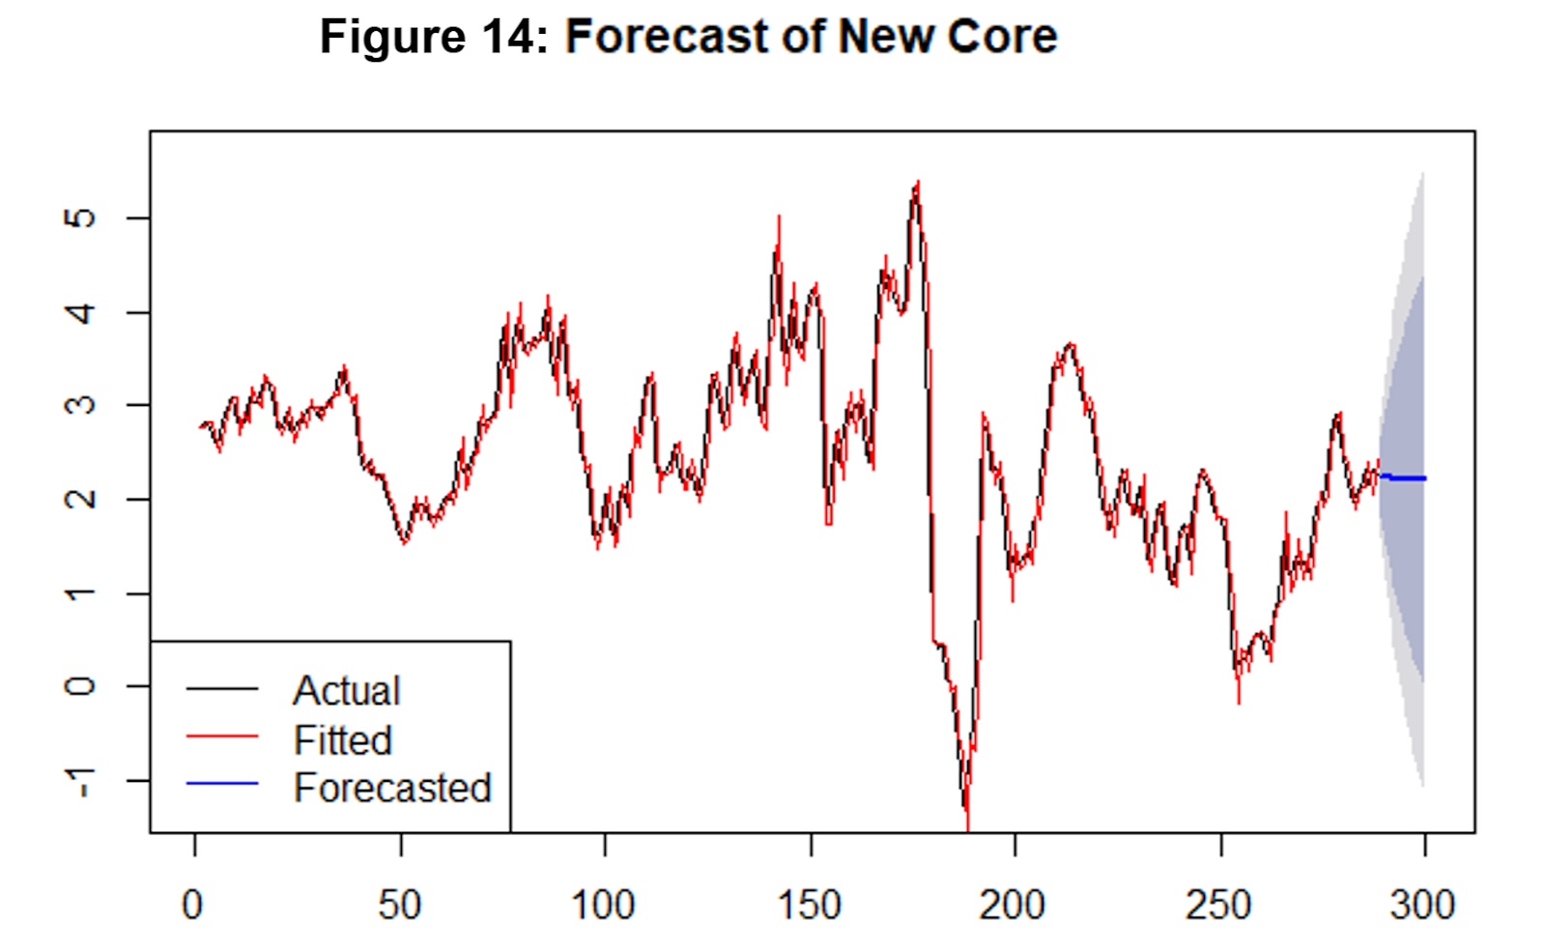
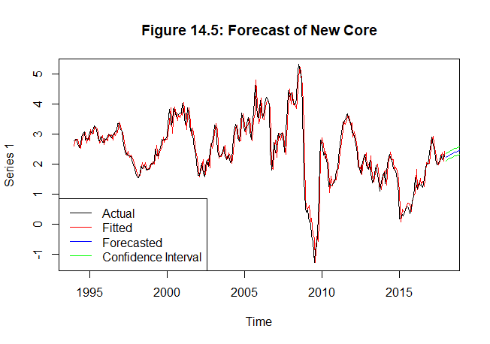
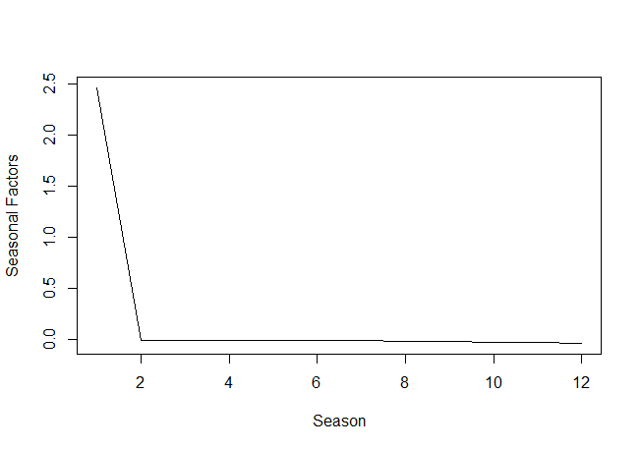
Forecast of New Core CPI
Core CPI Forecast
RMSE: 0.57
MAPE: 0.20
ARIMA VS. ARIMA-GARCH
RMSE: 0.37 MAPE: 0.11
RMSE: 0.31 MAPE: 0.10

Slide 8
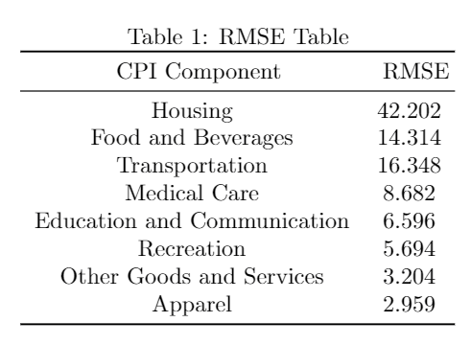
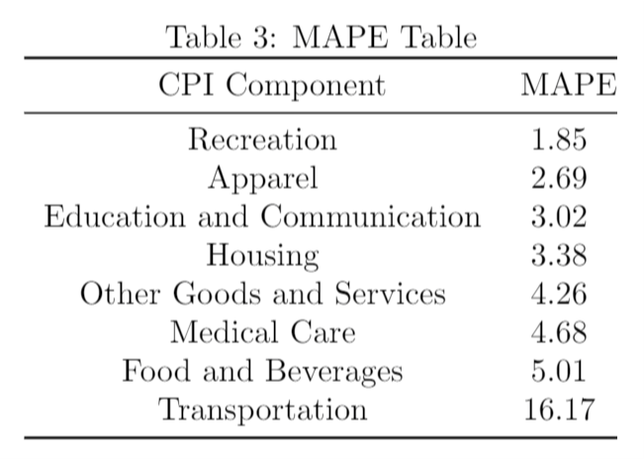
Survey of Professional Forecasters & Building a new Predictive CPI metric
Survey of Professional Forecasters
RMSE: 0.29
MAPE: 0.09

Slide 9
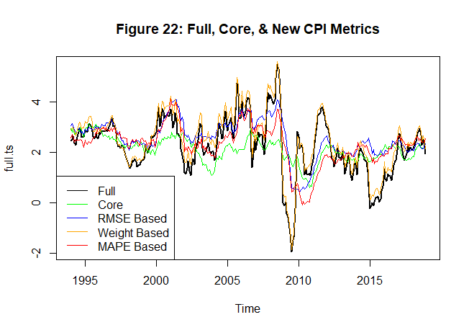
Comparing Different Models

Slide 10
Comparing Different Models (continued)
MODEL TYPE | MODEL FIT | RMSE | MAPE | WEIGHT
Core CPI | ARIMA(2,1,0)(1,0,0) with drift | 0.57 | 0.20 | 86%
SPF | N/A | 0.29 | 0.09 | 86%
New Core CPI (all components of full CPI) | sGARCH(1,1)ARIMA(1,0,1) | 0.31 | 0.10 | 100%
Top 5 components based on RMSE | sGARCH(1,1)ARIMA(1,0,1) | 0.36 | 0.11 | 77%
Top 5 components based on MAPE | sGARCH(1,1)ARIMA(1,0,1) | 0.32 | 0.10 | 60%
To 5 components based on weight | sGARCH(1,1)ARIMA(0,0,1) | 0.34 | 0.13 | 88%
Additional | ETS / Holt Winters | 0.32 | 0.11 | 100%

Slide 11
Future Work & Conclusion
Future Work:
Apply different weights to each component of CPI
Try different forecasting models
Combine forecasts from different models
Conclusion:
Central banks and forecasters should consider including food and beverage prices into their models.
This may have significant implications for monetary policy.

