Slide 1

SUBNETTING

Slide 2
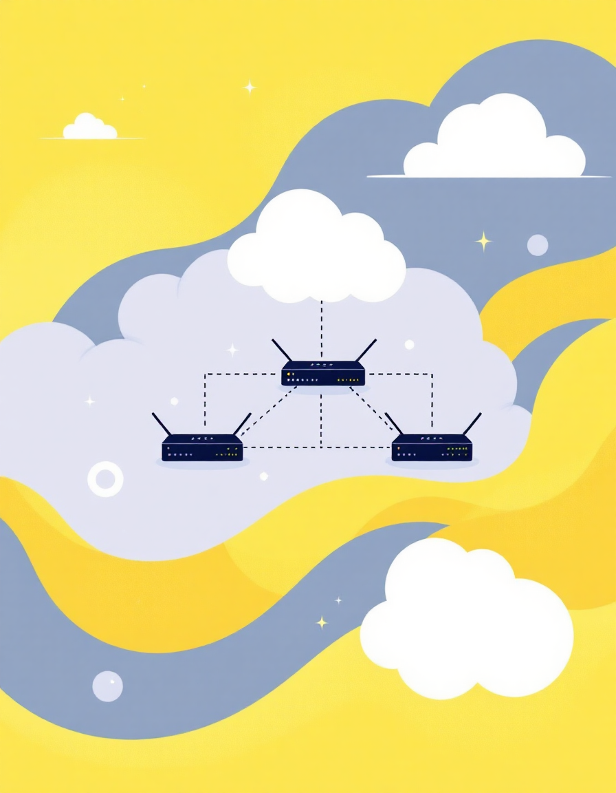
Subnetting:
Subnetting is a process of dividing a large network(ip) into smaller, more manageable sub-networks, called subnets.
BENEFITS:
Improve network performance,
Security,
Scalability.

Slide 3
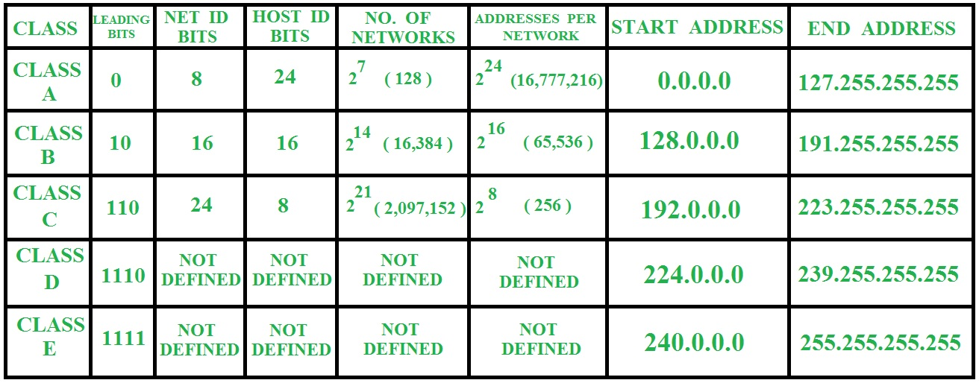
CLASSES OF IPV4 ADDRESS:

Slide 4
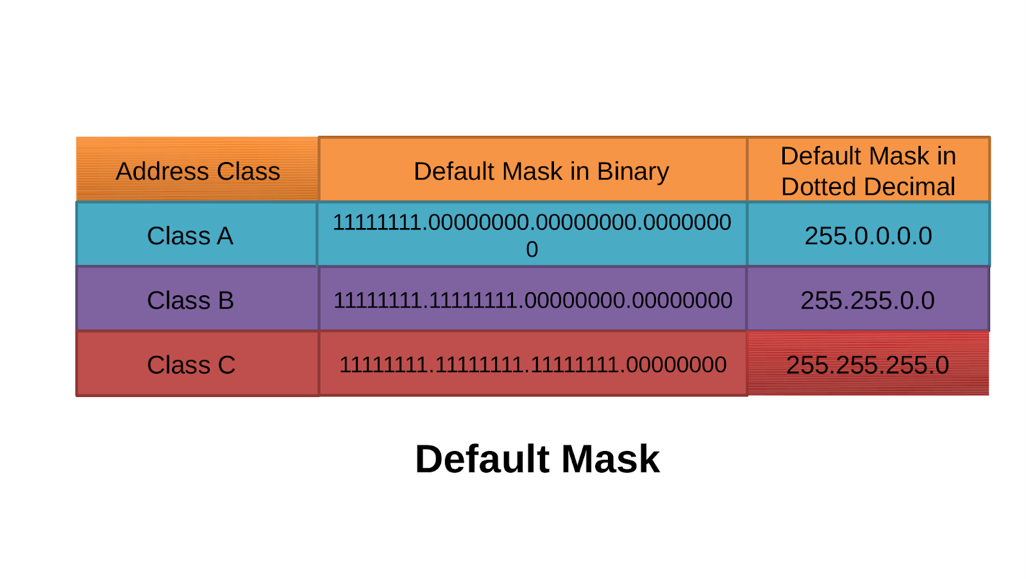

Slide 5
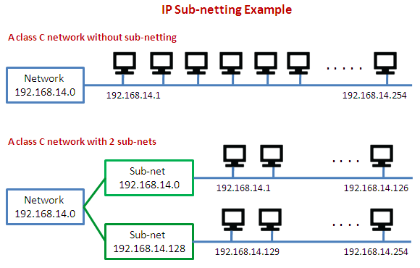

Slide 6
UNDERSTANDING SUBNETTING :
10.10.10.1
255.255.255.0 or 255.255.0.0 or 255.0.0.0 (SAME NETWORK) SWITCH
10.10.10.9
BUT…..
10.10.10.1
255.255.255.248 (DIFFERENT NETWORK) ROUTERS
10.10.10.9
IPs are in different networks because:
With a subnet mask of 255.255.255.248 (/29),
The subnet range is smaller.
- 10.10.10.1 is in one subnet, and 10.10.10.9 is in another subnet because they fall into different ranges defined by this tighter subnet mask.

Slide 7
SUBNETTING - 5 STEPS
Identify the class of the IP address and note the Default Subnet Mask.
2. Convert the Default Subnet Mask into Binary.
3. Note the number of hosts required per subnet and find the Subnet Generator (SG) and octet position.
4. Generate the new subnet mask.
5. Use the SG and generate the network ranges (subnets) in the appropriate octet position.

Slide 8
Q) Subnet the IP address 216.21.5.0 into 30 hosts in each subnet?
Step1:
Class C – Default Subnet Mask : 255.255.255.0
Step2:
1 1 1 1 1 1 1 1 . 1 1 1 1 1 1 1 1 . 1 1 1 1 1 1 1 1 . 0 0 0 0 0 0 0 0
Step3:
No . Of hosts/subnet : 30 (11110) – 5 bits SG : 32 OCTET POSITON : 4
1 1 1 1 1 1 1 1 . 1 1 1 1 1 1 1 1 . 1 1 1 1 1 1 1 1 . 1 1 1 0 0 0 0 0
Step4: New subnet mask:
255.255.255.224 or /27

Slide 9
Step5:
Network Ranges(Subnets)
216.21.5.0 - 216.21.5.31 (30 host/subnet)
216.21.5.32 - 216.21.5.63
216.21.5.64 - 216.21.5.95
216.21.5.96 - 216.21.5.127
216.21.5.128 - 216.21.5.159
& so on ……

Slide 10

Midde Sravya

