Slide 1
World Population Analysis
Domain:
Data Analyst

Slide 2
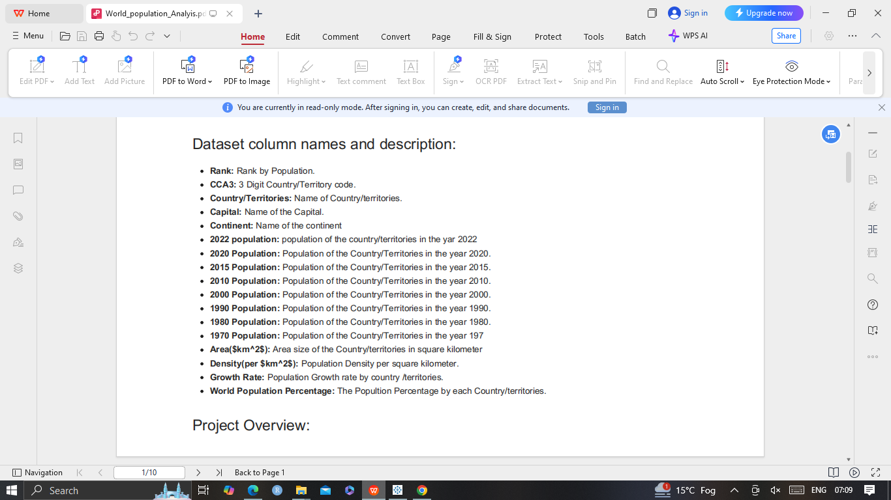
project Title:
World population anaysis
The Goal of the project is to analyze global population trends using historical data and predict future population growth. This involves
using machine learning techniques to explore demograpic data,identify key factors influencing population changes and build predictive model.
Tools:
Machine leraning,Python

Slide 3
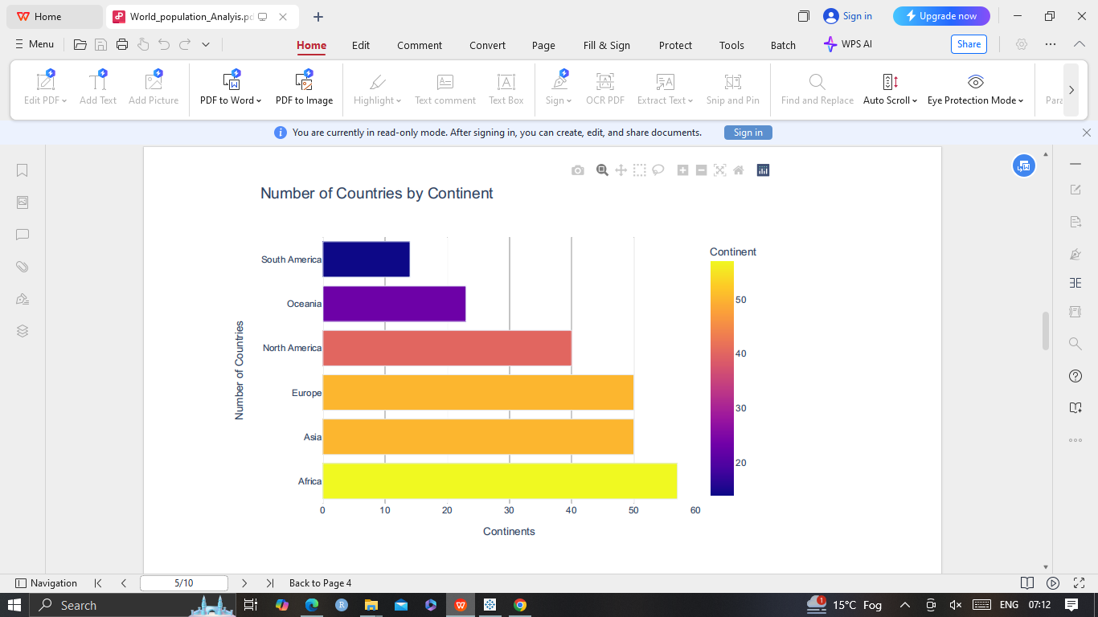
A Bar chart to Represent Number of Countries by Continent

Slide 4
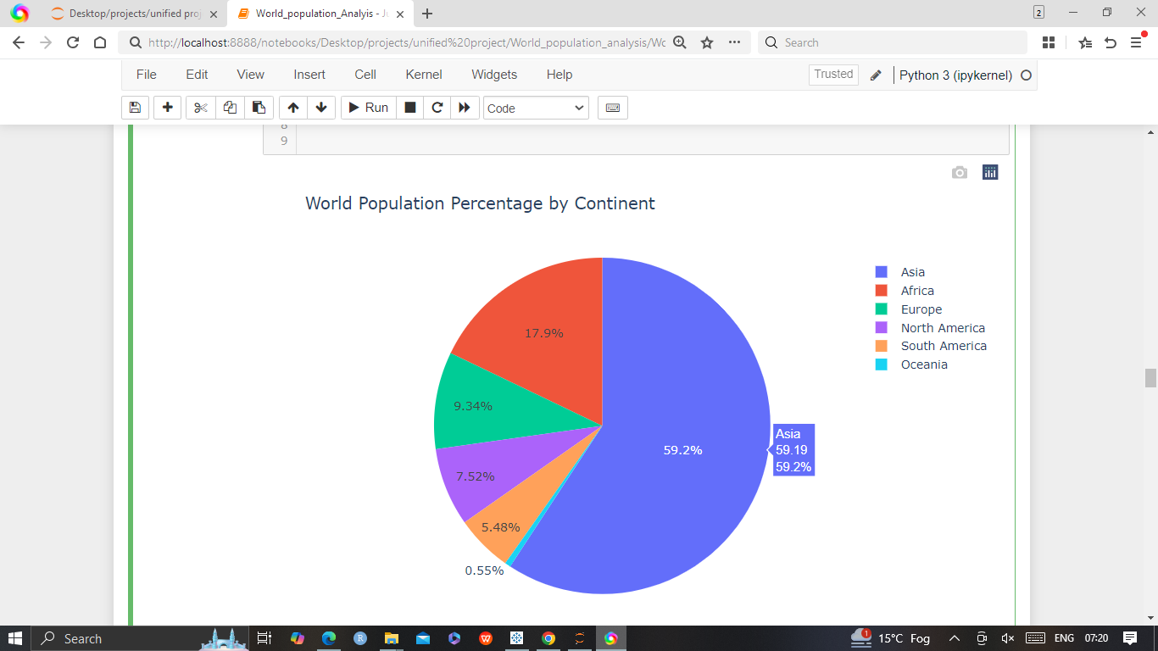
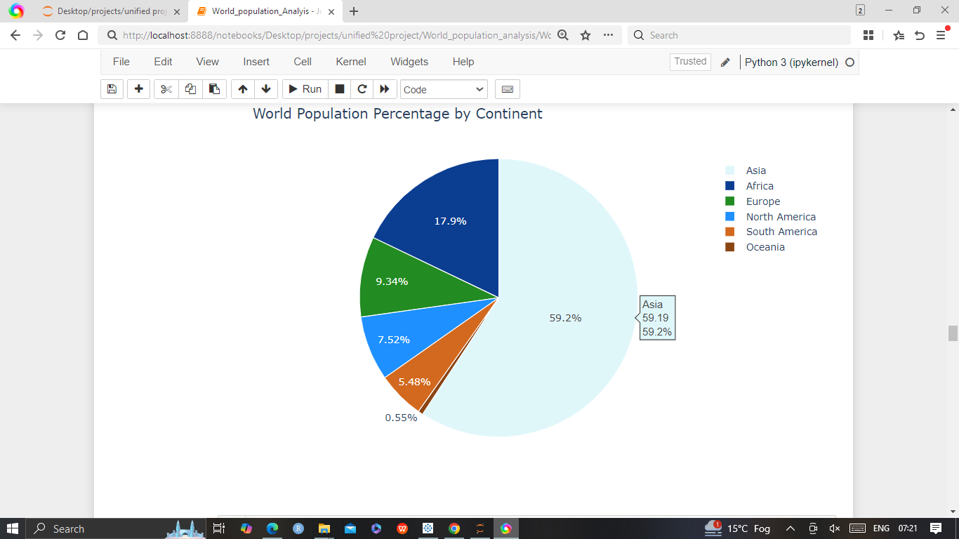
World Population Percentage by Continent

Slide 5
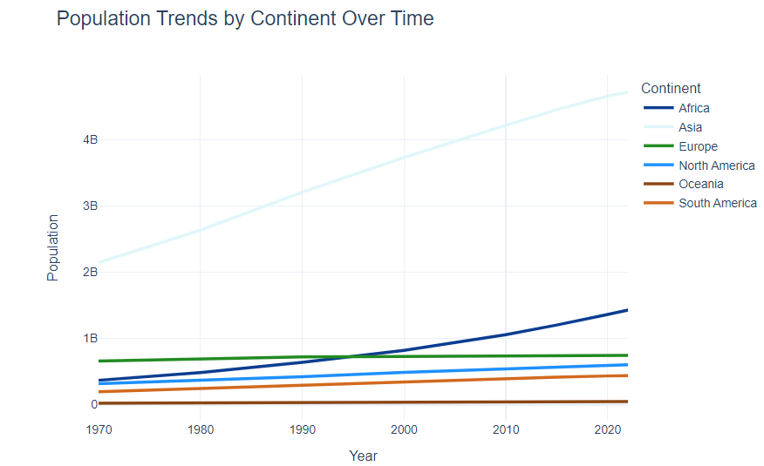
Population Trends by Continent Over Time

Slide 6
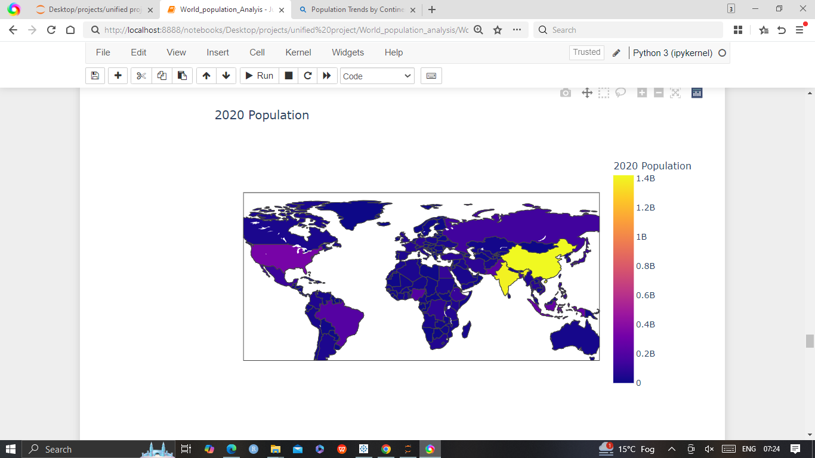
World Population Comparison: 1970 to 2020

Slide 7
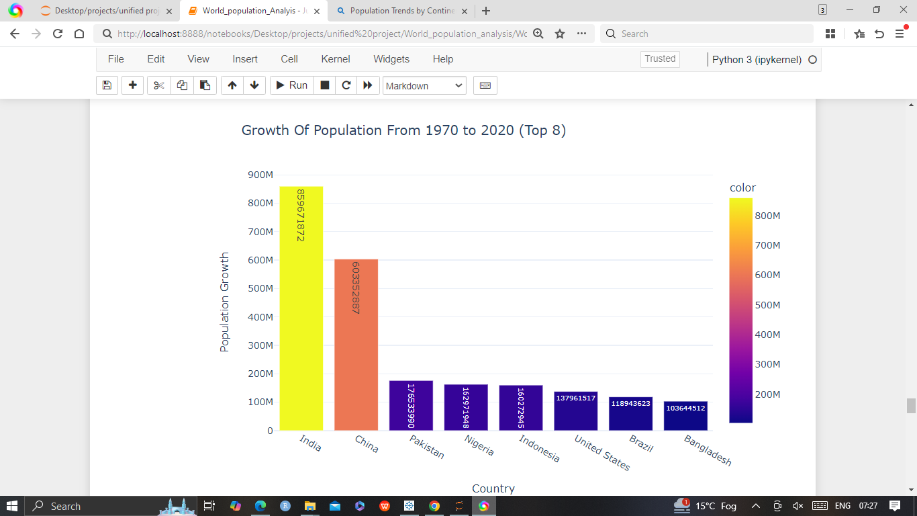
World Population Comparison: 1970 to 2020

Slide 8
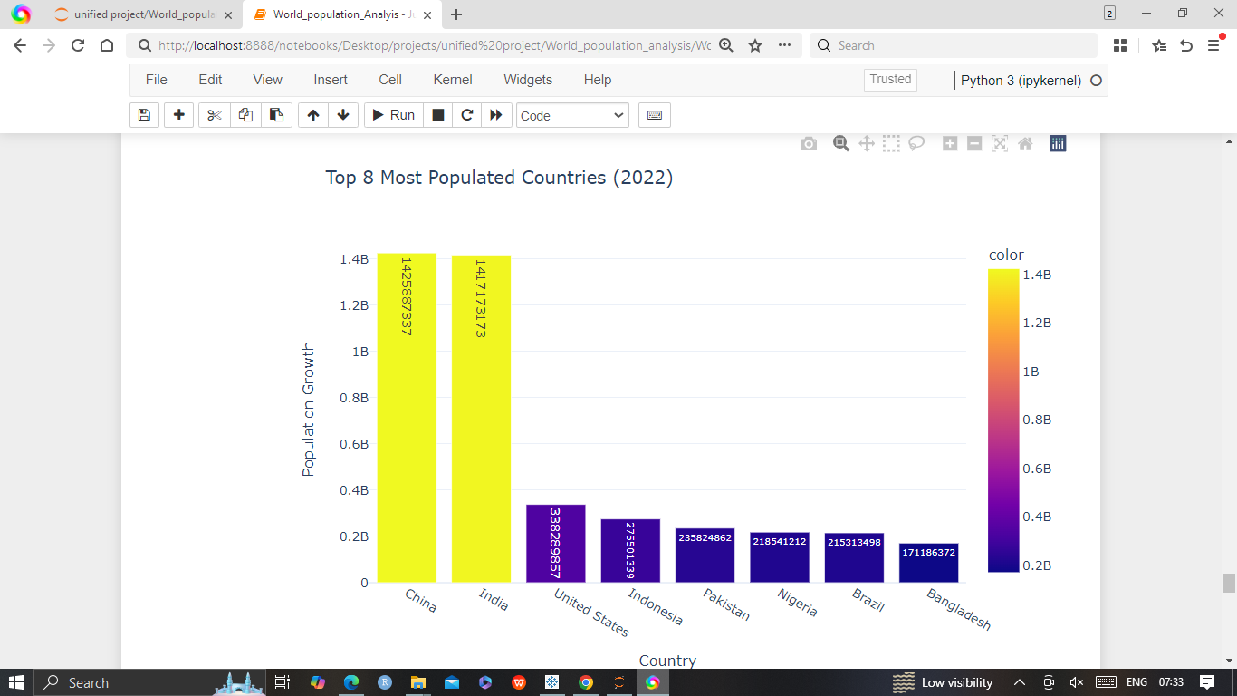
World Population Comparison: 1970 to 2020: Top Populated countries

Slide 9
World Population Comparison: 1970 to 2020: Top Populated countries

