Slide 1
Data Science Tools
Nam Pham
Sudip Baral
Dibakar Barua
Araceli Lopez
Notes:
Please refer which slide you want to present. We will take turn and go like a circle.

Slide 2
What is Data Science?
Data science is a processes and systems to extract knowledge from data in various forms.
It is a continuation of some of the data analysis fields such as statistics, machine learning, data mining, and predictive analytics.
Businesses today are accumulating new data at a rate that exceeds their capacity to extract value from it. So,there is a significant and growing demand for data
scientists:
#16
Highest Paying Job in Demand
$105,395
Average Base Salary
#1
Best Job in America for 2016
Notes:
Nam: I can go with this slide: 1 minute

Slide 3
Top Data Science Tools - Why is Python?
The top 5 tools by job listing are:Python, R, SQL, Hadoop, and Java.
Python was created by Guido Van Rossem in 1991 and emphasizes productivity and code readability.
Python is a general-use high-level programming language that bills itself as powerful, fast, friendly, open, and easy to learn. Python “plays well with others” and “runs everywhere”.
Python has packages which consists of libraries.
Notes:
Sudip: i can go with this slide: 1 minute

Slide 4
When and how to use Python?
Data analysis tasks need to be integrated with web apps
Statistics code needs to be incorporated into a production database.
Being a fully-fledged programming language, it’s a great tool to implement algorithms for production use.
The Python testing framework is a built-in, low-barrier-to-entry testing framework that encourages good test coverage. This guarantees your code is reusable and dependable.
Notes:
Nam.
End of Intro.

Slide 5

Pandas
A Python Data Science Tool
Pandas is built on top of NumPy
A fundamental high-level building block in Python
Mostly used for data manipulation and aggregation
Notes:
Lopez

Slide 6
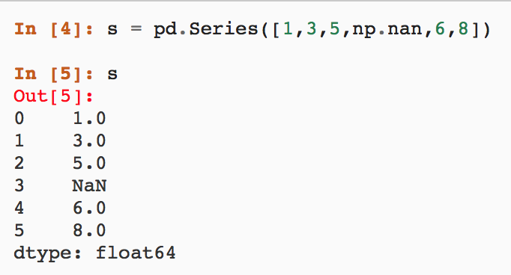
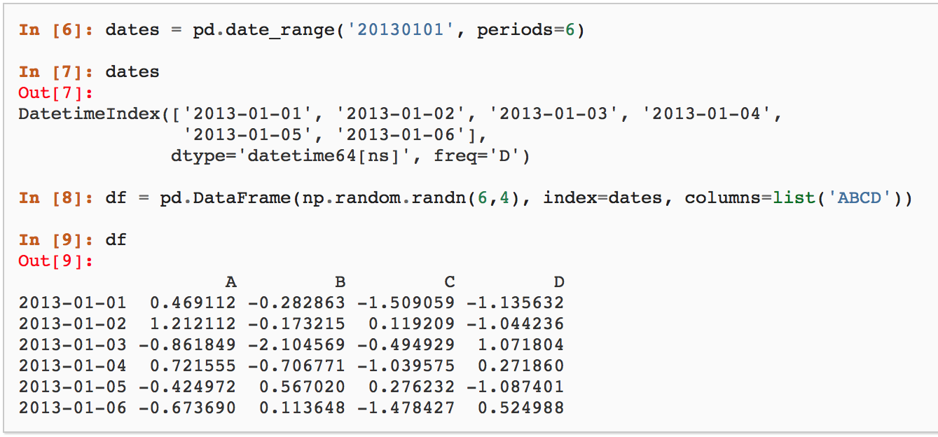
Two Primary Data Structure Of Pandas:
Series (1-dimensional):
One-dimensional ndarray
Labels don’t have to be unique
Supports integers and label indexing
Operators used (+, -, /, *)
DataFrame (2-dimensional):
Two-dimensional data
Organize arithmetic operations
Dict-like container for Series Objects
Primary data structure for pandas

Slide 7
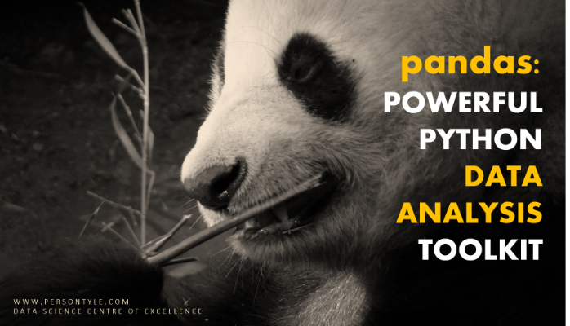
Pandas is well suited for:
•Tabular Data (SQL table & Excel spreadsheet)
•Ordered and Unordered Time Series Data
•Arbitrary Matrix Data
•Any other form of observational / statistical data sets

Slide 8

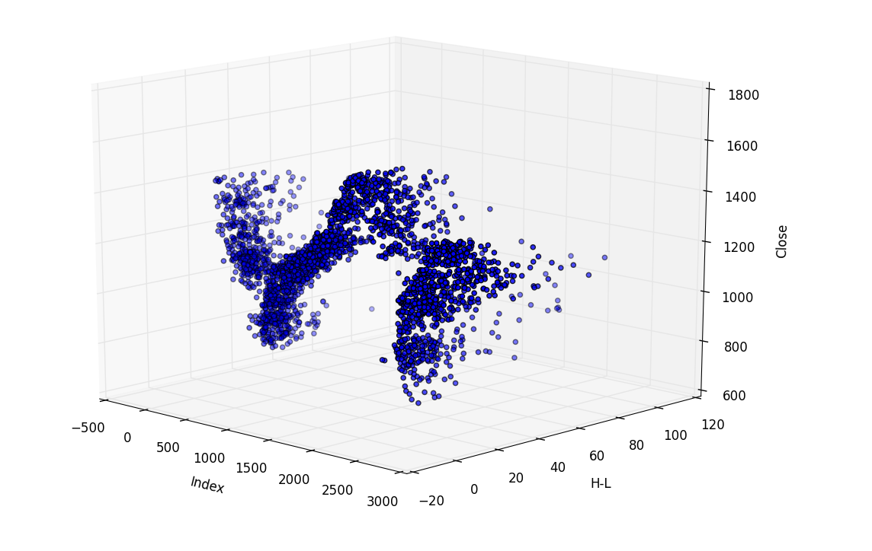
What is Pandas Good For?
•Handling Missing Data
•Inserting and Deleting from DataFrame
•Data Alignment
•Group By
•Easy to Convert
•Merging and Joining Data Sets
•Reshaping Data Sets
•Hierarchical labeling
•Loading Data from flat files
•Time Series
Notes:
After this slide we present the demo for Pandas

Slide 9
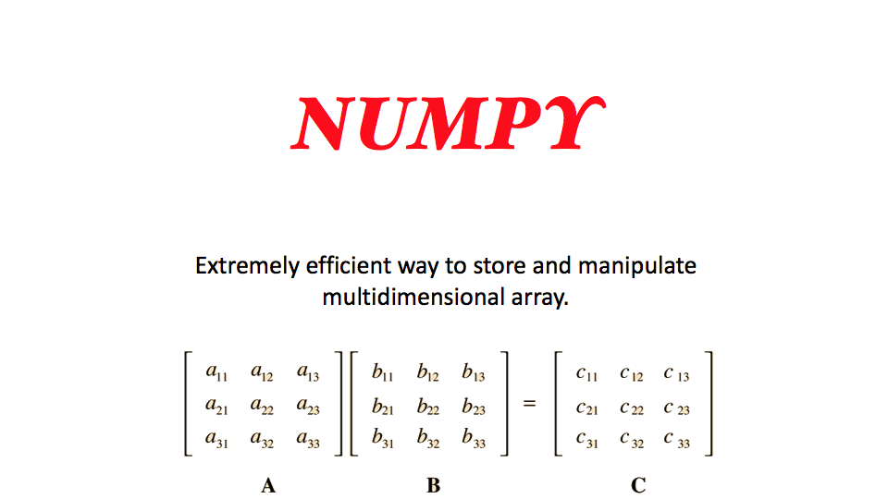
Notes:
Supdip

Slide 10
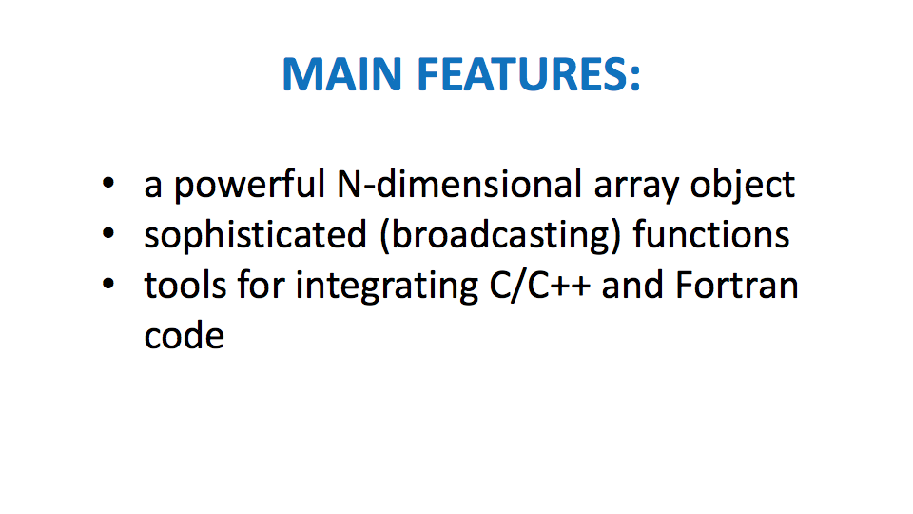

Slide 11
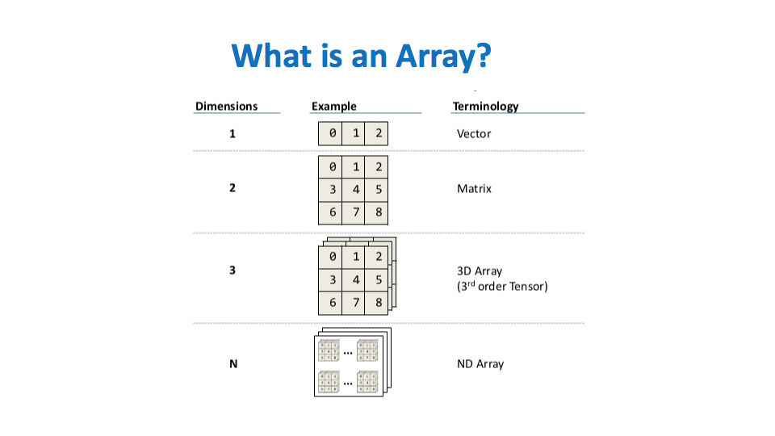

Slide 12
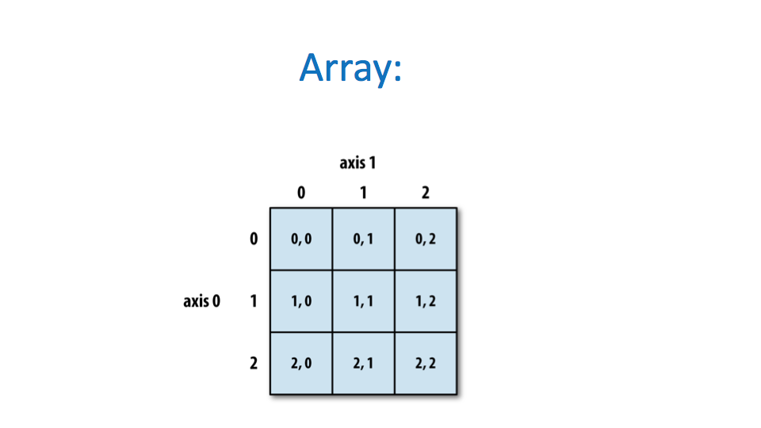

Slide 13
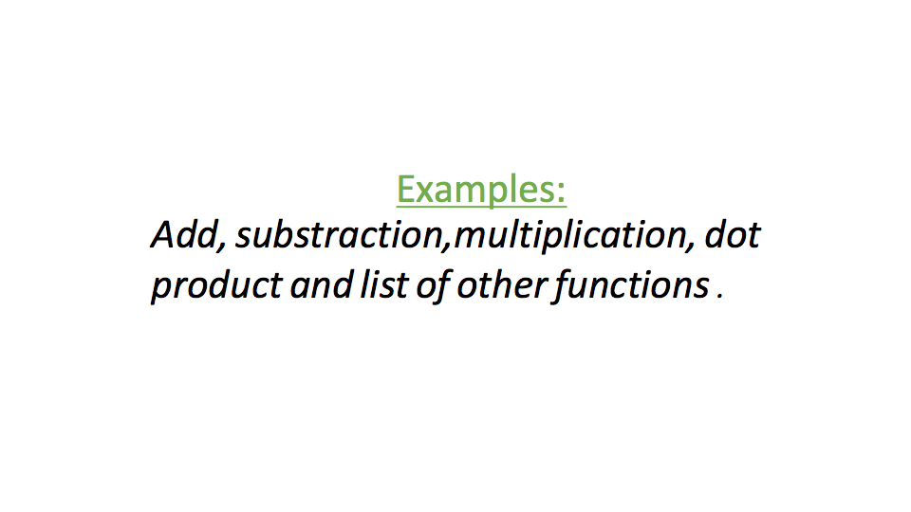

Slide 14
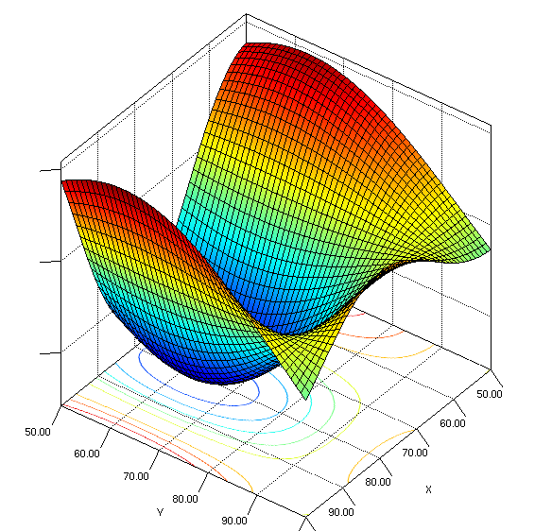
SciPy
Collection of Mathematical algorithms
Built on the NumPy extension of Python
System prototyping environment revalving system
Such as MATLAB, IDL, Octave, R-Lab and SciLab
SciPy are mostly good at
Rapid Prototyping
Research Code
Large Numerical or matrix computations
Data Analysis

Slide 15
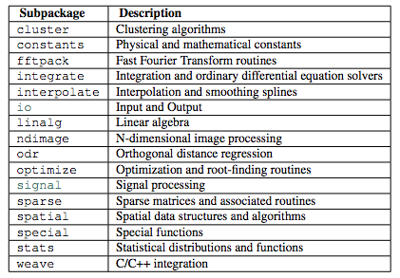
Subpackages of SciPy
SciPy is organized into subpackages.
Subpackages of SciPy needed to be imported separately (ex: >>> from scipy import cluster

Slide 16

Special Sub-Package ( scipy.special )
Mathematical Physics
Available function include
Airy, elliptic, bessel, gamma, beta, hypergeometric, parabolic cylinder, spheroidal wave, stuve and kelvin.
Stats module
Intended for general use as an easier interface
Bessel functions of real order (jn, jn_zeros)
Bessel’s differential equation with real or complex order alpha
Function of wave propagation problem such as the vibrational modes of thin drum head.

Slide 17
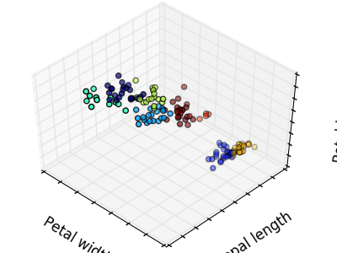
Scikit-learn: Machine Learning in Python
Simple and efficient tools for data mining and data analysis
Built on NumPy, SciPy, and matplotlib
Accessible to everybody, and reusable in various contexts
Open source, commercially usable - BSD license
Notes:
Nam: 30s

Slide 18
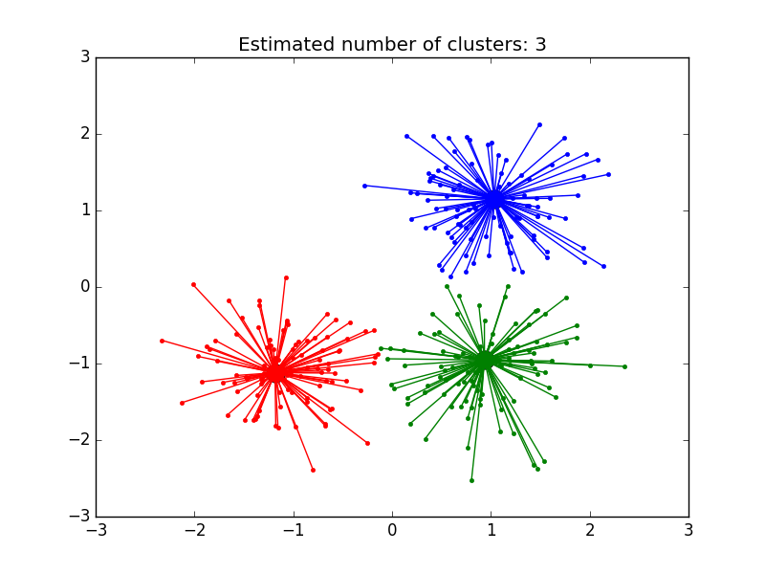
Scikit-learn: Machine Learning in Python
Some Applications:
Classification: Image recognition (identifying to which category an object belongs to).
Regression: Stock prices (predicting a continuous-valued attribute associated with an object).
Clustering: Grouping experiment outcomes (automatic grouping of similar objects into sets).
Dimensionality reduction: Visualization (reducing the number of random variables to consider).
Model Selection - Comparing, validating and choosing parameters and models
Notes:
Nam: 30s
End of the intro about Scikit-Learn:
after this slide i will go to the console and run the example: 2 minutes

Slide 19

How to Choose your Estimator
Notes:
Nam: 30s
End of the intro about Scikit-Learn:
after this slide i will go to the console and run the example: 2 minutes

Slide 20
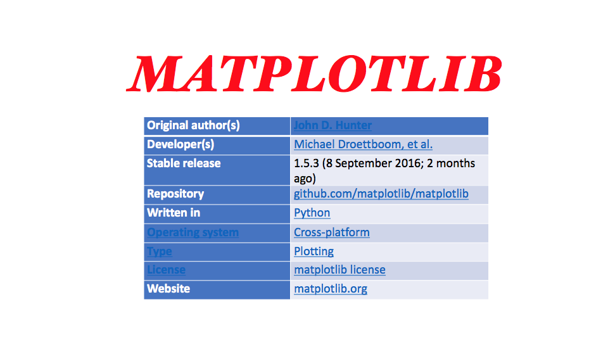
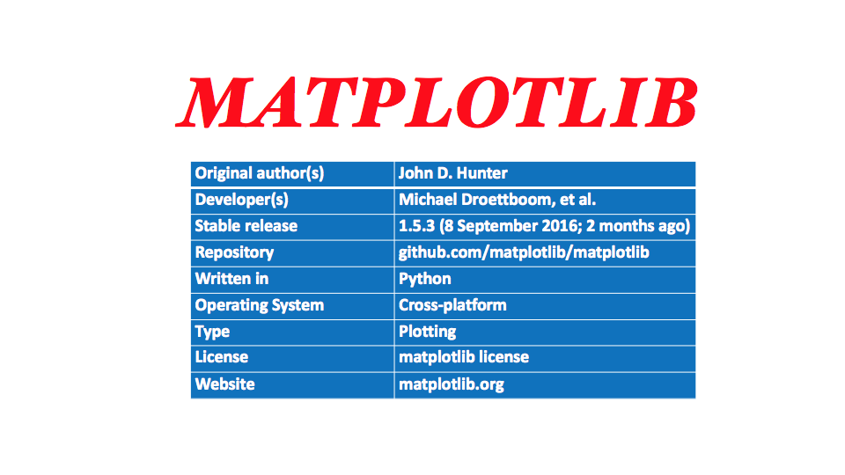

Slide 21
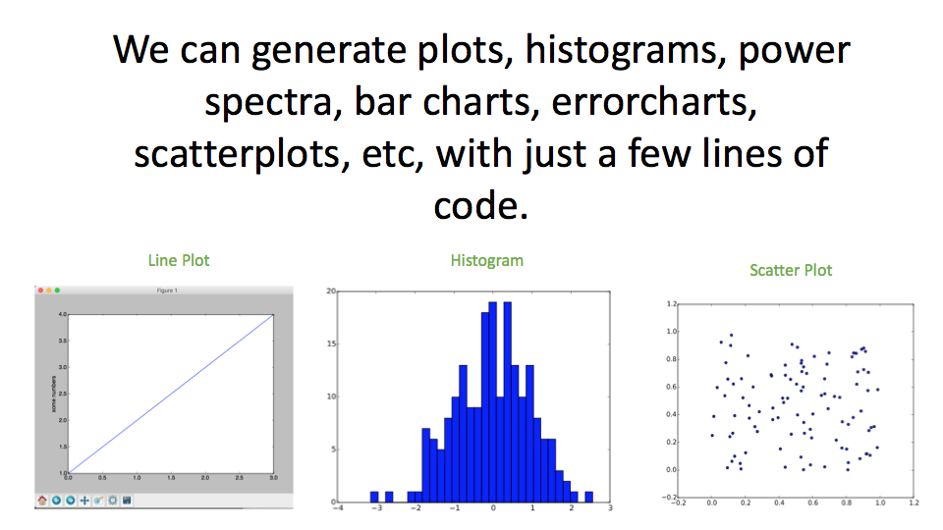

Slide 22
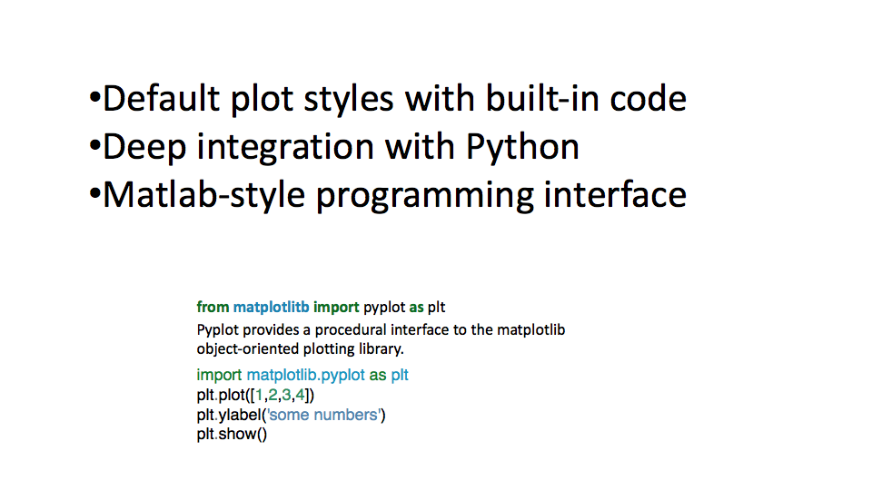

Slide 23
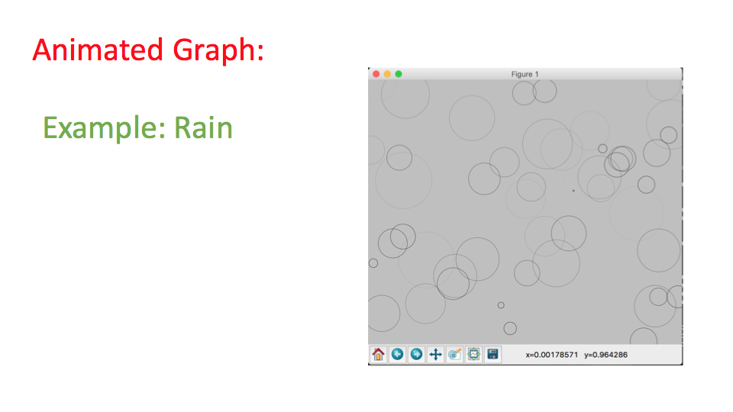

Slide 24
