Slide 1
Group NaSu
CS4660
Team-Members:
Nam Pham, CIN: 304915083
Sudip Baral, CIN: 303103065

Slide 2
House Price Prediction

Slide 3
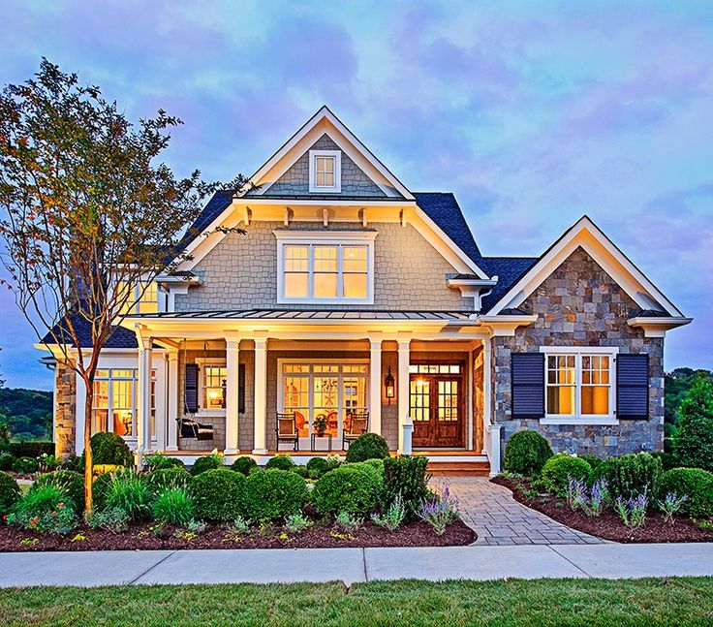
Data samples consist 80 features and 1 lable and number of data samples is 1460. Out of 80 features, we dropped some of the features since they had lot of missing datas and some features didn’t contribute to the prediction of the price of houses.

Slide 4
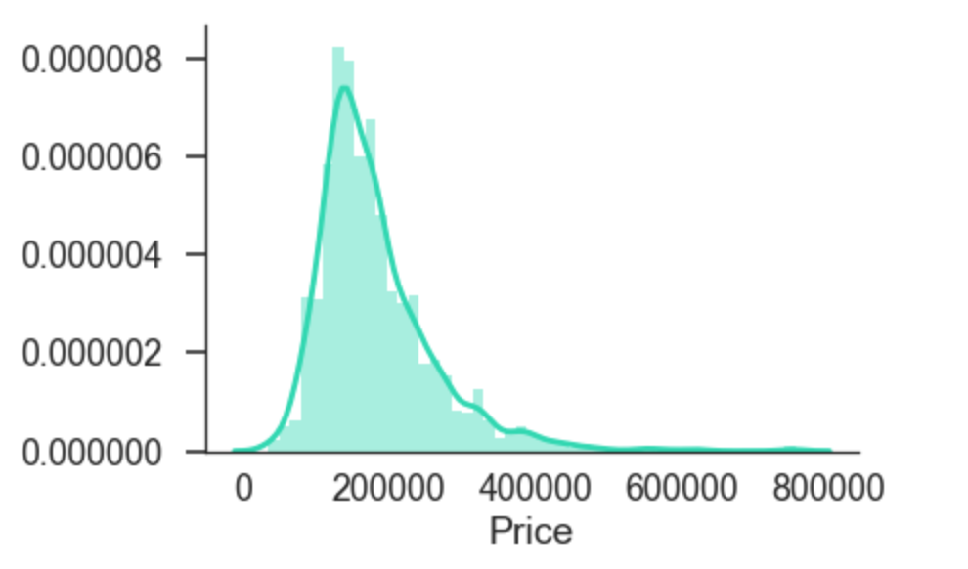
SEABORN
Seaborn provides a high-level interface to Matplotlib, a powerful but sometimes unwieldy Python visualization library.

Slide 5
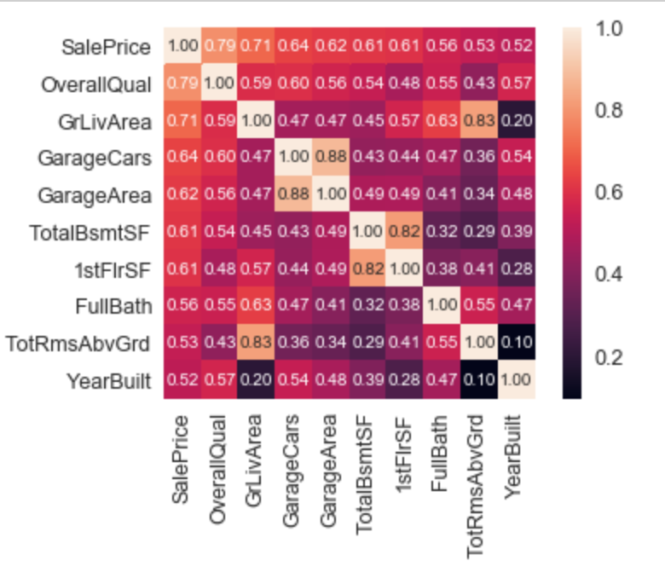
HEATMAP

Slide 6
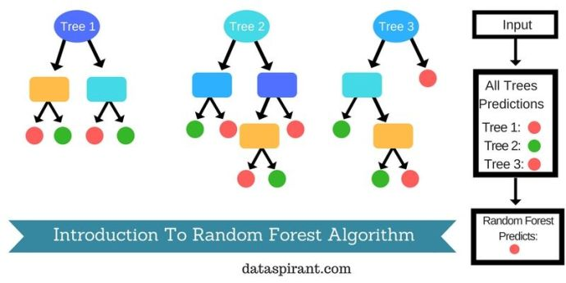
RANDOM FOREST
Ensemble Learning: It uses a group of machine learning algorithms
(called base learners), and then combine the results of them using some techniques such as Voting to achieve higher accuracy.
Bootstrapping: Suppose we have a Training Dataset S of size N.
Bootstrapping generates L new training sets S1, S2 ,…, SL each of size M,by sampling from S randomly and with replacement.

Slide 7
DECISIONTREE
Decision tree learning uses a decision tree (as a predictive model) to go from observations about an item (represented in the branches) to conclusions about the item's target value (represented in the leaves).

Slide 8
XGBOOST
XGBoost is an open-source software library which provides the gradient boosting framework for C++, Java, Python, R, and Julia. It works on Linux, Windows, and macOS. - Wikipedia
It supports regression, classification, ranking and user defined objectives.

Slide 9
CATBOOST
CatBoost is a machine learning method based on gradient boosting over decision trees.
Main advantages of CatBoost:
Superior quality when compared with other libraries.
Support for both numerical and categorical features.
Data visualization tools included.

Slide 10
CONCLUSION
Accuracy
Demonstration of the project contains accuracies and errors.
Let us Demo now …

