Slide 1
CEREBRO NEURAL SENTIMENT HACKATHON | IEM KOLKATA
ProcrastiScope
Detecting academic procrastination patterns from student activity history
Problem Statement 1 • Team: <nayakprayas323002> • <Prayas Kumar Nayak, CH PUJITA ACHARY, Swabhimaan Maharana >

Slide 2
The problem: deadline habits go unmeasured
Invisible pattern
Reactive support
No explanation
Grades show the outcome, not when the work happened. Late-night cramming stays hidden until performance drops.
Advisors usually intervene after a missed deadline or a failing grade, when it is already late.
Scores without reasons are not actionable. Students and mentors need to know why.
Our goal: turn raw submission timestamps into a measurable index, a behavior class, a trend and a plain-language explanation.

Slide 3
Our solution: an end-to-end analytics dashboard
Data layer
Metrics engine
Pattern classifier
Built-in datasets, CSV upload, strict validation
Lead Time, Urgency Ratio, Procrastination Index (0-100)
Early Bird, Steady, Last-Minute, Chronic Cruncher
Trend detector
Interactive visuals
Explainer
Improving, Stable or Worsening across tasks and semesters
Gantt timeline, distributions, gauge, trend lines
Rule-based paragraph and recommendation per student

Slide 4
Methodology: transparent, interpretable scoring
Pattern | Rule (student's task history)
Early Bird | mean index < 30
Steady Worker | mean index 30-55
Last-Minute Procrastinator | mean index ≥ 55
Chronic Cruncher | mean ≥ 70 and ≥ 50% of tasks in the last 10% of the window
Lead Time
deadline − submission, in hours (negative = late)
Urgency Ratio
time used at submission ÷ total time allowed
Procrastination Index
90 × clip(ratio, 0-1), plus 10 if late. Range 0-100.
Trend = mean index of 2nd half of history minus 1st half: ≥ +5 Worsening, ≤ −5 Improving.

Slide 5
Architecture: from raw CSV to explained insight
1 Ingest
2 Validate
3 Compute
4 Classify
5 Present
Built-in or uploaded CSV
Normalize columns, drop bad rows
Lead time, ratio, index
Pattern and trend
Charts and explanation
Stack: Python • Pandas • NumPy • Plotly • Streamlit
Errors never crash the app: invalid uploads fall back to sample data with a clear warning.

Slide 6
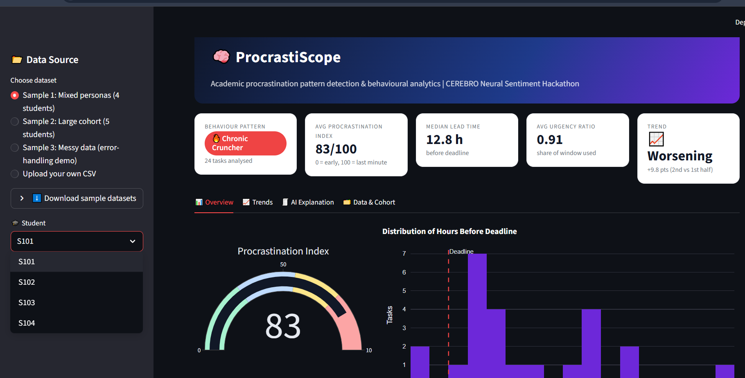
Live dashboard
Instant verdict
Pattern, index, lead time and trend on one row.
Interactive
Switch datasets and students without reloading.
Judge-friendly
Upload any CSV or download the samples.

Slide 7
Results: the engine separates behaviors clearly
ENG-A: Chronic Cruncher
Index 95, often late, getting worse.
ENG-D: Improving
From last-minute to steady across 4 semesters.
ENG-B: Early Bird
Index 14, consistently ahead of deadlines.

Slide 8
Explainable by design: every label comes with a reason
“S101 is classified as a Chronic Cruncher based on 24 tasks. The average Procrastination Index is 83/100, with submissions made after 91% of the allowed time. Behaviour is worsening: the later half scores +9.8 points higher than the earlier half. Recommendation: urgent intervention with enforced milestones and advisor check-ins.”
Evidence-based
Category insight
Actionable
Cites tasks, index, lead time, late rate.
Names the task types that cause delay.
Recommendation matched to the pattern.

Slide 9
Impact and future scope
Who benefits
What's next
Students: self-awareness of their habits.
Mentors and advisors: early, data-backed signals.
Institutions: scalable cohort-level insight.
Real LMS integration (Moodle, Canvas).
Learned thresholds via clustering.
Automatic early-warning alerts.
Sentiment and stress signals.
GitHub: github.com/pujita-achary/procrastination_analyzer |
Live demo: < https://procrastiscope.streamlit.app >
Thank you

