Slide 1
FIFA - Supply Chain - Memorabilia/Merchandise
Pujita Vijayakumar
April 23, 2024
Supply Chain Engineering II Spring 2024
Dr. Yeganeh Hayeri

Slide 2
Introduction
FIFA world cup 2026
Utilization of blockchain and machine learning and simulation to improve experience for customers and increase revenue

Slide 3
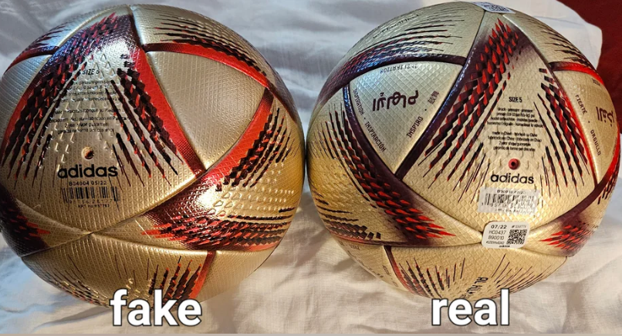
Blockchain In Supply Chain
The rise of counterfeit collectibles poses substantial hurdles for FIFA, jeopardizing its brand reputation, consumer confidence, and revenue streams.
This situation has led to a 5% decline in FIFA's market share.
To address these challenges, NFTs (Non-Fungible Tokens) can be integrated for authenticating collectibles.

Slide 4





NFT Authenticating Collectible
Minting NFT Associating collectible with special token in blockchain
Transfer of ownerships Transfer of Ownership is executed by transfer of NFT
2nd
4th
1st
3rd
5th
Creating Digital Representation Creating digital arts for collectibles
Verification by blockchain The permissioned blockchain system for authenticating FIFA collectibles.
Ensuring transparency and trust
The combination of decentralization, blockchain helps ensure trust in the NFT

Slide 5
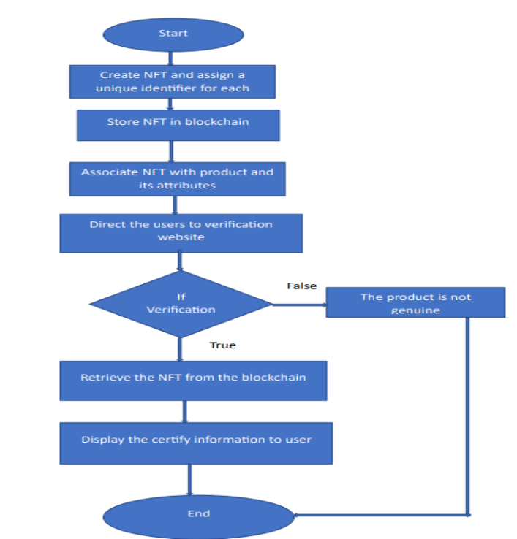
Flow Diagram for Verification

Slide 6
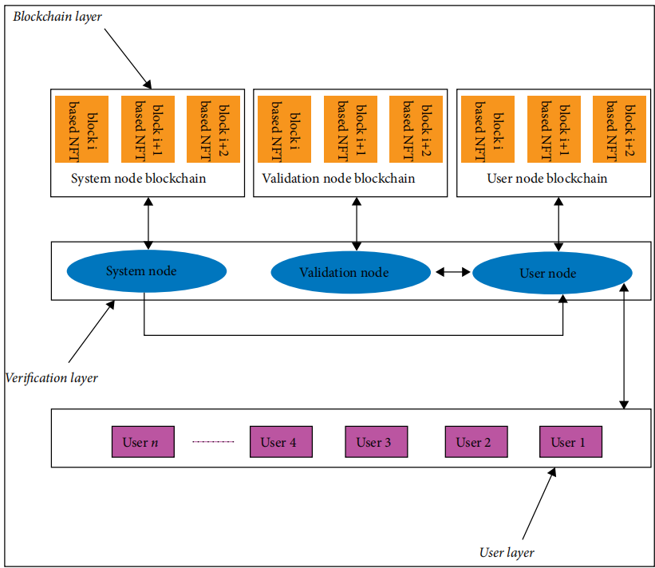
Verification by Blockchain
The permissioned blockchain system for authenticating FIFA collectibles, consists of three main layers: the User Layer, Verification Layer, and Blockchain Layer.
User Layer:
Buyers of collectibles interact with collectible sales website to submit authentication requests.
Information submitted by users, along with other encrypted data, generates an access code.
Blockchain Layer:
NFTs associated with FIFA collectibles in synchronized blocks serve as unique identifiers, facilitating authentication
Blockchain layer stores transaction details, NFT & Personal Information of users
Verification Layer:
Comprises multiple nodes including user nodes, verification nodes, and system nodes.
System nodes receive and classify authentication requests, forwarding them to other nodes for processing.
Verification nodes extract relevant information from blockchain transactions, such as NFT details (from blockchain layer), user information, and collectible attributes.
User nodes handle user requests and provide authenticated FIFA collectibles data back to the users once verification is complete. The access code generated in user layer is matched with blockchain transaction results to authenticate FIFA collectibles.

Slide 7
Employer Training
Accurately forecasting merchandise demand poses one of the biggest challenges for FIFA, yet it also holds the key to maximizing revenue potential.
Strategies Employed
Training employees to utilize AI models for predicting demand, placing supplier orders, and efficiently managing inventory.
Training on market research methodologies, including analyzing customer buying preference in previous FIFA matches to gather insights into consumer preferences, trends, and buying behavior.
Challenges Faced
Resistance to Change: Within FIFA, there may be resistance among stakeholders such as national football associations, clubs, and employers towards adopting new technology, including AI-driven solutions.
Technical Hurdle :Addressing technical challenges related to integrating AI models with FIFA’s existing systems .
Outcome
Improved Efficiency: AI-driven demand prediction and inventory management can lead to more accurate forecasts, optimized inventory levels, and reduced wastage.
Cost Reduction: By avoiding overstocking or understocking, businesses can minimize holding costs and optimize procurement, resulting in significant cost savings.

Slide 8
Simulation-Green Field Analysis
Objective:
Identify the most effective Distribution Center for merchandise
Forecast demand
Minimize Distribution network costs.
Demand: Derived from historical data.
GFA (Green Field Analysis): Any logistics is utilized for finding optimal distribution Center and minimize distribution cost .
Examples of Distribution Centers: New York, NY and East Rutherford, NJ.
East Rutherford may serve as a Distribution Center for in-house material, while New York NY, may be utilized for freight-involved supply distribution.

Slide 9





Simulation-Green Field Analysis
The inputs required are
Locations: The geographic locations of FIFA merchandise customers are identified . This includes fans, retailers, or distributors across different regions or countries.
Products: The types of FIFA merchandise being distributed, such as jerseys, footballs are determined
Demand Data: Data on the demand for each FIFA merchandise product from each customer location are determined . Involves historical sales data, market research, or customer surveys.
Distance Data: The direct distances between potential distribution center (DC) or production facility locations to the stadium are determined. This data will serve as input for determining transportation costs.
Constraints : Labor Availability, Time Constraints, Financial

Slide 10
Machine Learning / AI
Determining optimal dates for matches
Using air temperature, precipitation, wind speed & humidity as inputs regression methods can be used to forecast weather and optimal dates for matches can be fixed.
Ticketing Optimization
Recommendation Systems: Collaborative filtering or content-based recommendation systems can be used to personalize ticket recommendations for fans based on their past preferences, browsing history, or demographic information.
Predictive Analytics: Predictive models such as logistic regression or gradient boosting can analyze factors like match importance, team performance, opponent strength, and day/time of the match to forecast ticket demand and optimize pricing strategies accordingly.
Video recognition algorithms in decision making(AI)
Advanced image and video recognition algorithms can analyze replays in real time and identify key features and patterns that may not be immediately apparent to the human eye
Sales Prediction
Regression Models: Linear regression can be used to predict sales based on historical data such as past merchandise sales, match attendance, marketing efforts, and other relevant factors.

Slide 11
Conclusion
Enhanced outcomes and revenue growth in FIFA by implementing the strategies outlined in the presentation.
Utilization of NFT in authentication of collectibles
Training employees to utilize AI models .
Green Field Analysis for finding Optimal distribution centre for sports merchandise
Use of AI/Machine learning in forecasting Ticket sales, Merchandise sales & Weather forecast to find optimal dates for matches

Slide 12

Thank you!
Questions?
Presentation revised September 2023
Department of University Communications and Marketing
© 2023, Rutgers, The State University of New Jersey

Slide 13
References
Slide 4 : Sukhpreet Singh(2023) The Rise of NFTs: Revolutionizing Merchandise Authentication.Available at: https://www.linkedin.com/pulse/rise-nfts-revolutionizing-merchandise-authentication-sukhpreet-singh/(Accessed:April 2 2024)[4]
Slide 5: Brhan Zelalem Tsegaye (2019) ‘Tracing Authenticity: A Blockchain and NFT-Based Approach to Product Verification’. India. [5]
Slide 6: Huan wang (2022) ‘Construction and Application of a New Metal Random Matrix-Based Theory in a Numerical Phantom of the Metaverse NFT’.China: 13 June.Academic Editor: Ning Cao.pp-3. [6]
Slide 7: Jumpsix 2 (2018) Getting staffs ready for event. Available at: https://sportsfacilities.com/getting-your-staff-ready-for-an-event/(Accessed:April 2 2024) [7]
Slide 8: Ivanov D. (2018) ‘Supply Chain Simulation and Optimization with anyLogistix’.Berlin School of Economics and Law.pp-26[8]
Slide 10:How FIFA is using AI. Available at :https://www.linkedin.com/pulse/how-fifa-using-ai-artificial-intelligence-enhance-viewer-experience-/[10]

