Slide 1


Aum Amriteshwaryai Namaha !
Wideband Unequal Power Divider With Enhanced Power Dividing Ratio,
Fully Matching Bandwidth, and Filtering Performance
IEEE Transactions on Microwave Theory and Techniques, VOL. 70, NO. 6, JUNE 2022
Group No : B7
Student Names : PUJITH.B, DEVIKA VINOD, HASINI, HARSHITHA.N
Roll Nos : 22114,22116,22122,22123
19 ECE 381 RF & Simulation Lab

Slide 2
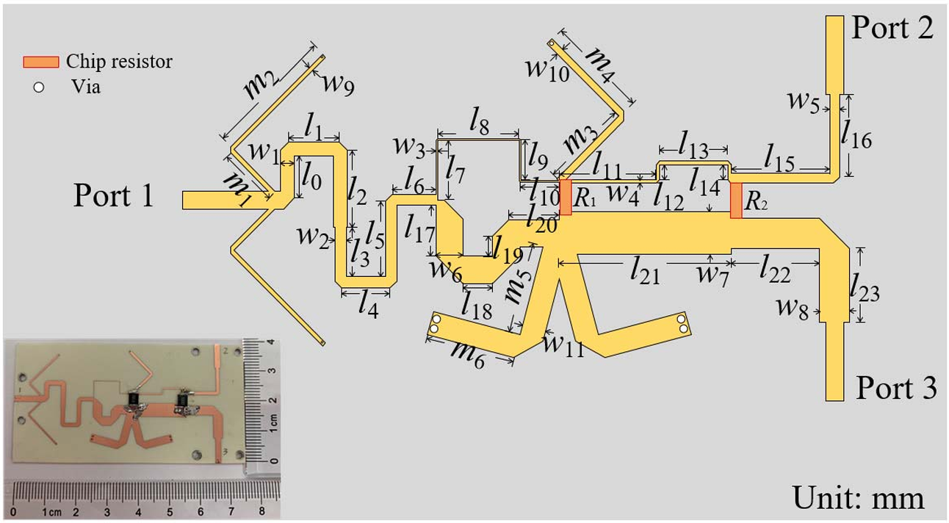


Abstract
A new class of wideband unequal power divider with enhanced power dividing ratio, fully matching bandwidth, and filtering performance is presented. A leading triple-mode resonator is inserted in front of the power dividing junction to relax the requirement of high impedance and bring in more poles in input return loss (RL) response and isolation response. Therefore, the power dividing ratio is significantly enhanced and bandwidths of input RL and isolation are enlarged. Moreover, the cascade of the leading triple-mode resonator and the following transmission line segments corporately construct Chebyshev filtering performance. Thus, the power divider can be synthesized by the required bandwidth of RL and power dividing ratio. Examples of 4:1 and 8:1 filtering power dividers operating at 2.4 GHz are designed and fabricated. The measured power dividing ratios of two filtering power dividers are 3.8:1 and 8.1:1 with corresponding RL bandwidths of 95.8% and 97.5% (|S11| <-10 dB), and the measured port-to-port isolation bandwidths are 100% (|S32| <- 14 dB) and 100% (|S32| <- 20 dB), respectively.
Index Terms-Filtering implanted, fully matching bandwidth, multimode resonator, unequal power divider, wideband power divider..
4:1 power divider
Objective: Development of a wideband unequal power divider with improved performance.
Innovation: Incorporation of a triple-mode resonator for enhanced power dividing ratio and bandwidth.
Performance Metrics:
Power dividing ratios: 3.8:1.
Return Loss bandwidths: 95.8%
Isolation bandwidths: 100%.

Slide 3
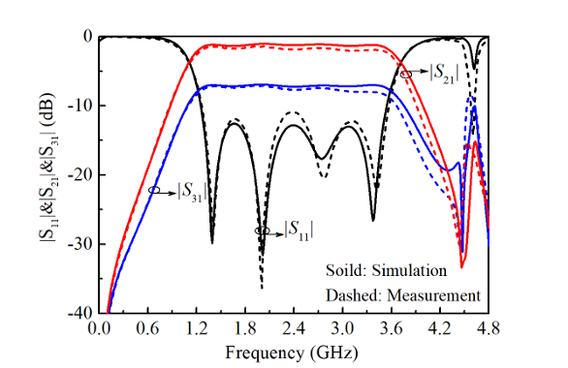
Context of the paper
PURPOSE:
It splits an input signal unequally between two output ports while ensuring wideband performance, impedance matching, and filtering characteristics.
APPLICATION:
Used in microwave circuits such as communication systems, radar, and signal distribution networks.
Published in: IEEE Transactions on Microwave Theory and Techniques
( Volume: 70, Issue: 6, June 202a2)

Slide 4
Objectives of the paper
Old system:
The paper compares the proposed wideband unequal power divider with the narrowband filtering power divider and the wideband unequal power divider based on the line-inserted method:
Narrowband Filtering Power Divider:
Based on coupled resonator theory.
Designed with a Chebyshev filtering response.
Operates only in a narrowband, making it unsuitable for wideband applications.
Limited to low power-dividing ratios.
Wideband Unequal Power Divider (Line-Inserted Method):
Utilized an additional λ/4 line and impedance-transforming networks.
Enhanced the input return loss (RL) bandwidth and power-dividing ratio.
Did not focus on isolation performance, making it hard to add isolation resistors without affecting other parameters like power division and filtering performance.
.
New system:
The authors introduced a leading triple-mode resonator into the topology to address the limitations of the old systems.
Leading Triple-Mode Resonator:
Placed in front of the power-dividing junction.
Provides three in-band poles, improving return loss bandwidth, isolation bandwidth, and power-dividing ratio.
Reduces the high impedance requirements of branches, enabling practical implementation.
Impedance Transformer Sections:
Designed in the two filtering branches to achieve Chebyshev filtering performance.
Simplifies the synthesis of power dividers, making them scalable and flexible.
Improved Isolation Network:
A single isolation resistor is added between output ports, achieving wide isolation bandwidth without degrading performance.

Slide 5
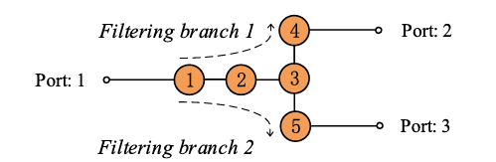
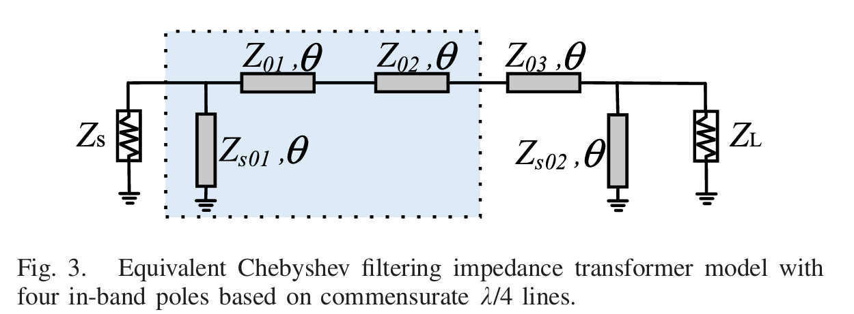
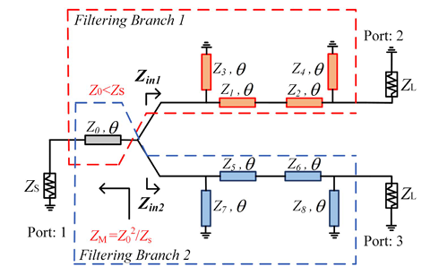
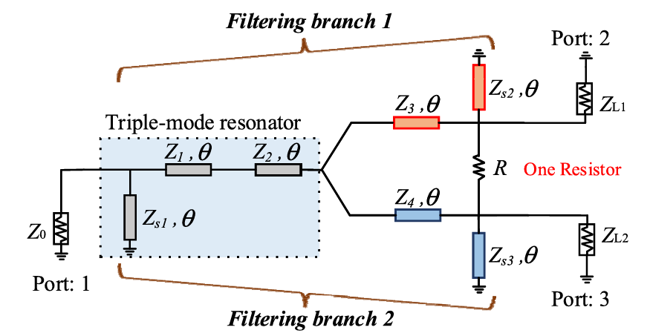
a)
b)
Chebyshev wideband filtering transformers with four poles can be achieved by introducing two λ/4 short-terminated stubs on three λ/4 transmission line sections
The designs of a conventional narrowband filtering power divider using coupled resonator in [28] and a wideband unequal power divider with high-power dividing ratio
Topologies of power dividers: (a) narrowband filtering power divider based on coupled resonator ; (b) wideband unequal power divider with high-power dividing ratio using line-inserted method;
Proposed wideband unequal power divider.
paper by Di Wang, Xin Guo, and Wen Wu (IEEE Transactions on Microwave Theory and Techniques, Vol. 70, No. 6, pp. 3200–3212, 2022)

Slide 6
Objectives of the paper
Old system:
The Wilkinson power divider is a well-established and widely used design in microwave systems. It provides a standard framework for evaluating the performance of new power divider designs, particularly in terms of:
Power division ratios
Return loss bandwidth
Isolation bandwidth
By discussing the Wilkinson divider, the authors could effectively demonstrate how the proposed system overcomes the limitations of traditional designs.
Limitations of the Wilkinson Power Divider
The Wilkinson power divider has inherent limitations when applied to wideband and unequal power-dividing scenarios:
Narrowband operation: The conventional Wilkinson design struggles to achieve wide bandwidth, especially when unequal power division is required.
Impedance constraints: High power-dividing ratios require impractically high characteristic impedances, making the design difficult to implement.
Limited isolation bandwidth: Isolation performance degrades quickly outside the narrow operating frequency range.
By addressing these limitations, the authors highlighted the need for an innovative design.
New system:
Comparisons to Demonstrate ImprovementsThe paper specifically compares the proposed power divider with the Wilkinson design to show significant improvements:
The proposed design achieves enhanced isolation bandwidth (100% compared to 68% for the Wilkinson divider with a 2:1 ratio).
The proposed power divider supports higher power-dividing ratios (e.g., 4:1 and 8:1) without requiring extreme impedance values.
The integration of filtering performance into the proposed design allows for a wider bandwidth while maintaining good isolation and return loss—features the Wilkinson design lacks.

Slide 7
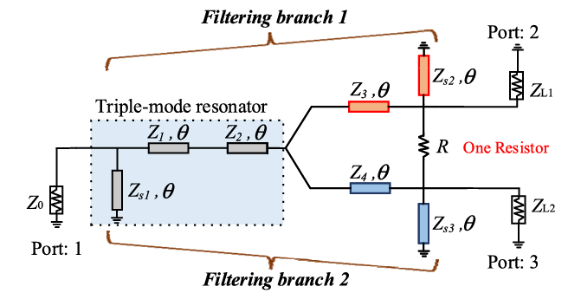
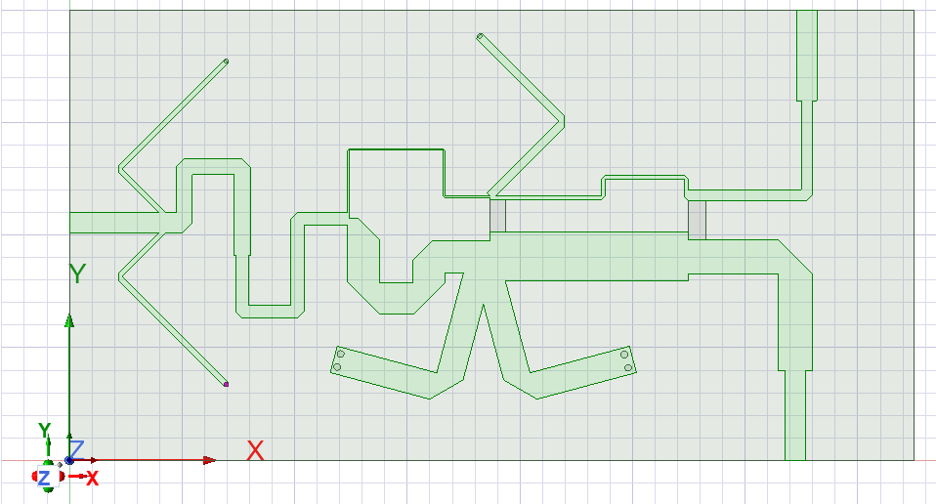
Methodology
Proposed device structure taken from the paper
Design Parameters for 4:1 Power Divider:
Center Frequency (f₀): 2.4 GHz.
Fractional Bandwidth (FBW): 90%.
Input RL: ≥ 15 dB.
Impedance Parameters:
Z1 = 57.57 Ω, Z2 = 64.91 Ω, Z3 = 148.93 Ω, Z4 = 37.23 Ω.
Isolation resistor R = 87 Ω.
Structure you drew in HFSS
Calculations/Formula Used in the Paper
1. Power Dividing Ratio
The power dividing ratio where ZL1 and ZL2 are the impedances of the two
branches. For a 4:1 ratio
· ZL1 = 100 ohm (main branch).
· ZL2 = 25 ohm (secondary branch).
2. Impedance Parameters for Resonator: Derived from Chebyshev filtering transformer synthesis:
. Z1= 57.5712, Z2 = 64.91 12, Z3 = 148.93 12, Z4= 37.23 1.
. ZS1 = 49.46 12, Z52 = 82.79 12, Zs3 = 20.712.

Slide 8
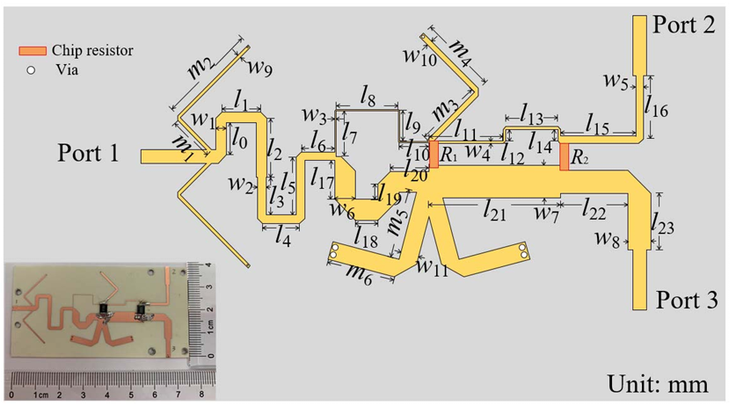






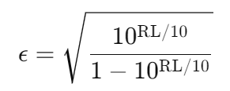


Methodology
The transformer uses cascaded λ/4 transmission lines and short-circuited stubs to create the Chebyshev response.
Impedance parameters:
Source impedance
Load impedance
Transmission line impedances
Shunt stub impedances
Ripple constant ϵ\epsilonϵ (related to in-band return loss):
Impedance Transformer Design for Power Division:
To achieve a power-dividing ratio ) for a 4:1 divider), the impedance transformer sections are calculated as follows:
Impedance Relations for Filtering Branches:
Impedance for the higher power branch:
ZT1 = 100 , ZT2 = 25 , ZT3 = 70.7 ,and ZT4 = 35.3 .
The proposed 4:1 power divider is designed, simulated in ADS software, and fabricated on RO4003C substrate with a relative permittivity of 3.55 and a thickness of 0.813 mm. After global tuning, the final dimensions displayed in Fig. 16 are listed as: w1 = 1.43, w2 = 1.15, w3 = 0.12, w4 = 0.35, w5 = 0.98, w6 = 2.81, w7 = 4.33, w8 = 3.04, w9 = 0.46, w10 = 0.7, w11 = 2.42,l0 = 4.26, l1 = 5.14, l2 = 7.88,l3 = 5, l4 = 4.92, l5 = 7.71, l6 = 4.46, l7 = 6.05,l8 = 8.38, l9 = 4.05, l10 = 4, l11 = 9.89, l12 = 1.5, l13 = 7, l14 = 1.57, l15 = 10.06, l16 = 8.39, l17 = 5.13, l18 = 3, l19 = 2.02, l20 = 5.12, l21 = 17.59, l22 = 8, l23 = 8.56, m1 = 5.49, m2 = 13.3, m3 = 9, m4 =10.4, m5 = 9.22, and m6 = 9.14 (unit: mm).

Slide 9

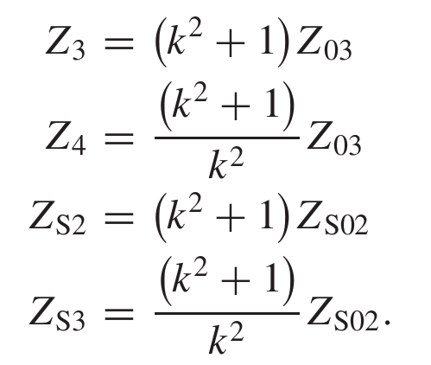
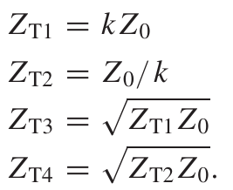
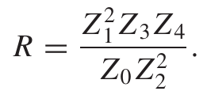
Methodology
Impedance parameters of transformer sections :
Output Matching:
λ/4 transformers are added to match the output impedances to 50 Ω:
Isolation Resistor Calculation:
An isolation resistor R is added between output ports to ensure good isolation bandwidth. The resistor value is calculated as:
To achieve wider isolation bandwidth and excellent port matching per formance, one more isolation resistor is introduced. The chip resistors in Fig. 16 are selected as R1 = 91 and R2 = 120 .

Slide 10
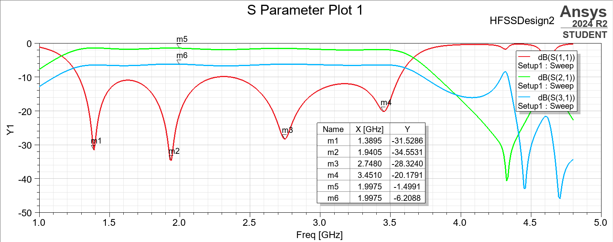
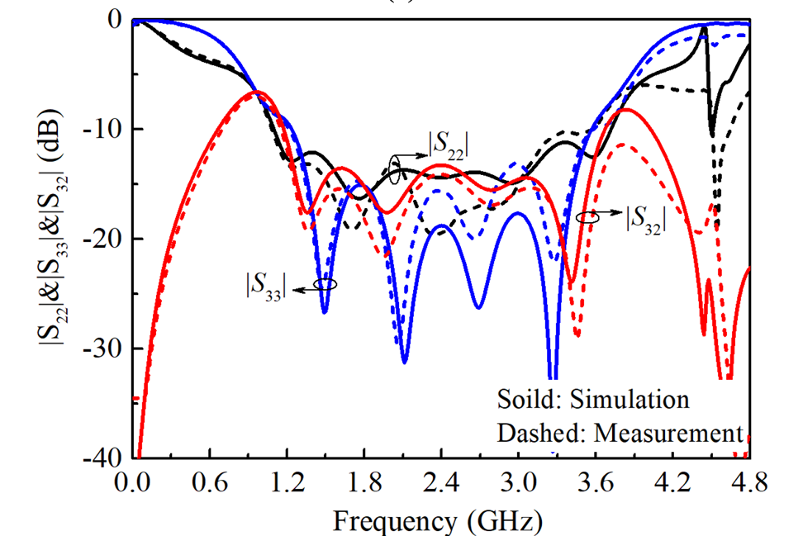
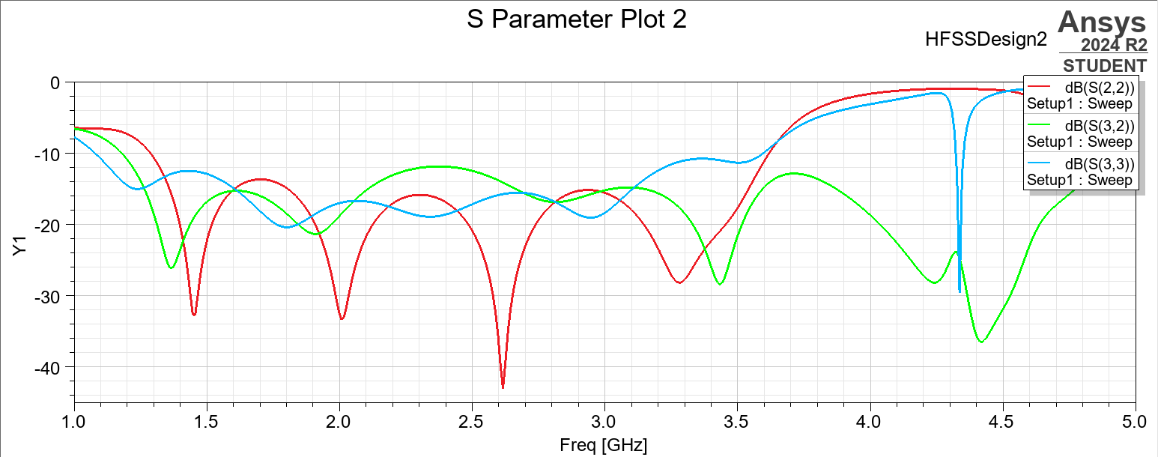
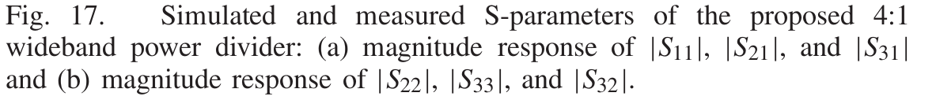
Results

Slide 11
Results continuation… if needed
Input Return Loss (|S11|):
Simulated Bandwidth: 1.25 to 3.54 GHz (95.4% 10-dB RL bandwidth).
Measured Bandwidth: 1.27 to 3.57 GHz (95.8% 10-dB RL bandwidth).
Minimal RL:
Simulated: -13 dB.
Measured: -11 dB.
Insertion Loss (|S21| and |S31|):
|S21|:
Simulated: -1.04 to -1.35 dB.
Measured: -1.38 to -1.85 dB.
|S31|:
Simulated: -6.91 to -7.23 dB.
Measured: -7.08 to -7.67 dB.
Isolation (|S32|):
Simulated: Better than -13 dB (97.5% isolation bandwidth).
Measured: Better than -14 dB (100% isolation bandwidth).
Port Matching (|S22| and |S33|):
|S22|:
Simulated: Below -11.2 dB (108.6% 10-dB bandwidth).
Measured: Below -10 dB (104.5% 10-dB bandwidth).
|S33|:
Simulated: Below -15 dB (96.6% 10-dB bandwidth).
Measured: Below -13 dB (98% 10-dB bandwidth).
Wide Fully Matching Bandwidth:
Measured Bandwidth: 95.8%.
Conditions:
|S11| ≤ -10 dB.
|S22| ≤ -10 dB.
|S33| ≤ -10 dB.
|S32| ≤ -10 dB.
Input Return Loss (|S11|):
Simulated Bandwidth: 1.39 GHz to 3.45 GHz (95.6% 10-dB RL bandwidth).
Minimal RL: -34.55 dB at 1.94 GHz.
Insertion Loss (|S21| and |S31|):
|S21| (Green Line):
Simulated Range: Approximately -1.5 dB to -2 dB.
|S31| (Blue Line):
Simulated Range: Approximately -6 dB to -20 dB with increasing frequency.
Isolation (|S21| and |S31|):
|S21| (Green Line): Better than -10 dB throughout the measured range.
|S31| (Blue Line): Exhibits strong isolation values especially around 4 GHz.
Port Matching (|S11| and others):
|S11|: Below -10 dB over significant bandwidth, marking excellent input matching.
Conditions:
|S11| ≤ -10 dB is achieved between 1.39 GHz and 3.45 GHz.
|S21| and |S31| suggest good performance with minimal losses across the operational range.
Wide Fully Matching Bandwidth: Overlapping bands where |S11|, |S21|, and |S31| satisfy conditions ensure a well-matched design.

Slide 12
Results continuation
Input Return Loss (|S11|):
Simulated Bandwidth: 1.25 to 3.54 GHz (95.4% 10-dB RL bandwidth).
Measured Bandwidth: 1.27 to 3.57 GHz (95.8% 10-dB RL bandwidth).
Minimal RL:
Simulated: -13 dB.
Measured: -11 dB.
Insertion Loss (|S21| and |S31|):
|S21|:
Simulated: -1.04 to -1.35 dB.
Measured: -1.38 to -1.85 dB.
|S31|:
Simulated: -6.91 to -7.23 dB.
Measured: -7.08 to -7.67 dB.
Isolation (|S32|):
Simulated: Better than -13 dB (97.5% isolation bandwidth).
Measured: Better than -14 dB (100% isolation bandwidth).
Port Matching (|S22| and |S33|):
|S22|:
Simulated: Below -11.2 dB (108.6% 10-dB bandwidth).
Measured: Below -10 dB (104.5% 10-dB bandwidth).
|S33|:
Simulated: Below -15 dB (96.6% 10-dB bandwidth).
Measured: Below -13 dB (98% 10-dB bandwidth).
Wide Fully Matching Bandwidth:
Measured Bandwidth: 95.8%.
Conditions:
|S11| ≤ -10 dB.
|S22| ≤ -10 dB.
|S33| ≤ -10 dB.
|S32| ≤ -10 dB.
Input Return Loss (|S22|):
Simulated Bandwidth: 1.35 to 3.60 GHz (95.8% 10-dB RL bandwidth).
Minimal RL: -37 dB at approximately 2.5 GHz.
Insertion Loss (|S32| and |S33|):
|S32| (Green Line):
Simulated Range: Better than -10 dB across 1.4 GHz to 4.6 GHz with two dips near 2.5 GHz and 4.3 GHz.
|S33| (Blue Line):
Simulated Range: Between -10 dB and -20 dB for a wide frequency range, especially stable in the midband region.
Isolation (|S32|):
|S32| (Green Line): Achieves isolation better than -15 dB across most of the range, with dips improving isolation further near 1.5 GHz and 4.5 GHz.
Port Matching (|S22| and |S33|):
|S22| (Red Line):
Below -10 dB across 1.35 to 3.60 GHz, ensuring excellent matching for Port 2.
|S33| (Blue Line):
Below -10 dB for wide bandwidth, particularly improving to -20 dB near 4 GHz.
Wide Fully Matching Bandwidth:
Measured Bandwidth: 95.8% of the total bandwidth.
Conditions:
|S22| ≤ -10 dB: Achieved between 1.35 and 3.60 GHz.
|S32| ≤ -10 dB: Maintains good isolation throughout the range.
|S33| ≤ -10 dB: Stable performance across the frequency range.

