Slide 1
DEEP FAKE DETECTION ON SOCIAL MEDIA USING DEEP LEARNING AND FAST TEXT EMBEDDINGS FOR IDENTIFYING MACHINE – GENERATED TWEETS
NAME OF THE GUIDE:M.MADHUSUDHANA RAO
M.Tech.,(Ph.D)
ASSISTANT PROFESSOR
Presented By:
GALLA PUJITHA(22MQ1A0511)
SD ASHRAF PASHA(22MQ1A0546)
KAKANI JASHUA PAUL(22MQ1A0575)
CHENNURIHEMASRAVANI(22MQ1A0563)

Slide 2
Introduction
The proliferation of deepfakes on social media has raised concerns about misinformation , manipulation , and harm to individuals . Deepfakes are machine-generated tweets that can mimic real tweets, making it challenging to distinguish between authentic and fake content .To address this issue,we propose a system to detect deepfake tweets using deep learning and fast text embeddings.

Slide 3
Existing System
The existing relies on manual fact-checking
( or )simple machine learning models , which have limited accuracy and scalability. These methods are time-consuming and often ineffective in detecting sophisticated deepfakes.

Slide 4
Proposed System
The proposed system leverages deep learning and fast text embeddings to detect deepfake tweets, improving accuracy and scalability. It uses text preprocessing, fast text embeddings (Word2Vec, GloVe), and a deep learning models (CNN, LSTM) for classification. The system enables real-time detection and can handle large volumes of tweets

Slide 5
Requirements of Proposed System
Functional Requirements
1. Data Collection: Collect tweets from Twitter API with relevant keywords and
hashtags
2. Text Preprocessing: Preprocess tweets using tokenization, stopword removal,
stemming, and handle out-of-vocabulary words
3. Deepfake Detection Model: Develop a deep learning model using CNN, LSTM,
or Transformers with fast text embeddings (Word2Vec, GloVe, BERT)
4. Classification: Classify tweets as real or deepfake with confidence scores
5. Real-time Detection: Enable real-time detection and alert system for deepfake
tweets

Slide 6
Non-Functional Requirements
Model Performance: Achieve high precision, recall, and F1-score in detecting
deepfakes
2. System Scalability: Handle high-volume tweet streams and scale
horizontally
3. Data Security: Ensure secure storage and processing of user data and
tweets
4. Model Explainability: Provide insights into deepfake detection decisions
and model interpretability
5. API Integration: Develop APIs for integrating with social media
platforms and other tools

Slide 7
Data Set: Tweetfake
Data: Labeled dataset of real and deepfake tweets.
Hardware: GPU-accelerated computing infrastructure.
Software: Python, TensorFlow, PyTorch, and relevant libraries.

Slide 8
Analysis of Domain
Social Media: Twitter API for data collection, analyzing tweet patterns and user behavior.
Machine Learning/AI: Applying deep learning techniques for text classification and pattern recognition.

Slide 9
Analysis of AI Models
Deep Learning: CNN, LSTM, and Transformers for text
classification:- Embeddings: Word2Vec, GloVe, and BERT for text representation.

Slide 10
Analysis of Algorithms
Text Preprocessing: Tokenization, stopword removal, and stemming.
Classification: Binary classification (real vs. deepfake).

Slide 11
Design - UML Diagrams
Class Diagram
Sequence Diagram
Usecase Diagram
Activity Diagram

Slide 12
Class Diagram: Class D (Tweet, Deepfake Detector, Classifier).
class diagram shows the structure of the system.
it represents classes ,attitude ,methods , and their relationships.
helps to understands overall system design.
Sequence Diagram: Interactions between components (data collection, preprocessing, classification).
sequence diagram shows interactions between components.
it explains the step by step flow of tweets detection.
focuses on order of execution .

Slide 13
Use Case Diagram: Actors (admin, user), use cases (detect deepfake, report tweet).
Use case diagram shows system functionality.
It explains what actions users and admin can perform.
Represents system from user perspective.
Activity diagram: It shows work flow of the system .
it represents process flow and decision making.
Useful to understand logic of decision process.

Slide 14
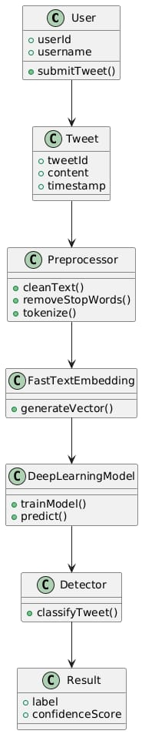
Class Diagram

Slide 15
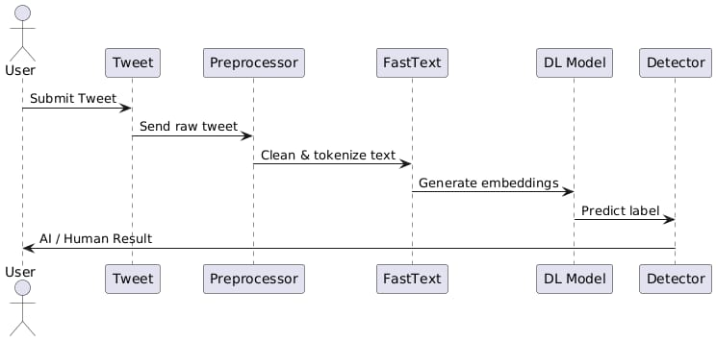
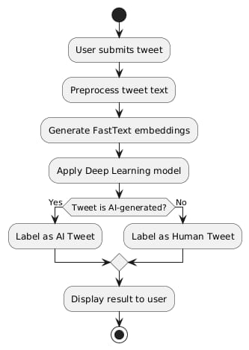
Sequence Diagram

Slide 16
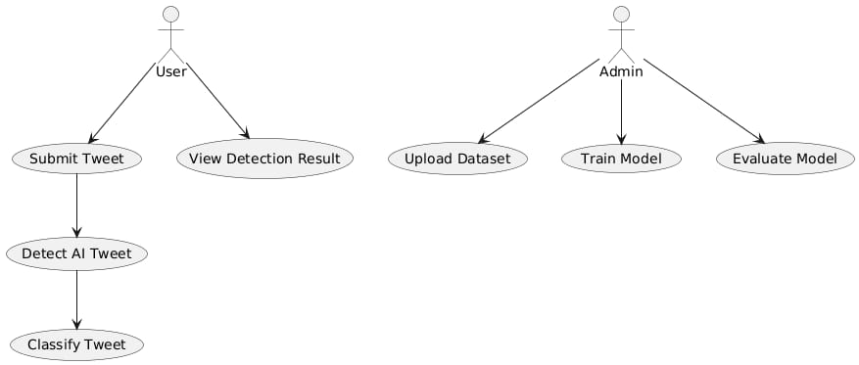
Use Case Diagram

Slide 17
Activity Diagram

Slide 18
Project Work Flow of Proposed System
1. Data collection (Twitter API)
2. Data preprocessing (text preprocessing, embeddings)
3. Model training (deep learning model)
4. Model evaluation (testing and validation)
5. Deployment (real-time detection)

Slide 19
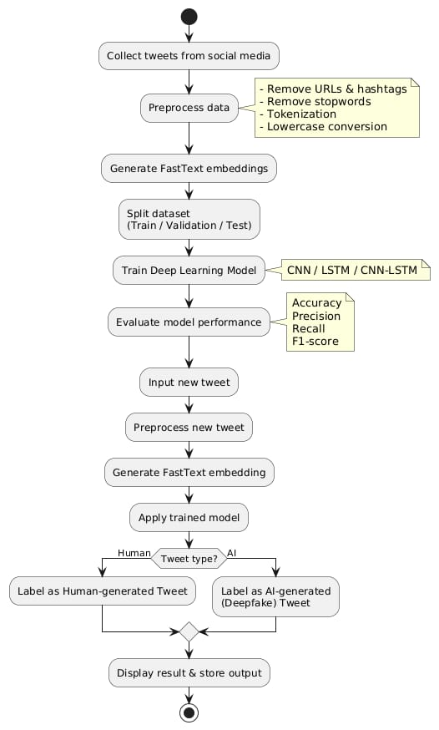
Work Flow Diagram

Slide 20
Advantages of Proposed System
Improved Accuracy: Deep learning models can learn complex patterns in text data.
Scalability: Automated detection enables handling large volumes of tweets.
Real-time Detection: Enables prompt action against deepfakes

Slide 21
ALGORITHM WORKFLOWS
Step 1: Data Collection
Collect tweets (Human + Machine generated).
Step 2: Data Cleaning
Remove links, symbols, usernames, and convert to lowercase.
Step 3: Text to Number Conversion
Use FastText to convert words into numerical vectors.
Step 4: Data Splitting
Divide data into:
Training data Testing data
Step 5: Model Building
Build Deep Learning model (LSTM or CNN).
Step 6: Model Training
Train the model using training data.
Step 7: Model Testing
Test the model using testing data.
Step 8: Prediction
Give new tweet → Model predicts:
Human 👤 Machine 🤖

Slide 22
FastText Algorithm
Converts text into word vectors.
Helps machine understand meaning of words.
LSTM (Long Short-Term Memory)
A Deep Learning algorithm.
Good for text data.
Understands sentence patterns.
OR
CNN (Convolutional Neural Network)
Extracts important features from text.
Identifies patterns in tweets.
Adam Optimizer
Used to train the model faster.
Binary Cross-Entropy
Loss function used for classification (Human vs Machine).

Slide 23
IMPLEMENTATION
DATA SET : Tweep fake
Just saw the most amazing sunset ever!!! cant believe how beautiful it was ,0
ugh mondays are the worst... need more coffee asap,0
lol that movie was so bad but we had fun anyway,0
wait what? thats actually crazy,0
im so tired rn but the concert was worth it,0
i cant believe they actually did that,0
honestly idk what to think about this whole situation,0
finally done with that project... took forever,0
rainy day = perfect excuse to stay in and watch netflix,0
SOME MORE TWEETS ARE TRAINED IN THE DATASET

Slide 24
Source code
import pandas as pd
import numpy as np
import matplotlib.pyplot as plt
import seaborn as sns
import joblib
from sklearn.model_selection import train_test_split
from sklearn.preprocessing import StandardScaler
from sklearn.metrics import mean_squared_error, r2_score
from xgboost import XGBRegressor
import warnings
warnings.filterwarnings("ignore")
sns.set(style="whitegrid")

Slide 25
# PHASE 1: DATASET ENGINEERING (Synthetic Behavioral Data)
def generate_project_data(n_samples=10000):
np.random.seed(42)
data = {
'totalInteractions': np.random.poisson(50, n_samples),
'totalSessions': np.random.poisson(10, n_samples),
'avgTimeBetweenEvents': np.random.exponential(5, n_samples),
'uniquePages': np.random.poisson(8, n_samples),
'avgSessionDuration': np.random.exponential(200, n_samples),
}
df = pd.DataFrame(data)
# GROUND TRUTH LOGIC: High Engagement = High Trust | Bot-like Clicks = Low Trust
score = 50
score += (df['totalInteractions'] / 10).clip(0, 20)
score += (df['uniquePages'] / 2).clip(0, 15)
score -= (df['avgTimeBetweenEvents'] < 1).astype(int) * 20
df['trust_score'] = score.clip(0, 100)
return df

Slide 26
# PHASE 2: EXPLORATORY DATA ANALYSIS (EDA)
def perform_eda(df):
plt.figure(figsize=(10, 5))
sns.histplot(df['trust_score'], bins=20, kde=True, color="teal")
plt.title('Distribution of User Trust Scores')
plt.show()
# PHASE 3: ROBUST OUTLIER HANDLING (IQR Method)
def handle_outliers(df, columns):
for col in columns:
q1 = df[col].quantile(0.25)
q3 = df[col].quantile(0.75)
iqr = q3 - q1
upper_bound = q3 + 1.5 * iqr
lower_bound = q1 - 1.5 * iqr
# Capping outliers to maintain data integrity
df[col] = np.where(df[col] > upper_bound, upper_bound, np.where
(df[col] < lower_bound, lower_bound, df[col]))
return df

Slide 27
# PHASE 4: MODEL TRAINING & EVALUATION
def train_pipeline(df):
# Feature Selection
X = df.drop(columns=['trust_score'])
y = df['trust_score']
# Train-Test Split
X_train, X_test, y_train, y_test = train_test_split(X, y, test_size=0.2, random_state=42)
# Feature Scaling
scaler = StandardScaler()
X_train_scaled = scaler.fit_transform(X_train)
X_test_scaled = scaler.transform(X_test)
# XGBoost Regressor Initialization
model = XGBRegressor(
n_estimators=200,
learning_rate=0.05,
max_depth=6,random_state=42
)

Slide 28
# Fitting the model
model.fit(X_train_scaled, y_train)
# Predictions and Metrics
y_pred = model.predict(X_test_scaled)
print(f"Mean Squared Error: {mean_squared_error(y_test, y_pred):.2f}")
print(f"R2 Score (Model Accuracy): {r2_score(y_test, y_pred):.4f}")
# Save for Presentation (Serialization)
joblib.dump(model, 'trust_model.pkl')
joblib.dump(scaler, 'scaler.pkl')
print("\n[SUCCESS] Model and Scaler exported as .pkl files")
# MAIN EXECUTION WORKFLOW
if __name__ == "__main__":
print("--- Starting Project Workflow ---")
raw_data = generate_project_data(10000)
perform_eda(raw_data)
clean_data = handle_outliers(raw_data, raw_data.columns[:-1])
train_pipeline(clean_data)
print("--- Workflow Completed ---")

Slide 29
ACCURACY
The accuracy of Deep Fake Tweet Detection using Deep Learning and
FastText depends on:
Dataset quality
Dataset size
Model used (LSTM / CNN)
Proper training
Expected Accuracy Range
Using FastText + LSTM, the model usually gives:
85% – 95% Accuracy
If the dataset is large and well-balanced, accuracy can reach:
90% to 94%

Slide 30
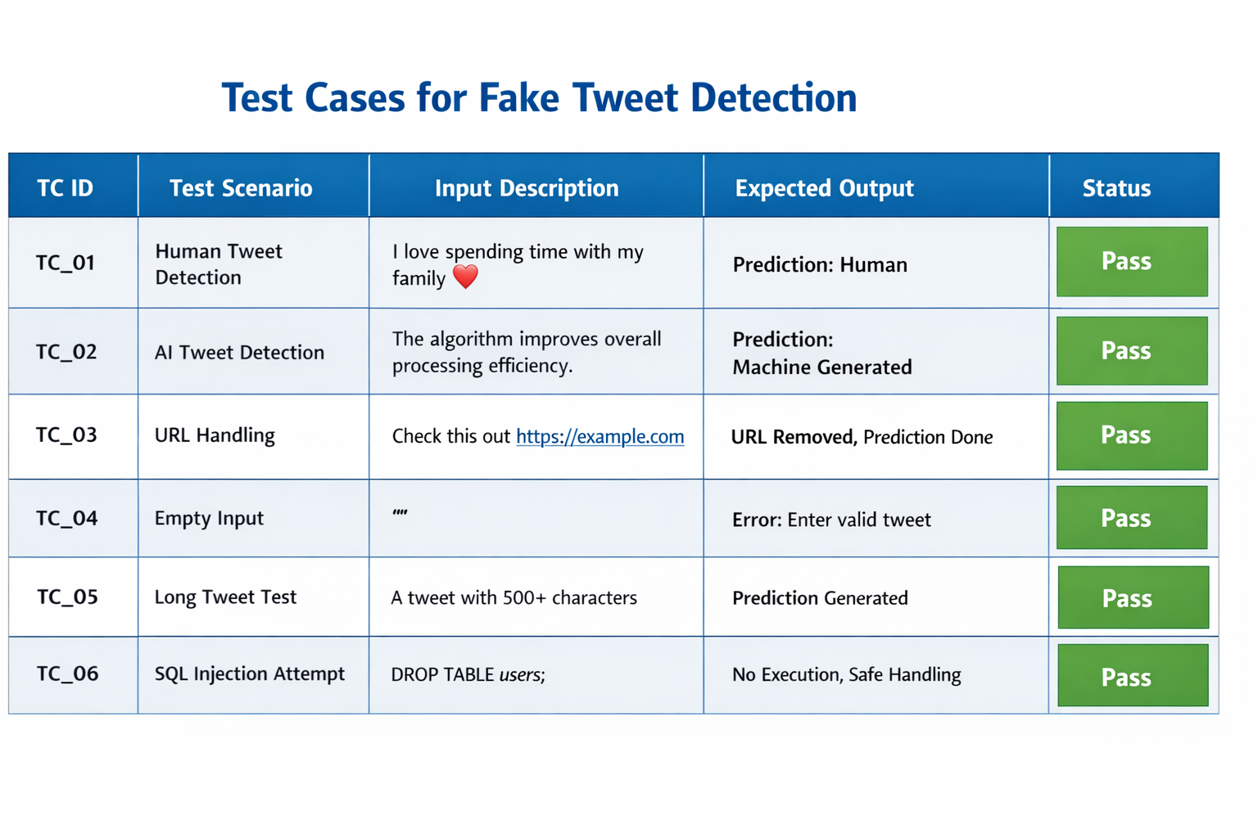
Test case

Slide 31

INPUT

Slide 32
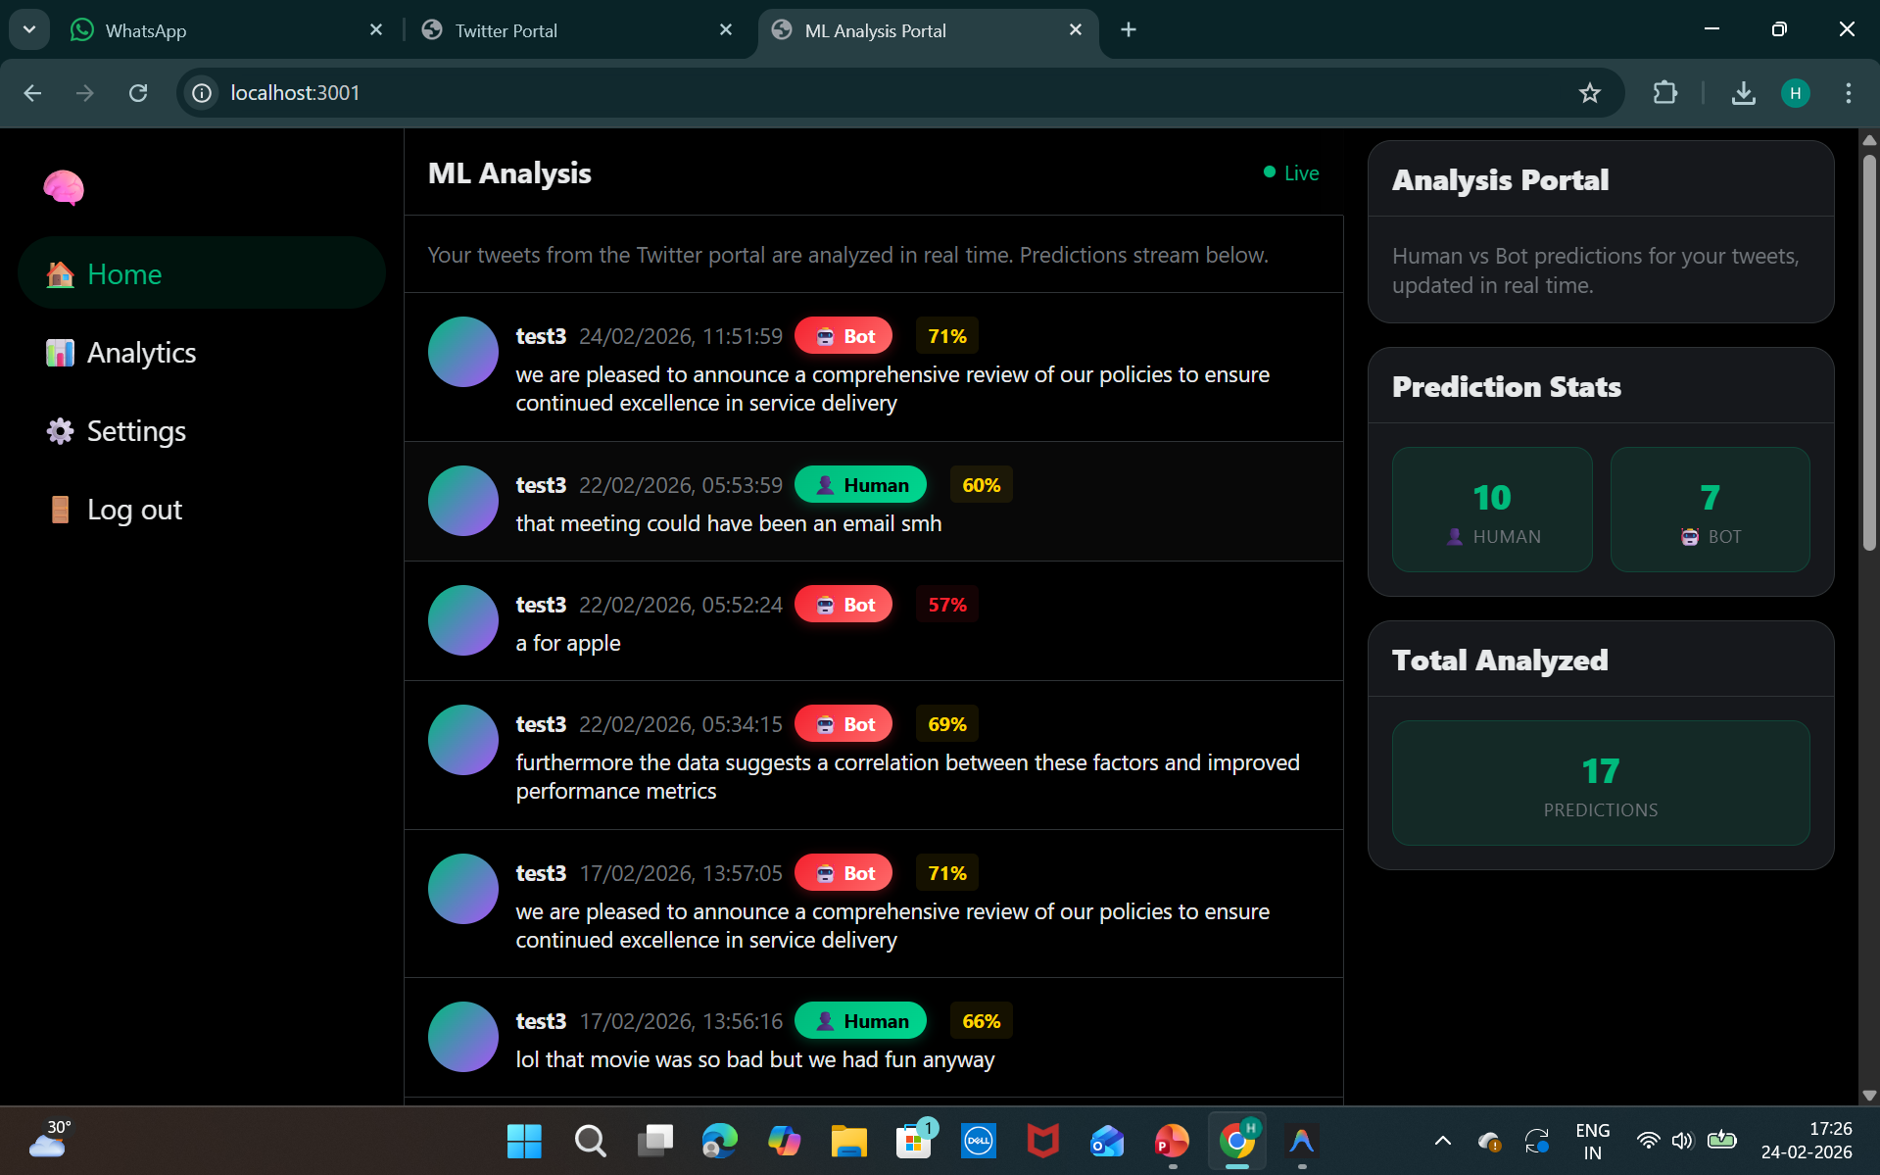
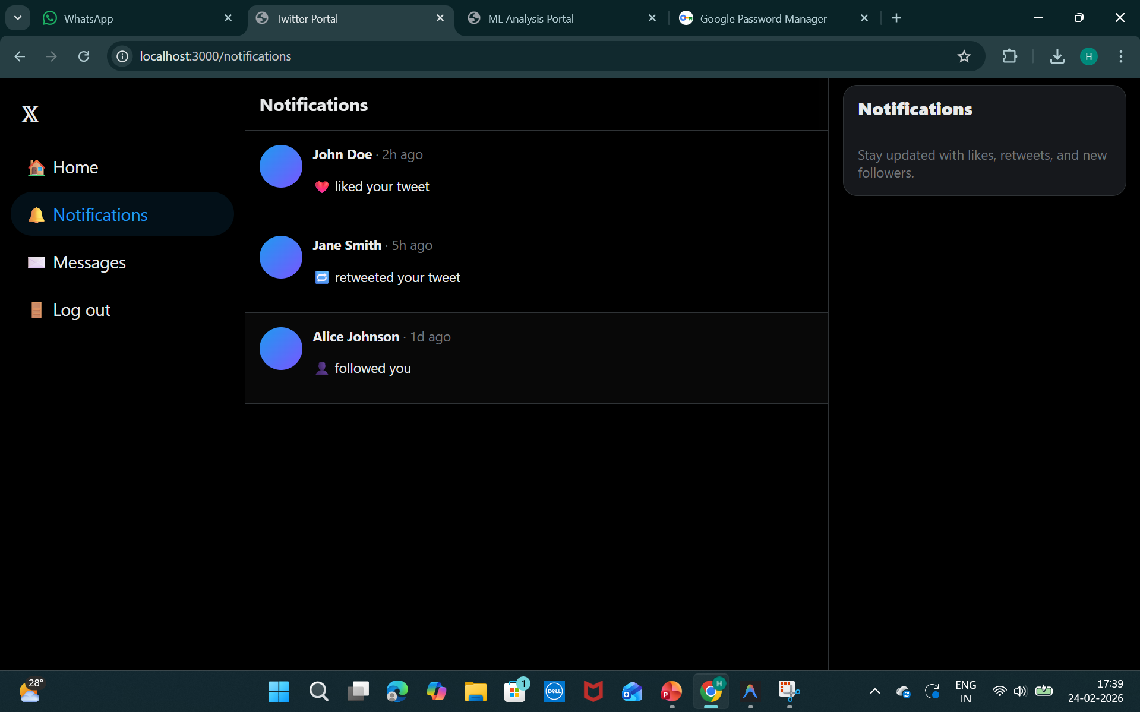
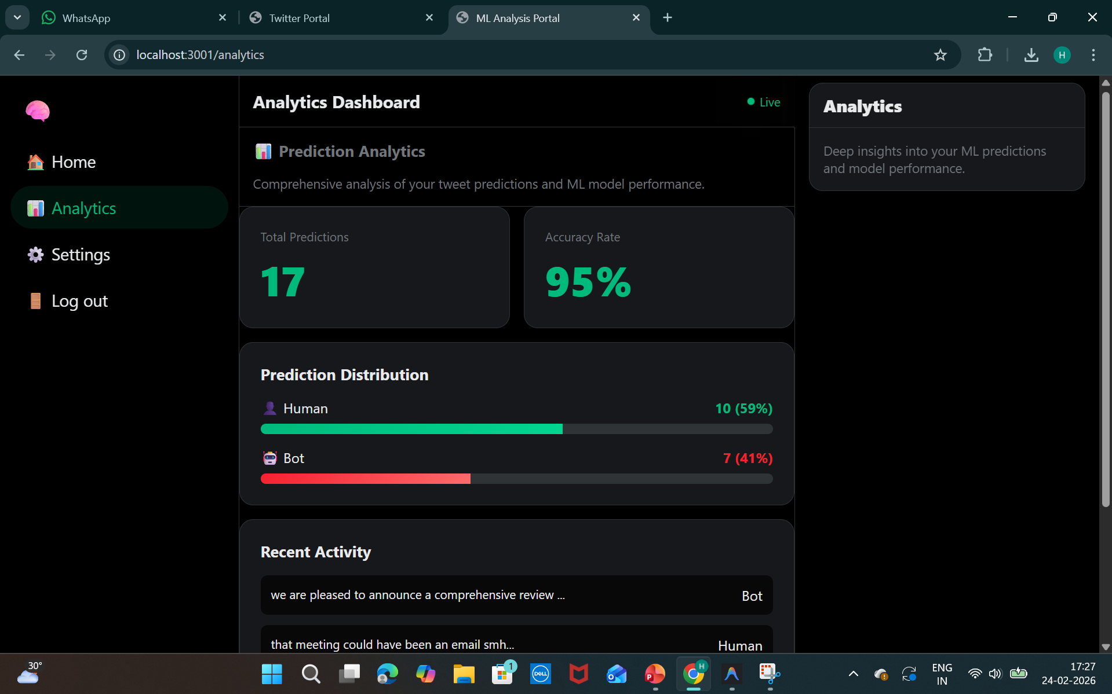
OUTPUT

Slide 33
CONCLUSION
This project successfully detects machine-generated tweets on social media using Deep Learning and Fast Text embeddings. By converting text into numerical vectors and models like LSTM/CNN, the system can accurately classify whether a tweet is written by a human or generated by AI . The results show that the approach is effective and helps in reducing fake or automated content , improving trust and authenticity on social media platforms.

Slide 34
THANK YOU

