Slide 1
RECIPEHUB
FOOD RECIPE MANAGEMENT SYSTEM
PROJECT EVALUATION PRESENTATION
A simple desktop application to create, organize,
search and rate food recipes.
Core Java | Java Swing | File Handling & Serialization
BREAKFAST
LUNCH
DINNER
SNACKS

Slide 2
01 | Problem Statement
Why a recipe management application is useful
The problem
Our solution
Recipes may be saved in notebooks, messages or separate files.
Finding a recipe, organizing it by meal type, keeping favourites and comparing ratings can become difficult.
RecipeHub brings common recipe-management tasks into one desktop application.
Users can add, browse, search, update, save and rate recipes from one interface.
PROJECT GOAL: Make everyday recipe management straightforward.
02

Slide 3
02 | Project Objectives
What the application is designed to achieve
Organize
Manage
Discover
Group recipes by Breakfast, Lunch, Dinner and Snacks.
Create, view, edit and delete recipes.
Search by recipe name or ingredients.
Personalize
Evaluate
Highlight
Save and remove favourite recipes.
Rate recipes from 1 to 5 and calculate averages.
Display the five highest-rated recipes.
03

Slide 4
03 | Key Features
Core functions available in the current version
Recipe management
Search & filter
Favourites
Add, view, update and delete your own recipes.
Search by name or ingredient; filter by category.
Save recipes to a personal list or remove them.
Rating system
Average score
Top 5 list
Give a 1–5 rating; update your previous rating.
Calculate the average rating for each recipe.
Display up to five recipes with the highest averages.
04

Slide 5
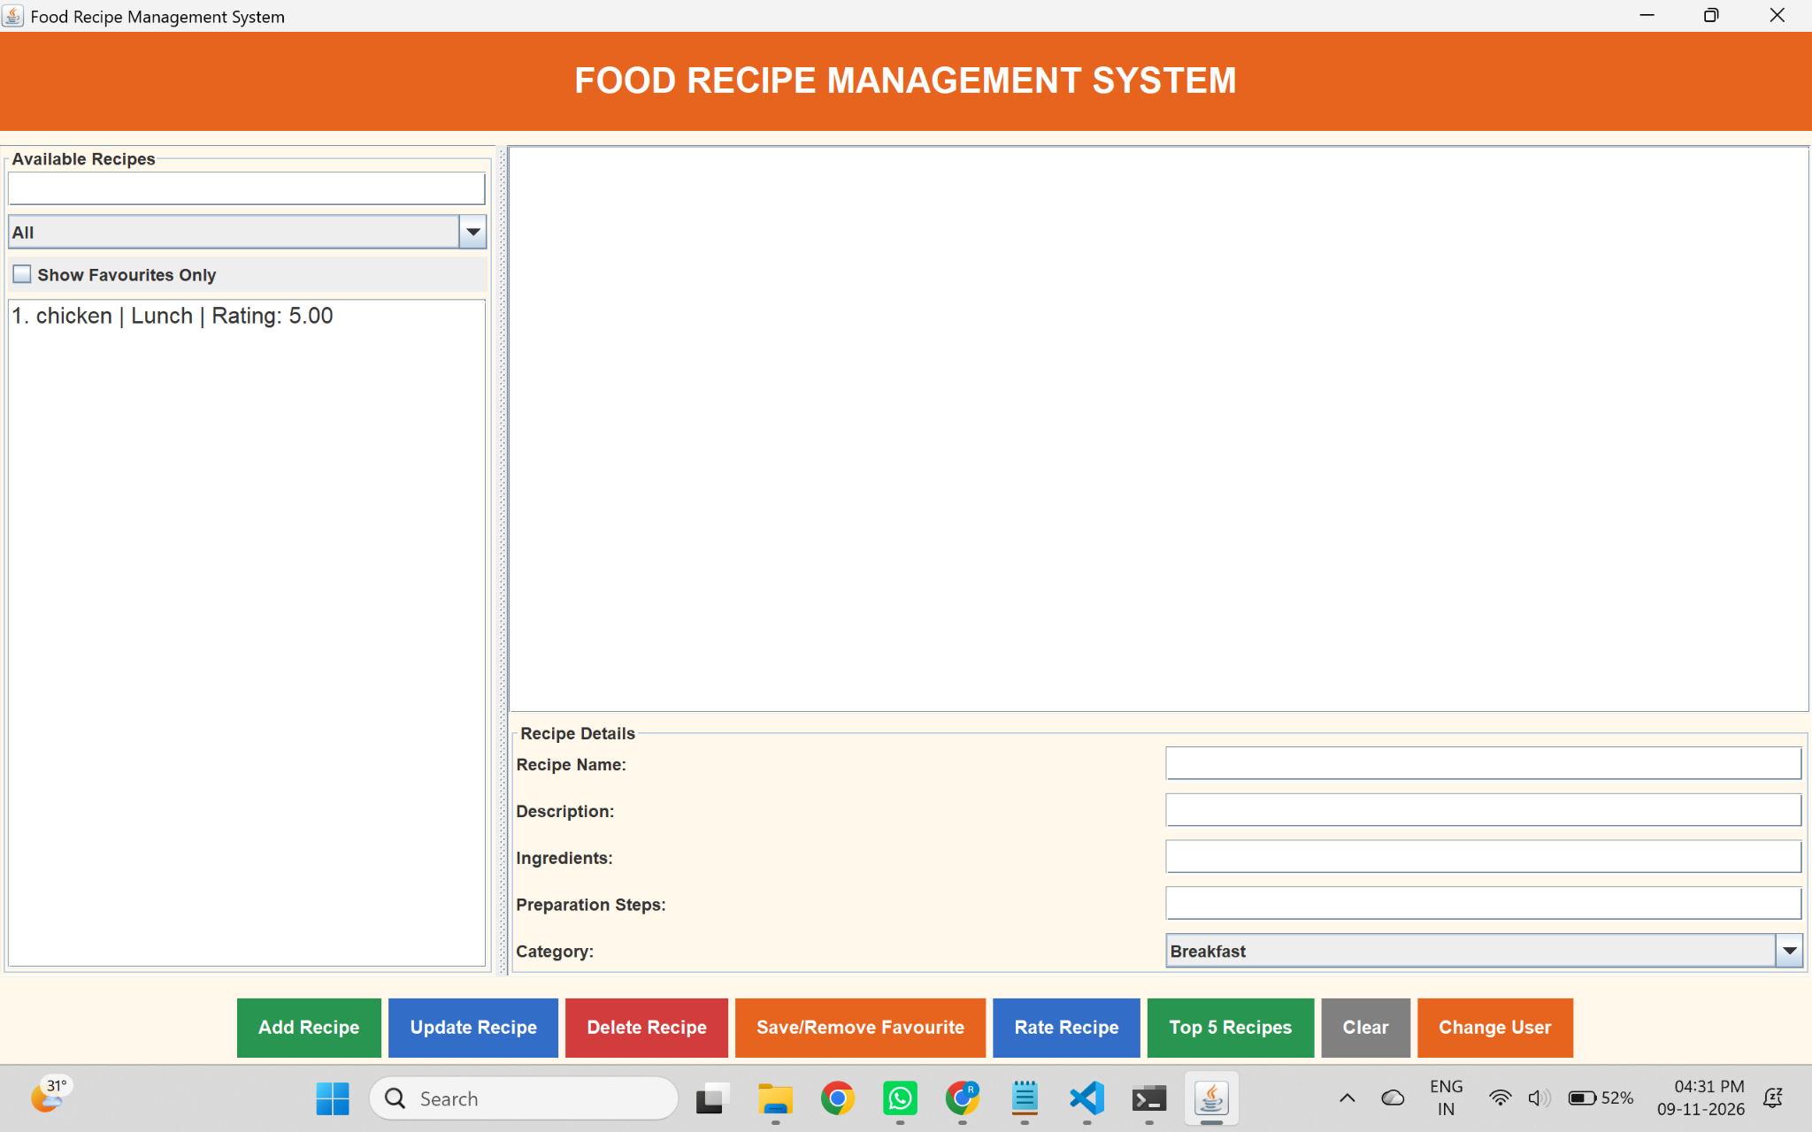
04 | Application Interface
Actual screenshot of the running RecipeHub desktop application
Recipe list • Search and category filters • Recipe details • Colour-coded action buttons
05

Slide 6
05 | Application Structure
A simple three-part Java project structure
MODEL
SERVICE
MAIN / UI
Recipe.java
Stores recipe information and rating data.
RecipeService.java
Handles recipe operations, favourites, ratings and storage.
Main.java
Builds the Swing interface and handles user actions.
→
→
LOCAL STORAGE
recipes.dat stores saved data using Java object serialization.
06

Slide 7
06 | Application Workflow
How a user works with RecipeHub
1
→
2
→
3
→
4
→
5
Launch
Select
Manage
Interact
Persist
Open the desktop app.
Choose a recipe or add one.
View, edit, delete, search or filter.
Save a favourite or submit a rating.
Save changes to the data file.
DATA PERSISTENCE
On startup, saved information is loaded. When data changes, it is written to recipes.dat.
07

Slide 8
07 | Technologies & Concepts
Tools and Java concepts used in the project
Technologies
Concepts demonstrated
• Core Java – application logic
• Java Swing – graphical interface
• Java Collections – lists, sets and maps
• File Handling – local data storage
• Serialization – save Java objects
• Object-Oriented Programming
• Classes and objects
• Encapsulation
• Methods and conditional logic
• Searching and sorting
• Event handling
08

Slide 9
08 | Suggested Live Demonstration
A short sequence to show during evaluation
1.
Add a sample recipe with its category and ingredients.
2.
Select the recipe and show its details.
3.
Search for the recipe by name or ingredient.
4.
Save it to favourites and show the favourites filter.
5.
Rate the recipe and display the average rating.
6.
Open the Top 5 Recipes list.
Tip: prepare one or two sample recipes before the evaluation begins.
09

Slide 10
09 | Current Scope & Future Work
Clearly distinguish the current prototype from planned features
Current version
Future enhancements
• Desktop application
• Local file-based storage
• Usernames simulate users on one computer
• No remote database or real-time online sharing
• No secure account authentication
• User registration and secure login
• Online database integration
• Recipe sharing across devices
• Recipe image uploads
• User profiles and comments
• Web or mobile version
10

Slide 11
CONCLUSION
RecipeHub demonstrates how Java can build a practical desktop application for organizing and managing recipes.
It combines a graphical interface, recipe management, search, favourites, ratings and local data storage.
THANK YOU
Questions & Feedback

