Slide 1
EduPulse
Student Dropout Prediction and Academic Success Analysis Using Machine Learning
Presented by:
PUJITHA (URK24CS6006)
SWETHA (URK24CS6005)

Slide 2
Educational institutions collect large amounts of student data.
Analyzing this data manually can be difficult and time-consuming.
Students may experience academic difficulties that require early attention.
A data-driven approach can help identify patterns in student outcomes.
Problem Statement
Goal: Use data analysis and machine learning to study academic success and potential dropout risks.

Slide 3





Analyze student academic and demographic data.
Understand patterns related to student outcomes.
Project Objectives
Explore machine learning for predicting academic outcomes.
Present insights through charts and a user-friendly website.
Support teachers and counsellors in making informed decisions.

Slide 4
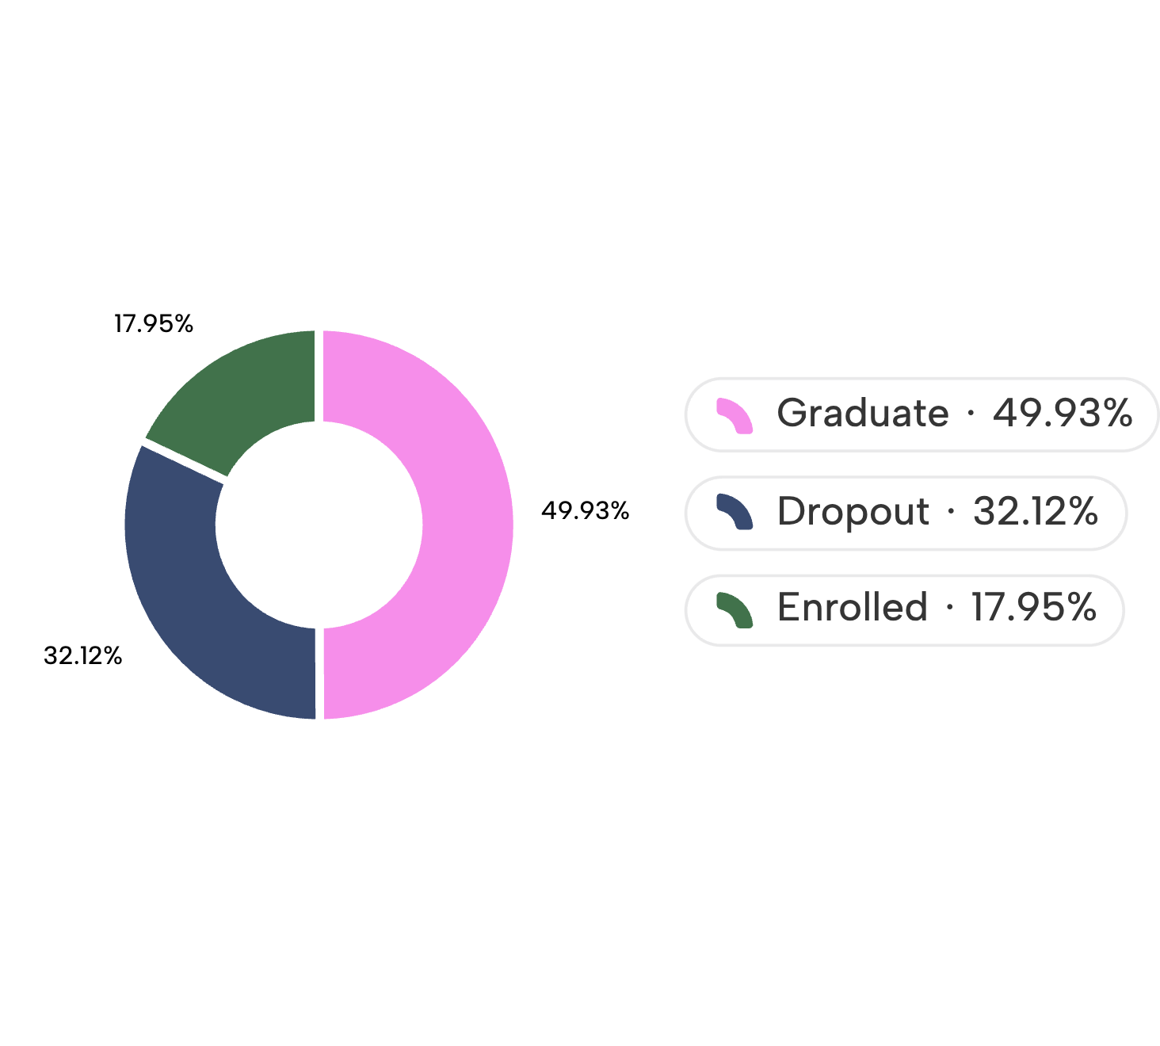
Dataset Overview
Dataset: Predict Students' Dropout and Academic Success
Source: UCI Machine Learning Repository
Data includes: Student background, admission details, academic performance, and other related factors.
Visual suggestion: Add a pie chart or bar chart showing the three student outcomes.
Total records: 4,424 students · Features: 36

Slide 5
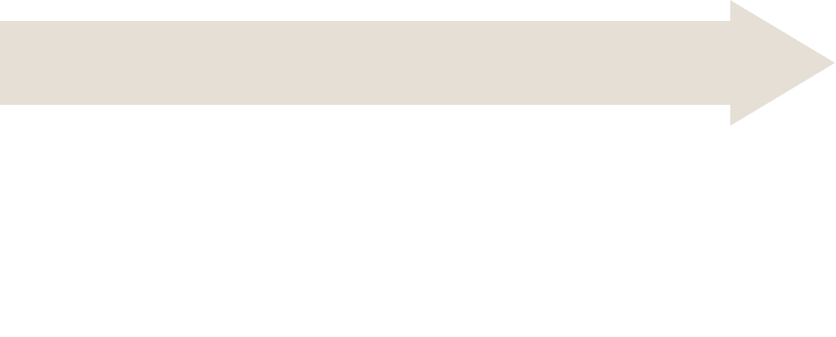

Proposed Methodology
Our project follows these steps:
Exploratory Data Analysis:
Data Preprocessing:
Identify patterns using charts and statistics.
Data Collection:
Check and prepare the data.
Obtain the student dataset.
Visualization:
Model Evaluation:
Display useful insights through the EduPulse website.
Model Development:
Measure predictive performance.
Train machine learning models.
Visual suggestion: Show these steps as a simple horizontal flowchart.

Slide 6
1. Logistic Regression
2. Decision Tree
3. Random Forest
A classification algorithm used to predict categories.
Uses decision rules to classify student outcomes.
Combines multiple decision trees to make predictions.
Machine Learning Algorithms
The following algorithms can be explored for predicting student outcomes:
Note: Present these as proposed algorithms unless you have actually trained and evaluated them.
Evaluation Metrics:
Accuracy
Precision
Recall
F1-score

Slide 7
Technologies Used
Visual suggestion: Use technology logos or simple icons.
Technology | Purpose
Python | Data processing and machine learning
Pandas | Dataset handling
NumPy | Numerical operations
Matplotlib | Data visualization
Seaborn | Statistical charts
Scikit-learn | Machine learning
HTML | Website structure
CSS | Website styling

Slide 8





Main Sections:
Dashboard: Overview of student outcomes.
EduPulse Website Features
Data Analysis: Explore patterns in student data.
Student Outcomes: View Graduate, Dropout, and Enrolled categories.
Student Records: Display student information.
EduPulse aims to make student data easier to understand through a simple interface.
Add screenshots of your actual website to make this slide more convincing.
Risk Assessment: Explore potential risk indicators.
About EduPulse: Project information.

Slide 9
Benefits, Limitations and Future Scope
Limitations
Future Scope
Predictions depend on data quality.
Model performance must be tested before practical use.
Predictions may be incorrect and should not be treated as final decisions.
Integrate a trained machine learning model.
Add updated student data.
Improve risk assessment.
Provide personalized academic support recommendations.
Benefits
Helps visualize student outcome patterns.
Makes student data easier to explore.
May support early identification of students who need assistance.
Can help teachers and counsellors make informed decisions.

Slide 10
Conclusion
EduPulse focuses on student dropout prediction and academic success analysis.
It uses student data to explore meaningful patterns.
Machine learning can help estimate student outcomes when properly trained and evaluated.
Visualizations can make the results easier to understand.
The project aims to support educational decision-making and student assistance.
Thank You!

