Slide 1
Sales Dashboard Analysis
ApexPlanet Data Analytics Internship
Task 4
Data Storytelling & Statistical Validation
Presented by
Pujitha Dadi

Slide 2
Project Overview
Objective • Analyze sales data using Microsoft Power BI. • Build an interactive sales dashboard. • Generate business insights. | Dataset • Sales Dataset • 1000 Records • 10 Columns Tools Used • Microsoft Excel • Microsoft Power BI | Dashboard Visuals • Total Sales Card • Sales by Category • Sales by City • Orders by Product • Orders by Gender

Slide 3
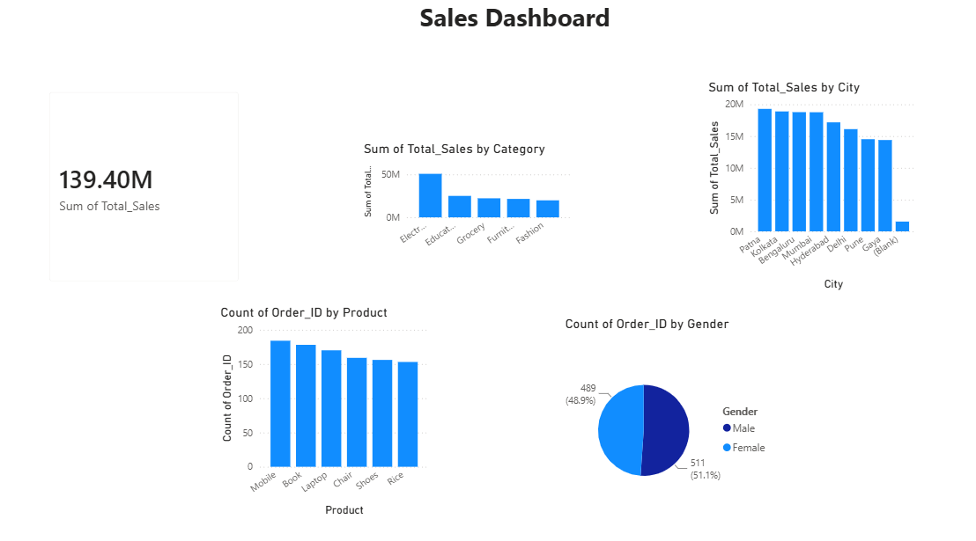
Sales Dashboard
This dashboard provides an overview of sales performance using interactive Power BI visuals including Total Sales,
Category-wise Sales, City-wise Sales, Product Orders, and Gender-wise Orders.

Slide 4
Business Insights
Key Findings • Total Sales: 139.40M • Electronics category generated the highest sales. • Patna recorded the highest sales among all cities. | Customer Insights • Mobile products received the highest number of orders. • Male and Female orders are almost equal. • The dashboard helps identify sales trends and customer behavior.

Slide 5
Hypothesis Testing
Business Hypothesis H0 (Null Hypothesis) There is no significant difference in Total Sales between Male and Female customers. H1 (Alternative Hypothesis) There is a significant difference in Total Sales between Male and Female customers. | Statistical Test • Test Used: Independent Sample T-Test • Confidence Level: 95% • P-value: 0.4950 Conclusion Since p-value > 0.05, we fail to reject the Null Hypothesis. Gender has no significant impact on Total Sales.

Slide 6
Conclusion
Project Summary | Business Impact
• Successfully analyzed the sales dataset using Microsoft Power BI. • Created an interactive dashboard with multiple visualizations. • Identified key sales trends and customer insights. • Statistical validation supported the business analysis. | • Easy to understand sales performance. • Helps identify top-performing categories and cities. • Supports better business decision-making. • Enables quick and interactive reporting.

Slide 7
Thank You
Thank you for your time and attention.
Questions?
Presented by
Pujitha Dadi
ApexPlanet Data Analytics Internship

