Slide 1
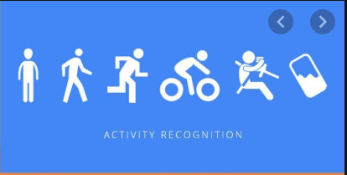
Human Activity
Recognition

Slide 2
Introduction
The Human Activity Recognition database was built from the recordings of 30 study participants.
Study participants performing activities of daily living (ADL) while carrying a waist-mounted smartphone with embedded inertial sensors.
The objective is to classify activities into one of the six activities performed.
Each person performed six activities:
(WALKING, WALKING_UPSTAIRS, WALKING_DOWNSTAIRS, SITTING, STANDING, LAYING) wearing a smartphone

Slide 3
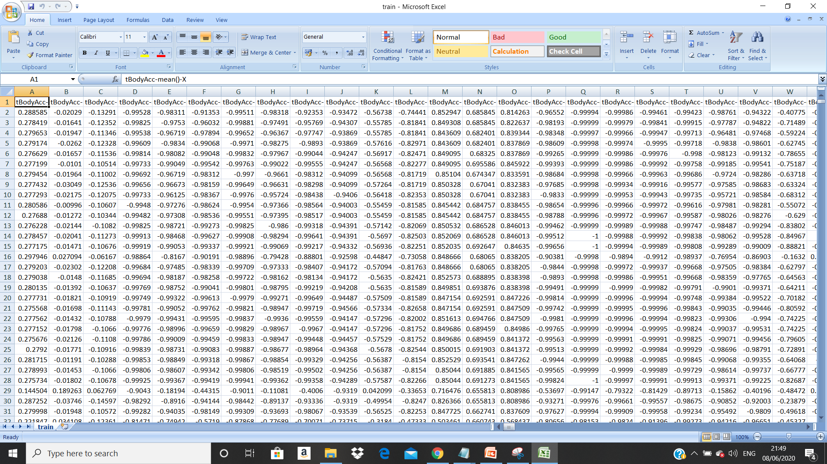
Dataset

Slide 4
Classification models implimented
Logistic Regression
Svm
Kernel SVM
XGBoost
Random Forest
KNN
Naïve Bayes
Decision Tree
CNN(Neural Networks)

Slide 5
XG Boost
XG Boost(Extreme Gradient Boosting) is an optimized distributed gradient boosting library.
It is an implementation of gradient boosted decision trees designed for speed and performance
The "state-of-the-art” machine learning algorithm to deal with structured data be it regression or classification.
Boosting is a sequential technique which works on the principle of an ensemble.
Boosting combines a set of weak learners and delivers improved prediction accuracy.

Slide 6
K-Fold Cross validation
Cross-validation is a statistical method used to estimate the skill of machine learning models and to evaluate predictive models by partitioning the original sample into a training set to train the model, and a test set to evaluate it..
It is commonly used in applied machine learning to compare and select a model for a given predictive modeling problem because it is easy to understand, easy to implement, and results in skill estimates that generally have a lower bias than other methods.
k-fold cross validation is a procedure used to estimate the skill of the model on new data.
Based on the models performance on unseen data we can say weather our model is Under-fitting/Over-fitting/Well generalised.

Slide 7
Grid search
A model hyperparameter is a characteristic of a model that is external to the model and whose value cannot be estimated from data. The value of the hyperparameter has to be set before the learning process begins. For example, c in Support Vector Machines, k in k-Nearest Neighbors, the number of hidden layers in Neural Networks.
In contrast, a parameter is an internal characteristic of the model and its value can be estimated from data. Example, beta coefficients of linear/logistic regression or support vectors in Support Vector Machines.
Grid-search is used to find the optimal hyperparameters of a model which results in the most ‘accurate’ predictions.

Slide 8
model selection Based on K-Fold Cross -Validation and grid search
Best Performing Model : SVM - > BestAccuracy – 94.68%
2nd : Logistic Regression –> BestAccuracy - 94.46%
3rd : Kernel SVM(with rbf kernel) – > BestAccuracy – 93.77%
4th : Random Forest –> BestAccuracy – 93.81%
5th : XGBoost – > Accuracy – 93.50%
6th : KNN -> MeanAccuracy – 88.36%
7th : Decision Tree – > MeanAccuracy – 86.79%
Least Performing Model : Naïve Bayes - > MeanAccuracy – 69.79%

Slide 9
Thank you

