Slide 1
NRI INSTITUTE OF TECHNOLOGY
(Autonomous)
(Approved by A.I.C.T.E & Affiliated to Jawaharlal Nehru Technological University Kakinada)
(Accredited by NAAC with ‘A’ Grade, ISO 9001 : 2015 Certified)
Agiripalli (M), Pothavarapadu (V), Krishna (DT)-521212.
2020-2024
DEPARTMENT OF ELECTRONICS & COMMUNICATION ENGINEERING
DESIGN AND IMPLEMENTATION OF TWO BAND LOW PROFILE MICROSTRIP ARRAY ANTENNA FOR WIRELESS APPLICATIONS
Under the Guidance of
Dr. Abdul Rahiman Sheik
M.Tech, Ph.D
Batch Number A1
G.V.S.PUJITHA- 20KN1A0443
B.DINESH VARMA- 20KN1A0412
G.VIJAYALAKSHMI- 21KN5A0405
K.PRANAV SAI MOHAN - 20KN1A0455

Slide 2
CONTENTS
ABSTRACT
INTRODUCTION
PROBLEM DEFINITION
LITERATURE SURVEY
EXISTING METHOD
PROPOSED METHOD
PHYSICAL DIMENSION VALUES
MICROSTRIP BASIC EQUATIONS
TYPE OF FEED
RESULTS
FUTURE SCOPE
REFERENCES

Slide 3
ABSTRACT
The research on wireless communication demands technology-based efficient radio frequency devices.
This project focuses on array antenna for wireless applications.
A printed single strip, double strip, triple strip arrray antennas are designed and presented.
The presented antenna exhibits a promising response with improved gain.
The antenna radiates from 3.2 GHz to 4.1GHz, and 2.3 GHZ to 2.4GHZ respectively.
The improvements were significant, with the modified antennas achieving gains of 5.76 dB and 5.79 dB.

Slide 4
INTRODUCTION
Generally,in wireless applications, antennas act as the communication bridge between devices by converting electrical signals into electro magnetic signals for transmission and vice versa for reception.
They play a crucial role in enabling communication over long distances without the need for physical connections.
Therefore the study of communication systems is incomplete without an understanding of the operation and fabrication of antennas.
This was the main reason for choosing our project specializing in this field of research.

Slide 5
PROBLEM DEFINITION
In existing method, single element Antenna is presented.
But single element antenna has low gain.
So to overcome this drawback we are implementing array antenna to enhance gain.
Here, To achieve more gain we designed array antenna with single strip, double strip ,and triple strip.

Slide 6
LITERATURE SURVEY
Electronics and Communication Engineering Department, Chandubhai S Patel Institute of Technology, CHARUSAT University, Gujarat 388421, India;killolpandya.ec@charusat.ac.in ,2023.
The research on wireless communication demands technology-based efficient radio frequency devices. A printed monopole dual-band antenna is designed and presented. The presented antenna exhibits a promising response with improved bandwidth and gain. The antenna radiates from 3.49 GHz to 3.82 GHz and from 4.83 GHz to 5.08 GHz frequencies with 3.7 dB and 5.26 dB gain.
Donal Patrick Lynch, Student Member, IEEE Manos M. Tentzeris, Fellow, IEEE Vincent Fusco, Fellow, IEEE and Stylianos D. Assimonis Member, IEEE,Sep 2023.
In this study, we investigate and fabricate a superdirective antenna array composed of strip dipole elements operating at a frequency of 3.5 GHz. The spacing, dimensions, and phase difference of the elements are optimized to achieve a super realized gain antenna.

Slide 7
Karrar Shakir Muttair1, Oras Ahmed Shareef2, Mahmood Farhan Mosleh2 Iraq.2023.
With the rising need for high-speed data rates, the fifth generation (5G) has emerged as the dominant technology with in the telecommunications systems field. One of the most aspects of designing such high-capacity, low-latency, and adaptable systems is antenna design. In this article, we presented a two-element MIMO (multi-input & multi-output) antenna that has good advantages in terms of its small size (19 × 23 × 1.6 ) and operates in several wide frequencybands from 1 GHz to 18 GHz.
Iftikhar Ud Din, Supervi Mohammad Alibakhshikenari, Bal S. Virdee,Renu Karthick Rajaguru Jayanthi,2023.
In this paper, a radiating element consisting of a modified circular patch is proposed for MIMO arrays for 5G millimeter-wave applications. The radiating elements in the proposed 2 × 2 MIMO antenna array are orthogonally configured relative to each other to mitigate mutual coupling that would otherwise degrade the performance of the MIMO system.

Slide 8
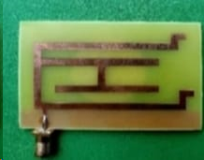
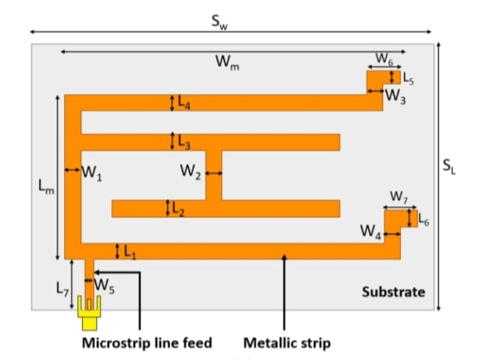
EXISTING METHOD
Single element antenna is used in existing method.
It is a simple and commonly used type of antenna.
These antennas are often used in wireless communication system.
Limitations:
Insufficient gain(3.22dB)
High returnloss(-13.04dB)

Slide 9
PROPOSED METHOD
In proposed method ,we are using array antenna for wireless applications.
Array antenna is a group of multiple individual antenna elements that work together.
The main role of an array antenna is to enhance the performance of wireless communication by improving signal strength, coverage, and capacity.
Array antenna has been proposed for improvement in Gain and return loss compared to single element antenna.

Slide 10
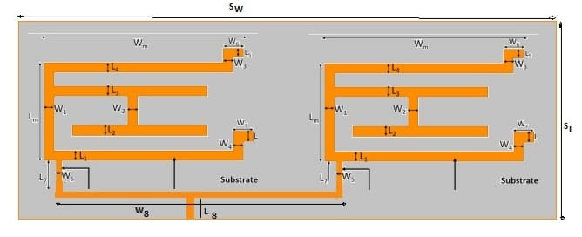
Structure of array antenna with single strip

Slide 11
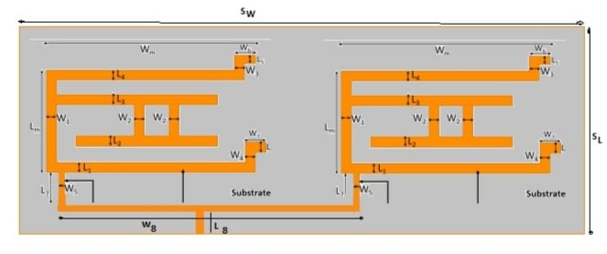
Structure of array antenna with double strip

Slide 12
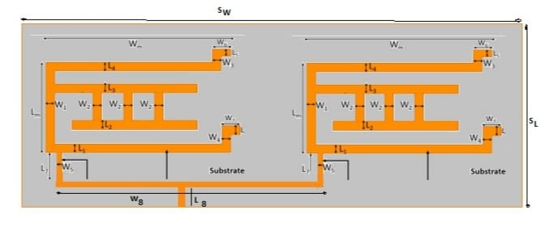
Structure of array antenna with triple strip

Slide 13
Objective of the project
The objective of this project is to design and implementation of array antenna for wireless communications with improved gain and return loss .
Implementation:
In the implementation of antennas, engineers typically engage in two main phases: simulation and fabrication.
Simulation involves using specialized software to model the antenna's performance and behaviour in various conditions.
Fabrication stage ensures that the antenna performs as intended in real-world scenarios.

Slide 14

Here we are using HFSS software for simulation.
HFSS - High Frequency Structure Simulator.
ANSYS HFSS 13.0 is a powerful software used for designing and simulating antennas.
It helps engineers and researchers understand how antennas work and how they perform in different situations.
After designing array antennas in HFSS software ,we go for fabrication.
It all begins with selecting the right materials, like the copper-clad substrate, often composed of FR4 epoxy, which provides the foundational support for the antenna.

Slide 15
PHYSICAL DIMENSION VALUES
Notations | Dimensions (mm) | Notations | Dimensions (mm)
W1 | 2.4 | L5 | 2
L1 | 2.4 | W6 | 5
W2,W2,W2 | 2.4,5,5 | L6 | 2.5
L2 | 2.5 | W7 | 5
W3 | 2.4 | L7 | 7.6
L3 | 2.5 | Lm | 24.8
W4 | 2.4 | Wm | 50
L4 | 2.4 | SW | 60
L4 | 1.3 | SL | 48.9
L8 | 7.9 | W8 | 61.5

Slide 16
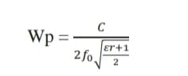
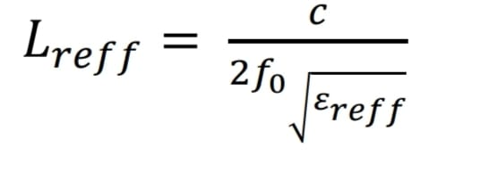
MICROSTRIP BASIC EQUATIONS
Width of the microstrip :
Length of the microstrip:

Slide 17
TYPE OF FEED
In this project we used co-axial feeding technique.
In this feeding method, inner conductor of coaxial cable is connected to the microstrip patch of an antenna and outer one is connected to ground plane.
Mostly, the feed networks are isolated from the microstrip patch, but in this mechanism, it is not like that.
Spurious radiation minimization, easy fabrication and efficient feeding are the advantages of coaxial feeding method.

Slide 18
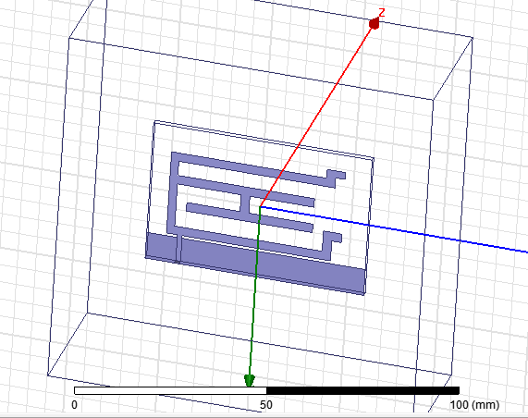
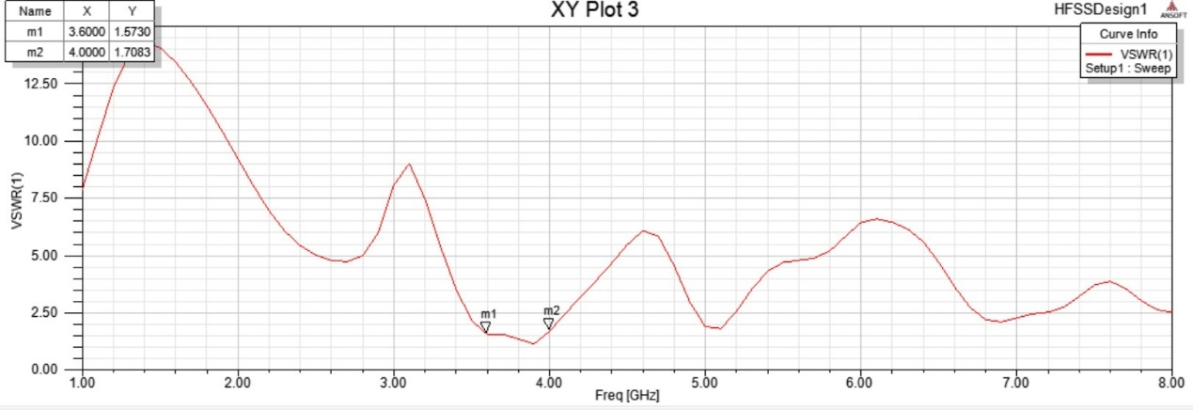
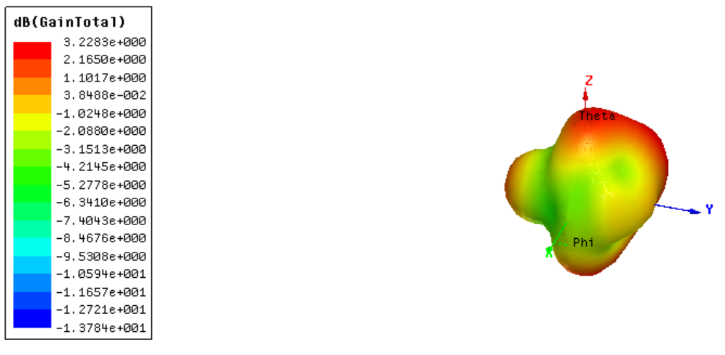
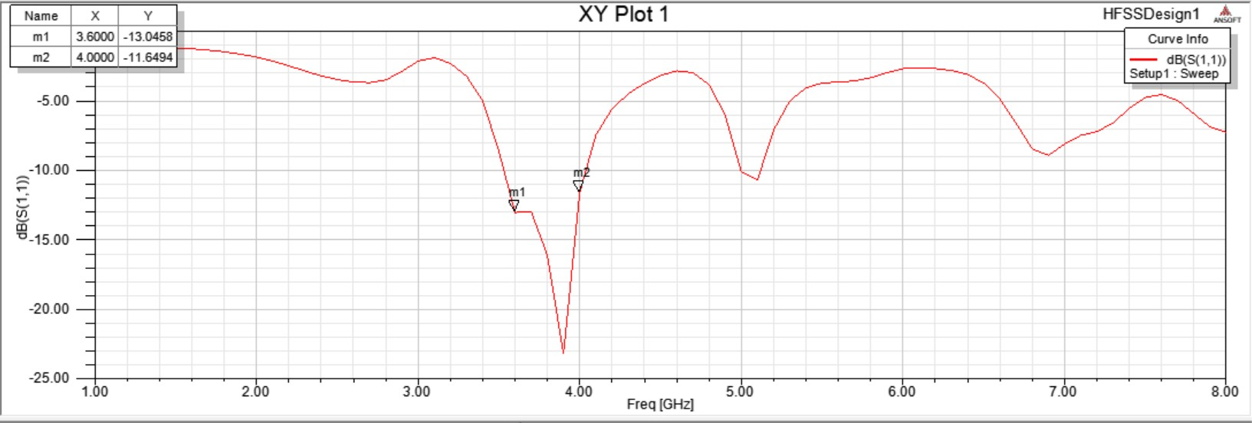
RESULTS
Single element antenna
VSWR
RETURNLOSS
GAIN

Slide 19
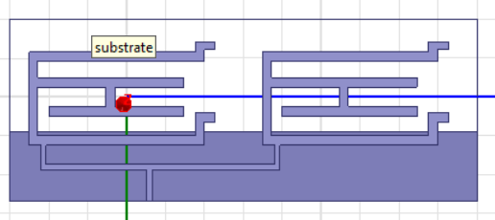
Array antenna design using HFSS
ARRAY ANTENNA WITH SINGLE STRIP

Slide 20
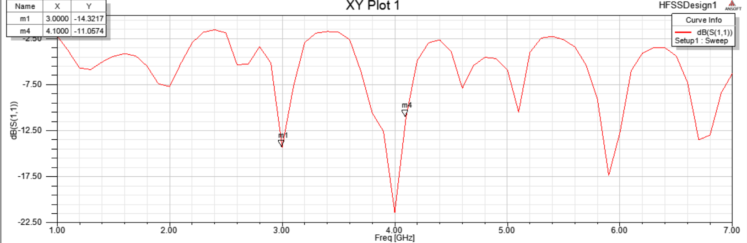
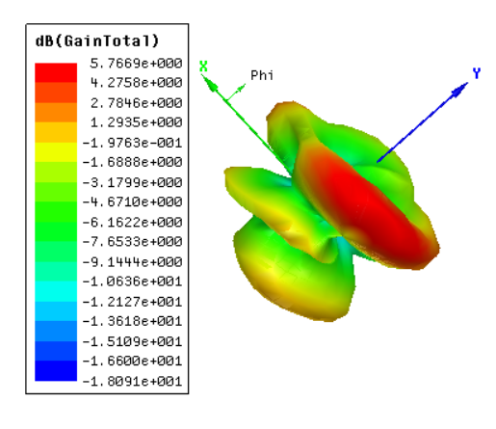
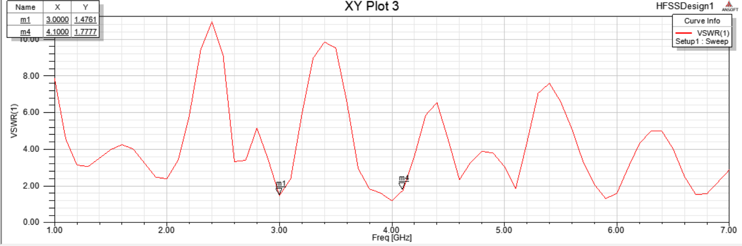
RETURNLOSS
GAIN
VSWR

Slide 21
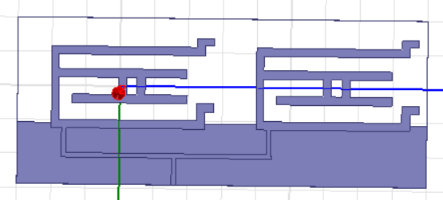
ARRAY ANTENNA WITH DOUBLE STRIP
ARRAY ANTENNA WITH DOUBLE STRIP

Slide 22
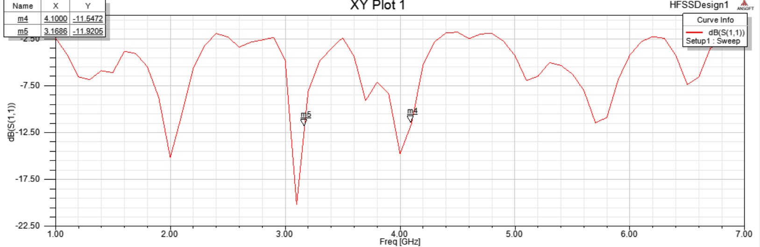
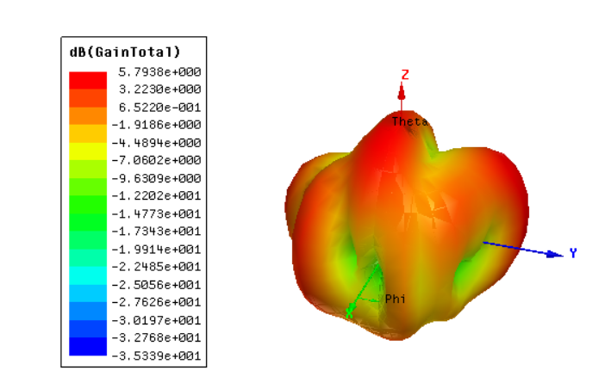
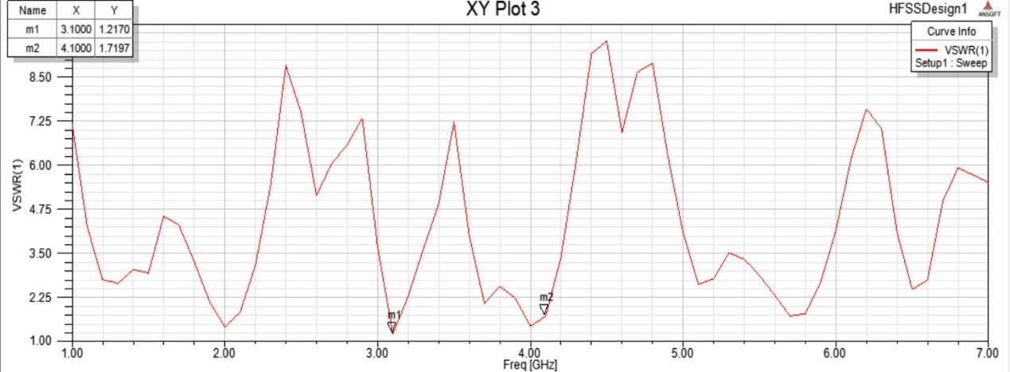
RETURNLOSS
GAIN
VSWR

Slide 23
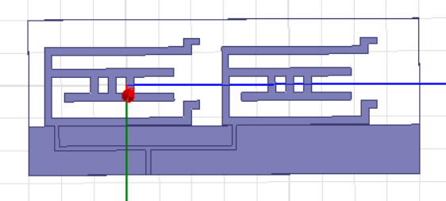
ARRAY ANTENNA WITH TRIPLE STRIP
ARRAY ANTENNA WITH TRIPLE STRIP

Slide 24
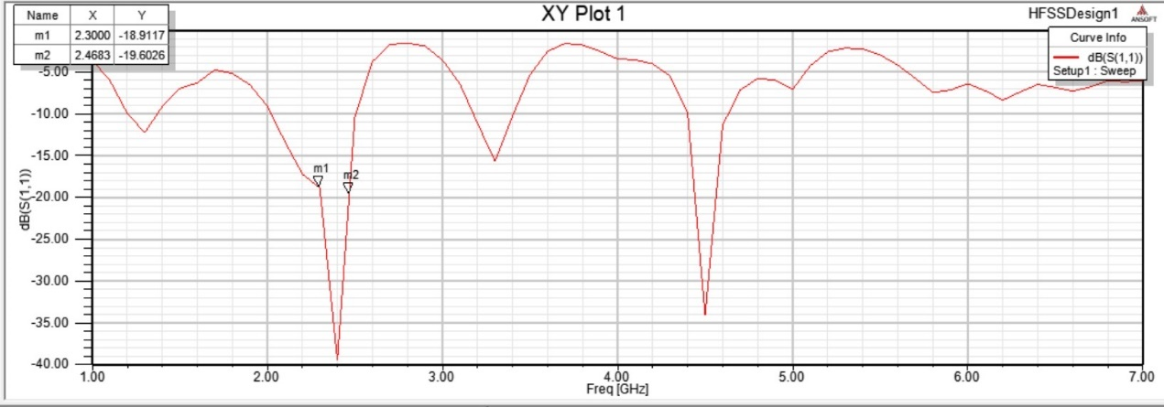
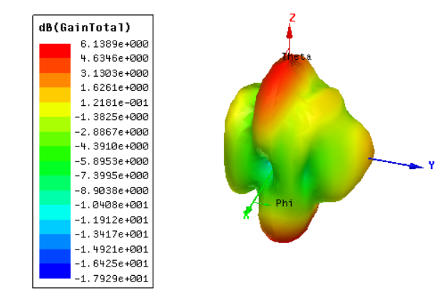
RETURNLOSS
GAIN
VSWR

Slide 25
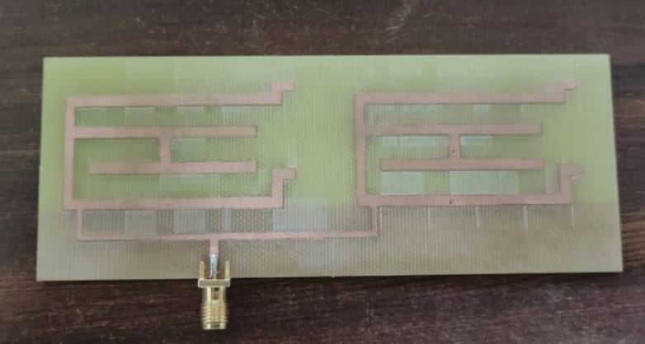
IMPLEMENTATION OF ARRAY ANTENNA
FABRICATED IMAGE OF ARRAY ANTENNA WITH SINGLE STRIP

Slide 26
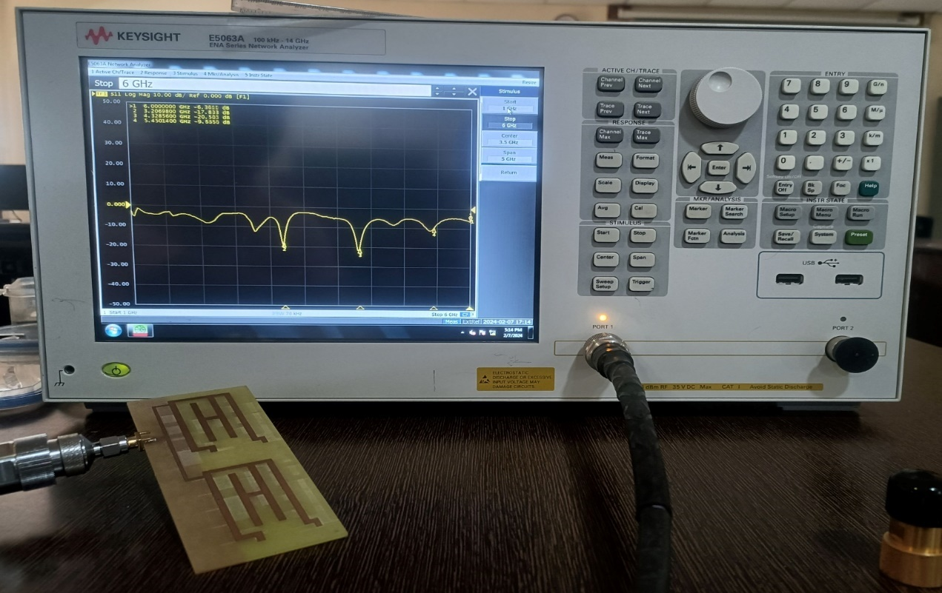

Slide 27
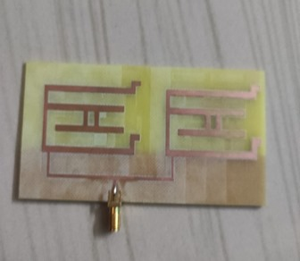
FABRICATED IMAGE OF ARRAY ANTENNA WITH DOUBLE STRIP

Slide 28
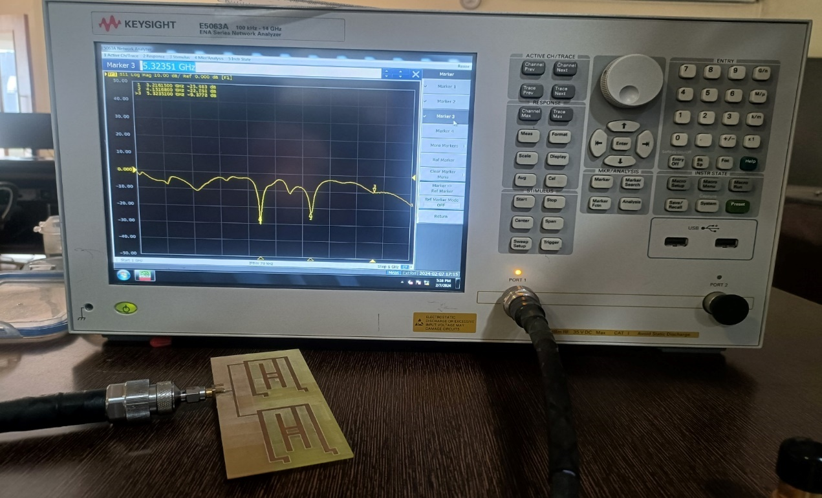

Slide 29
Comparision:
TYPE OF ANTENNA | RETURN LOSS(dB) | VSWR | GAIN(dB)
Antenna with single strip | -13.045 | 1.57 | 3.228
Array antenna with single strip | -11.05 | 1.77 | 5.76
Array antenna with double strip | -11.92 | 1.21 | 5.793
Array antenna with triple strip | -19.60 | 1.02 | 6.13

Slide 30
Advantages:
Increased gain
Compact size
Improved directivity
Applications:
Radar systems
Wireless networks
Satellite communication

Slide 31
CONCLUSION
The low profile array antenna has been implemented. Because, In existing method single element antenna has low gain, to overcome that disadvantage, we implemented an array antenna and it has high gain for wireless applications .

Slide 32
FUTURE SCOPE
Moving forward, the future scope of this project involves the exploration and implementation of an array antenna with triple strip for fabrication.
This expansion presents exciting possibilities for further enhancing gain performance and directional radiation characteristics.
By increasing the number of strips in the array configuration, it is possible to achieve even higher gain.

Slide 33
REFERENCES
Electronics and Communication Engineering Department,Chandubhai S Patel Institute of Technology, CHARUSAT University, Gujarat 388421, India; killolpandya.ec@charusat.ac.in 2023.
Donal Patrick Lynch, Student Member, IEEE Manos M. Tentzeris, Fellow, IEEE Vincent Fusco, Fellow, IEEE and Stylianos D. Assimonis Member, IEEE,Sep 2023.
Karrar Shakir Muttair1, Oras Ahmed Shareef2,Mahmood Farhan Mosleh2 Iraq.2023.
Iftikhar Ud Din, Supervi Mohammad Alibakhshikenari, Bal S. Virdee,Renu Karthick Rajaguru Jayanthi,2023.

Slide 34
THANK YOU

