Slide 1

NARASARAOPETA ENGINEERING COLLEGE
DEPARTMENT OF CSE(AI&ML)
MINI PROJECT
ON
HEART DISEASE PREDICTION USING MACHINE LEARNING TECHNIQUES
Under the guidence of
Team Members:
J.Pujitha(22471A4213)
M.Kavya(22471A4228)
T.Anitha(22471A4248)
B.PavanKalyan(22471A4204)
T.Venkatesh(22471A4250)
Ms.P.Mallika

Slide 2
CONTENTS
1
Abstract
2
Introduction
3
Key factors
A concise overview of the project's scope, methodology, and key findings.
A discussion of the context, significance, and objectives of the research.
A description about the main key factors of heart disease.
Methodologies
5
Result
6
future Scope
4
A detailed description of the data used, preprocessing techniques, and model implementation.
An analysis of the performance metrics and visualizations of the model results.
Which explore potential improvements, advancements, and extensions for the system
7
8
Challenges
Conclusion
About the limitations and difficulties faced during the project
A summary of the key findings, implications, and recommendations.

Slide 3
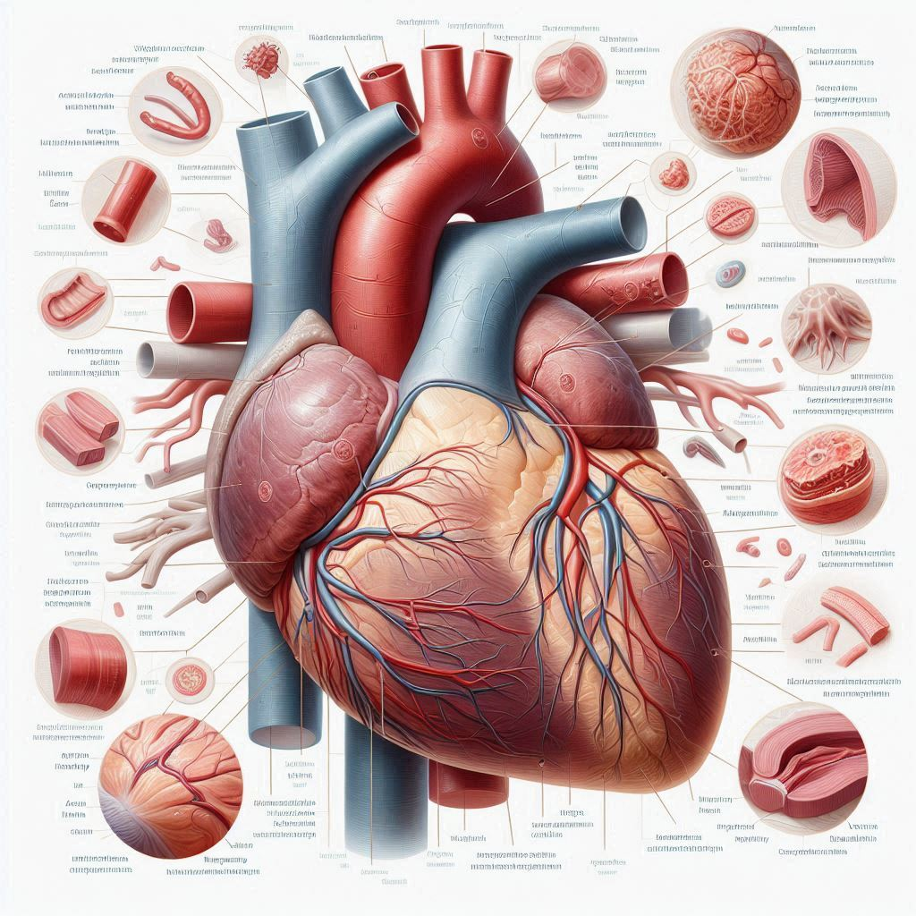
Abstract
This project uses a machine learning technique called “Support Vector Machine” to predict the likelihood of heart disease.
We are going to use a dataset of patient information to train the model, which can predict whether someone is likely to have heart disease based on their characteristics.
Our goal is to help doctors and patients identify high-risk individuals early on, so they can take steps to prevent heart disease.
This project demonstrates the potential of machine learning in medical diagnostics, offering a reliable, automated, and scalable solution for heart disease prediction. Future improvements may involve integrating deep learning techniques, real-time patient monitoring, and expanding the dataset to enhance model generalization.

Slide 4
Introduction
Heart disease, also referred as cardiovascular diseases, is broad term used for diseases and conditions affecting the heart and circulatory system. It is a major cause of disability all around the world.
Since heart is amongst the most vital organs of the body, its diseases affect other organs and part of the body as well. There are several different types and forms of heart diseases. The most common ones cause narrowing or blockage of the coronary arteries, malfunctioning in the valves of the heart, enlargement in the size of heart and several others leading to heart failure and heart attack.
Objective
To develop a predictive model using the Support Vector Machine (SVM) algorithm for heart disease prediction.
To evaluate the performance of the model using key metrics such as accuracy, precision, recall, and F1-score.
To identify the most important risk factors contributing to heart disease and provide insights for preventive measures.
To design and implement a user-friendly interface using Streamlit for easy accessibility by both healthcare professionals and individuals.
To enhance early diagnosis capabilities, enabling timely medical intervention and lifestyle modifications.

Slide 5
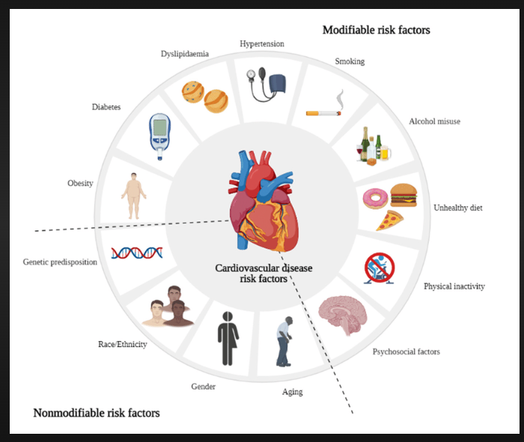
Key Factors
High Blood Pressure (Hypertension) – Increased blood pressure puts extra strain on the heart, leading to a higher risk of heart disease and stroke.
High Cholesterol Levels – Excess LDL (bad cholesterol) can lead to plaque buildup in arteries, restricting blood flow and increasing the likelihood of heart attacks.
Obesity – Excess body weight, particularly abdominal obesity, is linked to higher blood pressure, cholesterol, and insulin resistance, increasing cardiovascular risk.
Smoking – Tobacco use damages blood vessels, reduces oxygen supply, increases blood clotting, and significantly raises the risk of coronary artery disease.
Diabetes – High blood sugar levels contribute to artery damage, leading to an increased risk of heart disease and stroke.

Slide 6
Existing systems
1. Framingham Heart Study Model: This model predicts the risk of cardiovascular disease (CVD) based on traditional risk factors such as:
- Age,Sex,Blood Pressure,Cholestral levels, Smoking status,Diabetes status
-The model estimates the 10-year risk of developing CVD, including heart attacks, strokes, and peripheral artery disease. It's widely used in clinical practice to identify individuals at high risk of CVD.
2. ACCORD Model: This model predicts the risk of major cardiovascular events (MCEs) in patients with type 2 diabetes. It considers factors such as:
- Blood pressure,cholesterol levels
- Hemoglobin A1c (HbA1c)
- Kidney function
- History of cardiovascular disease
The ACCORD model estimates the 5-year risk of MCEs, including heart attacks, strokes, and deaths from cardiovascular causes. It's used to guide treatment decisions and risk factor management in patients with diabetes

Slide 7
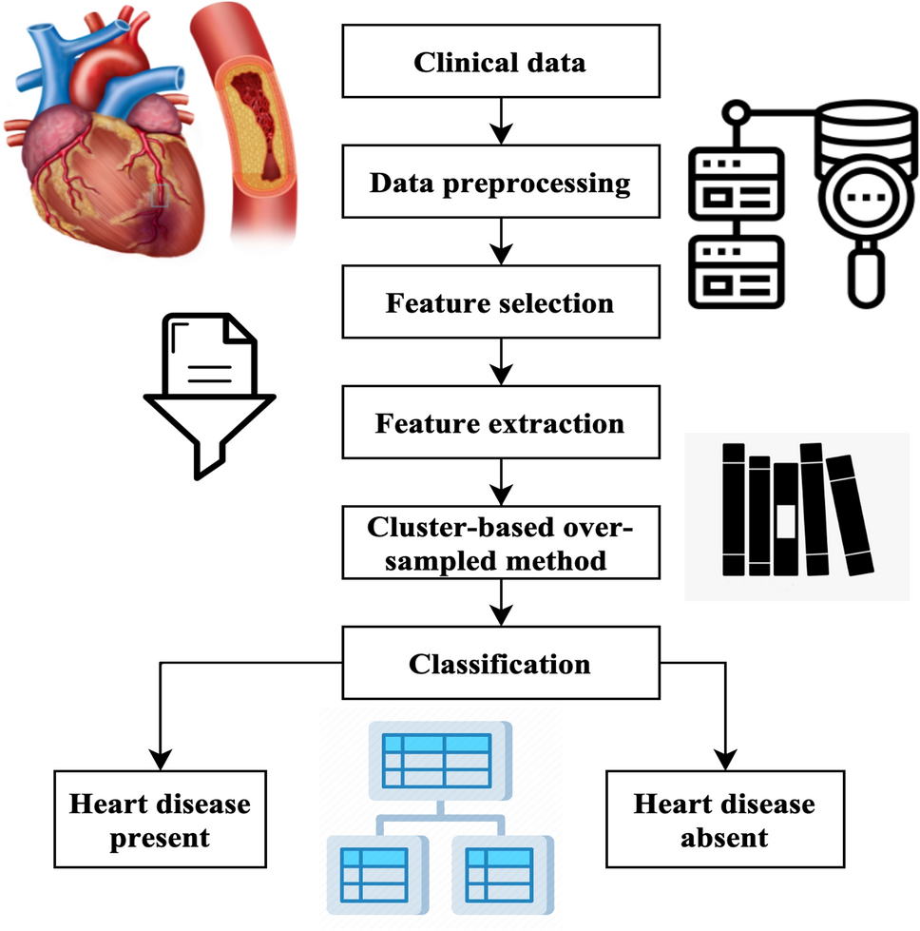
Methodologies
The methodology for this heart disease prediction project follows as
1. Dataset Description
The dataset used for heart disease prediction contains features related to medical attributes relevant to heart disease diagnosis.
2. Data Preprocessing
Data preprocessing steps include handling missing values, encoding categorical variables, and scaling numerical features to prepare the data for model training.
3. Data Visualization
Data visualization techniques like correlation heatmaps, bar charts, and scatter plots are used to explore relationships between features and identify key patterns in the data.
4. Model Implementation
Predictive models such as Logistic Regression and Support Vector Machine (SVM) are trained using the preprocessed data, with model evaluation based on accuracy and other performance metrics.
5. Deployment Using Streamlit
The final model is deployed using Streamlit, allowing users to interact with the model in real-time through a user-friendly web interface for heart disease prediction.
.

Slide 8
Data Description
This dataset, sourced from Kaggle, contains 303 rows and 14 columns, with no missing values. It provides
information about patients, including attributes such as age, sex, cholesterol levels, and heart rate. The dataset is used to predict the presence of heart disease, indicated by the target column (1 for disease presence, 0 for absence). The features include both categorical and numerical data, offering a comprehensive basis for logistic regression analysis.
1.Age
2.Sex
3.CP
4.Trestbs
5.chol
6.fbs
7.restecg
8.exang
9.Oldpeak
10.slope
11.ca
12.thal
14.target
13.Thalach
Data Preprocessing
Data preprocessing is the process of cleaning, transforming, and preparing raw data into a format suitable for analysis or modeling. It involves handling missing values, removing duplicates, scaling/normalizing data, and converting data types to improve data quality and accuracy.But the dataset i have taken is already preprocessed

Slide 9
Data Visualization
Visualizing the data is crucial for understanding relationships between variables and informing modeling decisions. The project employs various plots to gain insights into the dataset:
1
Scatter Plots
2
Box Plots
3
Bar Plots
Visualize relationships between variables. These plots help identify potential correlations and non-linear relationships
Analyze patterns based on day of the age distribution by target.
A barplot is a graphical representation of categorical data using bars of varying lengths.
4
Histograms
5
Correlation Heat Map
Analyze the distribution of demand and temperature values.
Visualize the correlation between all variables in the dataset.

Slide 10
Model Implementation
The dataset is split into training and testing sets using the train_test_split function from Scikit-learn. Two machine learning models, LSTM and Random Forest, are implemented and compared.
Logistic Regression
Support Vector Machine(SVM)
Logistic regression is a machine learning algorithm used for binary classification. It predicts the probability of an event occurring (0 or 1). The model uses a logistic function to map input features to a probability output. It's widely used in applications such as credit risk assessment and medical diagnosis. The goal is to find the best-fitting model that separates the classes.
A Support Vector Machine (SVM) is a machine learning algorithm that classifies data by finding the best hyperplane to separate classes. It maximizes the margin between classes, ensuring accurate predictions and robustness to noise.

Slide 11
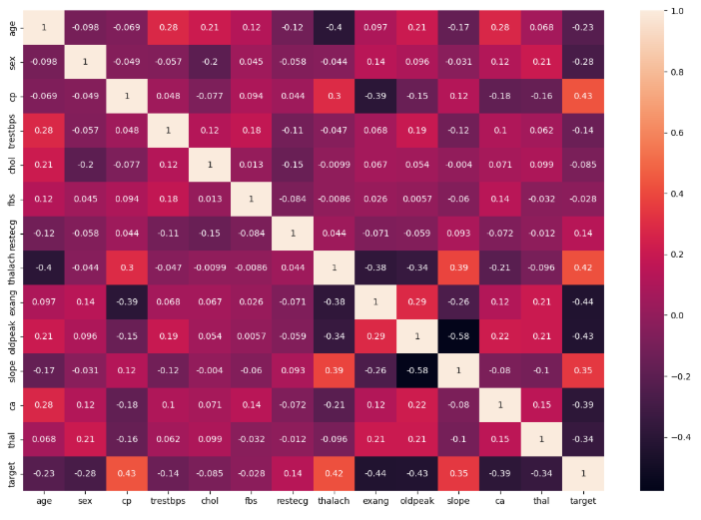
LIBRARIES USED
Pandas (pd)
Data manipulation library
Handles data in table format (DataFrames)
Matplotlib.pyplot (plt)
Basic plotting library
Creates graphs and charts
Seaborn (sns)
Statistical visualization library
Makes prettier plots than matplotlib
Scikit-learn Components
train_test_split: Splits data into training/testing sets
LogisticRegression: For binary classification
SVC: Support Vector Machine classifier
Metrics: Tools to measure model performance (accuracy, reports, confusion matrix)

Slide 12
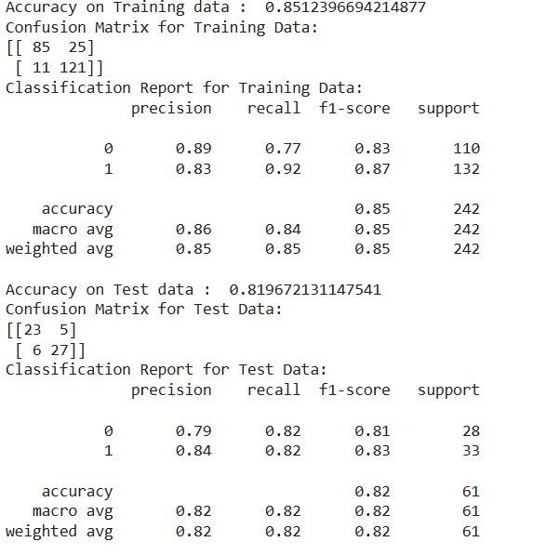
Result of Logistic regression
The model achieved an accuracy of 85.12% on the training data, with a strong classification report.
It correctly classified 121 true positives and 85 true negatives, while misclassifying 25 false positives and 11 false negatives.
The model's performance on the test data was slightly lower, with an accuracy of 81.97%. The test data classification report showed a precision of 0.79-0.84 and recall of 0.82.
The model's macro average and weighted average metrics were above 0.82. Overall, the model performed well, but with a slight drop in performance on the test data.

Slide 13
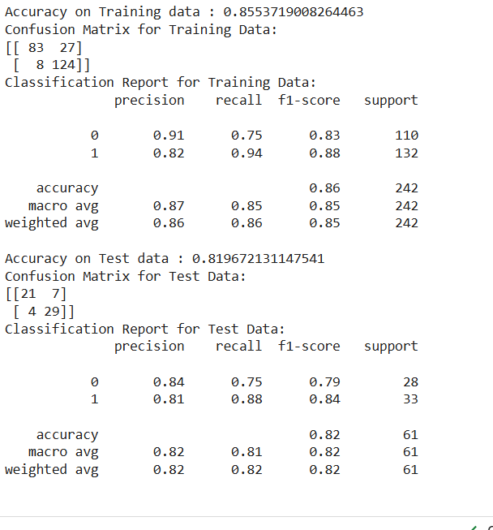
Results of SVM
The model achieved an accuracy of 85.54% on the training data, with a precision of 0.91 and 0.82 for classes 0 and 1, respectively. The training data confusion matrix showed 83 true positives and 124 true negatives.
The model's performance on the test data was 81.97%, with a precision of 0.84 and 0.81 for classes 0 and 1. The test data confusion matrix showed 21 true positives and 29 true negatives.
The macro average and weighted average metrics were above 0.82 for both datasets. Overall, the model performed well, with a slight drop in performance on the test data.
.

Slide 14
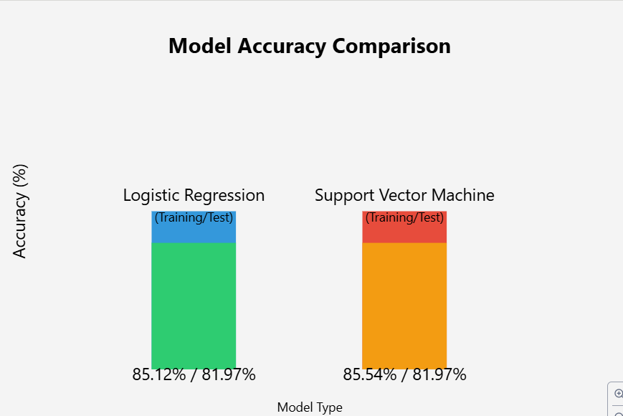
Result
Both the SVM and Logistic Regression models perform similarly well, with identical test accuracies of 81.97%.
The SVM shows a slightly higher training accuracy (85.54% vs 85.12%) and better generalization with more balanced precision-recall metrics across classes.
While both models are viable choices, the SVM might be marginally preferred due to its more balanced performance across classes and slightly better handling of false positives and false negative.
So I have fitted support vector machine model.

Slide 15
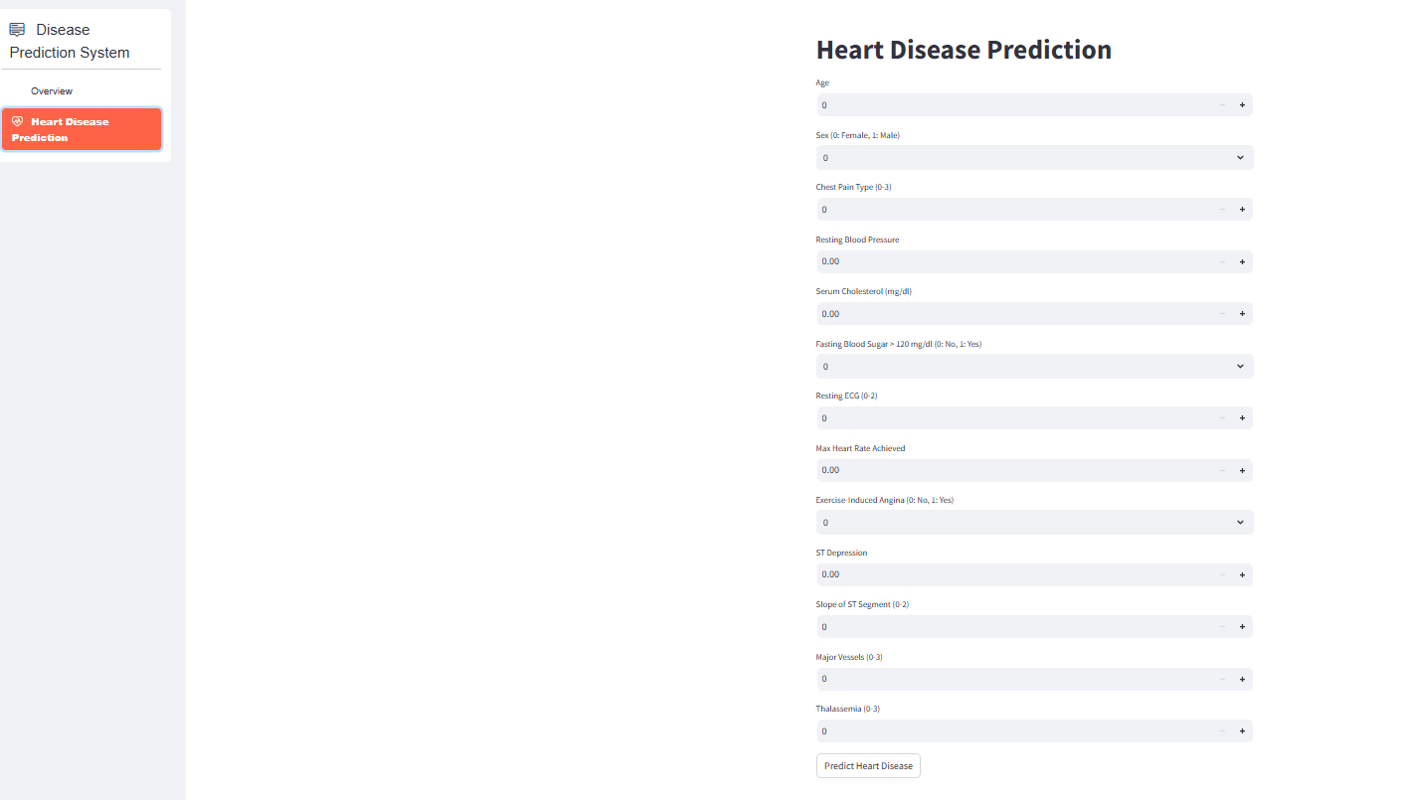
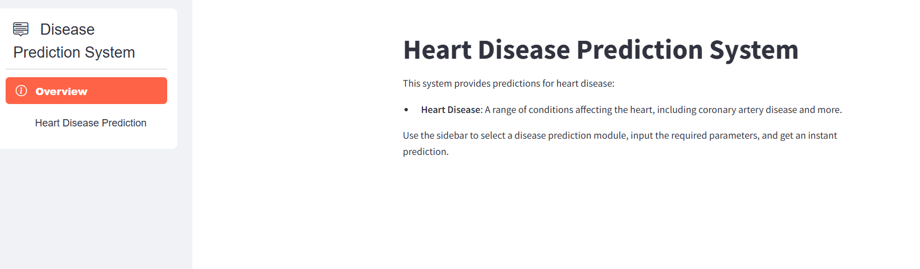
USER INTERFACE
The user interface provides a simple, interactive platform for users to input medical data and receive heart disease prediction results in real-time.

Slide 16
Future Scope
Integration of Deep Learning Models – Enhancing the prediction accuracy by incorporating advanced deep learning techniques such as Artificial Neural Networks (ANNs) or Convolutional Neural Networks (CNNs) for feature extraction and improved classificaton.
Feature Engineering and Optimization – Implementing advanced feature selection techniques to identify the most influential factors affecting heart disease, improving model performance.
Hybrid Model Implementation – Combining multiple machine learning models (e.g., ensemble methods like Random Forest, XGBoost, or stacking approaches) to achieve more robust and accurate predictions.
Larger and More Diverse Datasets – Expanding the dataset by including more patient records from diverse geographical, ethnic, and genetic backgrounds, making the model more generalized and reliable for different populations.
Multi-Disease Prediction Model – Expanding the scope of the system to include other cardiovascular diseases (e.g., stroke, arrhythmia, hypertension) or even integrating it with other disease prediction models (diabetes, Parkinson’s, etc.).
CHALLENGES
Data Quality and Availability
Overfitting Issues
Deployment and Maintenance Challenges
Handling Missing or Incomplete Data

Slide 17
Conclusion
This project demonstrates the successful implementation of a Support Vector Machine (SVM) model for heart disease prediction, achieving a robust training accuracy of 85.54% and test accuracy of 81.97%. The model shows particularly strong performance in detecting heart disease cases with an 88% recall rate while maintaining 84% precision in identifying healthy patients. These balanced metrics across both classes indicate the model's reliability as a screening tool.
The minimal difference between training and test accuracy suggests good generalization without overfitting. While the model demonstrates promising results, it's designed to serve as a supportive tool for healthcare professionals rather than a standalone diagnostic solution. The consistent performance metrics and balanced predictions make this SVM model a valuable addition to clinical decision-making processes, particularly for preliminary patient screening and risk assessment.
To make the model more accessible and user-friendly, it has been deployed using Streamlit, allowing healthcare professionals and users to input patient data and receive predictions in a simple web-based interface. Future enhancements could focus on expanding the dataset, refining feature selection, and improving deployment scalability to further enhance the model’s predictive capabilities and usability

Slide 18


