Slide 1
HW2 – Part 1

Slide 2
Preparation - 1
Please make sure you have read the Lectures 4 & 5
Please read Textbook chapter 38, at least the portions covered by the lectures.
The notations in this slide deck may be a bit different from the lecture slides! The goal is to make implementation easier.

Slide 3
Caution
Please do not import packages (like scikit learn) that are not listed in the provided code.
In this homework, you are NOT allowed to use NumPy’s or other Python libraries’ built-in convolution, filter functions, down-sampling, up-sampling, Gaussian pyramid, and Laplacian pyramid functions. If you use them, you will get 0 points for the entire assignment.

Slide 4
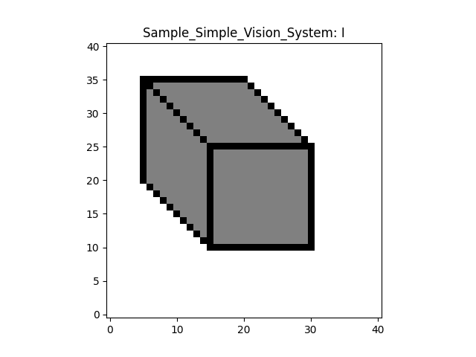
Convention
In this homework, given a map (or a matrix), say I
  I[n, m] means the i-th horizontal index (left-right) and j-th vertical index (bottom-up)
  n >= 0, m >= 0
m
n

Slide 5
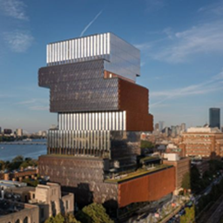
Color images
Please note that a color image I means that the image I is a 3D tensor. The 3rd dimension corresponds to R, G, and B.
In this homework, you will process each channel separately. You can extract each by I[:, :, c], where c is between 0 and 2.

Slide 6
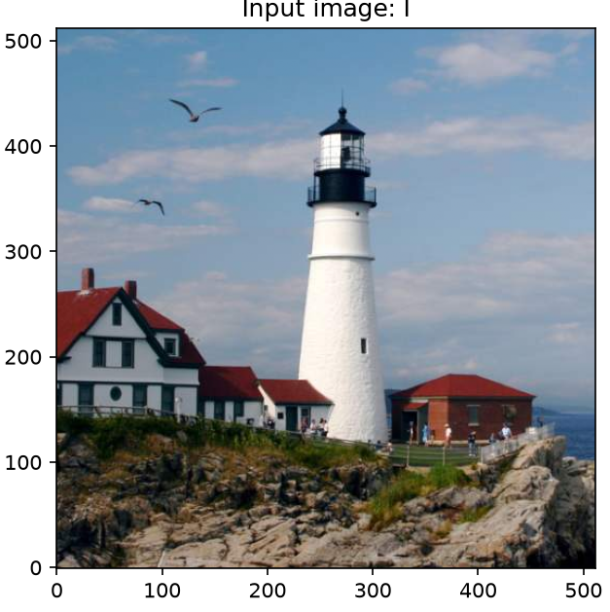
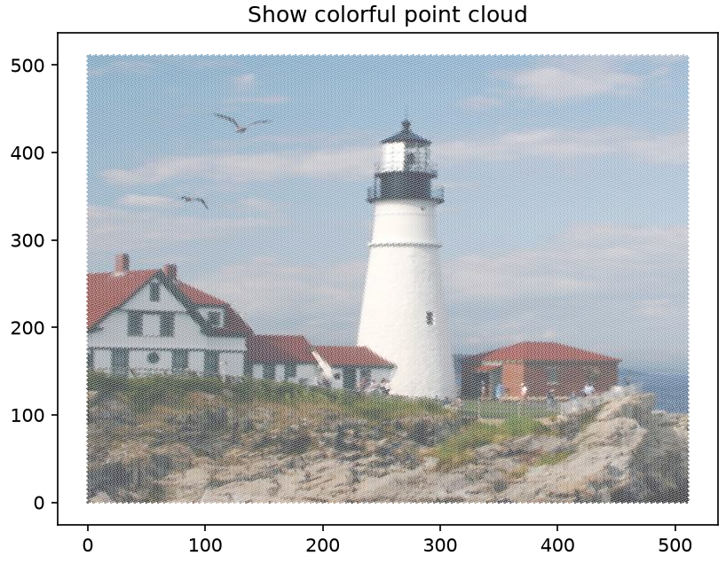

Question 1
Represent an image by a list of points and their pixel colors
  Given an image I, where pixel coordinates start from (0, 0)
  Convert it into a list of (n, m, R, G, B), where R, G, B are associated with pixels (n, m)
Point cloud visualization
m
$$\left\{[n, m, R, G, B]\right\}$$
n

Slide 7
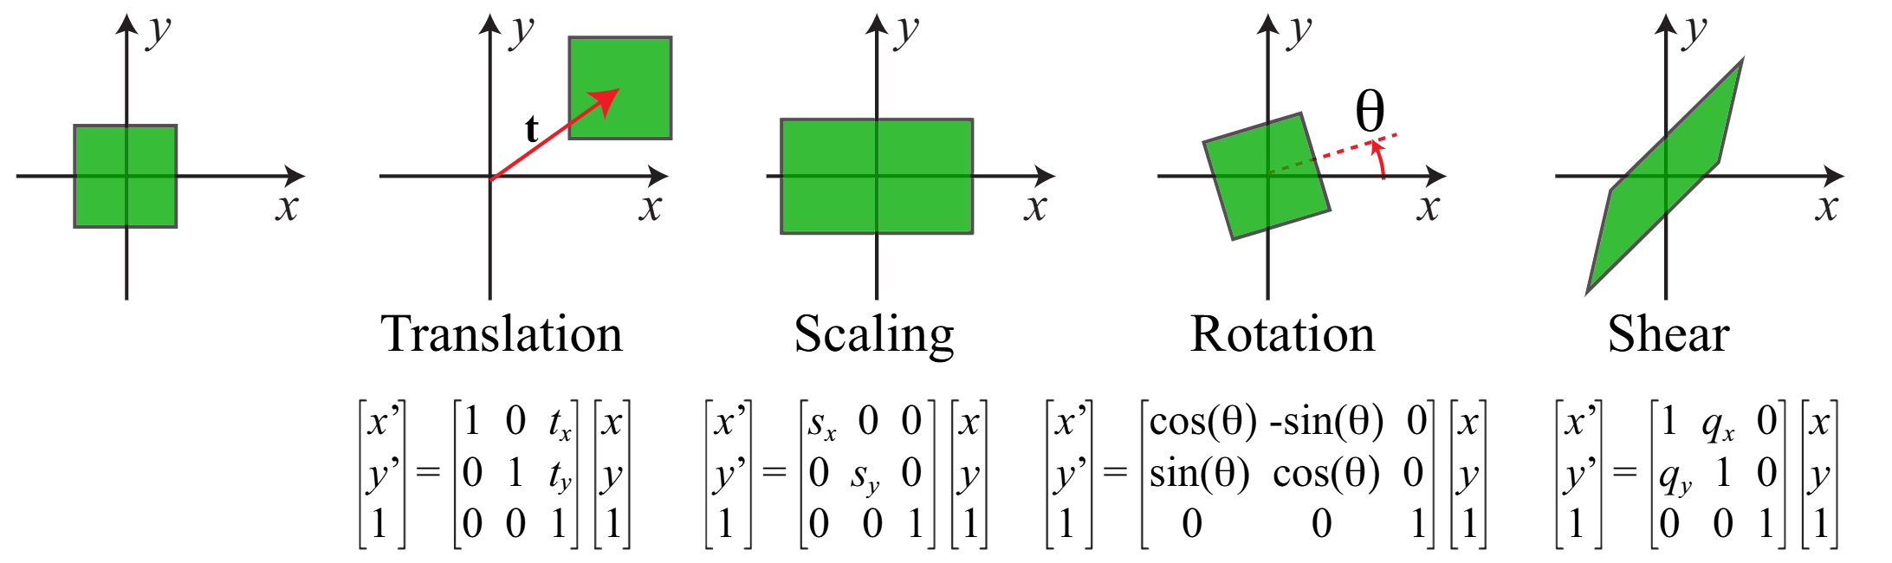
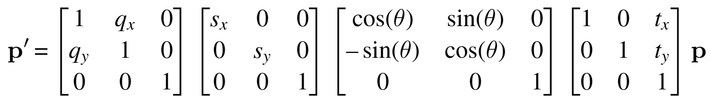
Questions 2 & 3

Slide 8
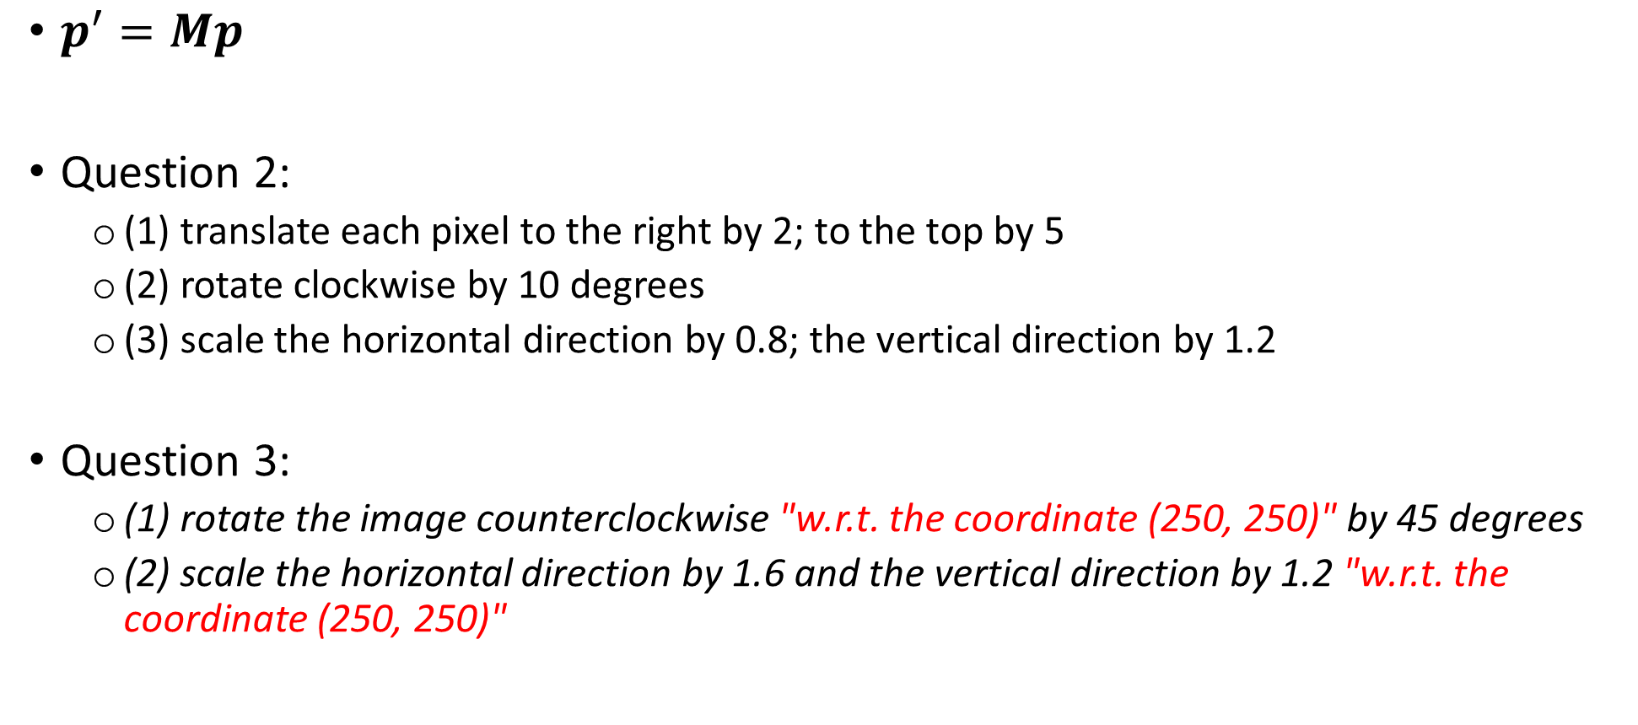
Questions 2 & 3
$p^{′}=Mp$
Question 2:
  (1) translate each pixel to the right by 2; to the top by 5
  (2) rotate clockwise by 10 degrees
  (3) scale the horizontal direction by 0.8; the vertical direction by 1.2
Question 3:
  (1) rotate the image counterclockwise "w.r.t. the coordinate (250, 250)" by 45 degrees
  (2) scale the horizontal direction by 1.6 and the vertical direction by 1.2 "w.r.t. the coordinate (250, 250)"

Slide 9
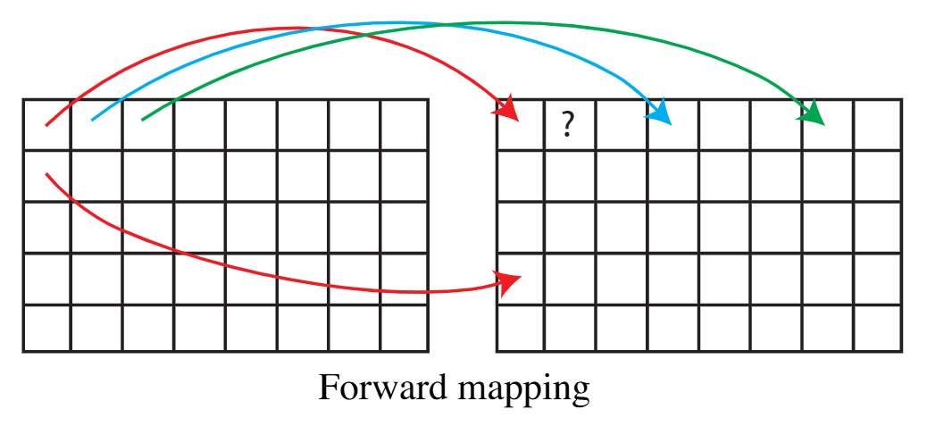

Question 4: Forward mapping
For every original pixel $p= {[n,m,1]}^{T}$
  Apply the transformation $M$ to the coordinate (i.e., $Mp$), to map the original image to the target image
  Round the resulting coordinate to the closest pixel coordinate (on regular spatial grid)
Original image
Target image

Slide 10
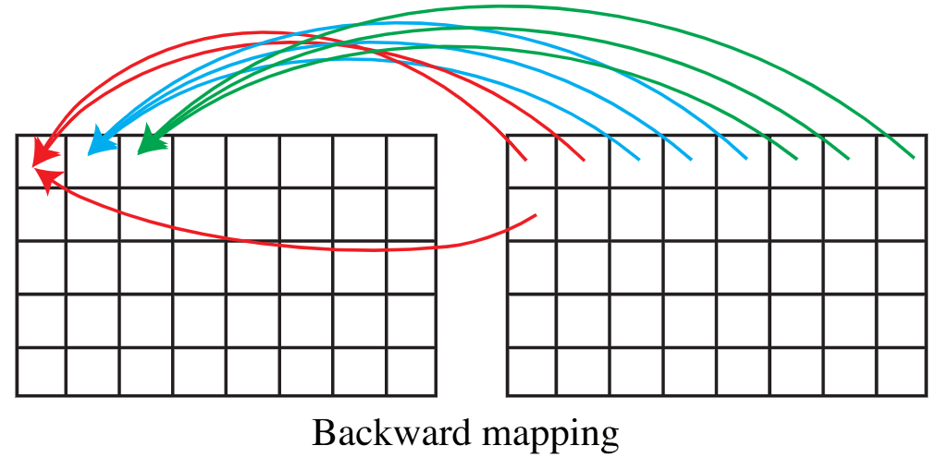

Question 5: Backward mapping
For every target pixel $p= {[n,m,1]}^{T}$
  Apply the inverse transformation $M^{−1}$ to the coordinate (i.e.,$M^{−1}p$), to map the target image back to the original image
  Copy the color of the closest pixel coordinate (on regular spatial grid) in the original image to the target image
Original image
Target image

