Slide 1
HW2 – Part 3

Slide 2
Preparation
Please make sure you have read Lecture 6
Please read Textbook chapter 16, at least the portions covered by the lectures.
The notations in this slide deck may be a bit different from the lecture slides! The goal is to make implementation easier.

Slide 3
Caution
Please do not import packages (like scikit learn) that are not listed in the provided code.
In this homework, you are NOT allowed to use NumPy’s or other Python libraries’ built-in convolution, DFT, IDFT, and filter functions. If you use them, you will get 0 points for the entire assignment.

Slide 4
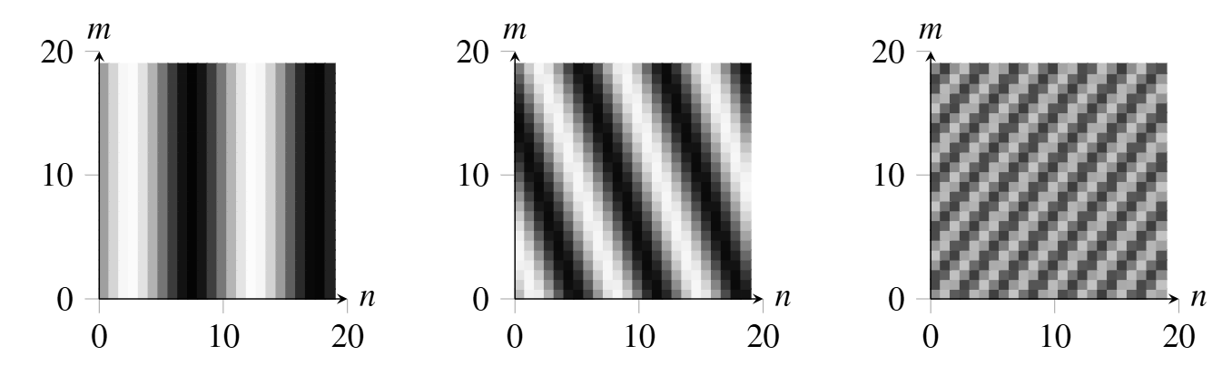




Question 1: Periodic function
Let’s consider a square image
$l\left[n, m\right]=\cos\left(2π\left(\frac{un}{N}+\frac{vm}{N}\right)+θ\right)$, where $θ$is the phase

Slide 5
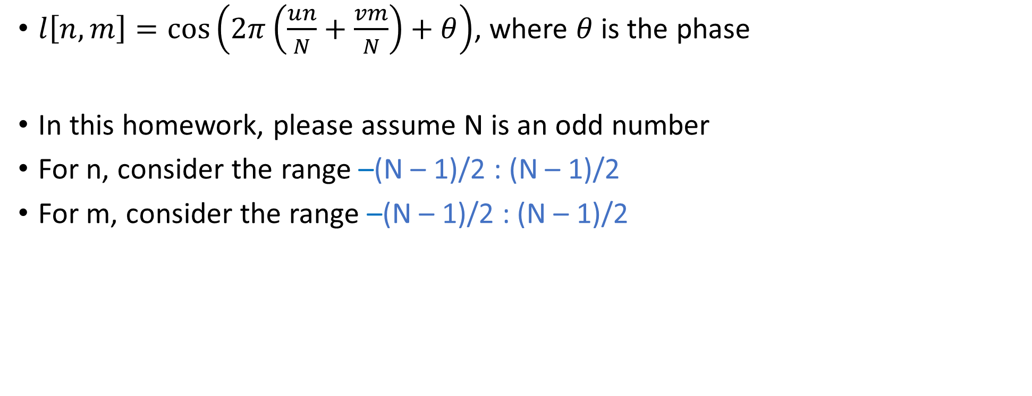
Question 1: Periodic function
$l\left[n, m\right]=\cos\left(2π\left(\frac{un}{N}+\frac{vm}{N}\right)+θ\right)$, where $θ$is the phase
In this homework, please assume N is an odd number
For n, consider the range –(N – 1)/2 : (N – 1)/2
For m, consider the range –(N – 1)/2 : (N – 1)/2

Slide 6
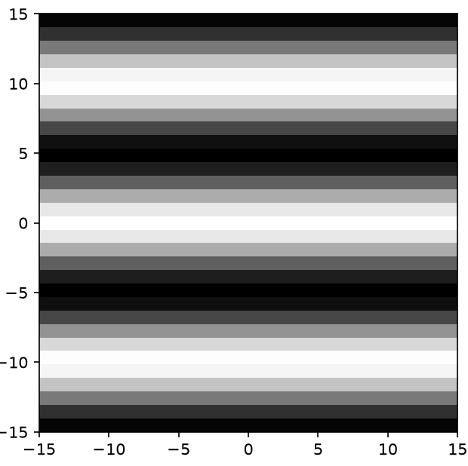

Question 1: Periodic function
Let N = 31, u = 0, v = 3, and $θ=0$, you will generate a 31-by-31 matrix (image)
m
n

Slide 7
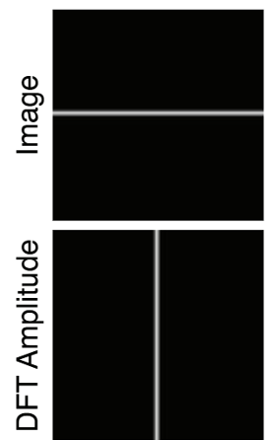

Other experiments
In Lecture 6, we see this example
Now let’s reproduce it by
  $$l\left[n, m\right]=\sum_{v=−(N−1)/2}^{v=(N−1)/2}{\cos\left(2π\left(\frac{0n}{N}+\frac{vm}{N}\right)\right)}$$

Slide 8
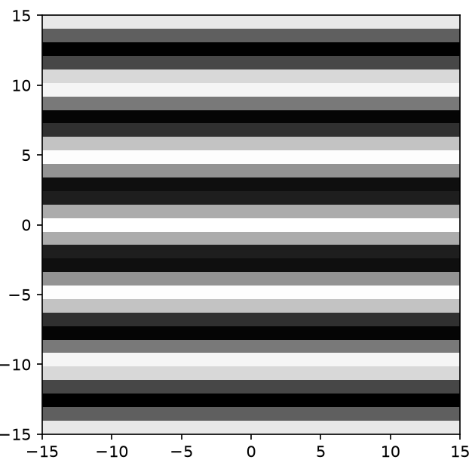






Other experiments
$$l\left[n, m\right]=\sum_{v=−(N−1)/2}^{v=(N−1)/2}{\cos\left(2π\left(\frac{0n}{N}+\frac{vm}{N}\right)\right)}$$
means
$$…+ …$$
$$…+ …$$
$$…+ …$$
$$…+ …$$
m
n

Slide 9
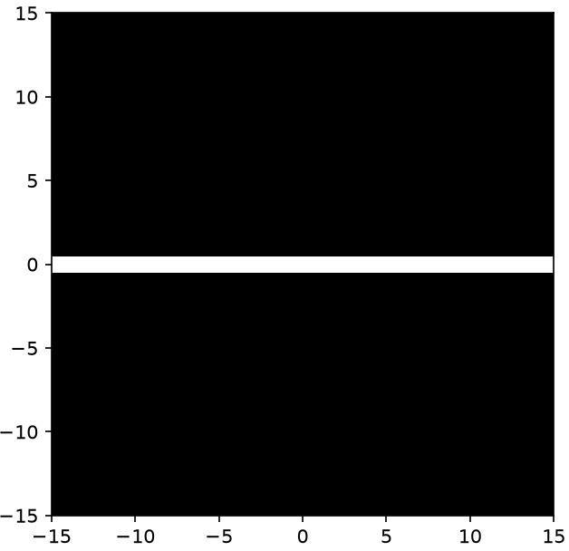
Other experiments
You will get

Slide 10

Other experiments
How about $l\left[n, m\right]=\sum_{v=−(N−1)/2}^{v=(N−1)/2}{\cos\left(2π\left(\frac{0n}{N}+\frac{vm}{N}\right)+θ\right)}$,
where $θ$ is a random number for each $v$ value?

