Slide 1
HW3

Slide 2
Caution & AI Usage
Please do not import packages (like scikit-learn) that are not listed in the provided code.
For this homework, you are welcome to use AI (e.g., ChatGPT) to understand the models, algorithms, PyTorch, and the code.
However, you are not allowed to directly ask AI to implement the solutions and simply copy and paste them.

Slide 3
Preparation
Please make sure you have gone through:
Week 2 materials
Slide decks of Lectures 8 – 11
Please read Textbook chapters 9 – 14, 24, and 26, at least the portions covered by the lectures.
The notation in this slide deck may differ slightly from the lecture slides! The goal is to make implementation easier.

Slide 4
Preparation
In this homework, you will need to use PyTorch. You may find tutorials here:
https://docs.pytorch.org/tutorials/beginner/basics/intro.html

Slide 5
Topic
In this homework, you are going to experience convolutional neural networks (CNNs) and vision transformers, in particular:
ResNet-50
DINO-v2
We demoed both models in Week 2 of this semester. You are also encouraged to check the corresponding papers and blog posts:
ResNet: paper, slides
DINO-v2: https://dinov2.metademolab.com/

Slide 6
Google Colab
https://colab.research.google.com/drive/1Sy9nqN8vqeNoNH44xJKXgRogqLhUPRqM?usp=sharing
Please save your own copy and implement there

Slide 7
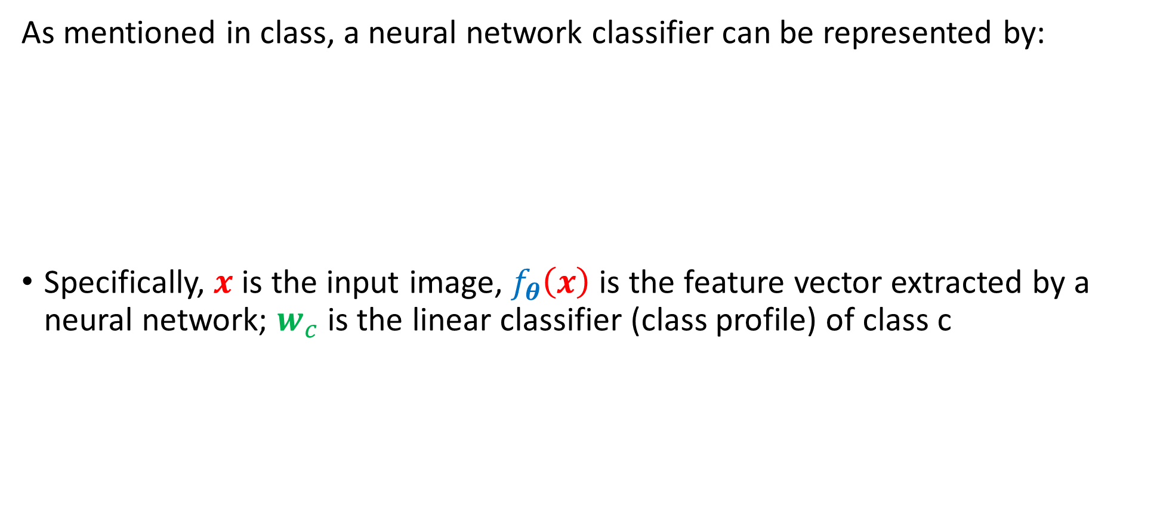
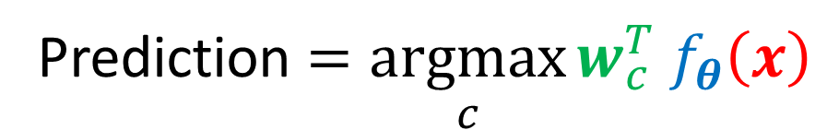
Part 1: linear probing
As mentioned in class, a neural network classifier can be represented by:
Specifically, $x$ is the input image, $f_{θ}\left(x\right)$ is the feature vector extracted by a neural network; $w_{c}$ is the linear classifier (class profile) of class c
Prediction $=\underset{c}{argmax}{w_{c}^{T} f_{θ}\left(x\right)}$

Slide 8
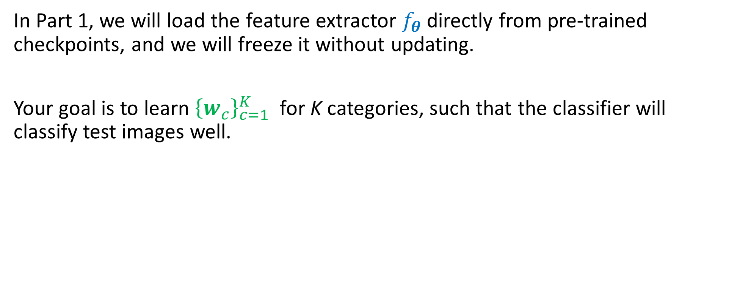
Part 1: linear probing
In Part 1, we will load the feature extractor $f_{θ}$ directly from pre-trained checkpoints, and we will freeze it without updating.
Your goal is to learn ${\left\{w_{c}\right\}}_{c=1}^{K}$ for K categories, such that the classifier will classify test images well.

Slide 9
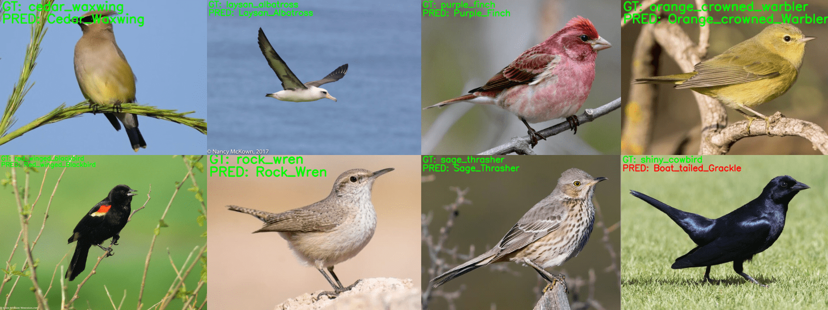
Part 1: linear probing
Dataset: Caltech-UCSD Birds-200-2011 (CUB-200-2011) with 200 bird species. https://www.vision.caltech.edu/datasets/cub_200_2011/

Slide 10
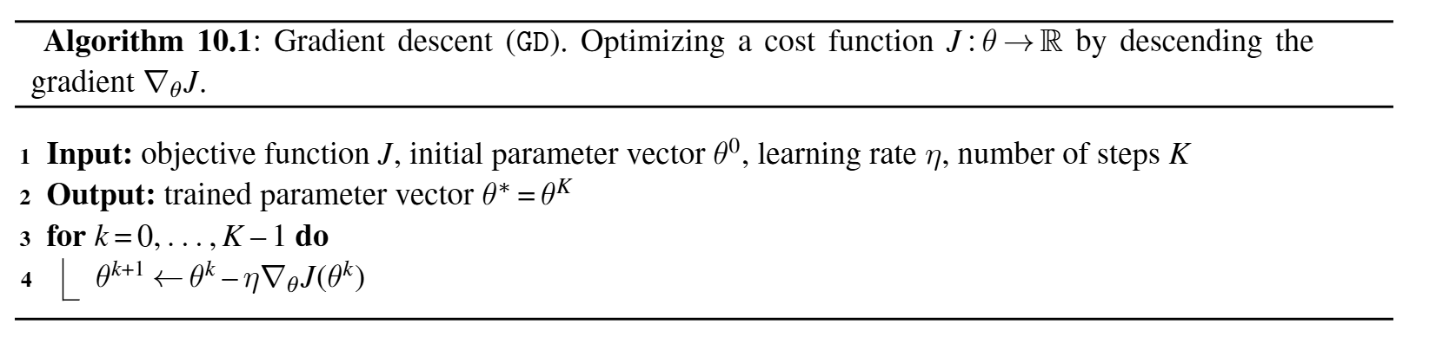
Part 1: linear probing
Your Jobs 1 to 4 include:
Set up the loss function (criterion) and optimizer
Set up the evaluation loop
Set up gradient computation and model weight update
Plot the training loss and test accuracy

Slide 11
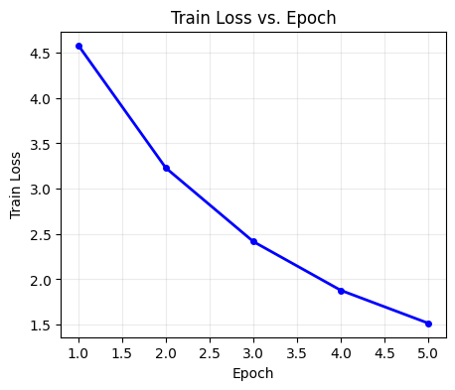
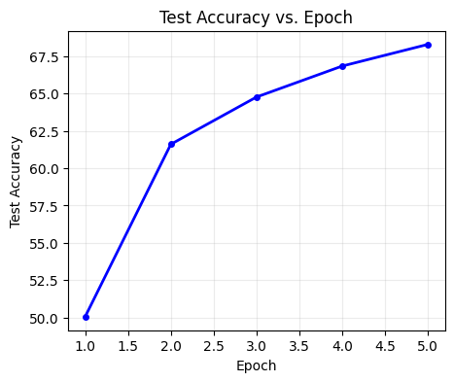
Part 1: linear probing
Example results

Slide 12
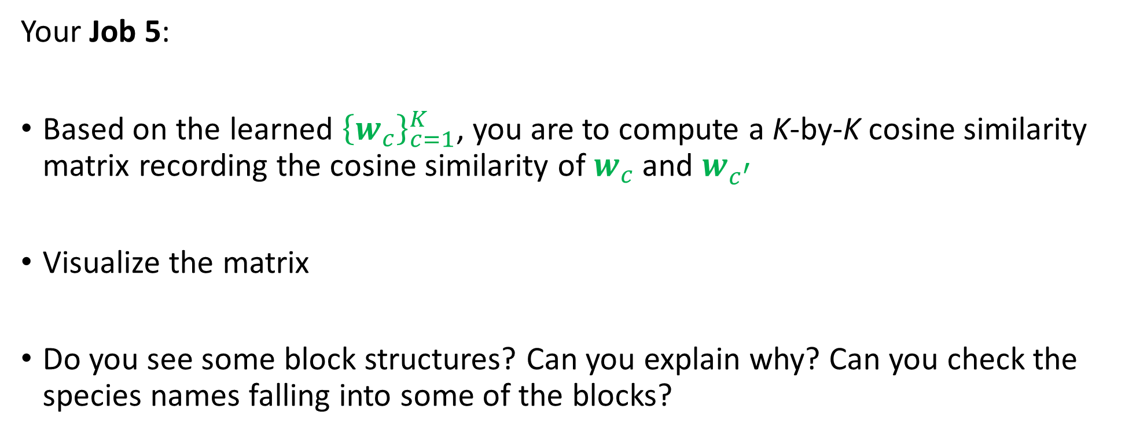
Part 1: linear probing
Your Job 5:
Based on the learned ${\left\{w_{c}\right\}}_{c=1}^{K}$, you are to compute a K-by-K cosine similarity matrix recording the cosine similarity of $w_{c}$ and $w_{c^{′}}$
Visualize the matrix
Do you see some block structures? Can you explain why? Can you check the species names falling into some of the blocks?

Slide 13
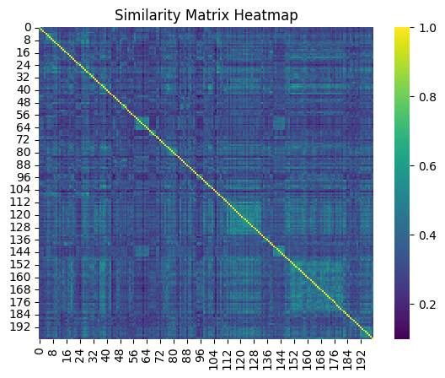
Part 1: linear probing
Example results

Slide 14
Part 1: linear probing
Your Job 6: repeat all steps, but switch from ResNet-50 to DINO-v2!

Slide 15
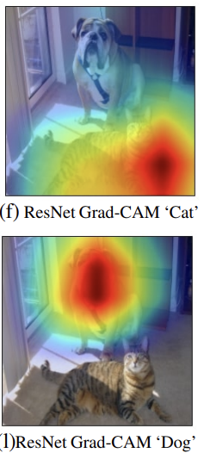
Part 2: Explainable AI (ResNet-50 only)
Implement Grad-CAM for visualization:
https://arxiv.org/pdf/1610.02391

Slide 16
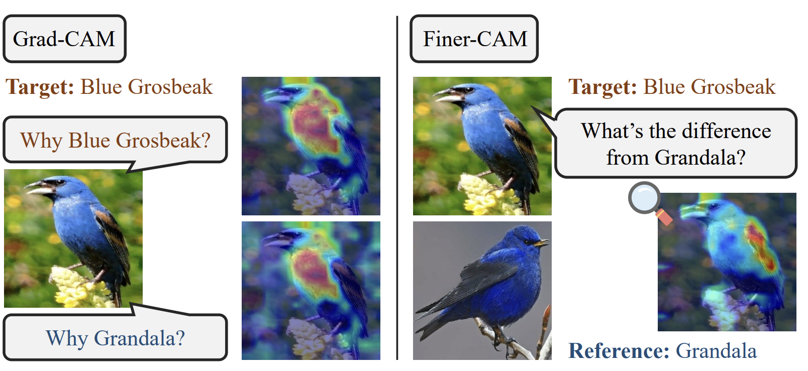
Part 2: Explainable AI (ResNet-50 only)
Implement Finer-CAM for visualization:
https://arxiv.org/pdf/2501.11309

Slide 17
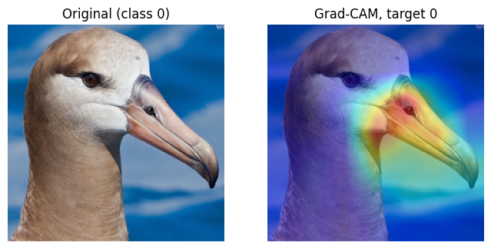
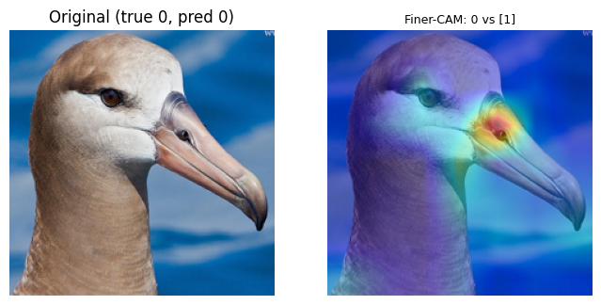
Part 2: Explainable AI (ResNet-50 only)
Example results

Slide 18
Submission
Your completed Google Colab ipynb file named BUusername.ipynb (70%)
A report (PDF) named BUusername.pdf: (30%)
  Part 1, job 4 – plots + description of observations (max 150 words)
  Part 1, job 5 – plots + description of observations (max 150 words)
  Part 1, job 6 – report the corresponding results of jobs 4 & 5 (max 150 words each)
  Part 2, job 7 – some plots + description of observations (max 250 words)
  Part 2, job 8 – some plots + description of observations (max 250 words)
  Your AI usage disclosure: what did you use and how did you use it (max 150 words)
  With whom did you discuss your homework?
Each description longer than the cap will get a 30% grade reduction.

