Slide 1
CSE 5523: HW2

Slide 2
Outline
You are to implement:
Pocket algorithm (improved perceptron)
Linear Gaussian discriminative analysis
Nonlinear Gaussian discriminative analysis

Slide 3
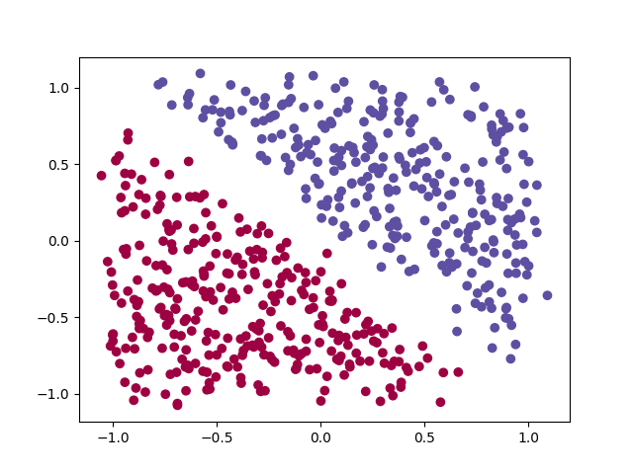
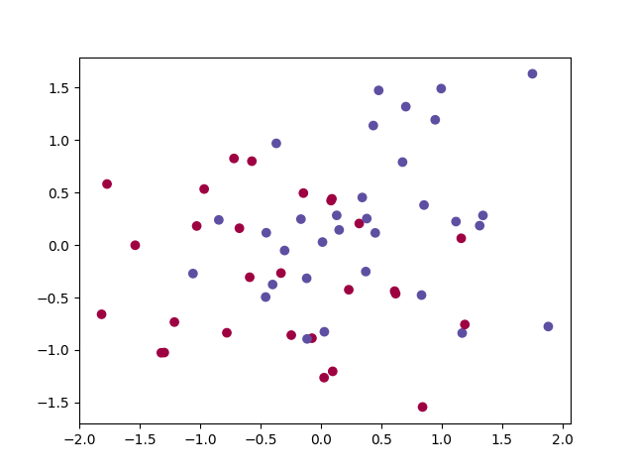
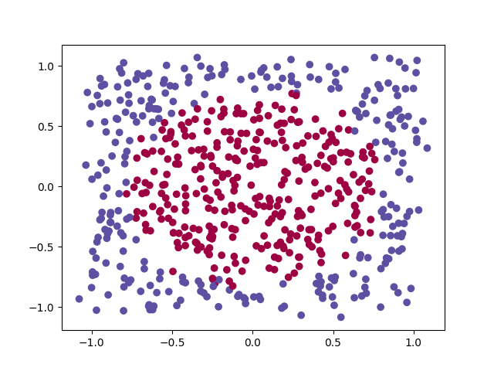
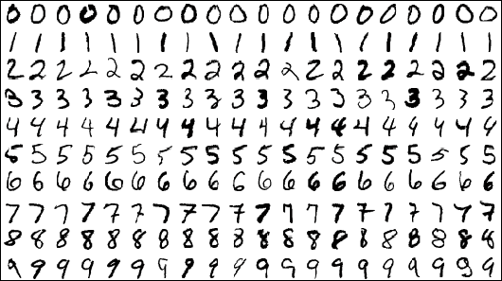

Data
Four data source
2D linear
2D noisy linear
2D quadratic (circle)
MNIST (<5 vs. >=5)
$X∈ℝ^{D×N}$:
A column as an instance
$Y∈{\left\{+1,−1\right\}}^{N×1}$

Slide 4
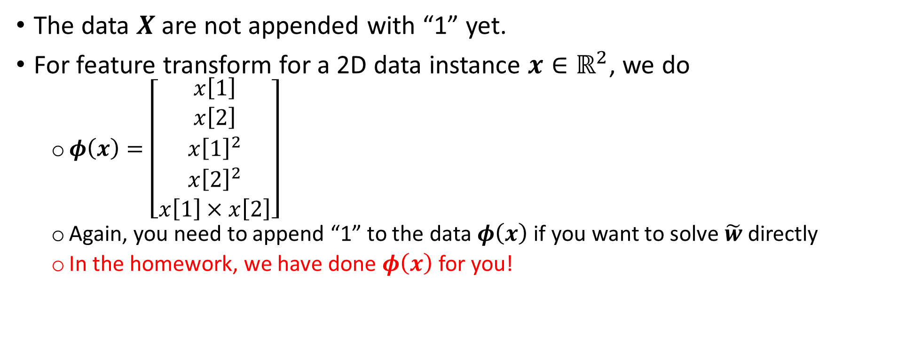
Data
The data $X$are not appended with “1” yet.
For feature transform for a 2D data instance $x∈ℝ^{2}$, we do
$φ\left(x\right)=\left[\begin{matrix}x\left[1\right] \\ x\left[2\right] \\ \begin{aligned}{x\left[1\right]}^{2} \\ {x\left[2\right]}^{2} \\ x\left[1\right]×x\left[2\right]\end{aligned}\end{matrix}\right]$
Again, you need to append “1” to the data $φ\left(x\right)$ if you want to solve $\tilde{w}$ directly
In the homework, we have done $φ\left(x\right)$ for you!

Slide 5

Accuracy
Data = ${\left\{ \left(x_{i}, y_{i}∈\left\{+1,−1\right\}\right) \right\}}_{i=1}^{N}$
Accuracy = $\frac{1}{N}\sum_{i=1}^{N}{1[{{\hat{y}}_{i}==y}_{i}]}$, where ${\hat{y}}_{i}$ is the prediction based on $x_{i}$

Slide 6
Pocket algorithm

Slide 7

Pocket algorithm
Training data: $D_{tr}={\left\{ \left(x_{i}∈ℝ^{D}, y_{i}∈\left\{+1, −1\right\}\right) \right\}}_{i=1}^{N}$
Model: $sign\left(wx+b\right)=sign\left({\tilde{w}}^{T}\tilde{x}\right)$

Slide 8

Pocket algorithm
Initialize $\tilde{w}$and ${\tilde{w}}^{best}=0$
For $t=1:T$
Loop for all training examples ${\tilde{x}}_{n}$ (random order!)
Predict ${\hat{y}}_{n}=sign\left({\tilde{w}}^{T}{\tilde{x}}_{n}\right)$
If ${\hat{y}}_{n}≠y_{n}$
Update: $\tilde{w}←\tilde{w}+η(y_{n}{\tilde{x}}_{n})$
Evaluate $\tilde{w}$ on the “training data” and calculate the training accuracy
If training accuracy by $\tilde{w}$ is “higher” than the training accuracy by ${\tilde{w}}^{best}$
${\tilde{w}}^{best}$ $←\tilde{w}$
Output ${\tilde{w}}^{best}$
See lecture 7 for extra details

Slide 9
Gaussian discriminant analysis

Slide 10
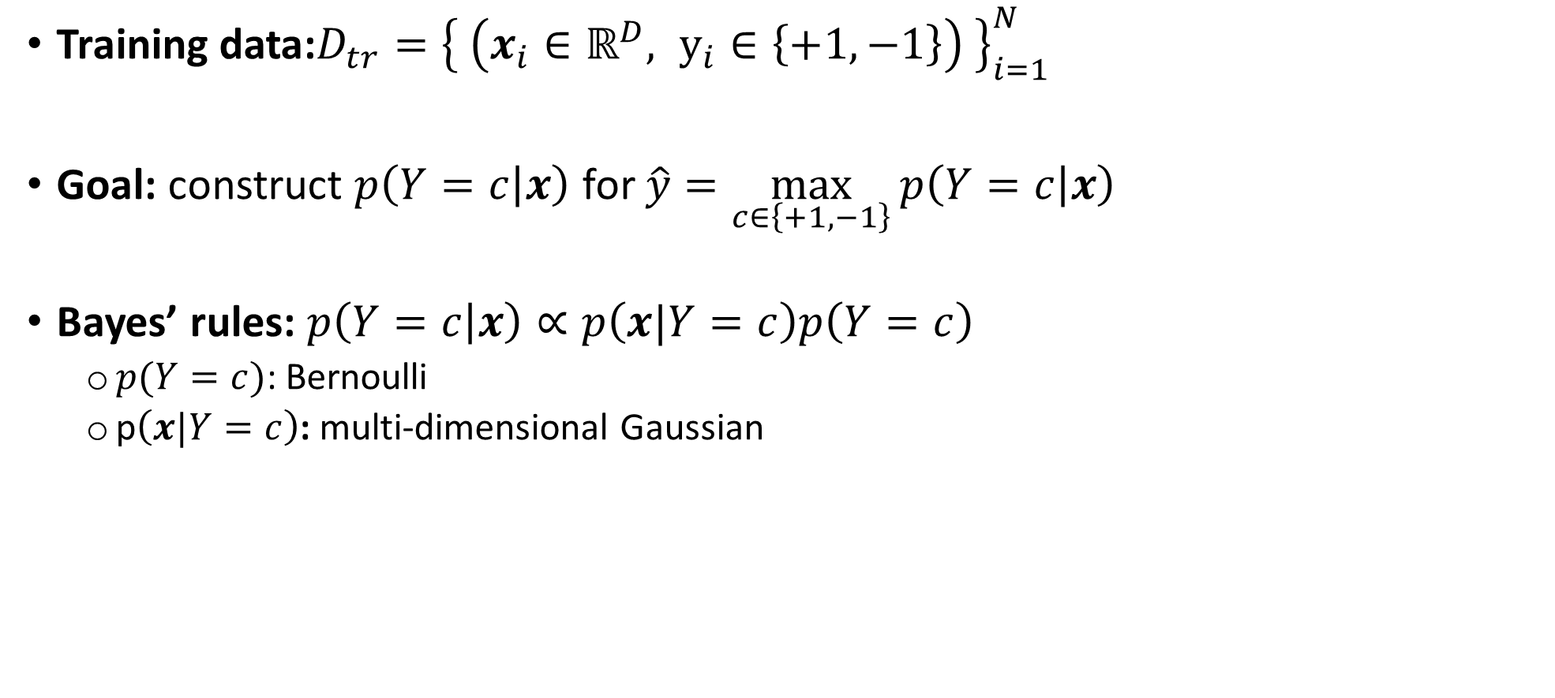
GDA
Training data:$D_{tr}={\left\{ \left(x_{i}∈ℝ^{D}, y_{i}∈\left\{+1, −1\right\}\right) \right\}}_{i=1}^{N}$
Goal: construct $p\left(Y=c | x\right)$ for $\hat{y}=\max_{c∈\left\{+1, −1\right\}}{p\left(Y=c | x\right)}$
Bayes’ rules: $p\left(Y=c | x\right)∝p\left(x|Y=c\right)p\left(Y=c\right)$
$p(Y=c)$: Bernoulli
p$\left(x|Y=c\right)$: multi-dimensional Gaussian

Slide 11

Nonlinear GDA
$p\left(x| Y=+1\right)$ and $p\left(x| Y=+1\right)$ have their own covariance matrices $Σ_{+1},Σ_{−1}$
See slides 9, 10 for how to compute them
See also your homework # 2

Slide 12
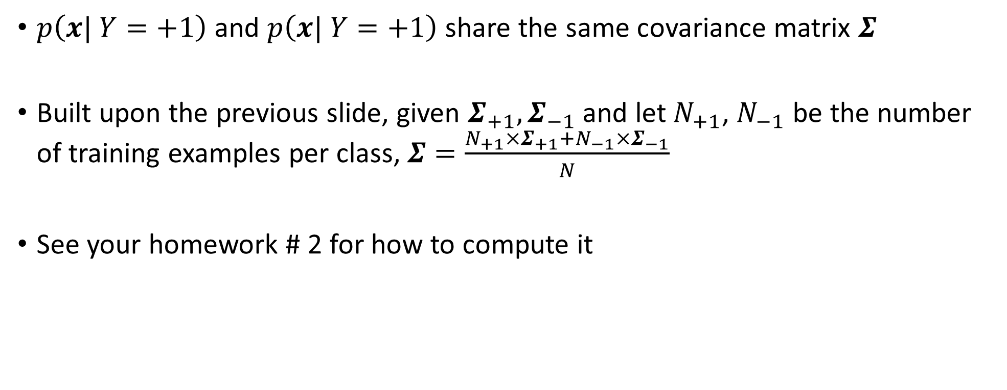
Linear GDA
$p\left(x| Y=+1\right)$ and $p\left(x| Y=+1\right)$ share the same covariance matrix $Σ$
Built upon the previous slide, given $Σ_{+1},Σ_{−1}$ and let $N_{+1}$, $N_{−1}$ be the number of training examples per class, $Σ=\frac{N_{+1}×Σ_{+1}+N_{−1}×Σ_{−1}}{N}$
See your homework # 2 for how to compute it

Slide 13

Prediction (please do “log” to prevent overflow)
$$\max_{c∈\left\{+1, −1\right\}}{p\left(Y=c | x\right)}=\max_{c∈\left\{+1, −1\right\}}{p\left(x|Y=c\right)p\left(Y=c\right)}$$
$$=\max_{c∈\left\{+1, −1\right\}}\log{p\left(x|Y=c\right)}+\log{p\left(Y=c\right)}$$

