Slide 1
HW2

Slide 2
Preparation - 1
Please make sure you have read the Lectures 6 & 7 & 9 slide decks, especially about convolutions and the binomial filter.
Please read Textbook chapters 15 & 17, at least those covered by lectures.
The notations in this slide deck may be a bit different from the lecture slides! The goal is to make implementation easier.

Slide 3
Preparation - 2
Please make sure you have read the Lectures 9 & 10 slide decks, especially about the Gaussian pyramid and the Laplacian pyramid.
Please read the Textbook chapter 23 about the Gaussian pyramid and the Laplacian pyramid.
The Gaussian pyramid down-samples an image sequentially.
The Laplacian pyramid records “information loss” during down-sampling.
By combining them, we can reconstruct the image of the original size.

Slide 4
Caution
Please do not import packages (like scikit learn) that are not listed in the provided code.
In this homework, you are NOT allowed to use NumPy’s or other Python libraries’ built-in convolution, filter functions, down-sampling, up-sampling, Gaussian pyramid, and Laplacian pyramid functions. If you use them, you will get 0 points for the entire assignment.

Slide 5
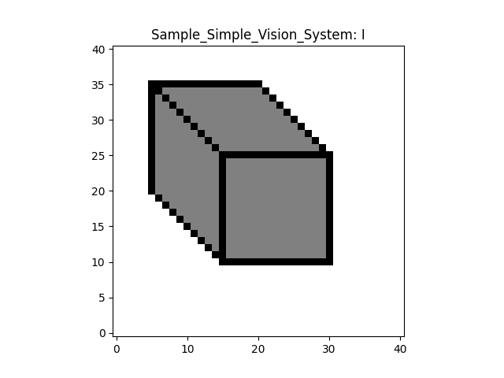
Convention
In this homework, given a map (or a matrix), say I
I[n, m] means the i-th horizontal index (left-right) and j-th vertical index (bottom-up)
n >= 0, m >= 0
m
n

Slide 6
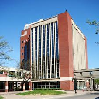
Color images
Please note that a color image I means that the image I is a 3D tensor. The 3rd dimension corresponds to R, G, and B.
In this homework, you will process each channel separately. You can extract each by I[:, :, c], where c is between 0 and 2.

Slide 7
Question 1: Convolution
There are many variants, but in this homework, please follow the formula below.
Given an image I, we will first do zero padding (think about why)
I
I_pad

Slide 8
Question 1: Convolution
Then, we perform
$I_{out}\left[n, m, c\right]= \sum_{k=0}^{K−1}{\sum_{l=0}^{L−1}{I_{pad}[n+k, m+l, c]}}h\left[K−1−k,L−1−l\right]$
K and L are the 2D kernel h’s shape
The range of n and m are [0, N-1] and [0, M-1], respectively, where N and M are the input image I’s shape (not I_pad)
That is, $I_{out}$ will have the same shape as the input image I

Slide 9

Question 1: Convolution
In your implementation, if you can implement $\sum_{k=0}^{K−1}{\sum_{l=0}^{L−1}{[something]}}$ without using a for loop, it will save a lot of computation time in Python

Slide 10
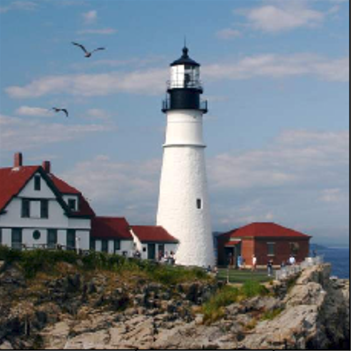
Question 2: Down-sampling
There are many variants, but please follow the formula below.
Given an image I, we will first convolve it with a 2D binomial filter to obtain I_convolved
I and I_convolved have the same size
We will then sub-sample the convolved image I_convolved by a factor of two
If I_convolved is 128 x 128, the subsampled image I_down is 64 x 64 by keeping pixels at “even” Python indices. That is, I_down[n, m, :] = I_convolved[2n, 2m, :]
Convolution
Subsampling

Slide 11
Question 3: Gaussian pyramid
Create a sequence of sub-sampled images
Down-sample
Down-sample
Down-sample

Slide 12
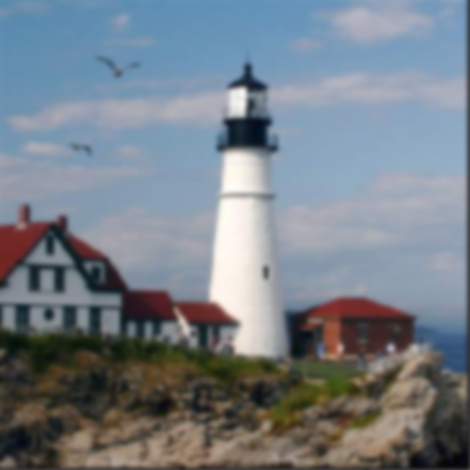
Question 4: Up-sampling
There are many variants, but please follow the formula below.
Given an image I, we will first double its size in each dimension to obtain I_up
If I is 64 x 64, I_up is 128.
I_up[n, m, :] = 4 * I[n/2, m/2, :] when n and m are “even” Python indices
Please make sure you multiply the pixel values by 4
I_up[n, m, :] = 0 when n and m are “odd” Python indices
We will then convolve I_up with a 2D binomial filter to obtain I_convolved
I_up and I_convolved have the same size
Double-size
Convolution

Slide 13
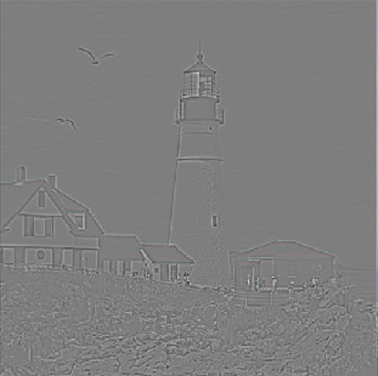
Question 5: Laplacian pyramid
Create a sequence of residual images
-
=
Up-
sample
Down-sample
……

Slide 14

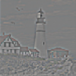

Question 6: Image reconstruction
=
Up-sample
……
+
=
Up-sample
+
Up-sample

