Slide 1
HW4: On Implementation of Object Detectors

Slide 2
Notes
Please make sure you read slide decks 16 – 17
Please make sure you read chapter 50 of the textbook

Slide 3
Outline
Recap of image classifiers
Recap of object detectors
Homework description (programming part)
Homework description (written part)

Slide 4
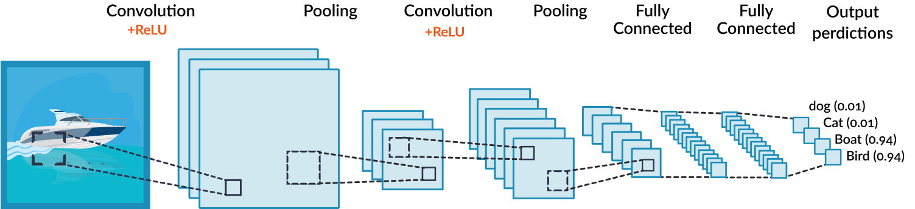
Image classifier: Recap
Given an “object-centric” image, a neural network classifier, like CNN classifiers, outputs the class label OR a probability vector of classes of the image
Inside a CNN classifier, it generates multiple feature maps, which implicitly record spatial information within the image, e.g., where the object is.

Slide 5
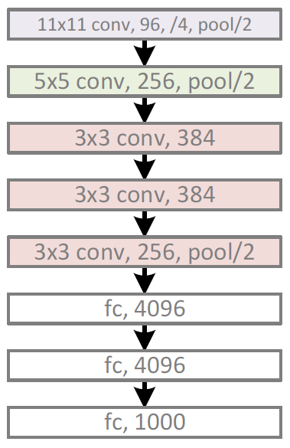
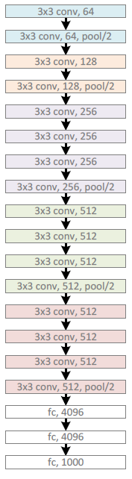
Image classifier: Recap
AlexNet
[Krizhevsky et al., 2012]
VGGnet
[Simonyan et al., 2015]
A block: computation
Edge: nodes/tensors

Slide 6
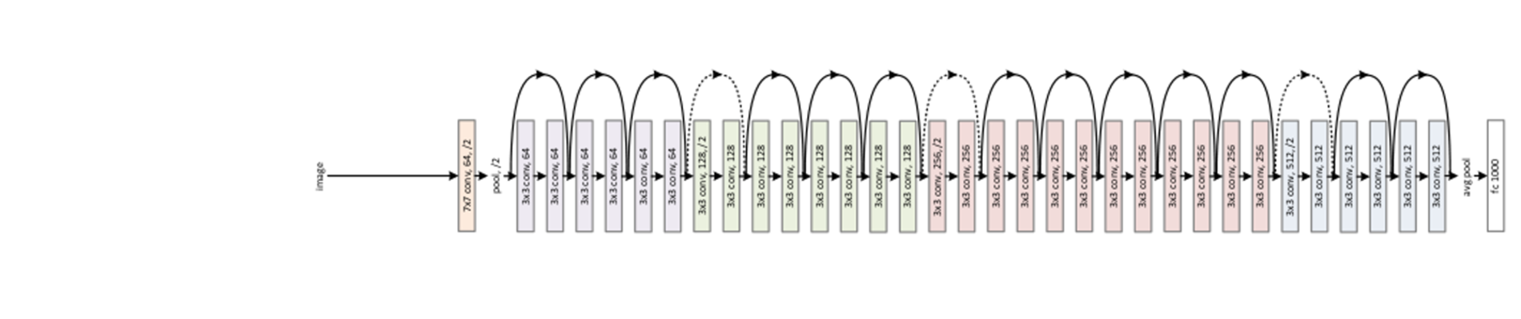
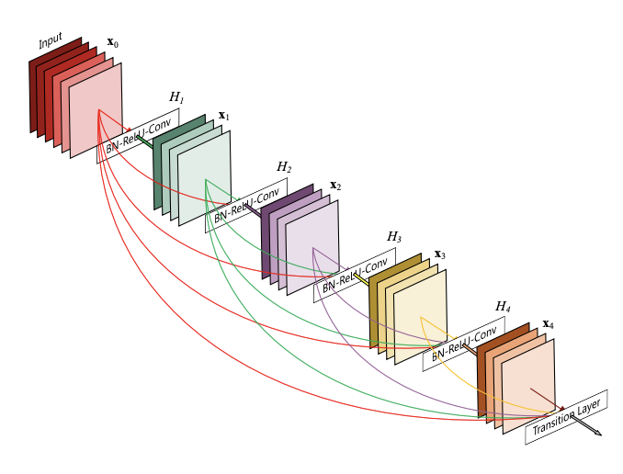
Image classifier: Recap
ResNet
[He et al, 2016]
DenseNet
[Huang et al, 2017]
A block: computation
Edge: nodes/tensors

Slide 7
Outline
Recap of image classifiers
Recap of object detectors
Homework description (coding part)
Homework description (written part)

Slide 8

Object detection: Recap
Given a “scene-centric” image, an object detector outputs a set of bounding boxes, each containing [class label, x-center, y-center, width, height]
The image is 600 (width) x 400 (height)
The output should be like:
[cat, 250, 180, 100, 170]
[dog, 400, 200, 170, 200]
This can be done in two stages:
Create object proposals
Classify/regress each object proposal
100
100
200
y coordinate
170
x coordinate

Slide 9
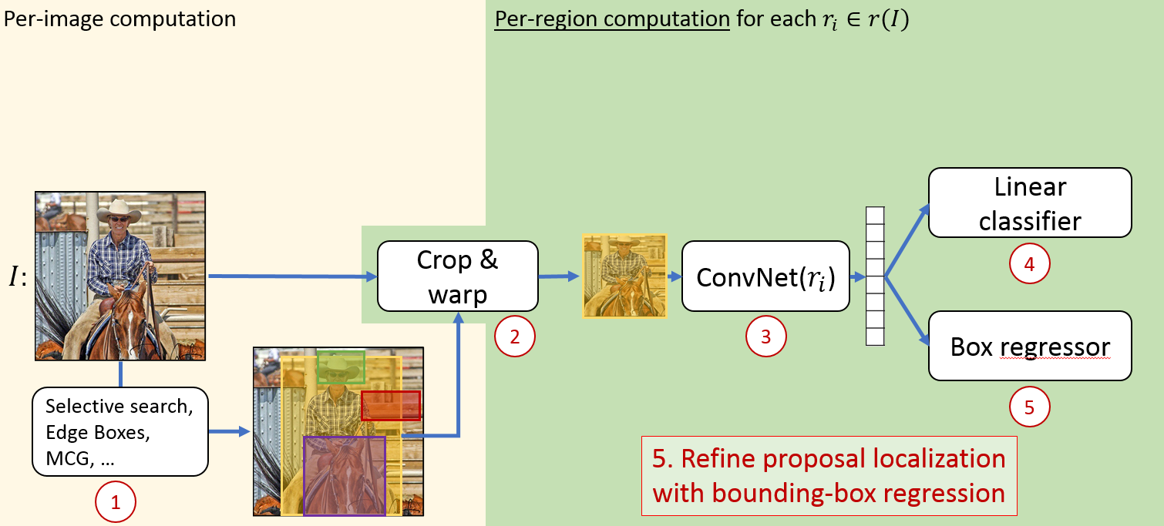
R-CNN
[Girshick et al., Rich feature hierarchies for accurate object detection and semantic segmentation, CVPR 2014]
[Girshick, CVPR 2019 tutorial]

Slide 10
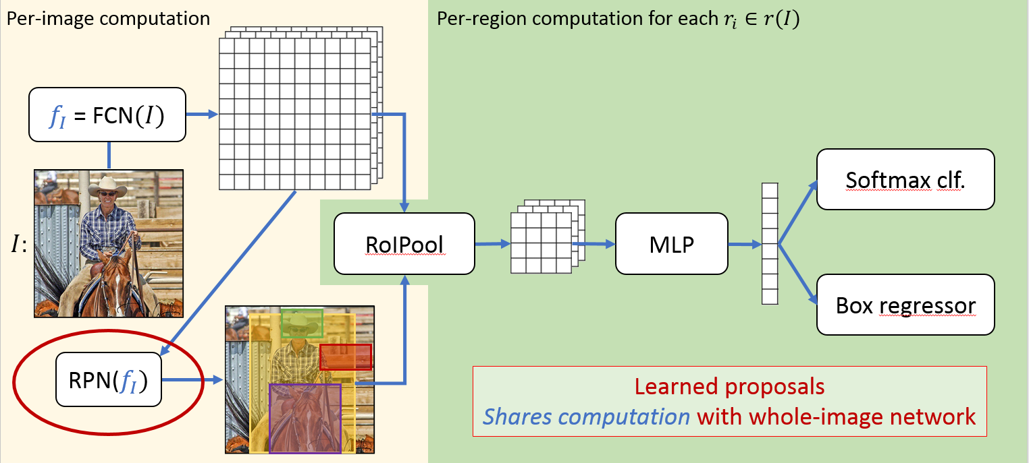
Faster R-CNN
[Ren et al., Faster r-cnn: Towards real-time object detection with region proposal networks, NIPS 2015]
[Girshick, CVPR 2019 tutorial]
ROI pooling

Slide 11
Object detection (object proposals): Recap
The region proposal network (RPN) is proposed in this paper: https://arxiv.org/pdf/1506.01497
The basic idea is to predict the existence of objects and their corresponding locations at each spatial grid (i.e., patch) of the feature map
5
Does each patch belong to an object?
MLP
Fully convolutional
net (FCN)
If yes, what is the size? Where is the center?
5
MLP
d

Slide 12
Object detection (object proposals): Recap
For example, if at each patch location, the model outputs the following vectors
Then we can write code to read this information and further output:
[250, 180, 100, 170]
[400, 200, 170, 200]
[1, 0]
[1, 0]
[250, 180, 100, 170]
[400, 200, 170, 200]
Existence tensor
Location tensor

Slide 13
Object detection (object proposals): Recap
For the neural network (FCN, MLPs) to accurately output the object locations, we must train it using stochastic gradient descent, using ground truth object locations as supervised signals.
The ground truth tensors encode the ideal output tensors
Output
Ground truth
5
MLP
FCN
5
MLP
d

Slide 14
Outline
Recap of image classifiers
Recap of object detectors
Homework description (coding part)
Homework description (written part)

Slide 15
Homework description
You will focus on a simplified region proposal network (RPN).
You are NOT asked to build it and train it.
Instead, you are asked to:
Create the ground truth (GT) tensors, given the ground truth (GT) object locations
Given the output tensors, read them and output a list of object proposal locations
Along with the implementation, you will also experience
Anchors
Non-Maximum Suppression (NMS)

Slide 16
Outline
Recap of image classifiers
Recap of object detectors
Homework description (coding part)
Naïve implementation
Implementation with anchors and offsets
Non-Maximum Suppression (NMS)
Homework description (written part)

Slide 17
Caution!
The image size and patch/grid size in this slide deck are examples. Please follow what is in the code to implement your answer.

Slide 18
Q1: Naïve implementation
In Q1, you are to implement (or experience) the following steps
Image and GT resizing
GT tensors creation
Output tensors by a neural net
Read box locations
GT resizing

Slide 19
Q1: Naïve implementation: resizing
Image and GT resizing
Image and GT resizing
H
GT locations [u-center, v-center, width, height]
[250, 180, 100, 170]
[400, 200, 170, 200]
W
Resized GT locations
Locations should be divided by the original image sizes and then multiplied by the new sizes

Slide 20
Q1: Naïve implementation: encoding
Suppose the resized image is 200-by-200, and the feature map spatial resolution is 5-by-5, each patch is 40-by-40 of the resized image
Now you need to create the following existence tensor with two channels:
0 | 0 | 0 | 0 | 0
0 | 1 | 1 | 1 | 0
0 | 1 | 1 | 1 | 0
0 | 1 | 1 | 1 | 0
0 | 0 | 1 | 1 | 0
1 | 1 | 1 | 1 | 1
1 | 0 | 0 | 0 | 1
1 | 0 | 0 | 0 | 1
1 | 0 | 0 | 0 | 1
1 | 1 | 0 | 0 | 1
GT tensors creation
Resized GT locations
[83.3, 90, 33.3, 85]
[133.3, 100, 56.7, 100]
Existence: Yes
Existence: No
These two matrices sum to 1 at each patch location

Slide 21
Q1: Naïve implementation: encoding
Basically, if a patch overlaps with ANY of the resized GT box, you set the “existence: Yes” to 1; otherwise, 0.
0 | 0 | 0 | 0 | 0
0 | 1 | 1 | 1 | 0
0 | 1 | 1 | 1 | 0
0 | 1 | 1 | 1 | 0
0 | 0 | 1 | 1 | 0
1 | 1 | 1 | 1 | 1
1 | 0 | 0 | 0 | 1
1 | 0 | 0 | 0 | 1
1 | 0 | 0 | 0 | 1
1 | 1 | 0 | 0 | 1
GT tensors creation
Resized GT locations
[83.3, 90, 33.3, 85]
[133.3, 100, 56.7, 100]
Existence: Yes
Existence: No
These two matrices sum to 1 at each patch location

Slide 22
Q1: Naïve implementation: encoding
You also need to create the following location tensor with four channels:
x-center
y-center
0 | 0 | 0 | 0 | 0
0 | 83.3 | ? | 133.3 | 0
0 | 83.3 | ? | 133.3 | 0
0 | 83.3 | ? | 133.3 | 0
0 | 0 | 133.3 | 133.3 | 0
0 | 0 | 0 | 0 | 0
0 | 90 | ? | 100 | 0
0 | 90 | ? | 100 | 0
0 | 90 | ? | 100 | 0
0 | 0 | 100 | 100 | 0
GT tensors creation
0 | 0 | 0 | 0 | 0
0 | 33.3 | ? | 56.7 | 0
0 | 33.3 | ? | 56.7 | 0
0 | 33.3 | ? | 56.7 | 0
0 | 0 | 56.7 | 56.7 | 0
0 | 0 | 0 | 0 | 0
0 | 85 | ? | 100 | 0
0 | 85 | ? | 100 | 0
0 | 85 | ? | 100 | 0
0 | 0 | 100 | 100 | 0
Resized GT locations
[83.3, 90, 33.3, 85]
[133.3, 100, 56.7, 100]
width
height

Slide 23
Q1: Naïve implementation: encoding
If a patch overlaps with one resized GT box, you record the GT box information inside the location tensor
What if a patch overlaps with multiple boxes?
x-center
y-center
0 | 0 | 0 | 0 | 0
0 | 83.3 | ? | 133.3 | 0
0 | 83.3 | ? | 133.3 | 0
0 | 83.3 | ? | 133.3 | 0
0 | 0 | 133.3 | 133.3 | 0
0 | 0 | 0 | 0 | 0
0 | 90 | ? | 100 | 0
0 | 90 | ? | 100 | 0
0 | 90 | ? | 100 | 0
0 | 0 | 100 | 100 | 0
GT tensors creation
0 | 0 | 0 | 0 | 0
0 | 33.3 | ? | 56.7 | 0
0 | 33.3 | ? | 56.7 | 0
0 | 33.3 | ? | 56.7 | 0
0 | 0 | 56.7 | 56.7 | 0
0 | 0 | 0 | 0 | 0
0 | 85 | ? | 100 | 0
0 | 85 | ? | 100 | 0
0 | 85 | ? | 100 | 0
0 | 0 | 100 | 100 | 0
Resized GT locations
[83.3, 90, 33.3, 85]
[133.3, 100, 56.7, 100]
width
height

Slide 24
Q2: Naïve implementation: decoding
Suppose an RPN, after training, can output both the existence and location tensors close to the ideal tensors, then we can read the object locations.
Please note that in the “Existence: Yes” matrix, the outputted value may NOT be exactly 0 or 1, but a value within [0, 1]. We typically call it “confidence.”
For patches whose “Existence: Yes” values > a threshold (e.g., 0.2), we will read out its corresponding location and output a box
Output tensors by a neural net
[0.8, 0.2]
[83.3, 90, 33.3, 85]
Read box locations
[x-center, y-center, width, height, “Existence: Yes” value]
[83.3, 90, 33.3, 85, 0.9]
[83.3, 90, 33.3, 85, 0.8]
…
…
[0.1, 0.9]
[0.9, 0.1]
[83.3, 90, 33.3, 85]

Slide 25
Q2: Naïve implementation: decoding
That is, for the same GT box, we may output multiple boxes with potentially different confidences (i.e., “Existence: Yes” values)
Output tensors by a neural net
[0.8, 0.2]
[83.3, 90, 33.3, 85]
Read box locations
[x-center, y-center, width, height, “Existence: Yes” value]
[83.3, 90, 33.3, 85, 0.9]
[83.3, 90, 33.3, 85, 0.8]
…
…
[0.1, 0.9]
[0.9, 0.1]
[83.3, 90, 33.3, 85]

Slide 26
Outline
Recap of image classifiers
Recap of object detectors
Homework description (coding part)
Naïve implementation
Implementation with anchors and offsets
Non-Maximum Suppression (NMS)
Homework description (written part)

Slide 27
Q3: Advanced implementation
Very much following the same steps in Q1, but you are now to implement (and experience) the use of anchors
Naïve implementation
Advanced implementation
Anchor: 0
Anchor: 1
“Existence: Yes” is 1 if a patch overlaps GT boxes
……

Slide 28
Q3: Advanced implementation
That is, for each anchor, you need to create the corresponding existence and location tensors.
If there are K anchors, you will need to create K corresponding existence and location tensors.
Advanced implementation
Anchor: 0
Anchor: 1
……

Slide 29
Q3: Advanced implementation
An anchor is a specific box shape centered at each patch
For example, if the image is 200-by-200, a patch is 40-by-40
We can then consider different anchors (box shapes) by scaling the patch size
Center at pixel (59, 99)
40 x 40: scale (1, 1)
80 x 40: scale (2, 1)
40 x 40
40 x 80: scale (1, 2)

Slide 30
Q3: Advanced implementation: encoding
If a GT object overlaps a patch (at this step, anchors are not used yet)
We need to choose ONE anchor out of K, and set the corresponding “Existence: Yes” to be 1
Center at pixel (59, 99)
40 x 40: scale (1, 1)
80 x 40: scale (2, 1)
40 x 40
40 x 80: scale (1, 2)

Slide 31
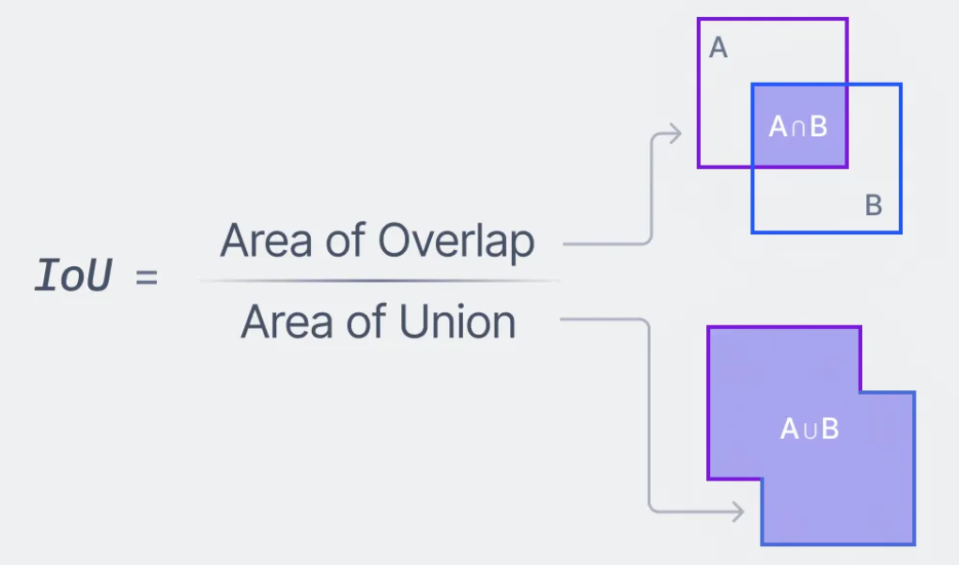
Q3: Advanced implementation: encoding
Choose the anchor with the highest “Intersection over union (IoU)”

Slide 32
Q3: Advanced implementation: encoding
Choose the anchor with the highest “Intersection over union (IoU)”
Center at pixel (59, 99)
40 x 40: scale (1, 1)
80 x 40: scale (2, 1)
40 x 40
Choose this one!
40 x 80: scale (1, 2)

Slide 33
Q3: Advanced implementation: encoding
Choose the anchor with the highest “Intersection over union (IoU)”
Anchor: 0
[0, 1]
[0, 0, 0, 0]
Anchor: 1
[0, 1]
[0, 0, 0, 0]
Anchor: 2
[1, 0]
Next slide

Slide 34
Q3: Advanced implementation: encoding
Encode in the location tensor the “offsets” between the GT box and the chosen anchor
[59, 99, 40, 80]
[83.3, 90, 33.3, 85]
Anchor: 2
[1, 0]
[24.3, -9, -6.7, 5]

Slide 35
Q3: Advanced implementation: encoding
Pseudocode: when there are multiple GT objects
For each GT object:
For each patch:
If the current GT object and the current patch overlap
Choose the anchor that has the highest IoU with the current GT object
If the chosen anchor has not been used by other GT objects OR
If the current object has a larger IoU with the chosen anchor vs. other GT objects:
Record the existence and location offset based on the current GT object

Slide 36

Q3: Advanced implementation: encoding
That is, be careful about patches that overlap multiple GT objects
At a patch, multiple anchors can be chosen (by multiple GT objects). However, one GT box can only choose one anchor at a patch.

Slide 37
Q4: Advanced implementation: decoding
Suppose an RPN, after training, can output both the existence and location offset tensors close to the ideal tensors (with anchors), then we can read the object locations.
For each anchor shape:
If a patch location has “Existence: Yes” values > a threshold (e.g., 0.2), we will read out its corresponding location (anchor location + offset) and output a box
[24.3, -49, -6.7, 5]
[24.3, -9, -6.7, 5]
[0.8, 0.2]
Read box locations
[x-center, y-center, width, height, “Existence: Yes” value]
[24.3 + 59, -9 + 99, -6.7 + 40, 5 + 80, 0.9]
[24.3 + 59, -49 + 139, -6.7 + 40, 5 + 80, 0.8]
…
…
[0.1, 0.9]
[0.9, 0.1]

Slide 38
Q4: Advanced implementation: decoding
That is, for the same GT box, we may output multiple boxes with potentially different confidences (i.e., “Existence: Yes” values)
[24.3, -49, -6.7, 5]
[24.3, -9, -6.7, 5]
[0.8, 0.2]
Read box locations
[x-center, y-center, width, height, “Existence: Yes” value]
[24.3 + 59, -9 + 99, -6.7 + 40, 5 + 80, 0.9]
[24.3 + 59, -49 + 139, -6.7 + 40, 5 + 80, 0.8]
…
…
[0.1, 0.9]
[0.9, 0.1]

Slide 39
Q4: Advanced implementation: decoding
Pseudocode:
For each anchor:
For each patch:
If the “Existence: Yes” value > a threshold:
Read out the box location (anchor location + offset) and confidence

Slide 40
Outline
Recap of image classifiers
Recap of object detectors
Homework description (coding part)
Naïve implementation
Implementation with anchors and offsets
Non-Maximum Suppression (NMS)
Homework description (written part)

Slide 41
Q5: Non-Maximum Suppression (NMS)
The decoding rule may output multiple boxes for a single GT object
We need to implement NMS to subsample them
Please note that, at this stage, you do not know where GT objects are
NMS

Slide 42
Q5: Non-Maximum Suppression (NMS): Pseudocode
Sort all the outputted boxes based on the “confidences,” from high to low
Define an empty set “S” to record the subsampled boxes
For each outputted box (from confidence high to low):
If the current box has IoU with every box in “S” smaller than a threshold:
Add the current box into the set “S”
Reference: https://builtin.com/machine-learning/non-maximum-suppression

Slide 43
Outline
Recap of image classifiers
Recap of object detectors
Homework description (coding part)
Homework description (written part)

Slide 44
Written Part: Q6
Q6.1: Please briefly describe your strategy when a patch overlaps with multiple GT boxes (no more than 30 words) in Programming question Q1. That is, while in the programming question Q1, we ask you to choose a random GT box, do you have any other idea?

Slide 45
Written Part: Q6
Q6.2: Given a 224-by-224 RGB image, what is the feature map size (e.g., 5 x 5 x 256) before the final fully connected layer (or final MLP) of the following classifiers? You may search for your answers online.
ResNet-50: https://arxiv.org/pdf/1512.03385
VGG-19: https://arxiv.org/pdf/1409.1556
ViT-B/32: https://arxiv.org/pdf/2010.11929
Specifically, for ViT-style models, your answer should be # horizontal patches x # vertical patches x # channels or token dimensions

