Slide 1
HW1

Slide 2
Preparation
Please make sure you have read Lectures 2 & 3 slides
Please make sure you have read the Textbook chapter 2
Please make sure you check page 20 of this PPT.
The notations in this slide deck are a bit different from the lecture slides! The goal is to make implementation easier.

Slide 3
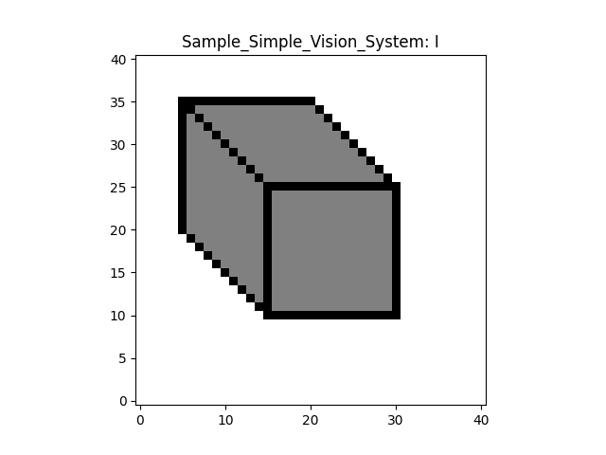
Problem overview
Given

Slide 4
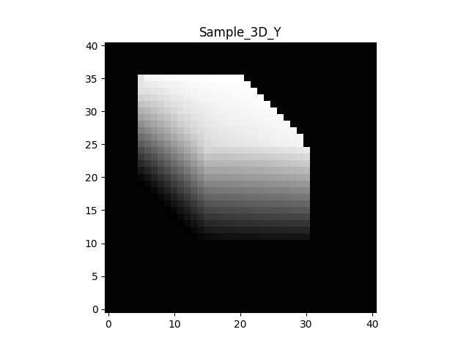
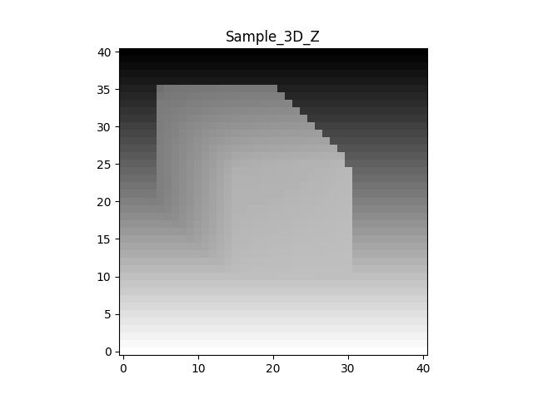
Problem overview
Given
Goal: Generate
Y: 3D height
Z: 3D depth

Slide 5
Convention
In this homework, given a map (or a matrix), say I
I[i, j] means the i-th horizontal index (left-right) and j-th vertical index (bottom-up)
i >= 0, j >= 0
j
i

Slide 6
Convention
There are differences in coordinate systems between (i, j) and (x, y)
We thus provide a function x, y = image_plane(args, I)
x[i, j] is the 2D x location of pixel (i, j)
y[i, j] is the 2D y location of pixel (i, j)
y
j
x
i

Slide 7
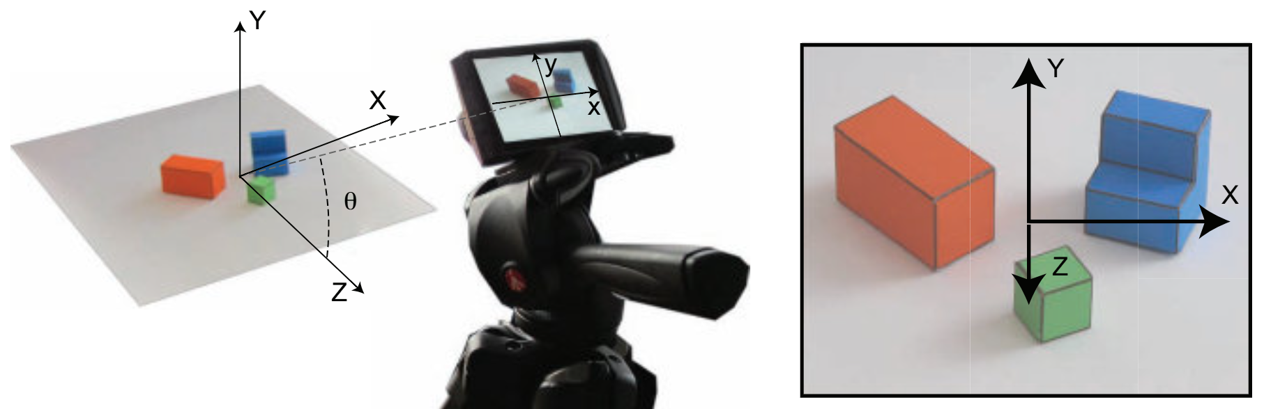
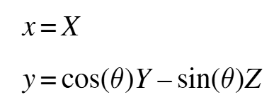
Recall (from lectures)
We want to know X(x, y), Y(x, y), and Z(x, y) from the given image!
What we know:
We need some cues from images and the 3D world!
[Figure credit: A. Torralba, P. Isola, and W. T. Freeman, Foundations of Computer Vision.]

Slide 8
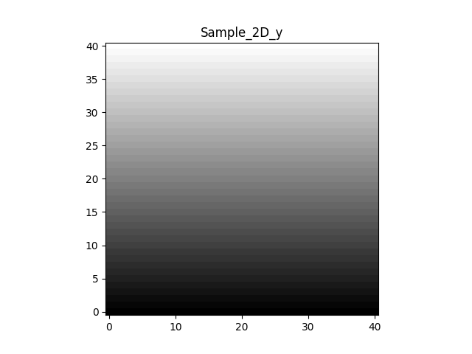


For implementation, locations are indexed by [I, j]
y: 2D vertical
Y: 3D height
Z: 3D depth
(i, j)
$$y=\cos\left(θ\right)Y−\sin\left(θ\right)Z$$
$$y\left[i,j\right]=\cos\left(θ\right)Y\left[i,j\right]−\sin\left(θ\right)Z\left[i,j\right]$$

Slide 9
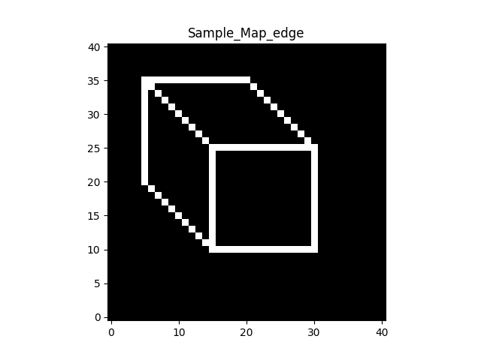
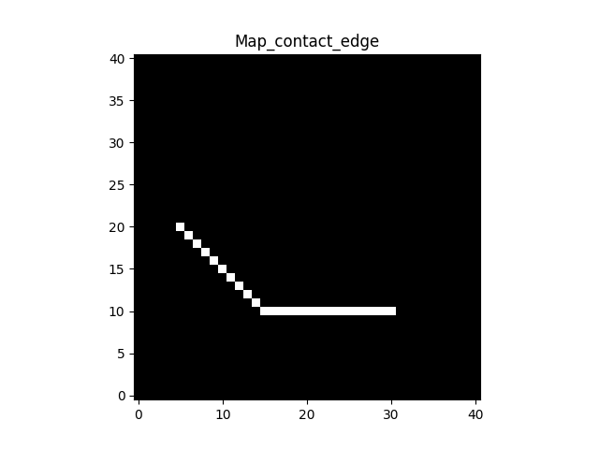
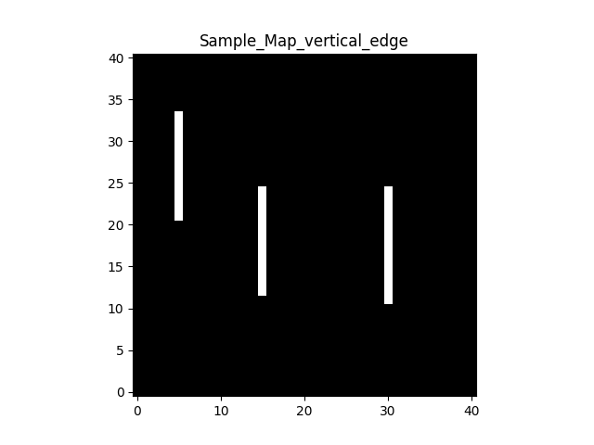
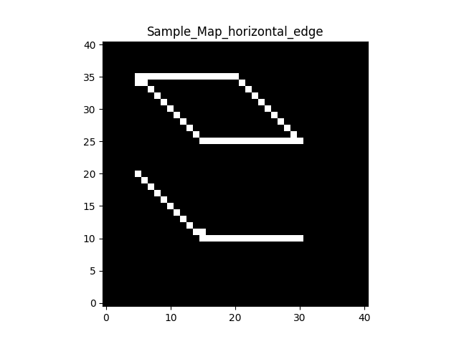
Cue 1: edges (white pixels mean edges)
All edges
Contact edges
Vertical edges
Horizontal
You need to find edge locations!

Slide 10
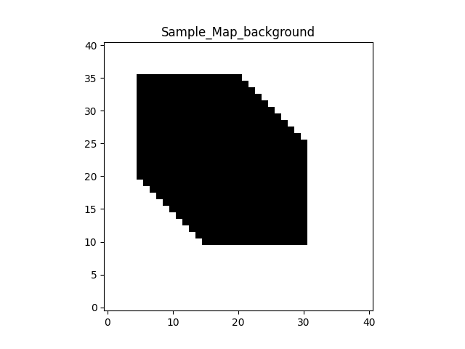
Cue 2: Surfaces & Cue 3: properties from 3D to 2D
Separate into foregrounds (figures)/backgrounds
Not always true, but let’s assume it is true
Vertical edges in 2D mean vertical in 3D
Non-vertical edges in 2D means horizontal in 3D

Slide 11
Recall (from lectures)
We want to know X(x, y), Y(x, y), and Z(x, y) from the given image!
If we know Y(x, y), we know Z(x, y)
[Figure credit: A. Torralba, P. Isola, and W. T. Freeman, Foundations of Computer Vision.]

Slide 12
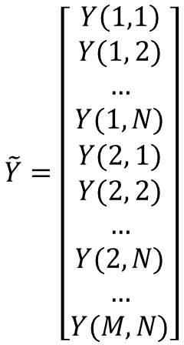
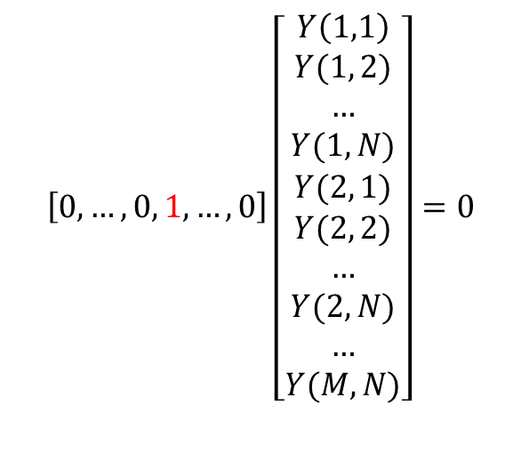
Estimating Y[I, j]: cues from the background
$$\tilde{Y}=\left[\begin{aligned}Y\left(1,1\right) \\ Y(1, 2) \\ … \\ Y(1,N) \\ Y(2, 1) \\ Y(2, 2) \\ … \\ Y(2, N) \\ … \\ Y(M, N)\end{aligned}\right]$$
$$\left[0, …, 0, 1,…, 0\right]\left[\begin{aligned}Y\left(1,1\right) \\ Y(1, 2) \\ … \\ Y(1,N) \\ Y(2, 1) \\ Y(2, 2) \\ … \\ Y(2, N) \\ … \\ Y(M, N)\end{aligned}\right]=0$$
One row for each background pixel
Meaning: these locations have height 0

Slide 13
Estimating Y[I, j]: cues from contact edges
$$\tilde{Y}=\left[\begin{aligned}Y\left(1,1\right) \\ Y(1, 2) \\ … \\ Y(1,N) \\ Y(2, 1) \\ Y(2, 2) \\ … \\ Y(2, N) \\ … \\ Y(M, N)\end{aligned}\right]$$
$$\left[0, …, 0, 1,…, 0\right]\left[\begin{aligned}Y\left(1,1\right) \\ Y(1, 2) \\ … \\ Y(1,N) \\ Y(2, 1) \\ Y(2, 2) \\ … \\ Y(2, N) \\ … \\ Y(M, N)\end{aligned}\right]=0$$
One row for each contact edge pixel
Meaning: these locations have height 0

Slide 14
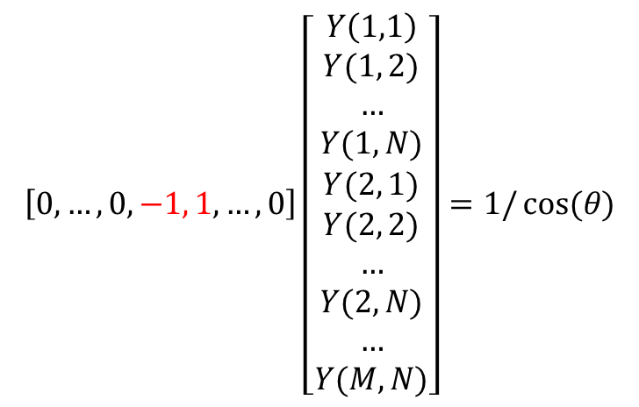
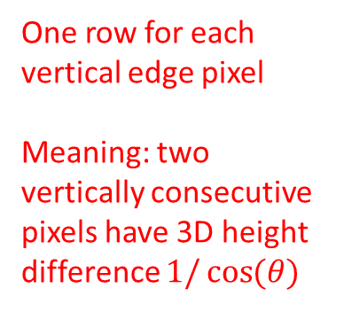

Estimating Y[I, j]: cues from vertical edges
$$\left[0, …, 0, −1, 1, …, 0\right]\left[\begin{aligned}Y\left(1,1\right) \\ Y(1, 2) \\ … \\ Y(1,N) \\ Y(2, 1) \\ Y(2, 2) \\ … \\ Y(2, N) \\ … \\ Y(M, N)\end{aligned}\right]=1/\cos{(θ)}$$
One row for each vertical edge pixel
Meaning: two vertically consecutive pixels have 3D height difference $1/\cos{(θ)}$
$$Y\left[i,j\right]−Y\left[i,j−1\right]=1/\cos{(θ)}$$

Slide 15
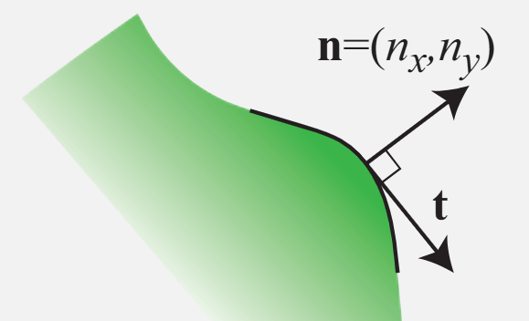
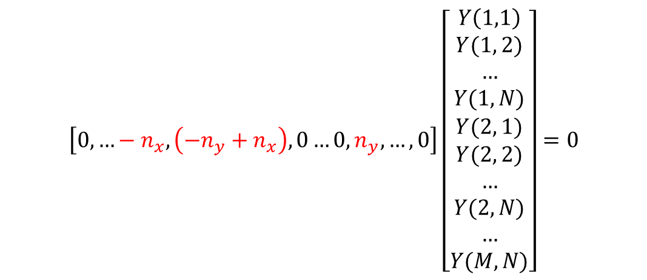
Estimating Y[I, j]: cues from horizontal edges
Horizontal edges: Y won’t change along the edge
$$\left[0,…−n_{x}, \left(−n_{y}+n_{x}\right), 0…0,n_{y}, …, 0\right]\left[\begin{aligned}Y\left(1,1\right) \\ Y(1, 2) \\ … \\ Y(1,N) \\ Y(2, 1) \\ Y(2, 2) \\ … \\ Y(2, N) \\ … \\ Y(M, N)\end{aligned}\right]=0$$
$${{−n}_{y}\left[i, j\right]\left(Y\left[i,j\right]−Y\left[i−1,j\right]\right)+n}_{x}\left[i, j\right](Y\left[i,j\right]−Y\left[i,j−1\right])=0$$
In the code, we have computed $n_{y}$ and $n_{x}$ for you!
One row for each horizontal edge pixel

Slide 16
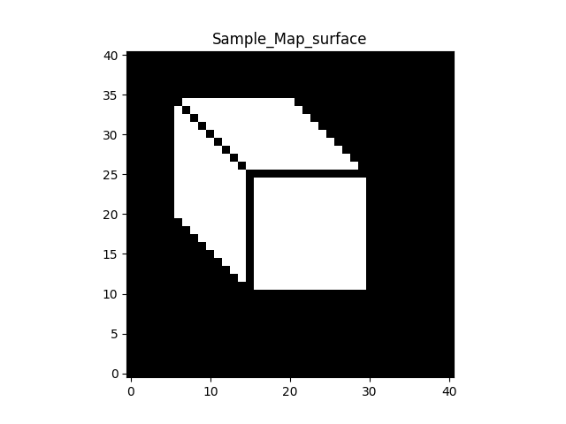
Estimating Y[I, j]: cues from surfaces
Three rows for each surface pixel
$$\left[0,…,−1, 0…,2,0, …−1, 0, …\right]\tilde{Y}=0$$
Surfaces: flat, not curved
$$\left[0,…,−1, 0…,2,0, …−1, 0, …\right]\tilde{Y}=0$$
$$2Y\left[i,j\right]−Y\left[i+1,j\right]−Y\left[i−1,j\right]= 0$$
$$\left[0,…,−1, 0…,1, …0,…1, 0, …−1, 0, …\right]\tilde{Y}=0$$
$$2Y\left[i,j\right]−Y\left[i,j+1\right]−Y\left[i,j−1\right]= 0$$
$$Y\left[i,j\right]−Y\left[i,j−1\right]−Y\left[i−1,j\right]+Y\left[i−1,j−1\right]= 0$$

Slide 17


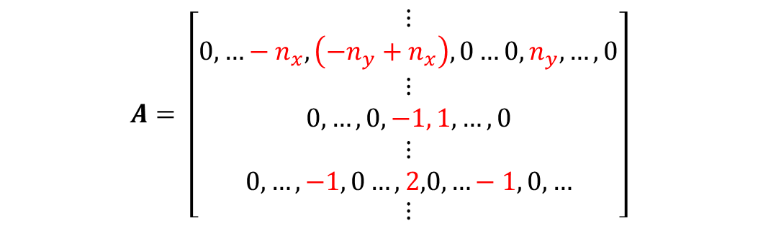


Put all the constraints together
$$A= \left[\begin{aligned}\begin{aligned}⋮ \\ 0,…−n_{x}, \left(−n_{y}+n_{x}\right), 0…0,n_{y}, …, 0 \\ ⋮ \\ 0, …, 0, −1, 1, …, 0 \\ ⋮ \\ 0,…,−1, 0…,2,0, …−1, 0, …\end{aligned} \\ ⋮\end{aligned}\right]$$
$$\left[\begin{aligned}\begin{matrix}− & a_{1} & −\end{matrix} \\ \begin{matrix}− & a_{2} & −\end{matrix} \\ …\end{aligned}\right]\tilde{Y}=b$$
For example,
$$b= \left[\begin{aligned}\begin{aligned}⋮ \\ 0 \\ ⋮ \\ 1/\cos{(θ)} \\ ⋮ \\ 0\end{aligned} \\ ⋮\end{aligned}\right]$$
$$A\tilde{Y}=b$$
Least square solution!
$\tilde{Y}={\left(A^{T}A\right)}^{−1} A^{T}$ $b$
A is like 2300-by-1681

Slide 18
Estimating Z from Y and y
$$y\left[i,j\right]=\cos\left(θ\right)Y\left[i,j\right]−\sin\left(θ\right)Z\left[i,j\right]$$

Slide 19
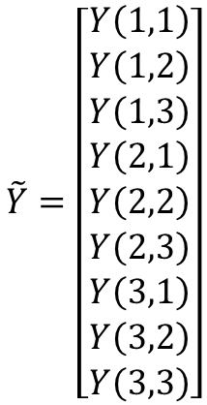
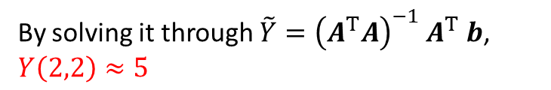
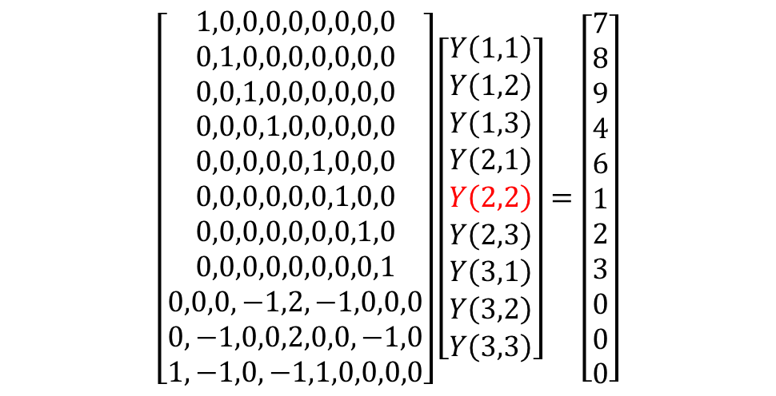
Why linear system? Try this toy example
$$\left[\begin{aligned}1,0,0,0,0,0,0,0,0 \\ 0,1,0,0,0,0,0,0,0 \\ 0,0,1,0,0,0,0,0,0 \\ 0,0,0,1,0,0,0,0,0 \\ 0,0,0,0,0,1,0,0,0 \\ 0,0,0,0,0,0,1,0,0 \\ 0,0,0,0,0,0,0,1,0 \\ 0,0,0,0,0,0,0,0,1 \\ 0,0,0,−1,2,−1,0,0,0 \\ 0,−1,0,0,2,0,0,−1,0 \\ 1,−1,0,−1,1,0,0,0,0\end{aligned}\right]\left[\begin{aligned}Y\left(1,1\right) \\ Y\left(1,2\right) \\ Y\left(1,3\right) \\ Y\left(2,1\right) \\ Y\left(2,2\right) \\ Y\left(2,3\right) \\ Y\left(3,1\right) \\ Y\left(3,2\right) \\ Y\left(3,3\right)\end{aligned}\right]=\left[\begin{aligned}7 \\ 8 \\ 9 \\ 4 \\ 6 \\ 1 \\ 2 \\ 3 \\ 0 \\ 0 \\ 0\end{aligned}\right]$$
1
2
3
j
4
?
6
7
8
9
i
$$\tilde{Y}=\left[\begin{aligned}Y\left(1,1\right) \\ Y\left(1,2\right) \\ Y\left(1,3\right) \\ Y\left(2,1\right) \\ Y\left(2,2\right) \\ Y\left(2,3\right) \\ Y\left(3,1\right) \\ Y\left(3,2\right) \\ Y\left(3,3\right)\end{aligned}\right]$$
By solving it through $\tilde{Y}={\left(A^{T}A\right)}^{−1} A^{T}$ $b$, $Y\left(2,2\right)≈5$

Slide 20
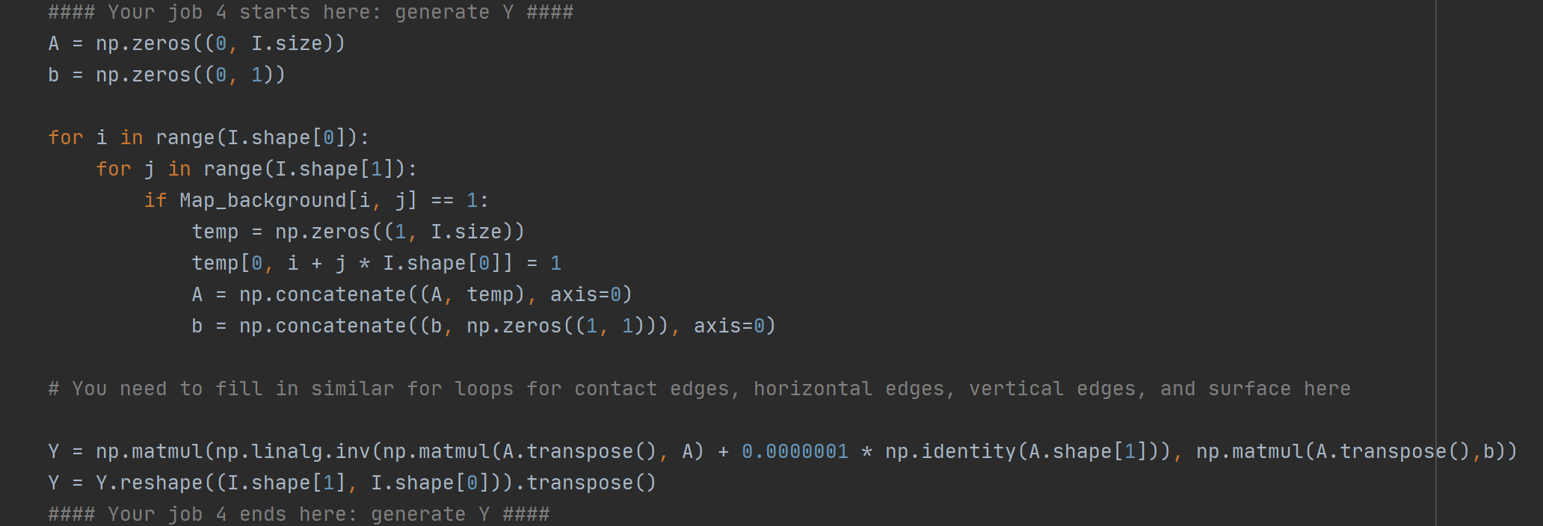
Additional hints on Part 4
See an example implementation for including rows corresponding to the background pixels below. I've also implemented the least square solution at the end. What you need to do is to fill in similar for loops for the vertical, horizontal, and contact edges, as well as the surface pixels.

