Slide 1
HW2

Slide 2
Preparation
Please make sure you have read Lectures 10 & 13 slides, in particular Lecture 13
Please make sure you have read Textbook chapters 15 – 18, at least those covered by lectures.
The notations in this slide deck may be a bit different from the lecture slides! The goal is to make implementation easier.

Slide 3
Caution
Please do not import packages (like scikit learn) that are not listed in the provided code.
In this homework, you are not allowed to use numPy or other Python libraries' built-in convolution, DFT, IDFT, and filter functions. If you use them, you will get 0 points for the entire homework.

Slide 4
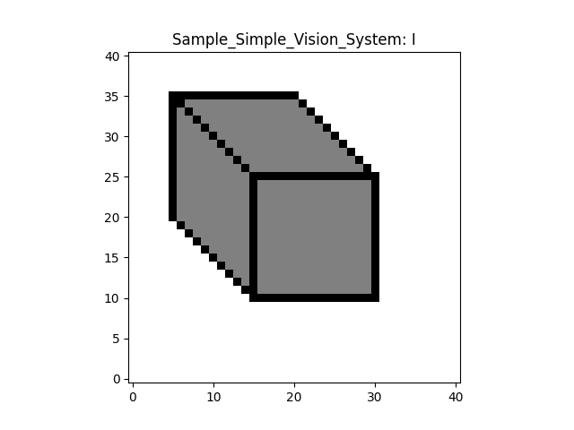
Convention
In this homework, given a map (or a matrix), say I
I[n, m] means the i-th horizontal index (left-right) and j-th vertical index (bottom-up)
n >= 0, m >= 0
m
n

Slide 5
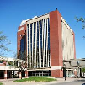
Color images
Please note that a color image I means that the image I is a 3D tensor. The 3rd dimension corresponds to R, G, and B.
In this homework, you will process each channel separately. You can extract each by I[:, :, c], where c is between 0 and 2.

Slide 6
Question 1: Convolution
There are many variants, but in this homework, please follow the formula below.
Given an image I, we will first do zero padding (think about why)
I
I_pad

Slide 7
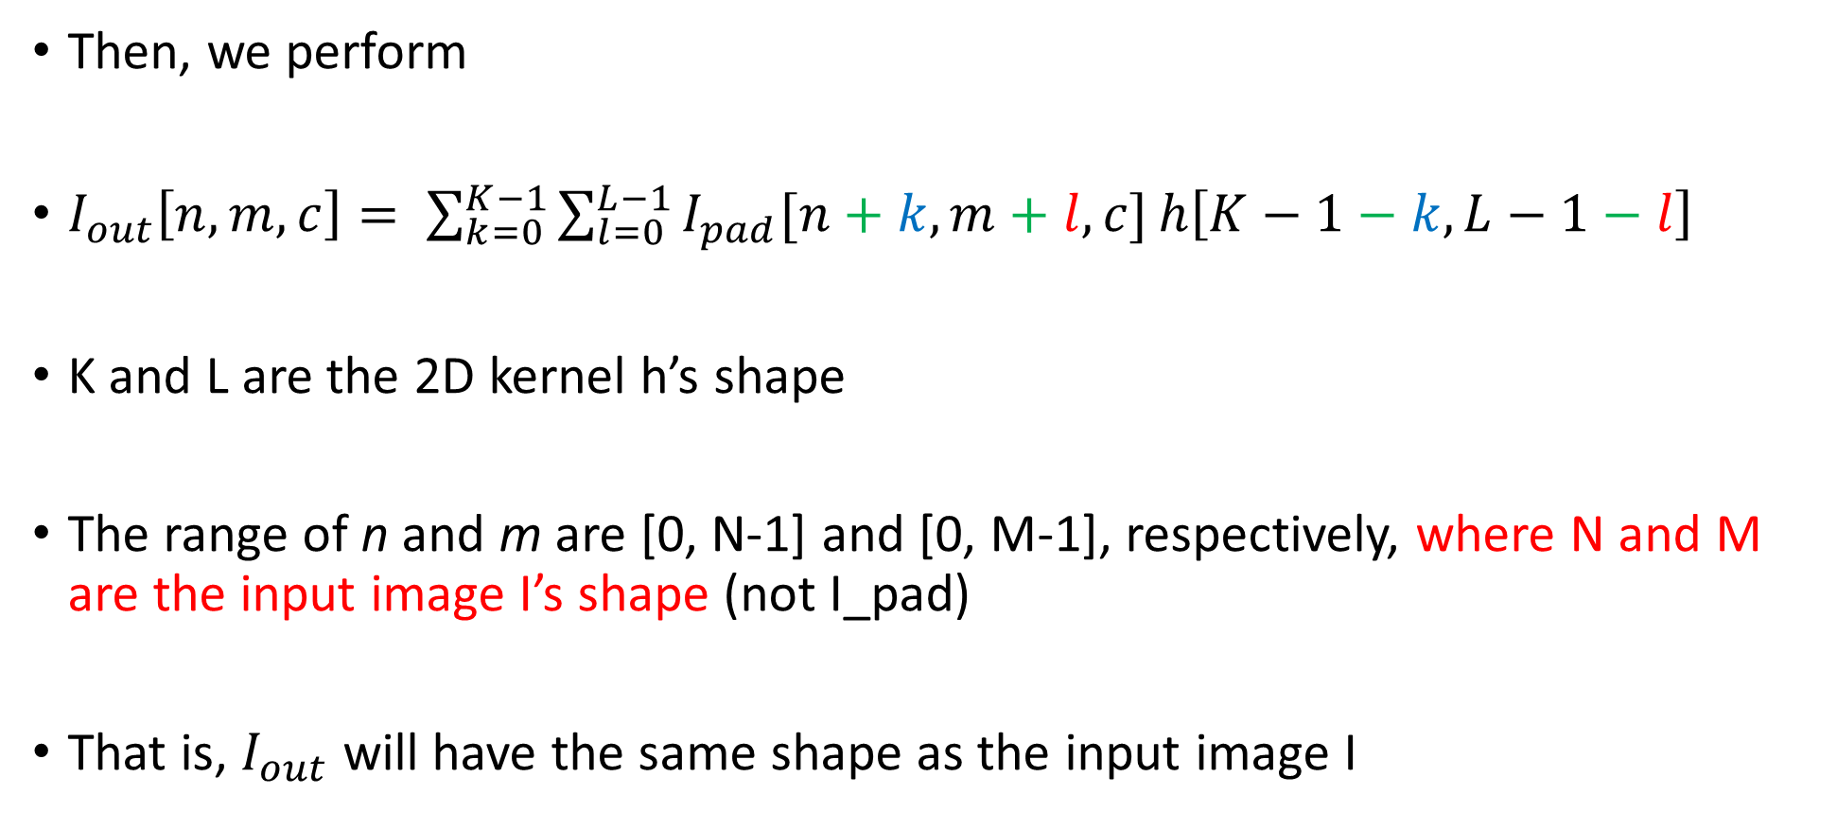
Question 1: Convolution
Then, we perform
$I_{out}\left[n, m, c\right]= \sum_{k=0}^{K−1}{\sum_{l=0}^{L−1}{I_{pad}[n+k, m+l, c]}}h\left[K−1−k,L−1−l\right]$
K and L are the 2D kernel h’s shape
The range of n and m are [0, N-1] and [0, M-1], respectively, where N and M are the input image I’s shape (not I_pad)
That is, $I_{out}$ will have the same shape as the input image I

Slide 8

Question 1: Convolution
In your implementation, if you can implement $\sum_{k=0}^{K−1}{\sum_{l=0}^{L−1}{}}$ without using a for loop, it will save a lot of computation time in Python

Slide 9
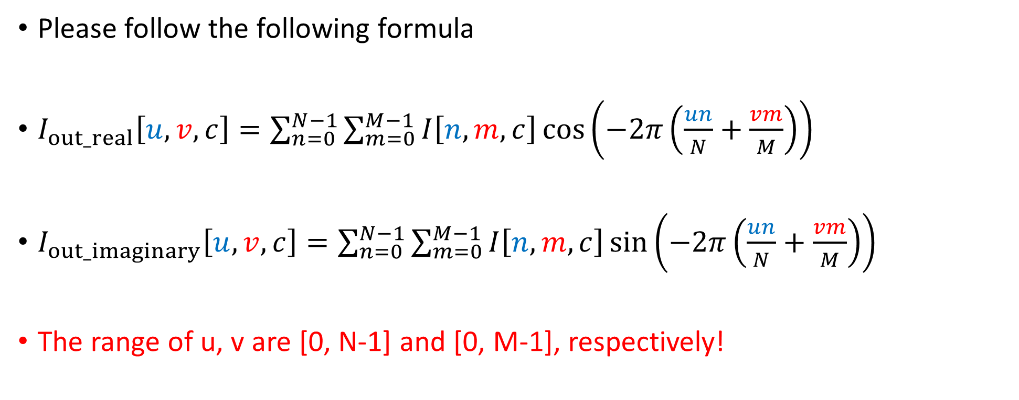
Question 2: DFT
Please follow the following formula
$I_{out_real}\left[u,v, c\right]=\sum_{n=0}^{N−1}{\sum_{m=0}^{M−1}{I\left[n,m, c\right]\cos\left(−2π\left(\frac{un}{N}+\frac{vm}{M}\right)\right)}}$
$I_{out_imaginary}\left[u,v, c\right]=\sum_{n=0}^{N−1}{\sum_{m=0}^{M−1}{I\left[n,m, c\right]\sin\left(−2π\left(\frac{un}{N}+\frac{vm}{M}\right)\right)}}$
The range of u, v are [0, N-1] and [0, M-1], respectively!

Slide 10
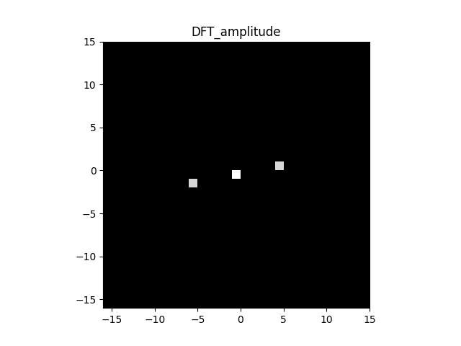

Question 2: DFT
When visualization, we have implemented a function to change the range to be surrounding (0, 0).
However, whenever you access $I_{out_real}$, $I_{out_imaginary}$, $I_{out_amplitude}$, $I_{out_phase}$, which are of shape N x M x 3, $\left[u,v, c\right]$ means horizontal frequency u and vertical frequency v

Slide 11

Question 2: DFT
In your implementation, if you can implement $\sum_{n=0}^{N−1}{\sum_{m=0}^{M−1}{}}$ without using a for loop, it will save a lot of computation time in Python

Slide 12
Questions 3 – 7
Please follow the homework instructions in GitHub

Slide 13
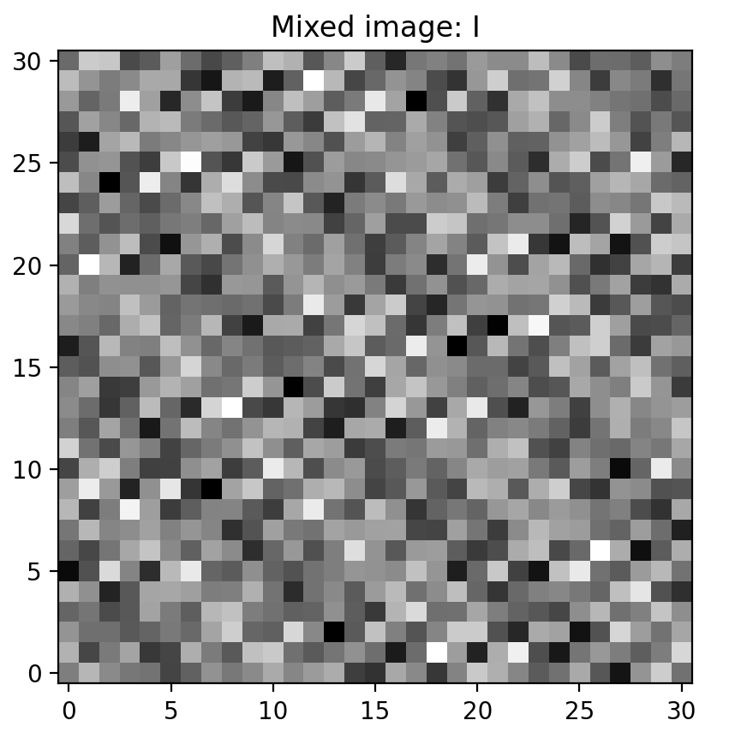
Question 8: Recovering the target image
Target image and the mixed image with other frequency components

Slide 14
Question 8: Recovering the target image
Your goal is to recover the target image, given the mixed image and target image’s frequencies

