Slide 1
HW4

Slide 2
Preparation
Please read Chapter 23 about the Gaussian pyramid and Laplacian pyramid
The Gaussian pyramid down-samples an image sequentially
The Laplacian pyramid records “information loss” during down-sampling
By combining them, we can reconstruct the image of the original size

Slide 3
Caution
Please do not import packages (like scikit learn) that are not listed in the provided code.
In this homework, you are NOT allowed to use NumPy’s or other Python libraries’ built-in convolution, filter functions, down-sampling, up-sampling, Gaussian pyramid, and Laplacian pyramid functions. If you use them, you will get 0 points for the entire assignment.
This homework uses the same Convolution function and kernel function you saw in HW 2 (but you don’t need to re-implement them again).

Slide 4
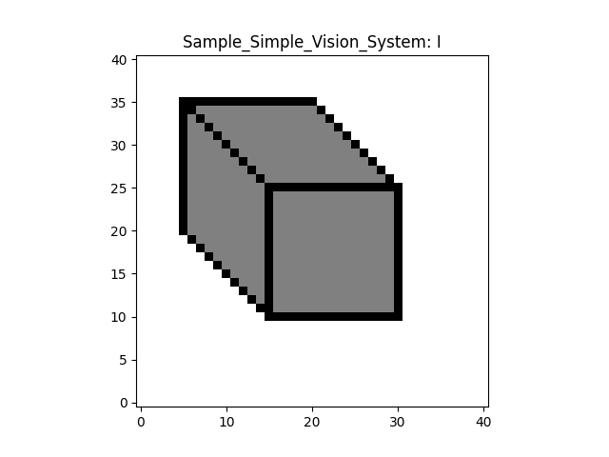
Convention
In this homework, given a map (or a matrix), say I
I[n, m] means the i-th horizontal index (left-right) and j-th vertical index (bottom-up)
n >= 0, m >= 0
m
n

Slide 5
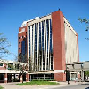
Color images
Please note that a color image I means that the image I is a 3D tensor. The 3rd dimension corresponds to R, G, and B.
In this homework, you will process each channel separately. You can extract each by I[:, :, c], where c is between 0 and 2.

Slide 6
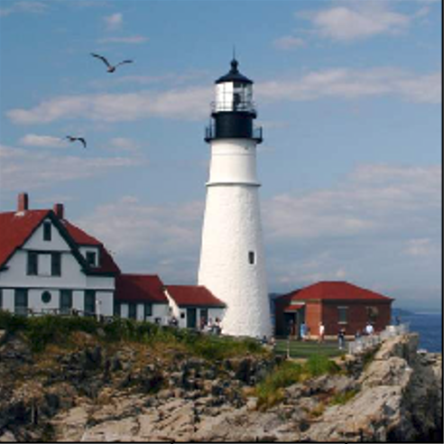
Question 1: Down-sampling
There are many variants, but please follow the formula below.
Given an image I, we will first convolve it with a 2D binomial filter to obtain I_convolved
I and I_convolved have the same size
We will then sub-sample the convolved image I_convolved by a factor of two
If I_convolved is 128 x 128, the subsampled image I_down is 64 x 64 by keeping pixels at “even” Python indices. That is, I_down[n, m, :] = I_convolved[2n, 2m, :]
Convolution
Subsampling

Slide 7
Question 2: Gaussian pyramid
Create a sequence of sub-sampled images
Down-sample
Down-sample
Down-sample

Slide 8
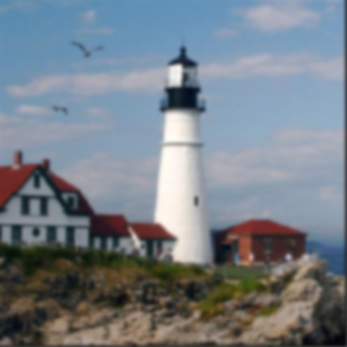
Question 3: Up-sampling
There are many variants, but please follow the formula below.
Given an image I, we will first double its size in each dimension to obtain I_up
If I is 64 x 64, I_up is 128.
I_up[n, m, :] = 4 * I[n/2, m/2, :] when n and m are “even” Python indices
Please make sure you multiply the pixel values by 4
I_up[n, m, :] = 0 when n and m are “odd” Python indices
We will then convolve I_up with a 2D binomial filter to obtain I_convolved
I_up and I_convolved have the same size
Double-size
Convolution

Slide 9
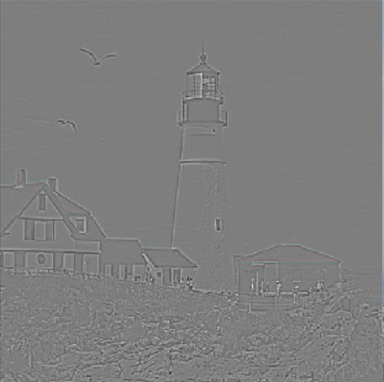
Question 4: Laplacian pyramid
Create a sequence of residual images
-
=
Up-
sample
Down-sample
……

Slide 10



Question 5: Image reconstruction
=
Up-sample
……
+
=
Up-sample
+
Up-sample

