Slide 1
Springboard data science capstone project
James Hamilton – March 2016

Slide 2
The Question
Local software company CEI would like an analysis of their invoice data.
Generalized insights
Are any customers over purchasing licenses
What are the relative sizes of the market segments

Slide 3
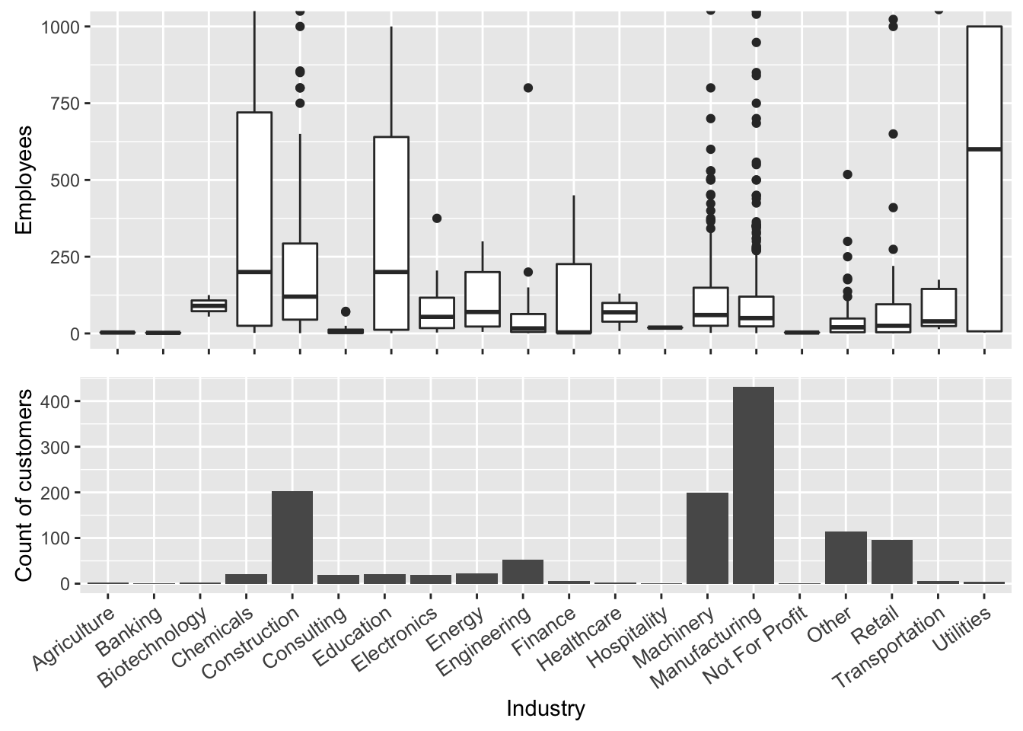
Account data
Relative sizes of market segments and customers within those markets

Slide 4
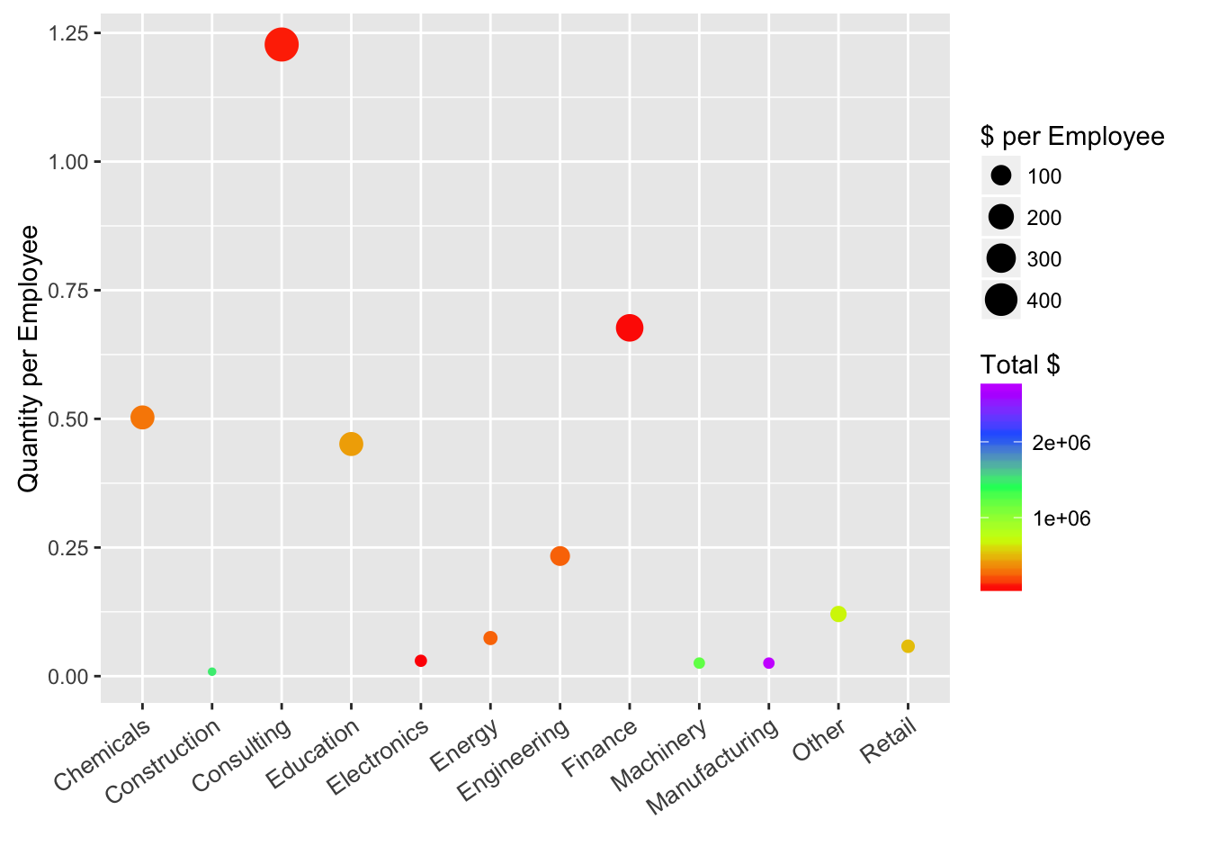
Order Data
Order Quantity per Employee by Industry

Slide 5
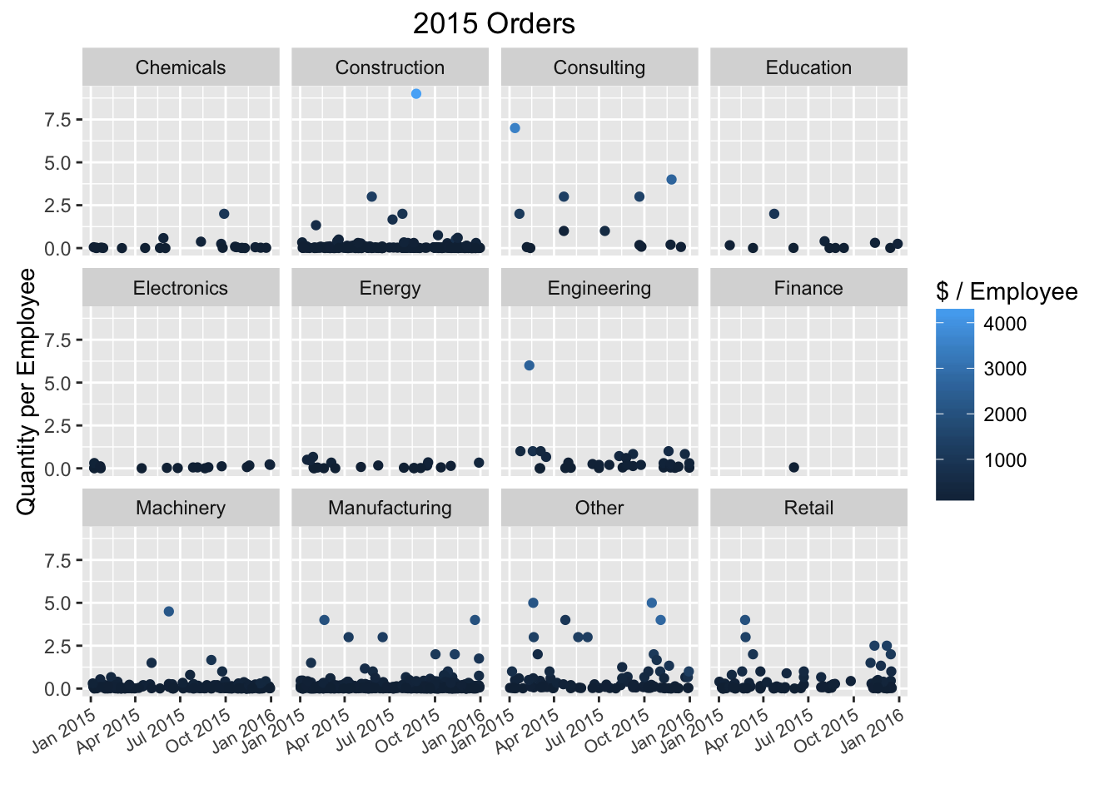
Order data
2015 Order quantity per Employee split across Industry

Slide 6
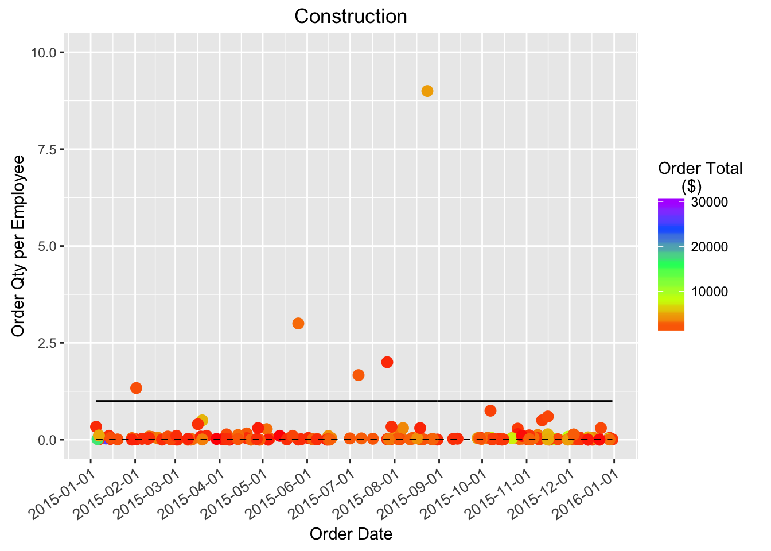
Order data
Industry focus - Construction

Slide 7
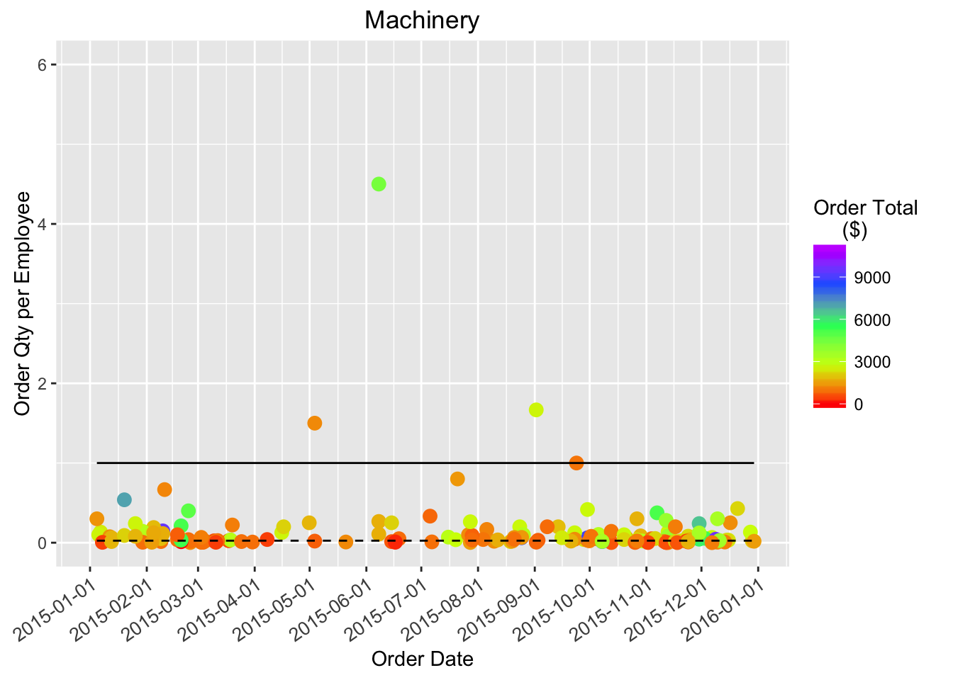
Order data
Industry Focus - Machinery

Slide 8
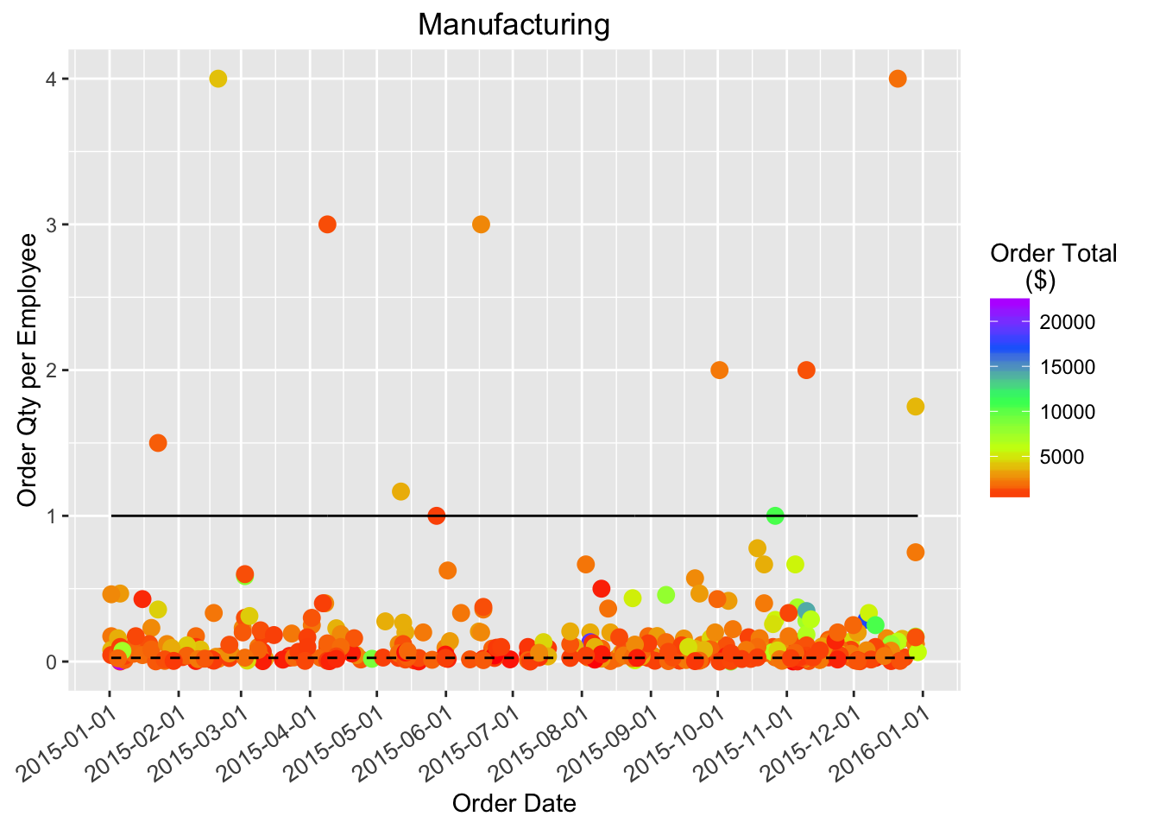
Order data
Industry Focus - Manufacturing

Slide 9
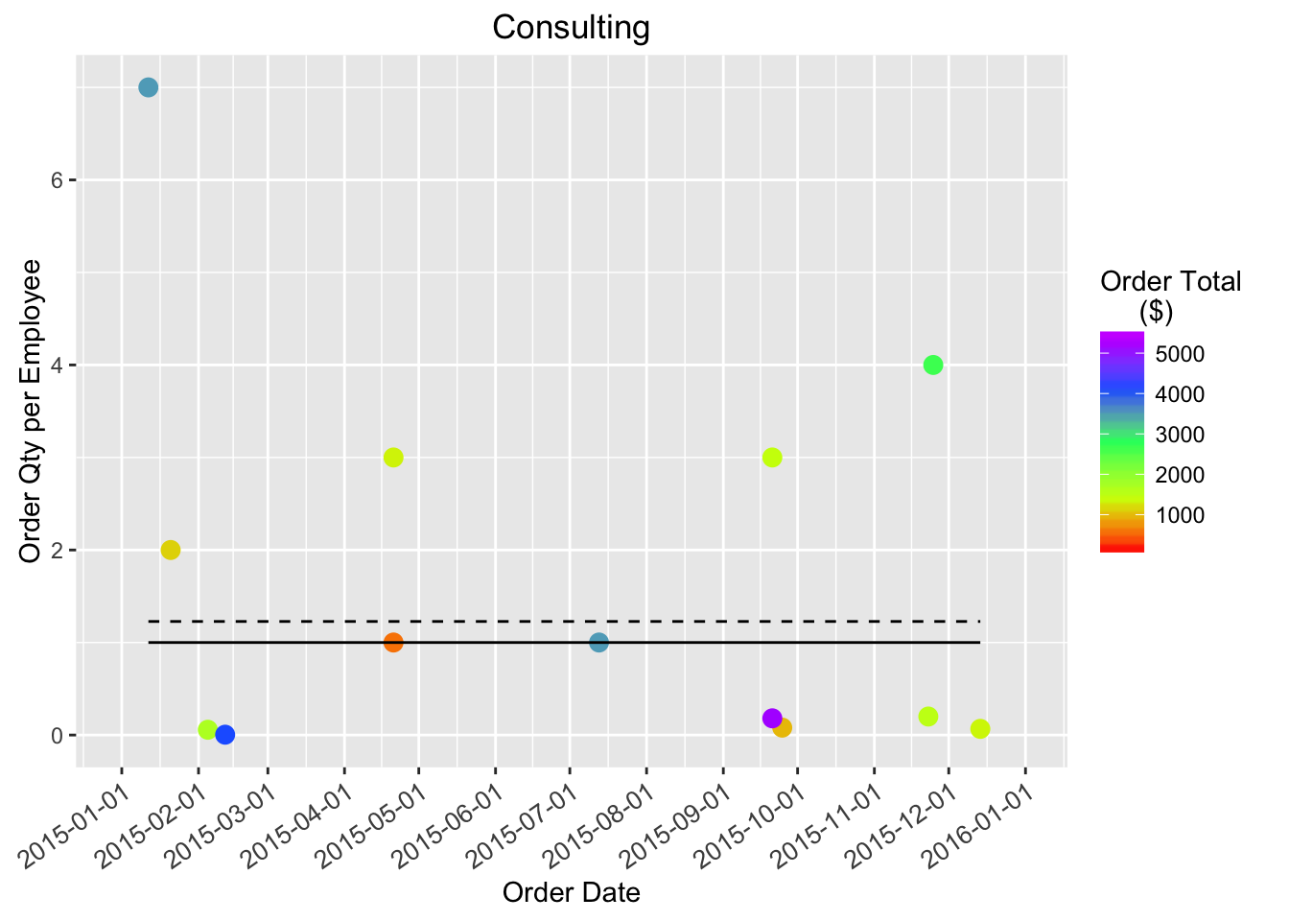
Order data
Industry Focus - Consulting

Slide 10
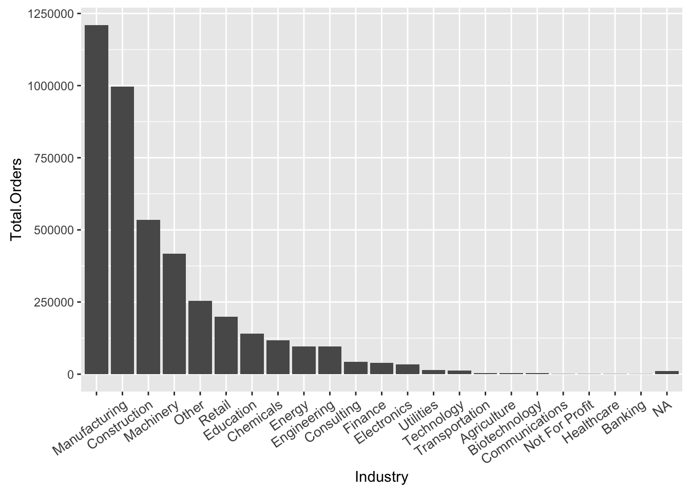
Order data
2015 Industry totals ($)

Slide 11
conclusions
Risk of over purchased customers is relatively low.
A large number of customers are not classified into any Industry.
Consulting industry is a bit odd due to their usage.
75% of clients have fewer than 145 employees
69% of clients are in Construction, Machinery, or Manufacturing
5% of clients are “large” or > 1000 employees

