Slide 1

NOTICE OF CONFIDENTIALITY AND USE RESTRICTIONS
For FRA502 only
This PowerPoint presentation, including all of its contents, is the intellectual property of Pi Thanacha Choopojcharoen. It has been exclusively designed and created for the "RobotDevOps" class.
Authorized Users:
If you are currently enrolled in or have previously taken the "RobotDevOps" class and are in possession of this presentation, you acknowledge and agree to the following:
This presentation is provided to you solely for your personal reference and educational use related to the "RobotDevOps" class.
You do not have the right to reproduce, distribute, share, or disseminate this presentation, in whole or in part, to any third parties, especially those who have not registered for the "RobotDevOps" class, unless explicitly authorized by Pi Thanacha Choopojcharoen.
Any unauthorized use or distribution of this presentation will result in legal action and potential academic sanctions.
Unauthorized Possession:
If you have come into possession of this presentation but have not registered for the "RobotDevOps" class: You must delete this presentation immediately.
You do not have any rights to view, use, copy, or distribute this presentation.
Any unauthorized retention or use will result in legal action.
Your respect for intellectual property rights ensures a fair academic and professional environment for all. Violation of these terms is a breach of trust and may have serious legal and academic consequences.

Slide 2
RBE502: RobotDevOps ROS2 Launch Engineering
For FRA502 only
by
Pi Thanacha Choopojcharoen

Slide 3
Agenda
For FRA502 only
package structure (review)
namespace
parameters
python argument/ argprase
launch scripts & launch action
launch arguments & launch configuration
deserialization w/ YAML
opaque function
scheduling
launch in launch

Slide 4
ROS2 Package Customization
For FRA502 only

Slide 5
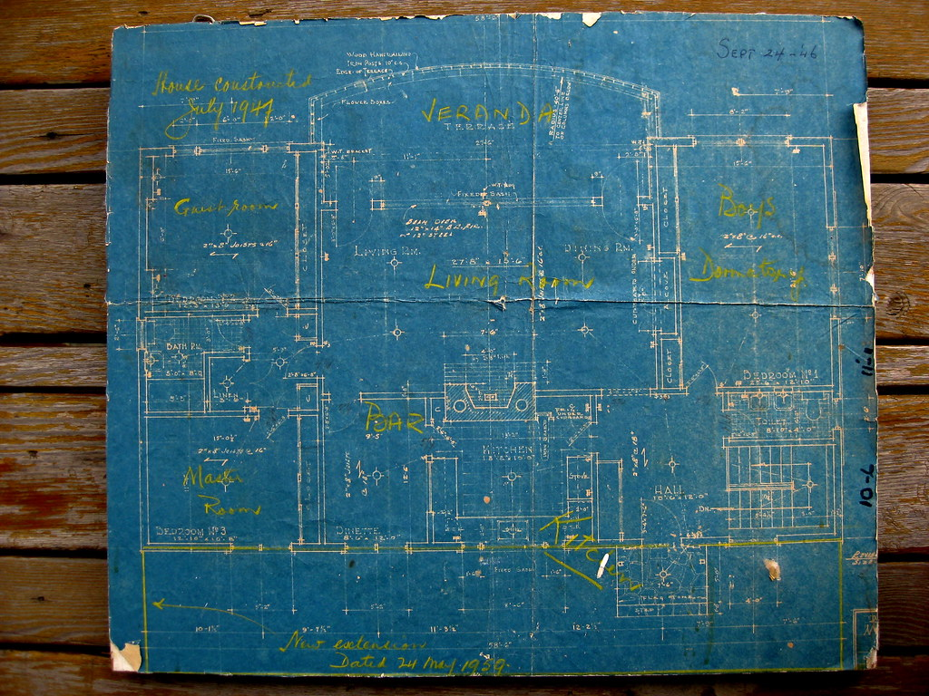
The concept of Package
For FRA502 only
[pkg]
Package is a collection of organized files in a form of directory, which will used to "synthesize" nodes, launch system, etc. (usually for a specific task)
An anology of a package would be a folder where we can keep all blue prints of a house but not the house itself.
ROS2 Package Customization

Slide 6
The concept of Package
For FRA502 only
sensor_calibration
ros_to_uart
trajectory_generator
But, where do we keep our packages ?
ROS2 Package Customization

Slide 7
Source folder (src)
For FRA502 only
src
sensor_calibration
ros_to_uart
trajectory_generator
"src" directory is where we put all custom packages together.
A package can be put inside another folder, which can be referred as a meta-package.
ROS2 Package Customization

Slide 8
The concept of Workspace
For FRA502 only
[workspace]
src
[ROS2] workspace is where we put every custom packages for a project.
ROS2 Package Customization

Slide 9
Build System
For FRA502 only
[workspace]
[workspace]
colcon build
src
src
build
install
log
"colcon build" command will build every packages in the source directory and generate 3 additional directories. When modify "src", always re-build these 3 directories. (with an exception of using symlink install)
ROS2 Package Customization

Slide 10
Build System
For FRA502 only
[workspace]
[workspace]
colcon build
src
src
build
install
log
"Install" directory is the location of codes that will be used by the ROS2 system. Therefore, only modifying "src" will not change the behavior of your system in run time.
ROS2 Package Customization

Slide 11
Build System
For FRA502 only
You must not create workspace inside another workspace
[workspace]
[workspace]
colcon build
src
src
build
install
log
"Install" directory is the location of codes that will be used by the ROS2 system. Therefore, only modifying "src" will not change the behavior of your system in run time.
ROS2 Package Customization

Slide 12
Creating a new workspace
For FRA502 only
Create and build a new workspace
Adding workspace to .bashrc
>> mkdir –p ~/[xxx]_ws/src >> cd ~/[xxx]_ws >> colcon build
>> source install/setup.bash
source ~/[xxx]_ws/install/local_setup.bash
ROS2 Package Customization

Slide 13
Package Layout
For FRA502 only
src
include
C++ Headers
CMakeLists.txt
C++ code
CMake
test
doc
README
Test data
.doc/.pdf
[pkg]
config
Setting Parameters
launch
package.xml
Launch file
Package Identifier
[pkg_name]
setup.py*
LICENSE
py code
https://automaticaddison.com/organizing-files-and-folders-inside-a-ros-2-package/
ROS2 Package Customization

Slide 14
Exercise
For FRA502 only

Slide 15
Example Repo- Branch: launch-exercise
For FRA502 only
https://github.com/kittinook/FRA501/tree/launch-exercise
Download & add “turtlesim_control” & “turtlesim_interfaces” to the “src” directory of your workspace. Then build these packages.
Follow the instruction on README.md
Exercise

Slide 16
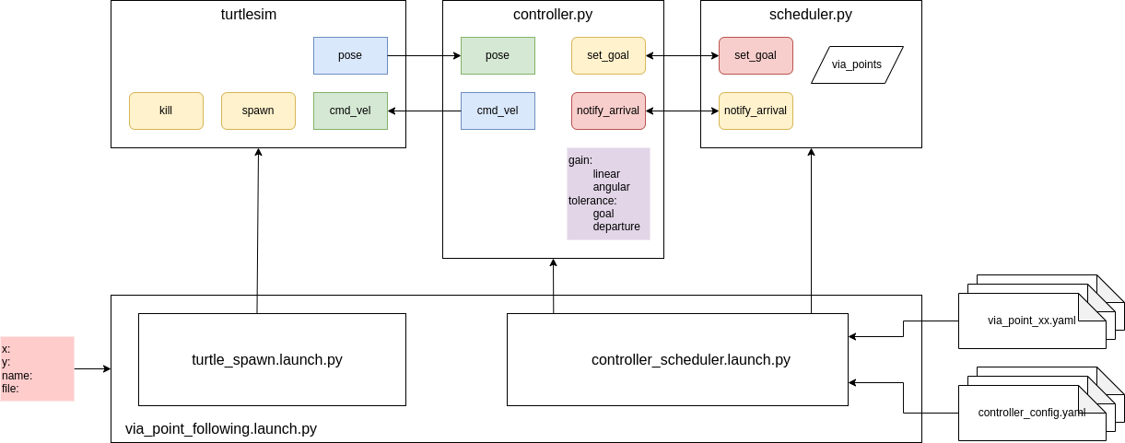
Example
For FRA502 only
Exercise

Slide 17
Goal 1: Launch multiple nodes
For FRA502 only
Launch turtlesim_node, controller.py, and scheduler.py with proper namespace, and executable arguments.
Exercise

Slide 18
Goal 2: Accepting Launch Arguments
For FRA502 only
The Launch script must accept 4 optional arguments:
x: spawn location in x-direction
y: spawn location in y-direction
name: name of the turtle
file: path of the via point file (relative to the ‘via point’ directory of the package)
Exercise

Slide 19
Goal 3: Pass parameters via a YAML file
For FRA502 only
Pass the full path to the via point file in the "via_point" directory of the package based on the given (relative) file name to the scheduler
Exercise

Slide 20
Goal 4: Creating a new YAML file
For FRA502 only
Given a “base” configuration file for a generic controller node, create a new configuration file for a fully-qualified node and update the parameters of the node using the file.
The base configuration conists of 'linear_gain','angular_gain',and 'tolerance’
The base configuration file is named “controller_config.yaml” as should look like this. [The parameters in the diagram are incorrect.]
controller: ros__parameters: linear_gain:1.0 angular_gain:5.0 tolerance:0.2
Exercise

Slide 21
Goal 5: Scheduling processes
For FRA502 only
1.
2.
3.
When turtlesim_node starts, kill any existing turtle in turtlesim, then spawn a new one with the given name and location.
Exercise

Slide 22
Remapping & namespace
For FRA502 only

Slide 23
Inconsistent topic names
For FRA502 only
Publisher
Publish to '/topic_a'
/topic_a
/topic_c
Subscription
Subscribe to '/topic_c'
Remapping & Namespace

Slide 24
Remapping Topics
For FRA502 only
Outside of our code, we can "remap" the name of the topic in the command line.
In the code, we can change the subscribed topic to "pose" instead of using "/turtle1/pose".
We can apply the same idea to other topics.
In the command line, we can add arguments at the end.
>> ros2 run turtlesim_control - -ros-args -r /pose:=/turtle1/pose
Publisher
Publish to '/topic_a'
remap /topic_a:=/topic_b
/topic_b
remap /topic_c:=/topic_b
Subscription
Subscribe to '/topic_c'
This only change the name, not the type
Remapping & Namespace

Slide 25
Having the same type of nodes in ROS network
For FRA502 only
/control_input
controller : robot_1
/control_output
Remapping & Namespace

Slide 26
Having the same type of nodes in ROS network
For FRA502 only
/control_input
/control_input
controller : robot_1
controller : robot_2
/control_output
/control_output
Remapping & Namespace

Slide 27
Having the same type of nodes in ROS network
For FRA502 only
/control_input
controller : robot_1
controller : robot_2
/control_output
Remapping & Namespace

Slide 28
Distinguishing topics using namespace
For FRA502 only
/robot_1/control_input
/robot_2/control_input
robot_1/controller
robot_2/controller
/robot_1/control_output
/robot_2/control_output
Remapping & Namespace

Slide 29
Name
For FRA502 only
Absolute name refers to a name that cannot be modified by other name token.
Topic : /pose
Relative name refers to a name that can be modified by other name token.
Topic : pose
Private name refers to a name that will be automatically add its associated node in front.
Topic : ~/pose
Hidden name refers to a name that will be hidden in ROS API interface.
Topic : _pose
http://design.ros2.org/articles/topic_and_service_names.html
Remapping & Namespace

Slide 30
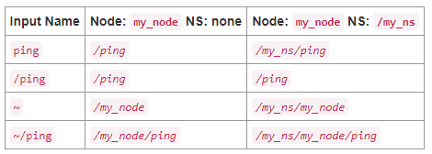
Namespace และ Uniform Resource Locators (URL)
For FRA502 only
Example:
Topic : /fleet_1/turtle_1/pose
Base name : pose
Namespace : /fleet_1/turtle_1
Topic : rosservice://turtle_1/clear
Base name : clear
Namespace : turtle_1
URL : rosservice://
http://design.ros2.org/articles/topic_and_service_names.html
Fully-qualified name (FQN)
Remapping & Namespace

Slide 31
Command Line for namespace
For FRA502 only
ros2 run [package] [executable] --ros-args -r __ns:=[/namespace]
For example:
>> ros2 run turtlesim_control controller.py --ros-args -r __ns:=/turtle1
Remapping & Namespace

Slide 32
Remapping topic
For FRA502 only
ros2 run [package] [executable] --ros-args -r __ns:=[/namespace]
For example:
>> ros2 run turtlesim_control controller.py --ros-args -r __ns:=/turtle1
Remapping & Namespace

Slide 33
Executable Arguments & ROS2 Parameters
For FRA502 only

Slide 34
Arguments & Parameters of a ROS Node
For FRA502 only
"Argument(s)" of an executable is assigned once when it is called.
sys.argv
"ROS2 Parameter(s)" is designed to be adjustable during runtime.
Executable (node)
ROS
ROS parameters
They are both "constants"
Executable Arguments & ROS2 Parameters

Slide 35
ROS2 Parameters in RCLPY
For FRA502 only
from rclpy.parameter import Parameter
class NewNode(Node):
def __init__(self):
super().__init__('my_node')
self.declare_parameter('length',3.0)
self.declare_parameter('width',4.0)
self.declare_parameter(‘area’,12.0)
def some_callback(self):
L = self.get_parameter('length').value
W = self.get_parameter('width').value
p = Parameter('area’,Parameter.Type.DOUBLE,L*W)
self.set_parameters([p])
Instead of being a standalone value in a ROS network, ROS2 Parameters must be associated with a node.​
​
One can declare parameters in rclpy.Node
Executable Arguments & ROS2 Parameters

Slide 36
Command Line for parameters
For FRA502 only
ros2 run [package] [executable] --ros-args -p [argument_name]:=[value]
For example:
>> ros2 run turtlesim_control controller.py --ros-args -r __ns:=/turtle1 -p angular_gain:=10.0
Executable Arguments & ROS2 Parameters

Slide 37
Command Line mixing ROS arguments with custom arguments
For FRA502 only
For example:
>> VP_FILE=~/[your_ws]/src/turtlesim_control/via_point/via_point_01.yaml >> ros2 run turtlesim_control scheduler.py --ros-args -r __ns:=/turtle1 -f $VP_FILE
Executable Arguments & ROS2 Parameters

Slide 38
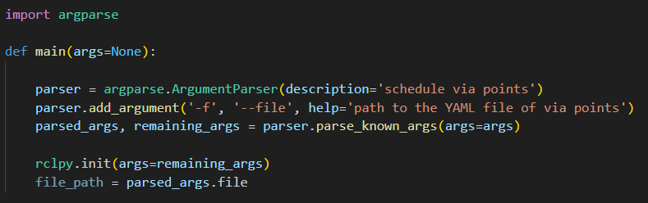
Command Line mixing ROS arguments with custom arguments
For FRA502 only
Executable Arguments & ROS2 Parameters

Slide 39
Launch Script & Launch Action
For FRA502 only

Slide 40
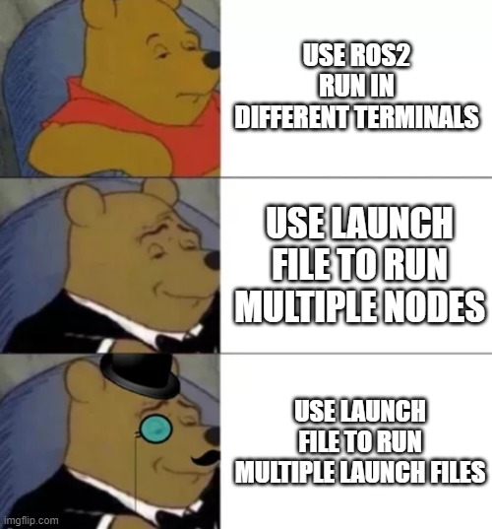
Launch Files in ROS2
For FRA502 only
A (ROS2) Launch file allows a user to run a system with multiple ROS nodes or other launch files at once. One can also scheduling the system's behavior as well.
XML
YAML
Python !!!!
Launch Script & Launch Action

Slide 41
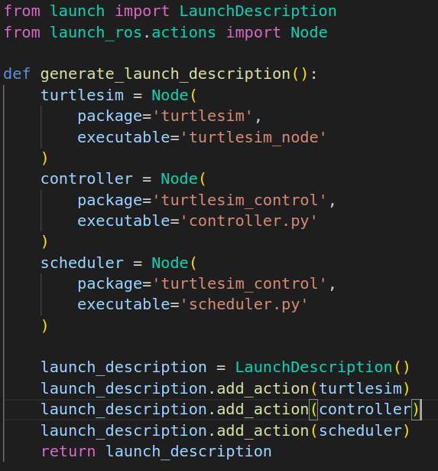
General Launch Pipeline
For FRA502 only
Launch Action
Node
Execute Process
Define your Launch action(s)
Add each Launch action to the description of your Launch
Launch the script
Launch Script & Launch Action

Slide 42
General Launch Pipeline
For FRA502 only
Define your Launch action(s)
Launch Description
Execute Process
Add each Launch action to the description of your Launch
Node
Launch the script
Not all Launch action will be launched right away.
Launch Script & Launch Action

Slide 43
Launch Script Structure
For FRA502 only
All action must
be "added" in
this function.
One must not forget to add the
action the launch description.
The function must return the Launch Description.
Launch Script & Launch Action

Slide 44
Launch Action: ROS Node
For FRA502 only
from launch_ros.actions import Node
node_action = Node( package = 'some_package', executable = 'something.py', parameters = [
{'param_1': 1.0},
{'param_2': 10.0}
],
namespace='my_ns', remappings=[
('/old_1', '/new_1'),
('/old_2', '/new_2'),
],
arguments= ['-f’, 'some_argument']
)
Launch Script & Launch Action

Slide 45
Launch Action: Executing command line
For FRA502 only
One can call a shell command in a Launch script.
from launch.actions import ExecuteProcess
spawn_turtle2 = ExecuteProcess(
cmd = [['ros2 service call /spawn turtlesim/srv/Spawn "{x: 2.0, y: 2.0, theta: 0.0, name: \'turtle2\'}"']],
shell=True
)
Launch Script & Launch Action

Slide 46
Package Layout: Launch
For FRA502 only
Don’t forget to add ‘launch’ directory to CMakeLists.txt
src
include
C++ Headers
CMakeLists.txt
C++ code
CMake
test
doc
README
Test data
.doc/.pdf
[pkg]
config
Setting Parameters
launch
package.xml
Launch file
[pkg_name]
setup.py
LICENSE
py code
Launch Script & Launch Action

Slide 47
Data Deserialization
For FRA502 only
Data Deserialization

Slide 48
Passing Parameters Manually
For FRA502 only
via_point_following.launch.py
controller
Parameters : ['linear_gain': 3.0]
Data Deserialization

Slide 49
Automatic Deserialization from YAML file
For FRA502 only
via_point_following.launch.py
Data file
linear_gain: 2.0
angular_gain: 10.0
…
controller
Parameters : [****]
path_to_data_file
Data Deserialization

Slide 50
Automatic Deserialization from YAML file
For FRA502 only
via_point_following.launch.py
Data file
linear_gain: 2.0
angular_gain: 10.0
…
turtle_follower
Parameters : [path_to_data_file]
path_to_data_file
Data Deserialization

Slide 51
Automatic Deserialization from YAML file
For FRA502 only
via_point_following.launch.py
Data file
linear_gain: 2.0
angular_gain: 10.0
…
turtle_follower
Parameters : [path_to_data_file]
path_to_data_file
Where is the file ?
How can we make sure that the Launch script load the correct data file regardless of the computer it was installed on?
Data Deserialization

Slide 52
Package Layout
For FRA502 only
src
include
C++ Headers
CMakeLists.txt
C++ code
CMake
test
doc
README
Test data
.doc/.pdf
[pkg]
config
Setting Parameters
launch
package.xml
Launch file
[pkg_name]
setup.py
LICENSE
py code
Data Deserialization

Slide 53
YAML Format for ROS2 Parameters
For FRA502 only
turtle1:
controller:
ros__parameters:
linear_gain: 1.0
angular_gain: 5.0
goal_tolerance: 0.1
turtle2/controller:
ros__parameters:
linear_gain: 0.75
angular_gain: 7.5
goal_tolerance: 1.0
rclpy automatically combines all keys "above" the keyword "ros__parameters" to obtain the associated node's name.
i.e. : /turtle1/via_point_follower
Data Deserialization

Slide 54
get_package_share_directory
For FRA502 only
To get the full path to the file, one must get the path to the "installed" package [NOT the one in src].
"get_package_share_directory" allows the software to automatically return the full path to the path with the given name.
"os.path.join" append the string together as an appropriate path (with /).
from ament_index_python.packages import get_package_share_directory​
​import os
control_pkg = get_package_share_directory('turtlesim_control')​
full_path = os.path.join(control_pkg,'config','turtle_parameters.yaml')​
Data Deserialization

Slide 55
General steps for deserializing YAML file
For FRA502 only
Get the package directory from share folder (in ‘install’) using
pkg = get_package_share_directory(‘my_pkg’)
Append the path with the relative path using
path = os.path.join(pkg,‘config’, ‘file_name.yaml’)
‘file_name.yaml’
If the YAML file is for ROS parameter, you can pass the path to the “parameter” argument of a Node Launch action.
Data Deserialization

Slide 56
Example
For FRA502 only
config
parameter_01.yaml
Package: my_pkg
Executable: something.py
Node name: my_node
parameter_02.yaml
my_node:
ros__parameters:
k_p: 1.0
k_i: 5.0
k_d: 0.3
Data Deserialization

Slide 57
Example
For FRA502 only
from launch import LaunchDescription
def generate_launch_description()
launch_description = LaunchDescription()
return launch_description
config
parameter_01.yaml
Package: my_pkg
Executable: something.py
Node name: my_node
parameter_02.yaml
my_node:
ros__parameters:
k_p: 1.0
k_i: 5.0
k_d: 0.3
Data Deserialization

Slide 58
Example
For FRA502 only
from launch import LaunchDescription
from launch_ros.actions import Node
def generate_launch_description()
config_path = …
my_node_action = Node(
package = 'my_pkg', executable = 'something.py',
parameters = [config_path] )
launch_description = LaunchDescription()
launch_description.add_action(my_node_action)
return launch_description
config
parameter_01.yaml
Package: my_pkg
Executable: something.py
Node name: my_node
parameter_02.yaml
my_node:
ros__parameters:
k_p: 1.0
k_i: 5.0
k_d: 0.3
Data Deserialization

Slide 59
Example
For FRA502 only
from launch import LaunchDescription
from launch_ros.actions import Node
from ament_index_python.packages import get_package_share_directory
import os
def generate_launch_description()
my_pkg = get_package_share_directory('my_pkg')
config_path = os.path.join(my_pkg,'config’,’parameter_01.yaml’)
my_node_action = Node(
package = 'my_pkg', executable = 'something.py',
parameters = [config_path] )
launch_description = LaunchDescription()
launch_description.add_action(my_node_action)
return launch_description
from launch import LaunchDescription
from launch_ros.actions import Node
from ament_index_python.packages import get_package_share_directory
import os
def generate_launch_description()
my_pkg = get_package_share_directory('my_pkg')
config_path = os.path.join(my_pkg,'config’,’parameter_01.yaml’)
my_node_action = Node(
package = 'my_pkg', executable = 'something.py',
parameters = [config_path] )
launch_description = LaunchDescription()
launch_description.add_action(my_node_action)
return launch_description
config
parameter_01.yaml
parameter_02.yaml
my_node:
ros__parameters:
k_p: 1.0
k_i: 5.0
k_d: 0.3
Data Deserialization

Slide 60
Example
For FRA502 only
Assume that this config directory is in “my_pkg”
from launch import LaunchDescription
from launch_ros.actions import Node
from ament_index_python.packages import get_package_share_directory
import os
def generate_launch_description()
my_pkg = get_package_share_directory('my_pkg')
config_path = os.path.join(my_pkg,'config’,’parameter_01.yaml’)
my_node_action = Node(
package = 'my_pkg', executable = 'something.py',
parameters = [config_path] )
launch_description = LaunchDescription()
launch_description.add_action(my_node_action)
return launch_description
config
parameter_01.yaml
parameter_02.yaml
my_node:
ros__parameters:
k_p: 1.0
k_i: 5.0
k_d: 0.3
Data Deserialization

Slide 61
Example: namespace ?
For FRA502 only
config
parameter_01.yaml
Package: my_pkg
Executable: something.py
Node name: my_node
Namespace: my_ns
parameter_02.yaml
my_node:
ros__parameters:
k_p: 1.0
k_i: 5.0
k_d: 0.3
Data Deserialization

Slide 62
Example: namespace ?
For FRA502 only
config
parameter_01.yaml
Package: my_pkg
Executable: something.py
Node name: my_node
Namespace: my_ns
parameter_02.yaml
my_node:
ros__parameters:
k_p: 1.0
k_i: 5.0
k_d: 0.3
Data Deserialization

Slide 63
Modifying namespace in YAML file
For FRA502 only
my_node:
ros__parameters:
k_p: 1.0
k_i: 5.0
k_d: 0.3
my_ns:
my_node:
ros__parameters:
k_p: 1.0
k_i: 5.0
k_d: 0.3
Data Deserialization

Slide 64
Programmatically namespace in YAML file
For FRA502 only
Get the path of the original YAML file
my_node:
ros__parameters:
k_p: 1.0
k_i: 5.0
k_d: 0.3
Load the content of the file to a dictionary
my_ns:
my_node:
ros__parameters:
k_p: 1.0
k_i: 5.0
k_d: 0.3
Create a new directory based on the original one
Create a path of the new YAML file
Dumpy the new dictionary to a new YAML
Data Deserialization

Slide 65
Programmatically namespace in YAML file
For FRA502 only
import yaml
# deserializing a YAML file
with open(path,'r') as file:
data = yaml.load(file,loader=yaml.SafeLoader)
my_node:
ros__parameters:
k_p: 1.0
k_i: 5.0
k_d: 0.3
my_ns:
my_node:
ros__parameters:
k_p: 1.0
k_i: 5.0
k_d: 0.3
Data Deserialization

Slide 66
Programmatically namespace in YAML file
For FRA502 only
import yaml
# deserializing a YAML file
with open(path,'r') as file:
data = yaml.load(file,loader=yaml.SafeLoader)
# creating new content
new_data = {'my_ns': data}
my_node:
ros__parameters:
k_p: 1.0
k_i: 5.0
k_d: 0.3
my_ns:
my_node:
ros__parameters:
k_p: 1.0
k_i: 5.0
k_d: 0.3
Data Deserialization

Slide 67
Programmatically namespace in YAML file
For FRA502 only
import yaml
# deserializing a YAML file
with open(path,'r') as file:
data = yaml.load(file,loader=yaml.SafeLoader)
# creating new content
new_data = {'my_ns': data}
# serializing to a new YAML file
with open(new_path,'w') as file:
yaml.dump(new_data,file)
my_node:
ros__parameters:
k_p: 1.0
k_i: 5.0
k_d: 0.3
my_ns:
my_node:
ros__parameters:
k_p: 1.0
k_i: 5.0
k_d: 0.3
Data Deserialization

Slide 68
Programmatically namespace in YAML file
For FRA502 only
import yaml
function modify_config_namespace(path:str,new_path,:str,namespace:str) -> None
with open(path,'r') as file:
data = yaml.load(file,loader=yaml.SafeLoader)
new_data = {namespace: data}
with open(new_path,'w') as file:
yaml.dump(new_data,file)
my_node:
ros__parameters:
k_p: 1.0
k_i: 5.0
k_d: 0.3
my_ns:
my_node:
ros__parameters:
k_p: 1.0
k_i: 5.0
k_d: 0.3
Data Deserialization

Slide 69
Programmatically namespace in YAML file
For FRA502 only
from launch import LaunchDescription
from launch_ros.actions import Node
from ament_index_python.packages import get_package_share_directory
import os
def generate_launch_description()
namespace = 'my_ns'
my_pkg = get_package_share_directory('my_pkg')
config_path = os.path.join(my_pkg,'config','parameter_01.yaml')
new_config_path = os.path.join(my_pkg,'config','parameter_01_'+namespace+'.yaml')
modify_config_namespace(config_path,new_config_path,namespace)
my_node_action = Node(
package = 'my_pkg', executable = 'something.py’,
namespace = namespace,
parameters = [config_path] )
launch_description = LaunchDescription()
launch_description.add_action(my_node_action)
return launch_description
my_node:
ros__parameters:
k_p: 1.0
k_i: 5.0
k_d: 0.3
my_ns:
my_node:
ros__parameters:
k_p: 1.0
k_i: 5.0
k_d: 0.3
Data Deserialization

Slide 70
Launch Argument & Launch Configuration
For FRA502 only

Slide 71
Launch Arguments
For FRA502 only
Executable Arguments
Executable
ROS2 Parameters
ROS
Argument(s) can be assigned when launching a launch file.
Executable Arguments
Executable
ROS2 Parameters
ROS
There is **NO** such thing as "Launch parameters"
Launch Arguments & Launch Configuration

Slide 72
Example: Launching with initial spawn location
For FRA502 only
controller
scheduler
spawn
x:=4.0
y:=7.0
turtlesim_node
>> ros2 launch turtlsim_control via_point_following.launch.py x:=4.0 y:=7.0
Launch Arguments & Launch Configuration

Slide 73
General Pipeline for adding arguments
For FRA502 only
Declare all arguments for the Launch script using
DeclareLaunchArgument(‘var’)
Define Launch Configuration using
LaunchConfiguration(‘var’)
Add each DeclareLaunchArgument action to the Launch description
Launch the script
‘var’ can be used in the Launch script.
Launch Arguments & Launch Configuration

Slide 74
Adding Launch Arugments to the Launch file
For FRA502 only
from launch.actions import DeclareLaunchArgument
from launch.substitutions import LaunchConfiguration
x_launch_arg = DeclareLaunchArgument('x', default_value='2.0')
y_launch_arg = DeclareLaunchArgument('y', default_value='2.0')
x = LaunchConfiguration('x')
y = LaunchConfiguration('y')
cmd = LaunchConfiguration('cmd',default=[
'ros2 service call /spawn turtlesim/srv/Spawn "{x: ',
x,
', y: ',
y,
', theta: 0.0, name: \'',turtle_name,'\'}"'
])
spawn_turtle = ExecuteProcess(cmd = [[cmd]], shell=True)
DeclareLaunchArgument adds an ability to assign argument of the given name when launching.
Instead of adding namespace manually to several nodes, one can use "GroupAction" to create a scope of the "launch" and use "PushRosNamespace" to add namespace to all subsequent nodes in the group.
LaunchConfiguration allows the Launch file to store and substitute value that is assigned to the variable.
Launch Arguments & Launch Configuration

Slide 75
Example:
For FRA502 only
from launch import LaunchDescription
from launch_ros.actions import Node
from ament_index_python.packages import get_package_share_directory
def generate_launch_description()
namespace = 'my_ns'
my_pkg = get_package_share_directory('my_pkg')
my_node_action = Node(
package = 'my_pkg', executable = 'something.py’,
namespace = namespace
parameters = [{'k_p': ...}] )
launch_description = LaunchDescription()
launch_description.add_action(my_node_action)
return launch_description
Launch Argument:
- k_p : (2.0)
Launch Arguments & Launch Configuration

Slide 76
Example:
For FRA502 only
from launch import LaunchDescription
from launch.actions import DeclareLaunchArgument
from launch_ros.actions import Node
from ament_index_python.packages import get_package_share_directory
def generate_launch_description()
k_p_launch_arg = DeclareLaunchArgument('k_p', default_value='2.0’)
namespace = 'my_ns'
my_pkg = get_package_share_directory('my_pkg')
my_node_action = Node(
package = 'my_pkg', executable = 'something.py’,
namespace = namespace
parameters = [{'k_p': ...}] )
launch_description = LaunchDescription()
launch_description.add_action(k_p_launch_arg)
launch_description.add_action(my_node_action)
return launch_description
Launch Argument:
- k_p : (2.0)
Creation order matters !!
Arguments must be declared before they are referred to.
Launch Arguments & Launch Configuration

Slide 77
Example:
For FRA502 only
from launch import LaunchDescription
from launch.actions import DeclareLaunchArgument
from launch_ros.actions import Node
from launch.substitution import LaunchConfiguration
from ament_index_python.packages import get_package_share_directory
def generate_launch_description()
k_p_launch_arg = DeclareLaunchArgument('k_p', default_value='2.0’)
k_p = LaunchConfiguration('k_p')
namespace = 'my_ns'
my_pkg = get_package_share_directory('my_pkg')
my_node_action = Node(
package = 'my_pkg', executable = 'something.py’,
namespace = namespace
parameters = [{'k_p': k_p}] )
launch_description = LaunchDescription()
launch_description.add_action(k_p_launch_arg)
launch_description.add_action(my_node_action)
return launch_description
Launch Argument:
- k_p : (2.0)
Launch Arguments & Launch Configuration

Slide 78
What if ?
For FRA502 only
ns:=my_other_ns
What do we have to do ?
Launch Arguments & Launch Configuration

Slide 79
What if ?
For FRA502 only
namespace_arg = DeclareLaunchArgument('namespace', default_value='my_ns’)
namespace = LaunchConfiguration('namespace')
ns:=my_other_ns
Add both Launch arguments and Launch configurations
Launch Arguments & Launch Configuration

Slide 80
What if ?
For FRA502 only
These are not Python string. They are Launch configuration, which cannot be used as ‘key’ to the directory.
# add launch arguments
. . .
. . .
modify_config_namespace(config_path,new_config_path,namespace)
my_node_action = Node(
package = 'my_pkg', executable = 'something.py’,
namespace = namespace,
parameters = [config_path] )
. . .
ns:=my_other_ns
Modify the parameter file with the namespace
Launch Arguments & Launch Configuration

Slide 81
What if ?
For FRA502 only
These are not Python string. They are Launch configuration, which cannot be used as ‘key’ to the directory.
# add launch arguments
. . .
. . .
modify_config_namespace(config_path,new_config_path,namespace)
my_node_action = Node(
package = 'my_pkg', executable = 'something.py’,
namespace = namespace,
parameters = [config_path] )
. . .
ns:=my_other_ns
Can we just turn Launch configuration to a string ?
Launch Arguments & Launch Configuration

Slide 82
What if ?
For FRA502 only
These are not Python string. They are Launch configuration, which cannot be used as ‘key’ to the directory.
# add launch arguments
. . .
. . .
modify_config_namespace(config_path,new_config_path,namespace)
my_node_action = Node(
package = 'my_pkg', executable = 'something.py’,
namespace = namespace,
parameters = [config_path] )
. . .
ns:=my_other_ns
… Not really… There is no function to convert LaunchConfiguration directly to string.
namespace.to_string(), namespace.to_str() , str(namespace)
Launch Arguments & Launch Configuration

Slide 83
Launch Action: OpaqueFunction
For FRA502 only
OpaqueFunction is a class defined in launch.actions. One can associate an OpaqueFunction with another function, which can access a Launch context (LaunchContext class from launch).
One method of the class LaunchContext allows us to perform the substitution on any Launch configuration. This will convert the Launch configuration to Python string. However, this has to be done in the function. We will refer to this as “render_function”.
Launch Arguments & Launch Configuration

Slide 84
Launch Context
For FRA502 only
namespace:LaunchConfiguration
namespace_str:str
Launch Arguments & Launch Configuration

Slide 85
Launch Context
For FRA502 only
namespace:LaunchConfiguration
namespace_str:str
context:LaunchContext
Launch Arguments & Launch Configuration

Slide 86
Launch Context
For FRA502 only
namespace:LaunchConfiguration
namespace_str:str
namespace_str =context.perform_substitution(namespace)
context:LaunchContext
Launch Arguments & Launch Configuration

Slide 87
Launch Context
For FRA502 only
from launch import LaunchDescription, LaunchContext
from launch.actions import DeclareLaunchArgument
from launch_ros.actions import Node
from launch.substitution import LaunchConfiguration
from ament_index_python.packages import get_package_share_directory
def render_namespace(context:LaunchContext,launch_description:LaunchDescription,namespace:LaunchConfiguration) -> None
namespace_str = context.perform_substitution(namespace)
my_pkg = get_package_share_directory('my_pkg’)
config_path = os.path.join(my_pkg,'config','parameter_01.yaml')
new_config_path = os.path.join(my_pkg,'config','parameter_01_'+namespace_str+'.yaml')
modify_config_namespace(config_path,new_config_path,namespace_str)
my_node_action = Node(
package = 'my_pkg', executable = 'something.py’,
namespace = namespace_str,
parameters = [config_path] )
launch_description.add_action(my_node_action)
Launch Arguments & Launch Configuration

Slide 88
OpaqueFunction
For FRA502 only
from launch import LaunchDescription, LaunchContext
from launch.actions import DeclareLaunchArgument, OpaqueFunction
from launch_ros.actions import Node
from launch.substitution import LaunchConfiguration
from ament_index_python.packages import get_package_share_directory
def render_namespace(context:LaunchContext,launch_description:LaunchDescription,namespace:LaunchConfiguration) -> None
...
def generate_launch_description()
namespace_launch_arg = DeclareLaunchArgument('namespace', default_value='my_ns’)
namespace = LaunchConfiguration('namespace')
launch_description = LaunchDescription()
launch_description.add_action(namespace_launch_arg)
opaque_function = OpaqueFunction(
function=render_namespace,
args=[launch_description,namespace]
)
launch_description.add_action(opaque_function)
return launch_description
Launch Arguments & Launch Configuration

Slide 89
What do we have now?
For FRA502 only
Launch Scripts
config.yaml
string and/or numeric Launch arguments
new_config.yaml
node_1
node_2
node_3
Launch Arguments & Launch Configuration

Slide 90
Scheduling in Launch File
For FRA502 only

Slide 91
Running shell command using ExecuteProcess
For FRA502 only
from launch.actions import ExecuteProcess
spawn_turtle2 = ExecuteProcess(
cmd = [['ros2 service call /spawn turtlesim/srv/Spawn "{x: 2.0, y: 2.0, theta: 0.0, name: \'turtle2\'}"']],
shell=True
)
launch_description.add_action(spawn_turtle2)
Scheduling in Launch file

Slide 92
Event Handlers
For FRA502 only
The state of launched processes is monitored by the Launch system and can be used to trigger "events".
One can schedule Launch actions to execute when one of the following event occurs.
OnProcessStart
OnProcessIO
OnExecutionComplete
OnProcessExit
OnShutdown
Scheduling in Launch file

Slide 93
OnProcessStart
For FRA502 only
from launch.actions import LogInfo, RegisterEventHandler
from launch.event_handlers import OnProcessStart
turtlesim_node = Node(
...
)
spawn_turtle = ExecuteProcess(
...
)
event_handler = RegisterEventHandler(
OnProcessStart(
target_action=turtlesim_node,
on_start=[
LogInfo(msg='Turtlesim started, spawning turtle’),
spawn_turtle
]
)
)
launch_description.add_action(event_handler)
Scheduling in Launch file

Slide 94
OnExecutionComplete
For FRA502 only
from launch.actions import LogInfo, RegisterEventHandler
from launch.event_handlers import OnExecutionComplete
turtlesim_node = Node(
...
)
spawn_turtle = ExecuteProcess(
...
)
event_handler = RegisterEventHandler(
OnExecutionComplete(
target_action= spawn_turtle,
on_completion=[
controller_node
]
)
)
launch_description.add_action(event_handler)
Scheduling in Launch file

Slide 95
OnProcessExit
For FRA502 only
from launch.actions import EmitEvent, LogInfo, RegisterEventHandler
from launch.event_handlers import OnProcessExit
from launch.events import Shutdown
turtlesim_node = Node(
...
)
spawn_turtle = ExecuteProcess(
...
)
event_handler = RegisterEventHandler(
OnProcessExit(
target_action=turtlesim_node,
on_exit=[
LogInfo(msg='closed the turtlesim window’)),
EmitEvent(event=Shutdown(reason='Window closed’))
]
)
)
launch_description.add_action(event_handler)
Scheduling in Launch file

Slide 96
Launch files in a Launch file
For FRA502 only

Slide 97
Calling another Launch file in a Launch file
For FRA502 only
from launch.actions import IncludeLaunchDescription
from launch.launch_description_sources import PythonLaunchDescriptionSource
turtlesim_spawn_launch = IncludeLaunchDescription(
PythonLaunchDescriptionSource(
os.path.join(turtlesim_control_pkg,'launch','turtlesim_spawn.launch.py')
),
launch_arguments = {
'x': x,
'y': y,
'name’:namespace
}.items()
)
Get full path of other Launch file
One can also pass along the arguments to other Launch file.
Launch files in Launch file

Slide 98
Summary
For FRA502 only
package structure (review)
namespace
parameters
python argument/ argprase
launch scripts & launch action
launch arguments & launch configuration
deserialization w/ YAML
opaque function
scheduling
Launch in Launch

Slide 99
Exercise
For FRA502 only

Slide 100
Exercise
For FRA502 only
Exercise

Slide 101
Goal 1: Launch multiple nodes
For FRA502 only
Launch turtlesim_node, controller.py, and scheduler.py with proper namespace, and executable arguments.
Exercise

Slide 102
Goal 2: Accepting Launch Arguments
For FRA502 only
The Launch script must accept 4 optional arguments:
x: spawn location in x-direction
y: spawn location in y-direction
name: name of the turtle
file: path of the via point file (relative to the ‘via point’ directory of the package)
Exercise

Slide 103
Goal 3: Pass parameters via a YAML file
For FRA502 only
Pass the full path to the via point file in the "via_point" directory of the package based on the given (relative) file name to the scheduler
Exercise

Slide 104
Goal 4: Creating a new YAML file
For FRA502 only
Given a “base” configuration file for a generic controller node, create a new configuration file for a fully-qualified node and update the parameters of the node using the file.
The base configuration conists of 'linear_gain','angular_gain',and 'tolerance’
The base configuration file is named “controller_config.yaml” as should look like this. [The parameters in the diagram are incorrect.]
controller: ros__parameters: linear_gain:1.0 angular_gain:5.0 tolerance:0.2
Exercise

Slide 105
Goal 5: Scheduling processes
For FRA502 only
1.
2.
3.
When turtlesim_node starts, kill any existing turtle in turtlesim, then spawn a new one with the given name and location.
Exercise

Slide 106
Example Repo- Branch: launch-solution
For FRA502 only
https://github.com/kittinook/FRA501/tree/launch-solution
Download & add “turtlesim_control” & “turtlesim_interfaces” to the “src” directory of your workspace. Then build these packages.
Follow the instruction on README.md
Exercise

