Slide 1
Multiple Shortest Path Planning With Energy Constraints
Pustilnik Mark

Slide 2
Problem Definition
Find the fastest path that M≥1 vehicles can take in order to visit N≥2M+1 nodes,
such that the total amount of time is minimized, subjected to SOC≥SOCmin.

Slide 3
Decision Variables
Defining the decision variables:
  Binary Decision Variable. Is a 1 if some vehicle travels from node i to node j. 0, otherwise. There are NxN such decision variables.
  SOC Variable: si The state-of-charge at node i arrival.
  Sub-contour elimination: ui is a dummy variable that ensures no sub contours. It’s meaning is the number of nodes visited prior to the current node.
  Charging Time. ti is the amount of time spent in node i to recharge. ti≥0 if node i has a charging station, ti=0 otherwise.

Slide 4
Decision Variables
Problem Parameters:
  Cost Matrix. is the cost of traveling from node i to node j.
  Energy Matrix. is the energy to travel from node i to node j.
  Max number of nodes a single vehicle can visit:
  Max Battery Capacity of every vehicle:
  Charging Rate of each Charging Station,

Slide 5
Problem Formulation
M exits from node 0
O(N) inequalities
M enter to node 0
1 enter to node 1,…,N-1
1 exit to node 1,…,N-1
Sub-contour elimination
O(N²) inequalities
First Var init
Var limits
Var connections
Initial SOC initialization
Energy nodes Connections
O(N²) inequalities
Can’t enter a node with more than capacity
Enter origin node with at least SOCmin
Can’t charge out of charging stations

Slide 6
Energy Constraints
Reminder: si is the SOC when entering node i
If Xi,j = 1, the SOC when entering node j
This connection is relaxed. At the optimal solution, when some ti>0, the inequality turns to equality
To disconnect the connection between si and sj, if Xi,j=0 → add term to make inequality trivial
Energy connection to last node:
Energy entering any node must be non-negative:
These energy constraints formulation are convex (although the whole program is not convex - MILP)

Slide 7
Alternative Energy Constraints
Reminder: si is the SOC when entering node i
If Xi,j = 1, the SOC when entering node j
To disconnect the connection between si and sj, if Xi,j=0 → add a dummy variable that can take any value
Energy connection to last node:
Energy entering any node must be non-negative:
These energy constraints formulation are non convex (whole program is not convex - MILP)

Slide 8
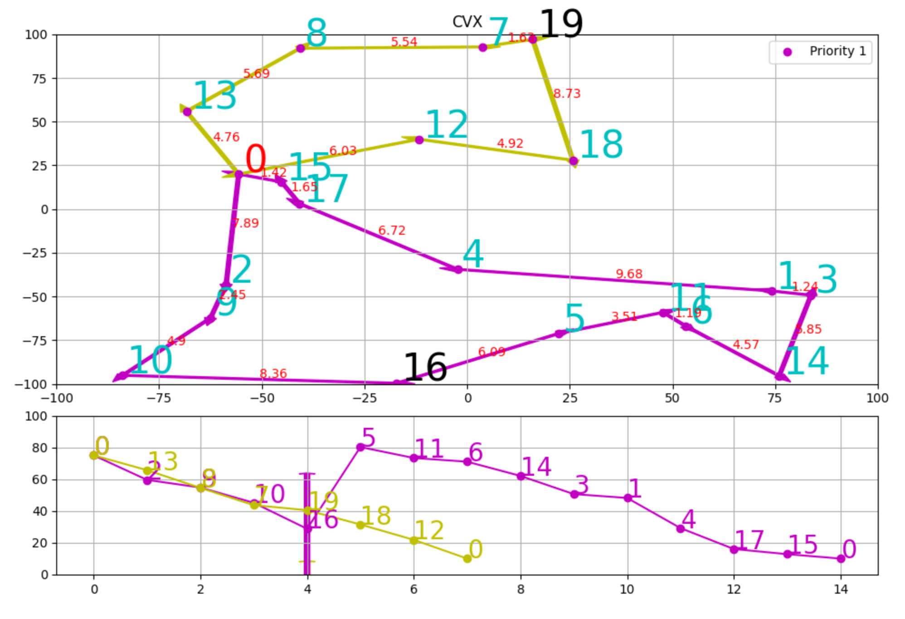
Example
20 Nodes, 2 vehicles
2 charging stations: 16, 19

Slide 9
Problem Definition
Find the path that M≥1 vehicles can take in order to visit N≥2M+1 nodes,
such that the Cost Function is minimized,
subjected to SOC≥SOCmin
Travel Times are Random →

Slide 10
Decision Variables
Defining the decision variables:
  Binary Decision Variable. Is a 1 if some vehicle travels from node i to node j. 0, otherwise. There are NxN such decision variables.
  SOC Variable: si The state-of-charge at node i arrival.
  Sub-contour elimination: ui is a dummy variable that ensures no sub contours. It’s meaning is the number of nodes visited prior to the current node.
  Charging Time. yi is the amount of time spent in node i to recharge. yi≥0 if node i has a charging station, yi=0 otherwise.
  Elapsed Time from origin – ti
  Elapsed Time when returning to origin – tfi. tfi>0 if , tfi=0 otherwise
  Sum of variance from origin at each node –
  Sum of variance if returning to origin from current node –

Slide 11
Decision Variables
Problem Parameters:
  Cost Matrix Mean. is the cost of traveling from node i to node j.
  Cost Matrix Variance. Is the cost variance for traveling node i to j.
  Energy Matrix. is the energy to travel from node i to node j.
  Max number of nodes a single vehicle can visit:
  Max Battery Capacity of every vehicle:
  Charging Rate of each Charging Station,

Slide 12
Problem Formulation
M exits from node 0
O(N) inequalities
M enter to node 0
1 enter to node 1,…,N-1
1 exit to node 1,…,N-1
Sub-contour elimination
O(N²) inequalities
First Var init
Var limits
Var connections
Initial SOC initialization
Energy nodes Connections
O(N²) inequalities
Can’t enter a node with more than capacity
Can’t charge out of charging stations

Slide 13
Problem Formulation
Initial Time initialization
Time Summation
O(N²) inequalities
Final Step Time
Initial Var initialization
Variance summation
O(N²) inequalities
Final Step Variance

Slide 14
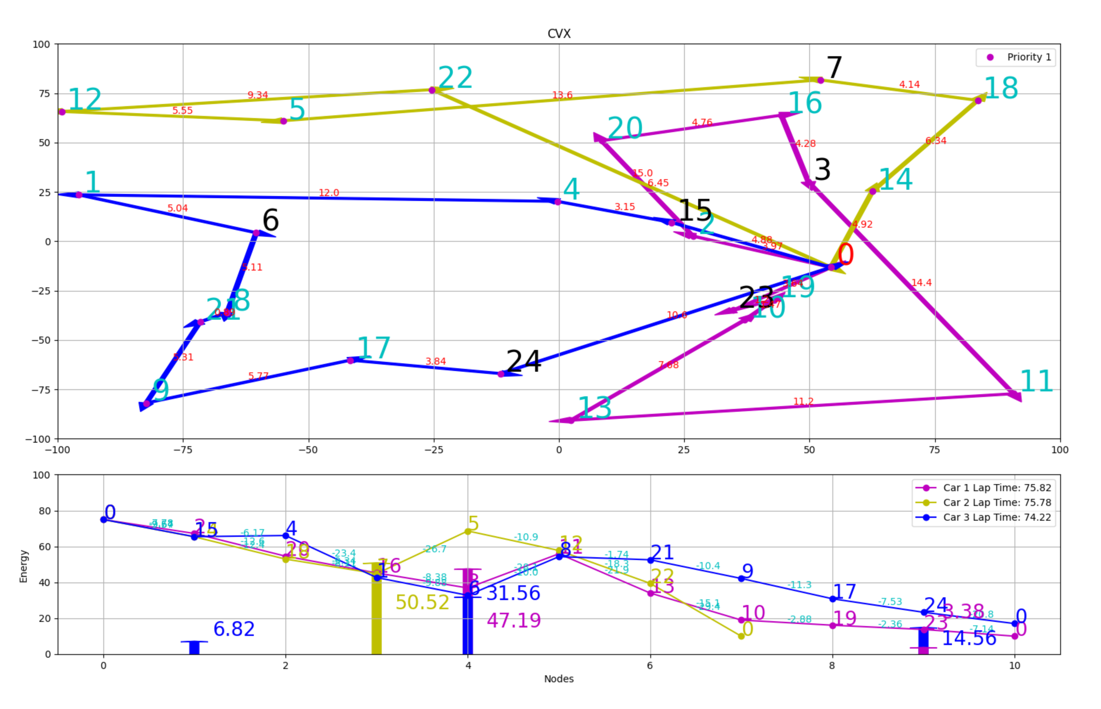
Example
25 Nodes, 3 vehicles
6 charging stations
Non linear charging
Minimize Max tour length with 90% certainty

Slide 15
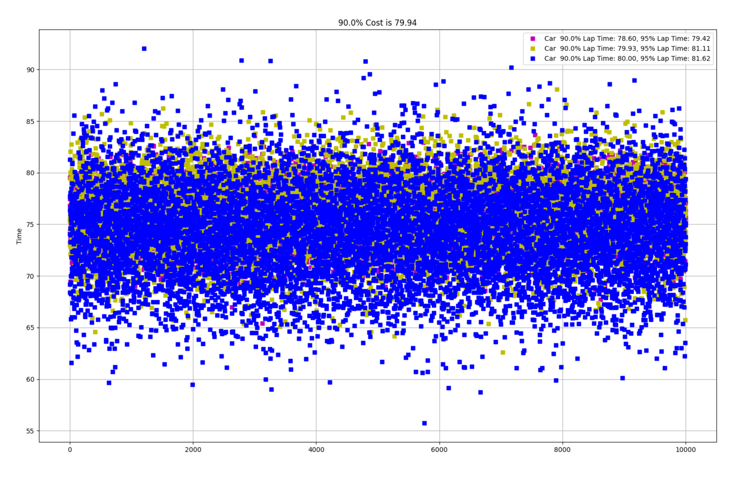
Example
25 Nodes, 3 vehicles
6 charging stations
Non linear charging
Minimize Max tour length with 90% certainty

Slide 16
Cost Function Consideration
Total time traveled by all agent (agent/car time is main consideration):
Max Time traveled by any agent (agent/car paid by day of work):
Charging Time has a different Cost than Travel Time
Maximize number of nodes visited over some time
Find the min time route that X% of times is minimal

Slide 17
Future Work
Learn for a single problem and try to solve with perturbation on initial energy levels
Try to design a solver faster than Gurobi
Use Ridgeback platform to demonstrate the algorithm
“Convexify” the problem – Approximate the problem with more convex form

Slide 18
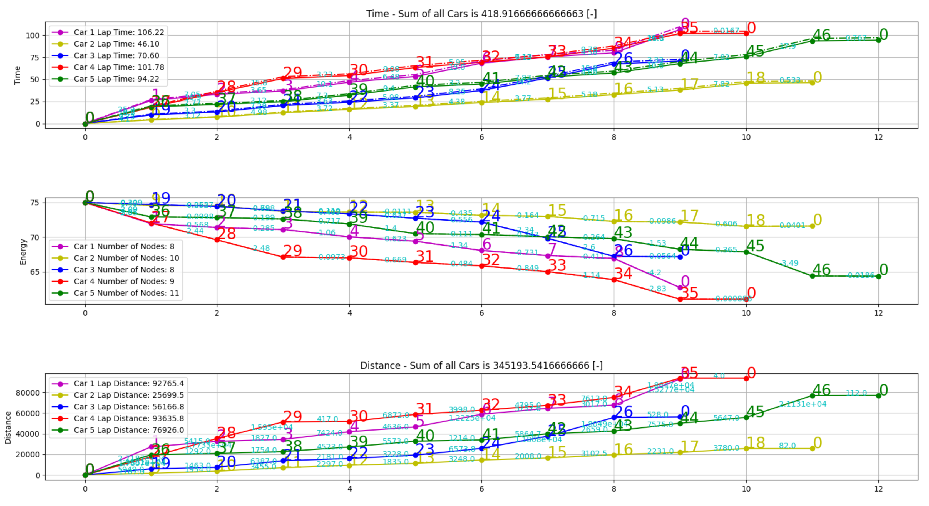
Budweiser Database
Current Solution

Slide 19
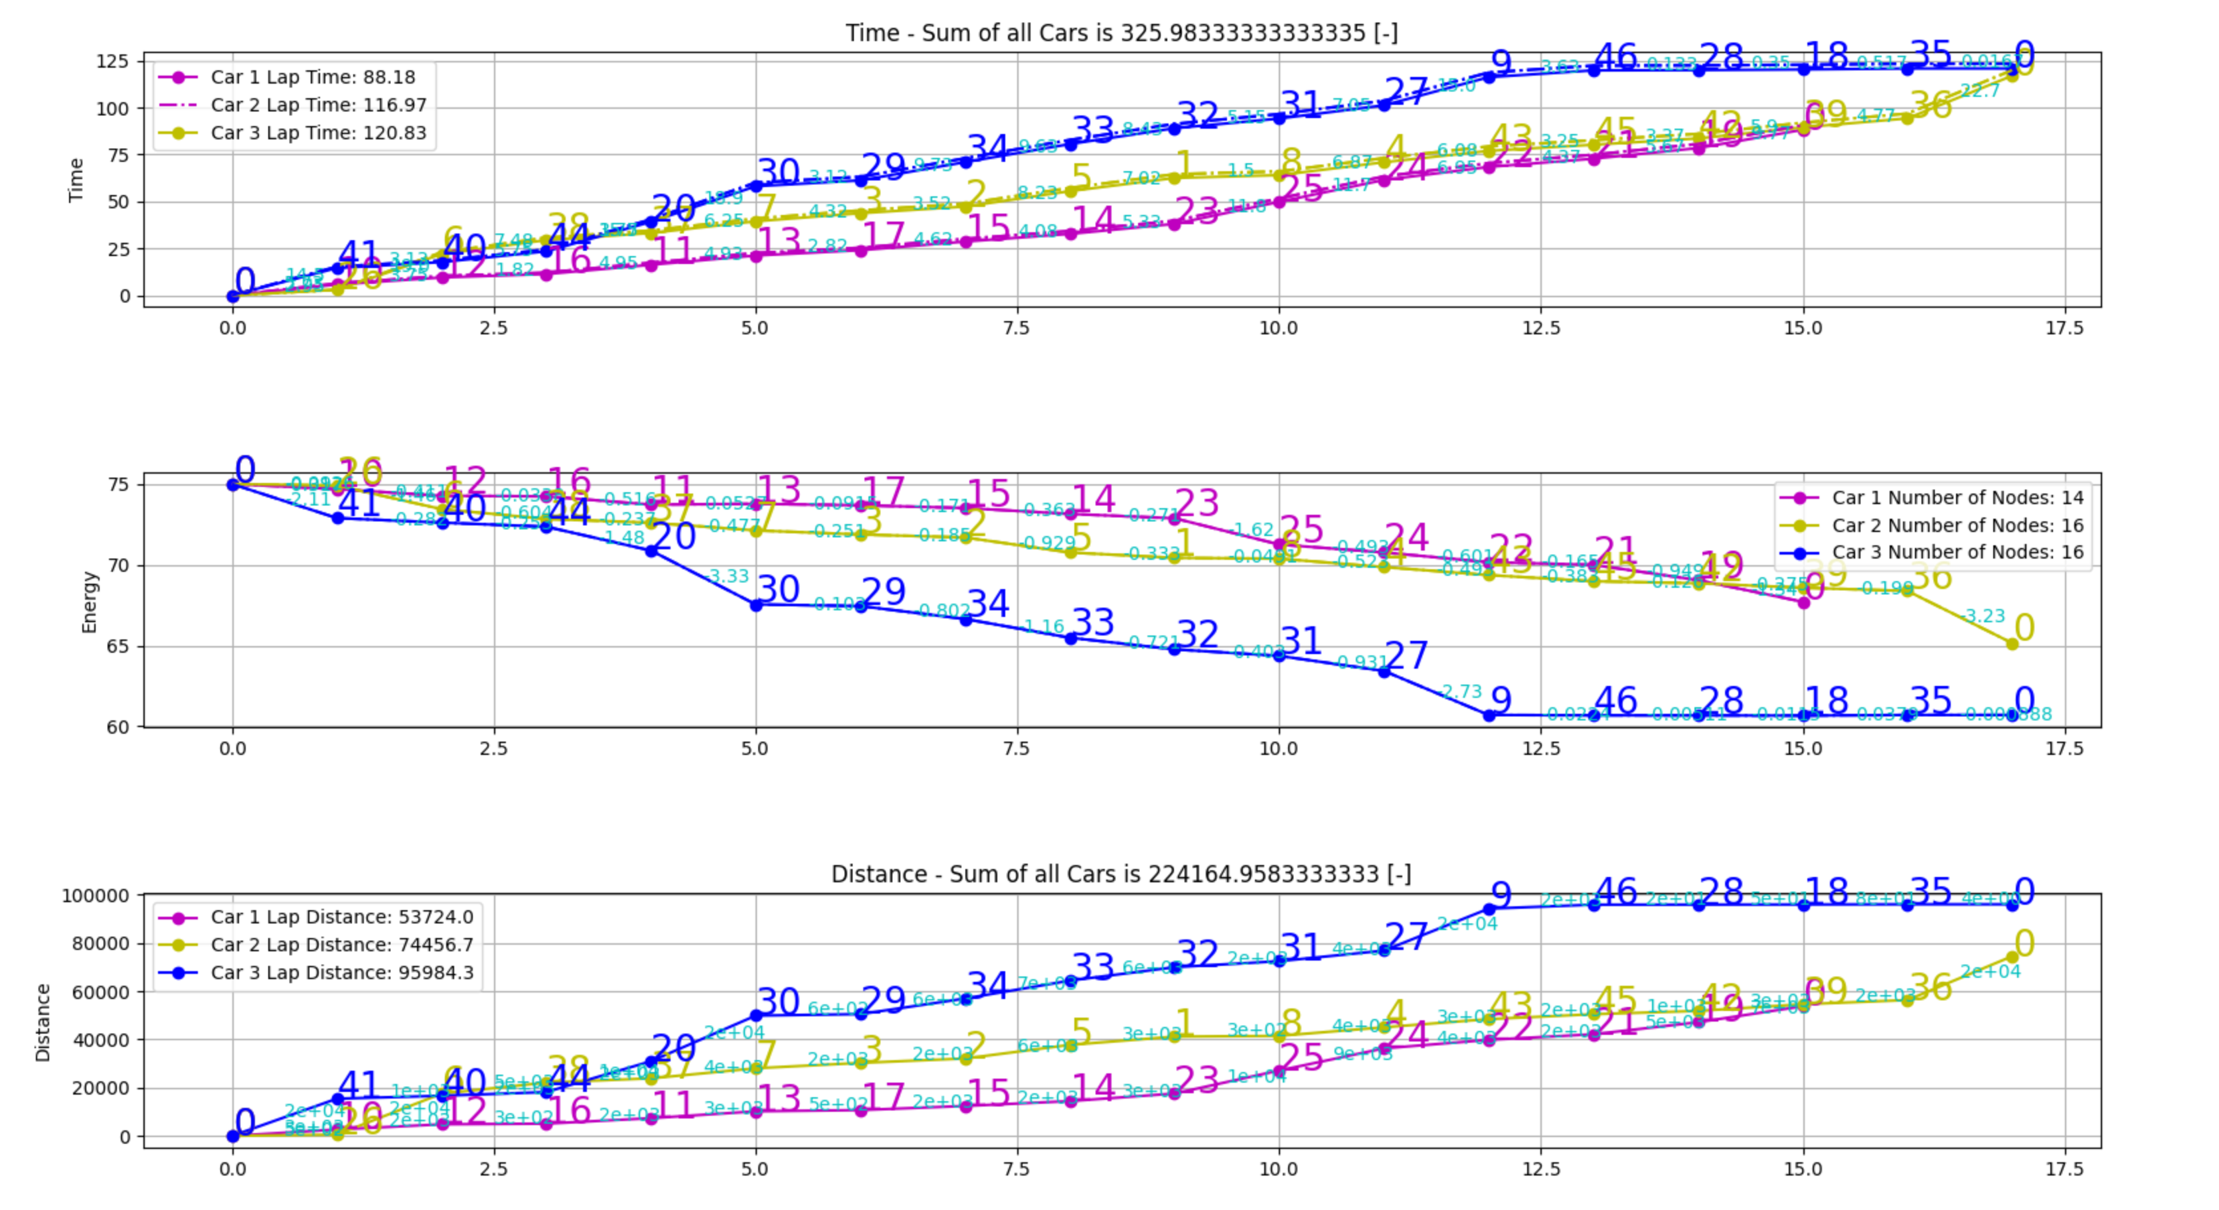
Budweiser Database
Current Optimization
Max Time Per Truck – 130[sec]

Slide 20
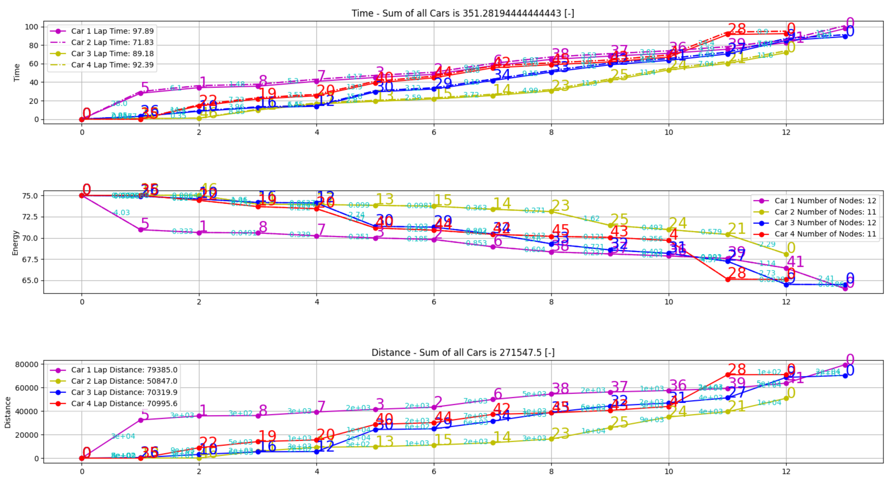
Budweiser Database
Current Optimization – 4 trucks
Max Time Per Truck – 110[sec]
Max Number of nodes per truck - 12

Slide 21
Budweiser Database
Current Optimization – 4 trucks
Max Time Per Truck – 110[sec]
Max Number of nodes per truck - 12

Slide 22
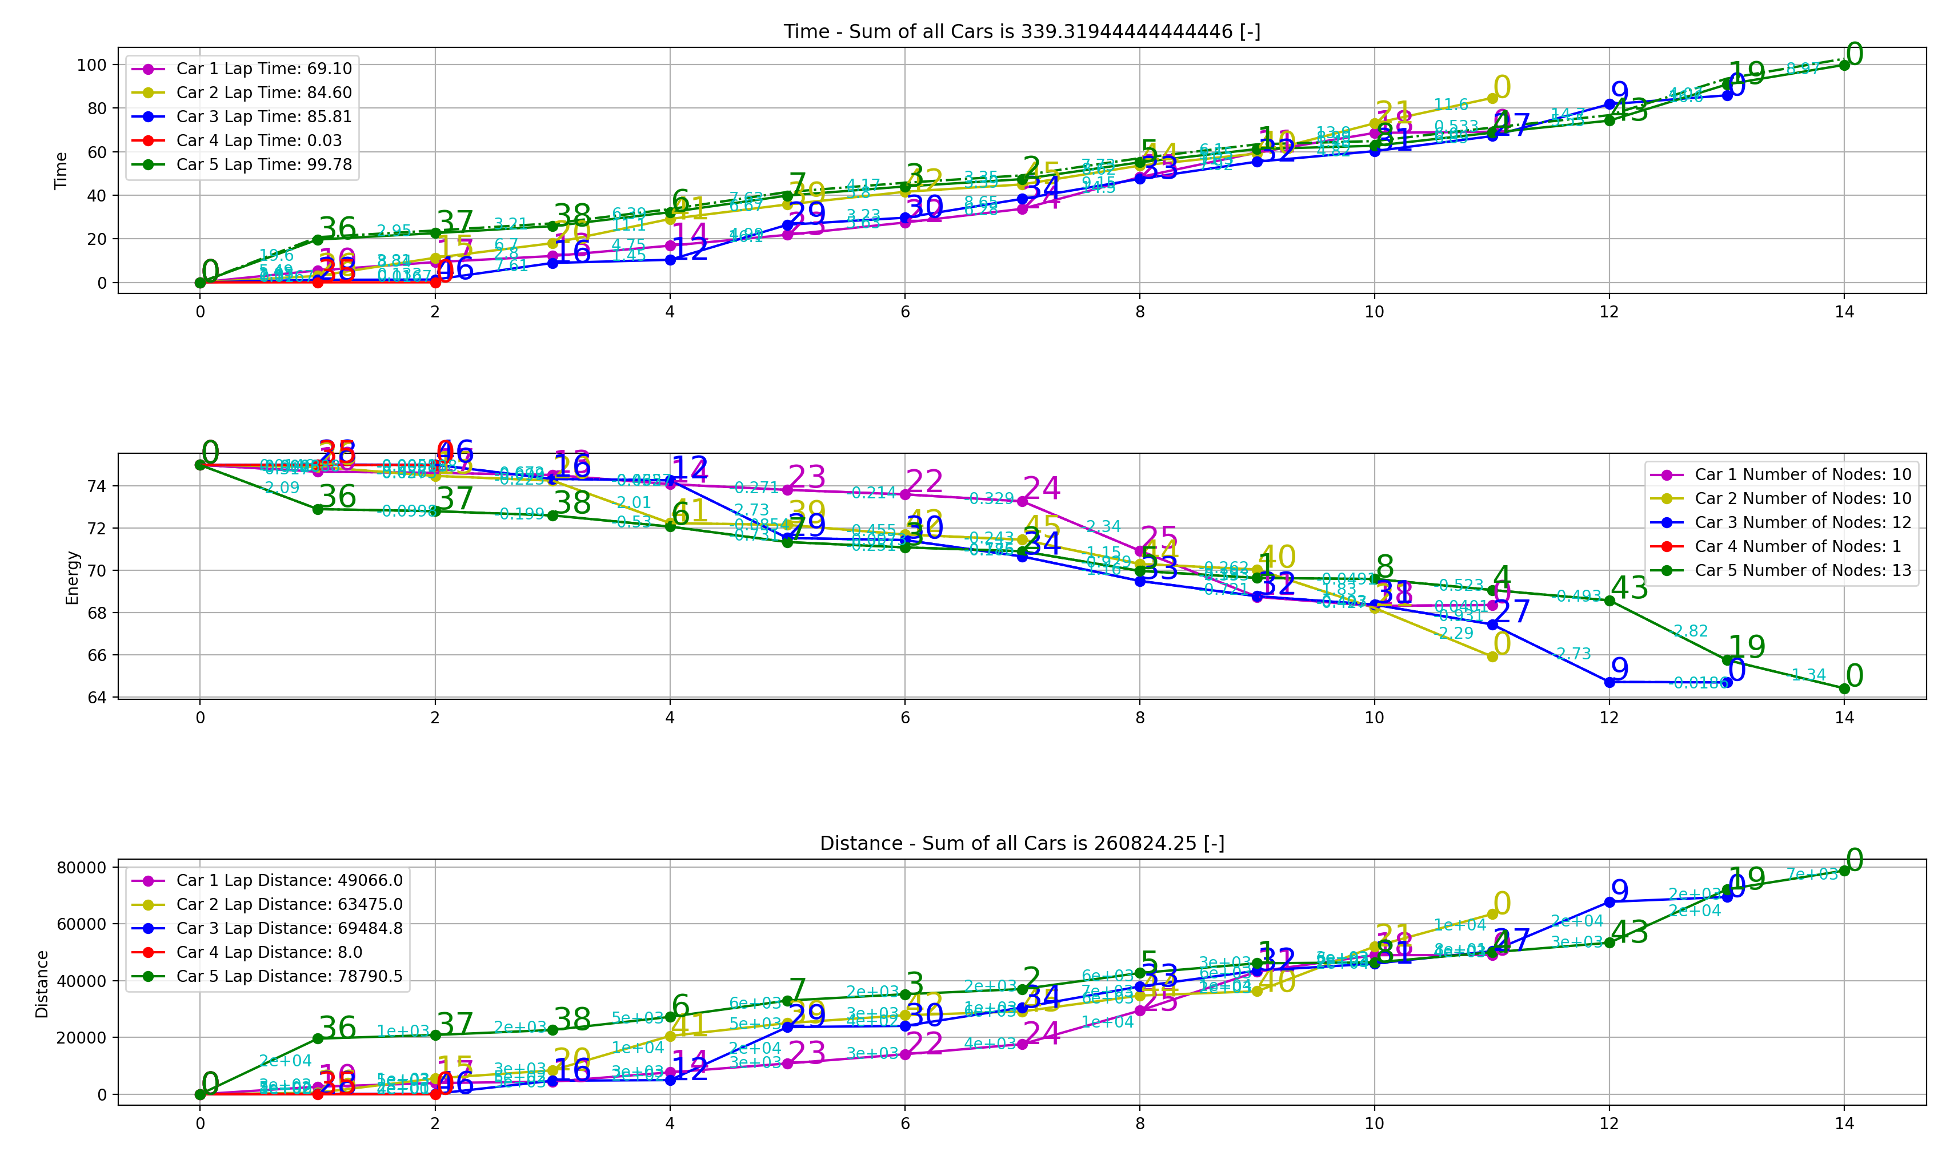
Budweiser Database
Current Optimization – 4 trucks
Max Time Per Truck – 110[sec]
Max Number of nodes per truck - 12
azZ

Slide 23
ECVRP instance | Clustering Result gap | Clustering Calc Time [sec] | BKS Time (*Similar problem) | BKS Year
X-n101-k25 | 5.3% | 5 | - | 2020
X-n251-k28 | 3.9% | 47 | 161.0**
X-n336-k84 | 7.1% | 104 | 1120.0
X-n351-k40 | 7.0% | 352 | 1119.4
X-n685-k75 | 6.60% | 2086 | 5511.7
X-n749-k98 | 3.92% | 1602.2 | 7258
X-n819-k171 | −2.39% | 364.9 | 6612.6
X-n916-k207 | -1.28% | 546. | 6775
X-n1001-k43 | 6.5%

