Slide 1
Multiple Shortest Path Planning With Energy Constraints
Pustilnik Mark

Slide 2
Problem Definition
Find the fastest path that M≥1 vehicles can take in order to visit N≥2M+1 nodes,
such that the total amount of time is minimized, subjected to SOC≥SOCmin.

Slide 3
Decision Variables
Defining the decision variables:
  Binary Decision Variable. Is a 1 if some vehicle travels from node i to node j. 0, otherwise. There are NxN such decision variables.
  SOC Variable: si The state-of-charge at node i arrival.
  Sub-contour elimination: ui is a dummy variable that ensures no sub contours. It’s meaning is the number of nodes visited prior to the current node.
  Charging Time. ti is the amount of time spent in node i to recharge. ti≥0 if node i has a charging station, ti=0 otherwise.

Slide 4
Decision Variables
Problem Parameters:
  Cost Matrix. is the cost of traveling from node i to node j.
  Energy Matrix. is the energy to travel from node i to node j.
  Max number of nodes a single vehicle can visit:
  Max Battery Capacity of every vehicle:
  Charging Rate of each Charging Station,

Slide 5
Problem Formulation
M exits from node 0
O(N) inequalities
M enter to node 0
1 enter to node 1,…,N-1
1 exit to node 1,…,N-1
Sub-contour elimination
O(N²) inequalities
First Var init
Var limits
Var connections
Initial SOC initialization
Energy nodes Connections
O(N²) inequalities
Can’t enter a node with more than capacity
Enter origin node with at least SOCmin
Can’t charge out of charging stations

Slide 6
Energy Constraints
Reminder: si is the SOC when entering node i
If Xi,j = 1, the SOC when entering node j
This connection is relaxed. At the optimal solution, when some ti>0, the inequality turns to equality
To disconnect the connection between si and sj, if Xi,j=0 → add term to make inequality trivial
Energy connection to last node:
Energy entering any node must be non-negative:
These energy constraints formulation are convex (although the whole program is not convex - MILP)

Slide 7
Alternative Energy Constraints
Reminder: si is the SOC when entering node i
If Xi,j = 1, the SOC when entering node j
To disconnect the connection between si and sj, if Xi,j=0 → add a dummy variable that can take any value
Energy connection to last node:
Energy entering any node must be non-negative:
These energy constraints formulation are non convex (whole program is not convex - MILP)

Slide 8
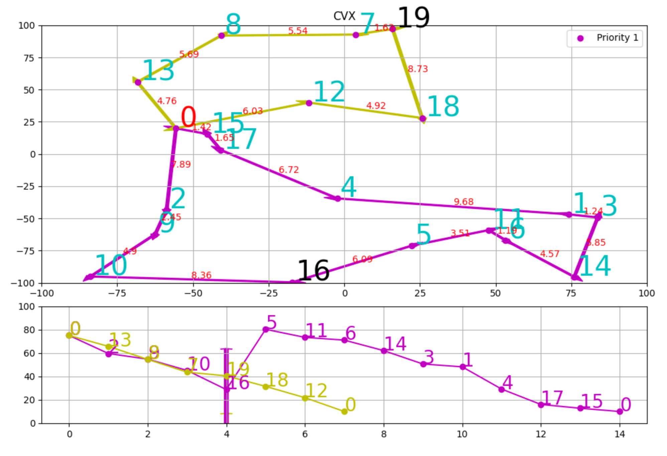
Example
20 Nodes, 2 vehicles
2 charging stations: 16, 19

Slide 9
Problem Definition
Find the fastest path that M≥1 vehicles can take in order to visit N≥2M+1 nodes,
such that the Maximum single vehicle trip time is minimized,
subjected to SOC≥SOCmin.

Slide 10
Decision Variables
Defining the decision variables:
  Binary Decision Variable. Is a 1 if some vehicle travels from node i to node j. 0, otherwise. There are NxN such decision variables.
  SOC Variable: si The state-of-charge at node i arrival.
  Sub-contour elimination: ui is a dummy variable that ensures no sub contours. It’s meaning is the number of nodes visited prior to the current node.
  Charging Time. yi is the amount of time spent in node i to recharge. yi≥0 if node i has a charging station, yi=0 otherwise.
  Elapsed Time from origin – ti
  Elapsed Time when returning to origin – tfi. tfi>0 if , tfi=0 otherwise

Slide 11
Decision Variables
Problem Parameters:
  Cost Matrix. is the cost of traveling from node i to node j.
  Energy Matrix. is the energy to travel from node i to node j.
  Max number of nodes a single vehicle can visit:
  Max Battery Capacity of every vehicle:
  Charging Rate of each Charging Station,

Slide 12
Problem Formulation
M exits from node 0
O(N) inequalities
M enter to node 0
1 enter to node 1,…,N-1
1 exit to node 1,…,N-1
Sub-contour elimination
O(N²) inequalities
First Var init
Var limits
Var connections
Initial SOC initialization
Energy nodes Connections
O(N²) inequalities
Can’t enter a node with more than capacity
Can’t charge out of charging stations

Slide 13
Problem Formulation
Initial SOC initialization
Energy nodes Connections
O(N²) inequalities
Can’t enter a node with more than capacity
Can’t charge out of charging stations

Slide 14
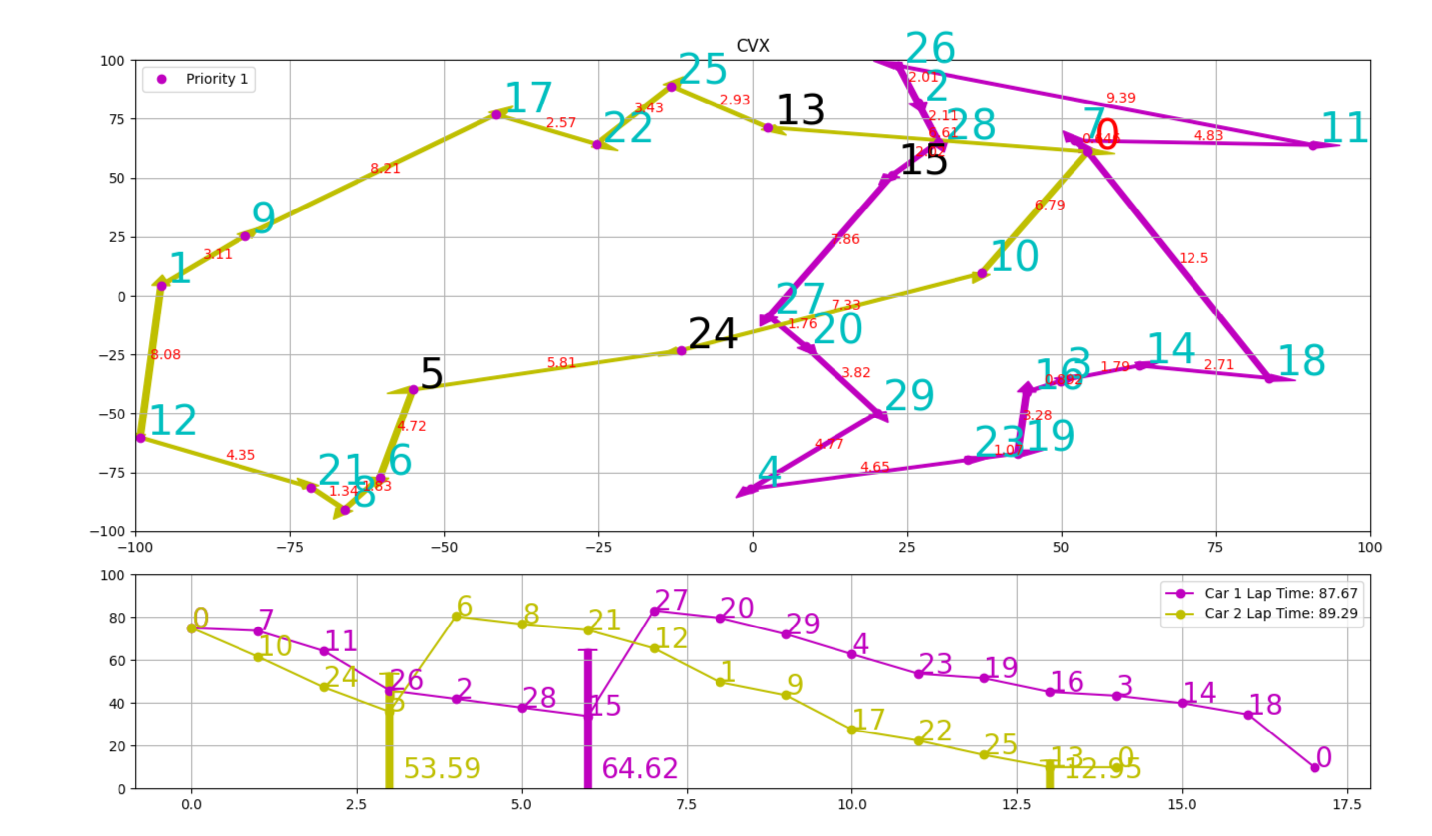
Example
30 Nodes, 2 vehicles
4 charging stations

