Slide 1
Launch vehicle optimization
with booster recovery
Falcon 9 case study
Maximum payload to a specified orbit, subject to ascent and recovery constraints
Mark Pustilnik and Francesco Borrelli
MPC Lab, UC Berkeley
01
Notes:
Source: https://github.com/pukmark/LaunchVehicleOptimization/tree/5295f20211b50467d81eac8f47408673b93e9190 . Current default-branch HEAD retrieved October 8, 2026, commit 5295f20 (gui update). Nominal Falcon 9, configuration 1, with unit dispersion factors and zero offsets. Parameter values: LV_Type_scaled.py lines 54–123 and derived initialization 144–151. Phase constraints: LV_Optimization_Type.py lines 125–324. Atmosphere: Atmosphere_Type.py. Values are optimizer inputs. Payload and target orbit remain mission-dependent.

Slide 2
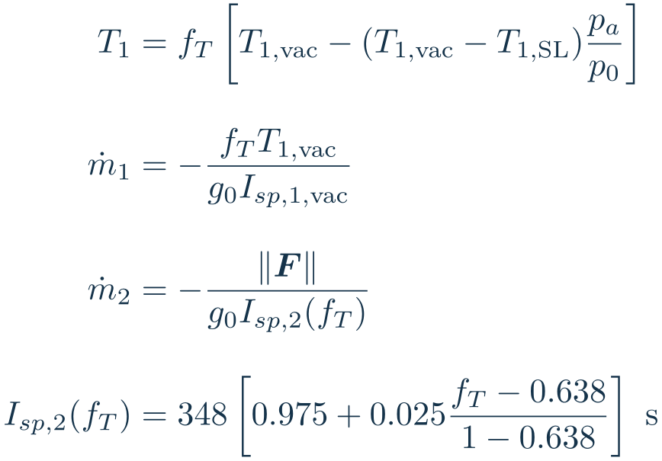
Propulsion model
Stage 1 (9 engines)
SL / vacuum thrust: 7.605 / 8.226 MN
SL / vacuum Isp: 282 / 305 s
Throttle: 0.57–1
Stage 2
Thrust: 981 kN
Isp at full thrust: 348 s
Throttle: 0.638–1
Stage-2 throttle is fT = ‖F‖ / 981 kN. Engine-off segments have zero thrust and mass flow.
02
Notes:
Active code equations: LV_Type_scaled.py lines 356–372 and 431–439. Ascent mass flow uses the vacuum reference Isp, not the diagnostic Isp_calc output. Upper-stage Isp varies from 339.3 s at minimum throttle to 348 s at full throttle. g0 is computed as mu / R0^2.
Source: https://github.com/pukmark/LaunchVehicleOptimization/tree/5295f20211b50467d81eac8f47408673b93e9190 . Current default-branch HEAD retrieved October 8, 2026, commit 5295f20 (gui update). Nominal Falcon 9, configuration 1, with unit dispersion factors and zero offsets. Parameter values: LV_Type_scaled.py lines 54–123 and derived initialization 144–151. Phase constraints: LV_Optimization_Type.py lines 125–324. Atmosphere: Atmosphere_Type.py. Values are optimizer inputs. Payload and target orbit remain mission-dependent.
LaTeX source:
\begin{aligned}T_1 &= f_T\left[T_{1,\mathrm{vac}}-(T_{1,\mathrm{vac}}-T_{1,\mathrm{SL}})\frac{p_a}{p_0}\right]\\[9pt]\dot m_1&=-\frac{f_TT_{1,\mathrm{vac}}}{g_0I_{sp,1,\mathrm{vac}}}\\[9pt]\dot m_2&=-\frac{\|\bm F\|}{g_0I_{sp,2}(f_T)}\\[9pt]I_{sp,2}(f_T)&=348\left[0.975+0.025\frac{f_T-0.638}{1-0.638}\right]\ \mathrm{s}\end{aligned}

Slide 3
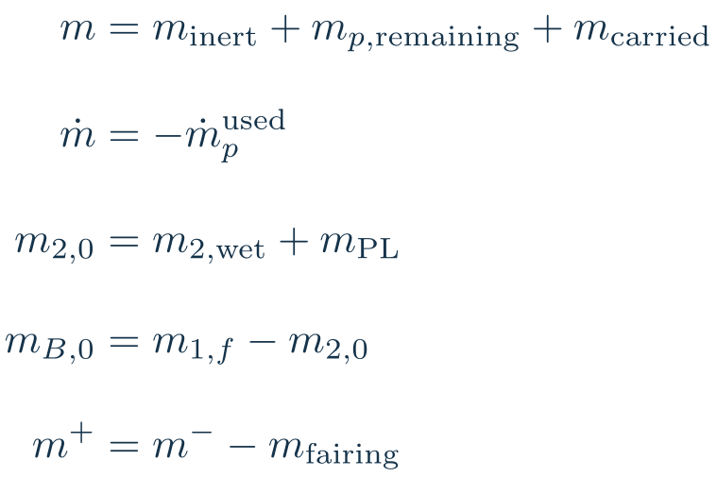
Mass and separation model
Stage 1 dry / propellant:
25.6 / 395.7 t
Stage 2 dry / propellant:
4.0 / 92.670 t
Fairing: 1.9 t
Total before payload: 519.870 t
Inert masses are inputs. The framework tracks mass rather than sizing structures.
03
Notes:
Code initializes second stage and recovery branch at separation and applies fairing mass jump. m2,wet includes attached fairing.
Source: https://github.com/pukmark/LaunchVehicleOptimization/tree/5295f20211b50467d81eac8f47408673b93e9190 . Current default-branch HEAD retrieved October 8, 2026, commit 5295f20 (gui update). Nominal Falcon 9, configuration 1, with unit dispersion factors and zero offsets. Parameter values: LV_Type_scaled.py lines 54–123 and derived initialization 144–151. Phase constraints: LV_Optimization_Type.py lines 125–324. Atmosphere: Atmosphere_Type.py. Values are optimizer inputs. Payload and target orbit remain mission-dependent.
LaTeX source:
\begin{aligned}m&=m_{\mathrm{inert}}+m_{p,\mathrm{remaining}}+m_{\mathrm{carried}}\\[9pt]\dot m&=-\dot m_p^{\mathrm{used}}\\[9pt]m_{2,0}&=m_{2,\mathrm{wet}}+m_{\mathrm{PL}}\\[9pt]m_{B,0}&=m_{1,f}-m_{2,0}\\[9pt]m^+&=m^--m_{\mathrm{fairing}}\end{aligned}

Slide 4
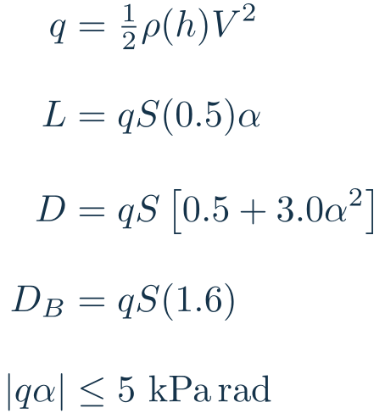
Aerodynamic model
Diameter: 3.66 m
Reference area: 10.52088 m²
Ascent uses constant base drag and an α² correction.
Return drag uses CD = 1.6 and neglects lift.
Air-relative speed equals local speed under the no-wind assumption.
04
Notes:
Active code uses constant CD0=0.5, Cda2=3.0 and CLa=0.5 rather than a Mach-dependent drag fit. Return uses CD0=1.6. LV_Type_scaled.py lines 79–96, 150, 356–357, 554–558. Positive lift convention is normal to velocity, en=[-sin gamma,cos gamma].
Source: https://github.com/pukmark/LaunchVehicleOptimization/tree/5295f20211b50467d81eac8f47408673b93e9190 . Current default-branch HEAD retrieved October 8, 2026, commit 5295f20 (gui update). Nominal Falcon 9, configuration 1, with unit dispersion factors and zero offsets. Parameter values: LV_Type_scaled.py lines 54–123 and derived initialization 144–151. Phase constraints: LV_Optimization_Type.py lines 125–324. Atmosphere: Atmosphere_Type.py. Values are optimizer inputs. Payload and target orbit remain mission-dependent.
LaTeX source:
\begin{aligned}q&=\tfrac12\rho(h)V^2\\[9pt]L&=qS(0.5)\alpha\\[9pt]D&=qS\left[0.5+3.0\alpha^2\right]\\[9pt]D_B&=qS(1.6)\\[9pt]|q\alpha|&\leq5\ \mathrm{kPa\,rad}\end{aligned}
\gamma=\operatorname{atan2}(v_z,v_x),\quad \bm e_v=[\cos\gamma,\sin\gamma]^{\mathsf T},\quad \bm e_n=[-\sin\gamma,\cos\gamma]^{\mathsf T}

Slide 5
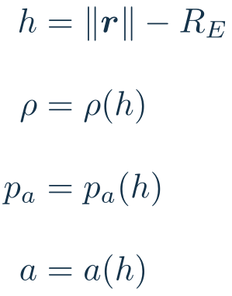
Atmosphere model
Sea-level values
Density: 1.225 kg/m³
Pressure: 101,325 Pa
Sound speed: 340.3 m/s
Density and pressure interpolate in log space. Sound speed interpolates linearly.
The nominal model assumes no wind and a spherical Earth.
05
Notes:
Atmosphere_Type.py lines 32–84 supplies tabulated altitude values from 0 to 1000 km. Density and pressure use log-linear interpolation, sound speed uses linear interpolation.
Source: https://github.com/pukmark/LaunchVehicleOptimization/tree/5295f20211b50467d81eac8f47408673b93e9190 . Current default-branch HEAD retrieved October 8, 2026, commit 5295f20 (gui update). Nominal Falcon 9, configuration 1, with unit dispersion factors and zero offsets. Parameter values: LV_Type_scaled.py lines 54–123 and derived initialization 144–151. Phase constraints: LV_Optimization_Type.py lines 125–324. Atmosphere: Atmosphere_Type.py. Values are optimizer inputs. Payload and target orbit remain mission-dependent.
LaTeX source:
\begin{aligned}h&=\|\bm r\|-R_E\\[9pt]\rho&=\rho(h)\\[9pt]p_a&=p_a(h)\\[9pt]a&=a(h)\end{aligned}

Slide 6
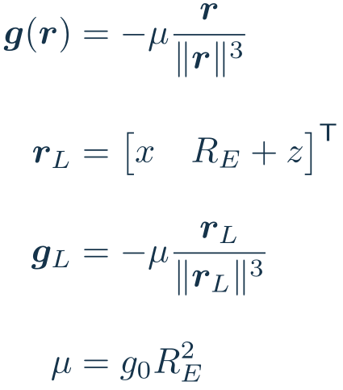
Gravity and coordinate frames
Earth radius: 6,378,137 m
μ = 3.986004418 × 10¹⁴ m³/s²
g₀ = μ / R² = 9.798285 m/s²
Local frame: planar ascent / return
ECI: 3D upper-stage flight
Local-phase Earth rotation effects are neglected. The ECI initialization includes rotation.
06
Notes:
Paper Sections 4.1 and 4.4. z is up at the surface-origin local frame. Vector gravity avoids inconsistent signs in printed component expressions.
Source: https://github.com/pukmark/LaunchVehicleOptimization/tree/5295f20211b50467d81eac8f47408673b93e9190 . Current default-branch HEAD retrieved October 8, 2026, commit 5295f20 (gui update). Nominal Falcon 9, configuration 1, with unit dispersion factors and zero offsets. Parameter values: LV_Type_scaled.py lines 54–123 and derived initialization 144–151. Phase constraints: LV_Optimization_Type.py lines 125–324. Atmosphere: Atmosphere_Type.py. Values are optimizer inputs. Payload and target orbit remain mission-dependent.
LaTeX source:
\begin{aligned}\bm g(\bm r)&=-\mu\frac{\bm r}{\|\bm r\|^3}\\[9pt]\bm r_L&=\begin{bmatrix}x & R_E+z\end{bmatrix}^{\mathsf T}\\[9pt]\bm g_L&=-\mu\frac{\bm r_L}{\|\bm r_L\|^3}\\[9pt]\mu&=g_0R_E^2\end{aligned}

Slide 7
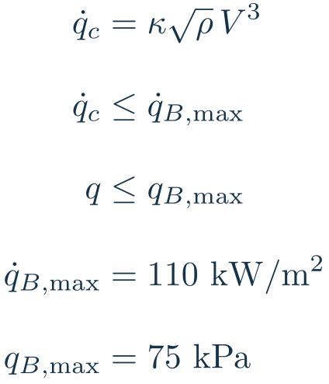
Heating model
Empirical coefficient κ = 2 × 10⁻⁴ in the code’s SI convention.
Return limits
Heat flux: 110 kW/m²
Dynamic pressure: 75 kPa
Entry burn reduces speed before descent.
The heat-flux constraint does not model wall temperature or accumulated thermal load.
07
Notes:
LV_Type_scaled.py lines 94–96 and 581–582. Heat-flux units are W/m² as used by VehicleDefinitions.py, despite the older Pa comment on the field. Code samples return constraints during post-entry descent and landing, not continuously throughout all recovery segments.
Source: https://github.com/pukmark/LaunchVehicleOptimization/tree/5295f20211b50467d81eac8f47408673b93e9190 . Current default-branch HEAD retrieved October 8, 2026, commit 5295f20 (gui update). Nominal Falcon 9, configuration 1, with unit dispersion factors and zero offsets. Parameter values: LV_Type_scaled.py lines 54–123 and derived initialization 144–151. Phase constraints: LV_Optimization_Type.py lines 125–324. Atmosphere: Atmosphere_Type.py. Values are optimizer inputs. Payload and target orbit remain mission-dependent.
LaTeX source:
\begin{aligned}\dot q_c&=\kappa\sqrt{\rho}\,V^3\\[9pt]\dot q_c&\leq\dot q_{B,\max}\\[9pt]q&\leq q_{B,\max}\\[9pt]\dot q_{B,\max}&=110\ \mathrm{kW/m^2}\\[9pt]q_{B,\max}&=75\ \mathrm{kPa}\end{aligned}

Slide 8



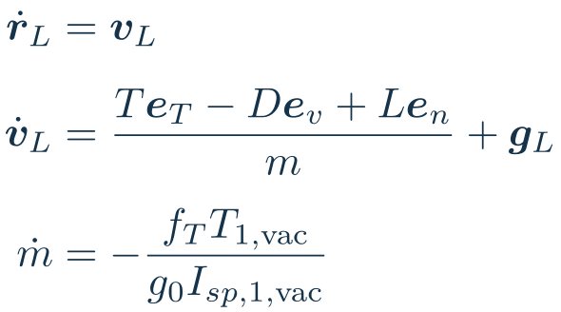
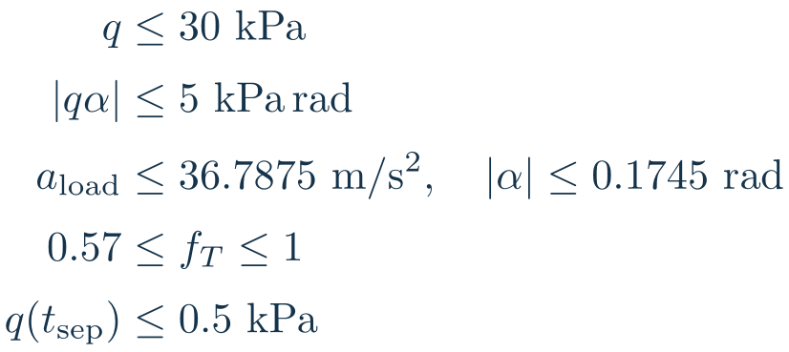
Phase 1: first-stage ascent
STATES (LOCAL FRAME, 5)
INPUTS
EQUATIONS OF MOTION
CONSTRAINTS AND TRANSITIONS
Optimize throttle, angle of attack, launch azimuth, and ascent duration.
Initial rise: 5 s. αmax = 0.1745 rad ≈ 10°. Payload load cap = 3.75 × 9.81 m/s².
08
Notes:
eT=[cos(gamma+alpha),sin(gamma+alpha)], ev=[cos gamma,sin gamma], en=[-sin gamma,cos gamma]. gamma=atan2(vz,vx). Nominal limits from current GitHub VLType defaults. The payload acceleration field is exactly 3.75*9.81=36.7875 m/s², while dynamics g0=mu/R0²=9.7982854791873 m/s². Maximum alpha=0.1745 rad (9.9981°). a_load is the specific-force/load metric used in the implementation, not net inertial acceleration. The conventional positive-normal lift resolves a printed lift-sign inconsistency. The optimizer input order is throttle then angle. The lower mass limit and coupled recovery branch preserve booster dry mass.
Source: https://github.com/pukmark/LaunchVehicleOptimization/tree/5295f20211b50467d81eac8f47408673b93e9190 . Current default-branch HEAD retrieved October 8, 2026, commit 5295f20 (gui update). Nominal Falcon 9, configuration 1, with unit dispersion factors and zero offsets. Parameter values: LV_Type_scaled.py lines 54–123 and derived initialization 144–151. Phase constraints: LV_Optimization_Type.py lines 125–324. Atmosphere: Atmosphere_Type.py. Values are optimizer inputs. Payload and target orbit remain mission-dependent.
LaTeX source:
\bm x_L=\begin{bmatrix}x&z&v_x&v_z&m\end{bmatrix}^{\mathsf T}
\bm u_1=\begin{bmatrix}f_T&\alpha\end{bmatrix}^{\mathsf T}
\bm e_T=[\cos(\gamma+\alpha),\sin(\gamma+\alpha)]^{\mathsf T}
\begin{aligned}\dot{\bm r}_L&=\bm v_L\\[4pt]\dot{\bm v}_L&=\frac{T\bm e_T-D\bm e_v+L\bm e_n}{m}+\bm g_L\\[4pt]\dot m&=-\frac{f_TT_{1,\mathrm{vac}}}{g_0I_{sp,1,\mathrm{vac}}}\end{aligned}
\begin{aligned}q&\leq30\ \mathrm{kPa}\\[2pt]|q\alpha|&\leq5\ \mathrm{kPa\,rad}\\[2pt]a_{\mathrm{load}}&\leq36.7875\ \mathrm{m/s^2},\quad |\alpha|\leq0.1745\ \mathrm{rad}\\[2pt]0.57&\leq f_T\leq1\\[2pt]q(t_{\mathrm{sep}})&\leq0.5\ \mathrm{kPa}\end{aligned}

Slide 9

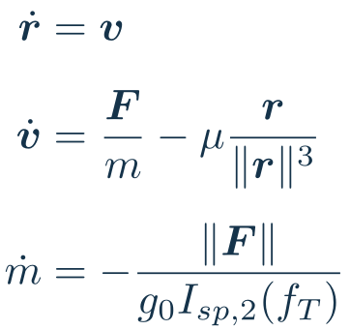
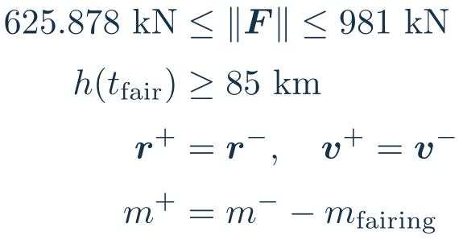
Phase 2: upper stage before fairing release
STATES (ECI FRAME, 7)
INPUTS
EQUATIONS OF MOTION
CONSTRAINTS AND TRANSITIONS
Separation sets the ECI initial state. A prescribed 10 s coast precedes SES-1.
The supplied code uses an altitude release gate and has no explicit acceleration bound in this segment.
09
Notes:
Code Phase 2. The paper describes a dynamic-pressure release condition, while this supplied implementation constrains altitude. Nominal configuration 1 uses hfair=85 km, fairing mass=1900 kg and post-separation coast=10 s. Numerical propulsion input T2,vac=981 kN and Isp2=348 s appear in the paper but are not required to define this phase.
Source: https://github.com/pukmark/LaunchVehicleOptimization/tree/5295f20211b50467d81eac8f47408673b93e9190 . Current default-branch HEAD retrieved October 8, 2026, commit 5295f20 (gui update). Nominal Falcon 9, configuration 1, with unit dispersion factors and zero offsets. Parameter values: LV_Type_scaled.py lines 54–123 and derived initialization 144–151. Phase constraints: LV_Optimization_Type.py lines 125–324. Atmosphere: Atmosphere_Type.py. Values are optimizer inputs. Payload and target orbit remain mission-dependent.
LaTeX source:
\bm x_E=\begin{bmatrix}r_x&r_y&r_z&v_x&v_y&v_z&m\end{bmatrix}^{\mathsf T}
\bm{u}_2=\begin{bmatrix}F_x&F_y&F_z\end{bmatrix}^{\mathsf T}
\begin{aligned}\dot{\bm r}&=\bm v\\[4pt]\dot{\bm v}&=\frac{\bm F}{m}-\mu\frac{\bm r}{\|\bm r\|^3}\\[4pt]\dot m&=-\frac{\|\bm F\|}{g_0 I_{sp,2}(f_T)}\end{aligned}
\begin{aligned}625.878\ \mathrm{kN}&\leq\|\bm F\|\leq981\ \mathrm{kN}\\[2pt]h(t_{\mathrm{fair}})&\geq85\ \mathrm{km}\\[2pt]\bm r^+&=\bm r^-,\quad\bm v^+=\bm v^-\\[2pt]m^+&=m^--m_{\mathrm{fairing}}\end{aligned}

Slide 10

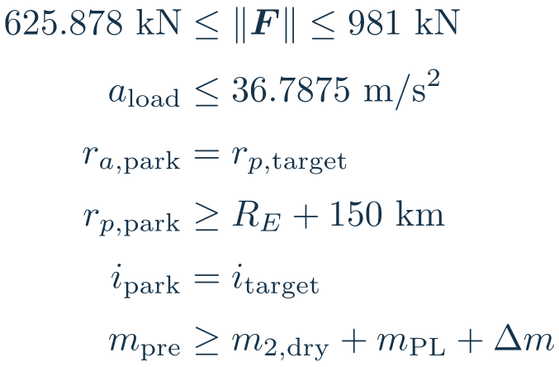
Phase 3: upper stage to parking orbit
STATES (ECI FRAME, 7)
INPUTS
EQUATIONS OF MOTION
CONSTRAINTS AND TRANSITIONS
Fairing jettison lowers mass. The optimizer reaches a parking orbit and preserves restart propellant.
SES-1 ends when the parking-orbit boundary conditions and propellant reserve are feasible.
10
Notes:
Code Phase 3. Both second-stage grids optimize controls and durations. Inclination, parking apsides, and reserve bound are explicit terminal constraints. Quantities r_p and r_a are Earth-center radii.
Source: https://github.com/pukmark/LaunchVehicleOptimization/tree/5295f20211b50467d81eac8f47408673b93e9190 . Current default-branch HEAD retrieved October 8, 2026, commit 5295f20 (gui update). Nominal Falcon 9, configuration 1, with unit dispersion factors and zero offsets. Parameter values: LV_Type_scaled.py lines 54–123 and derived initialization 144–151. Phase constraints: LV_Optimization_Type.py lines 125–324. Atmosphere: Atmosphere_Type.py. Values are optimizer inputs. Payload and target orbit remain mission-dependent.
LaTeX source:
\bm x_E=\begin{bmatrix}r_x&r_y&r_z&v_x&v_y&v_z&m\end{bmatrix}^{\mathsf T}
\bm u_3=\bm F
\begin{aligned}\dot{\bm r}&=\bm v\\[4pt]\dot{\bm v}&=\frac{\bm F}{m}-\mu\frac{\bm r}{\|\bm r\|^3}\\[4pt]\dot m&=-\frac{\|\bm F\|}{g_0 I_{sp,2}(f_T)}\end{aligned}
\begin{aligned}625.878\ \mathrm{kN}&\leq\|\bm F\|\leq981\ \mathrm{kN}\\[2pt]a_{\mathrm{load}}&\leq36.7875\ \mathrm{m/s^2}\\[2pt]r_{a,\mathrm{park}}&=r_{p,\mathrm{target}}\\[2pt]r_{p,\mathrm{park}}&\geq R_E+150\ \mathrm{km}\\[2pt]i_{\mathrm{park}}&=i_{\mathrm{target}}\\[2pt]m_{\mathrm{pre}}&\geq m_{2,\mathrm{dry}}+m_{\mathrm{PL}}+\Delta m\end{aligned}

Slide 11

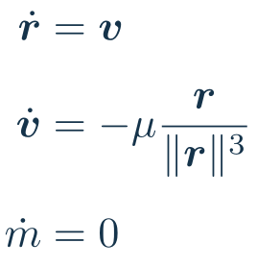
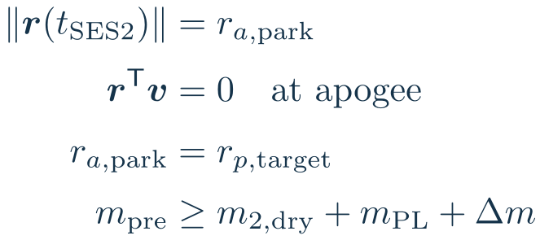
Upper-stage coast to the second ignition
STATES (ECI FRAME, 7)
INPUTS
EQUATIONS OF MOTION
CONSTRAINTS AND TRANSITIONS
The upper stage coasts to parking-orbit apogee before SES-2.
Current code evaluates the maneuver at this apsis analytically; it does not optimize the coast time.
11
Notes:
This explanatory coast is the physical interpretation of the reserve calculation. No thermal propellant loss or settling/start-up reserve is included in the supplied maneuver model. The apogee radius condition distinguishes apogee from perigee, since radial speed is zero at either apsis.
Source: https://github.com/pukmark/LaunchVehicleOptimization/tree/5295f20211b50467d81eac8f47408673b93e9190 . Current default-branch HEAD retrieved October 8, 2026, commit 5295f20 (gui update). Nominal Falcon 9, configuration 1, with unit dispersion factors and zero offsets. Parameter values: LV_Type_scaled.py lines 54–123 and derived initialization 144–151. Phase constraints: LV_Optimization_Type.py lines 125–324. Atmosphere: Atmosphere_Type.py. Values are optimizer inputs. Payload and target orbit remain mission-dependent.
LaTeX source:
\bm x_E=\begin{bmatrix}r_x&r_y&r_z&v_x&v_y&v_z&m\end{bmatrix}^{\mathsf T}
\bm u_{\mathrm{coast}}=\bm F=\bm0
\begin{aligned}\dot{\bm r}&=\bm v\\[4pt]\dot{\bm v}&=-\mu\frac{\bm r}{\|\bm r\|^3}\\[4pt]\dot m&=0\end{aligned}
\begin{aligned}\|\bm r(t_{\mathrm{SES2}})\|&=r_{a,\mathrm{park}}\\[2pt]\bm r^{\mathsf T}\bm v&=0\quad\text{at apogee}\\[2pt]r_{a,\mathrm{park}}&=r_{p,\mathrm{target}}\\[2pt]m_{\mathrm{pre}}&\geq m_{2,\mathrm{dry}}+m_{\mathrm{PL}}+\Delta m\end{aligned}

Slide 12

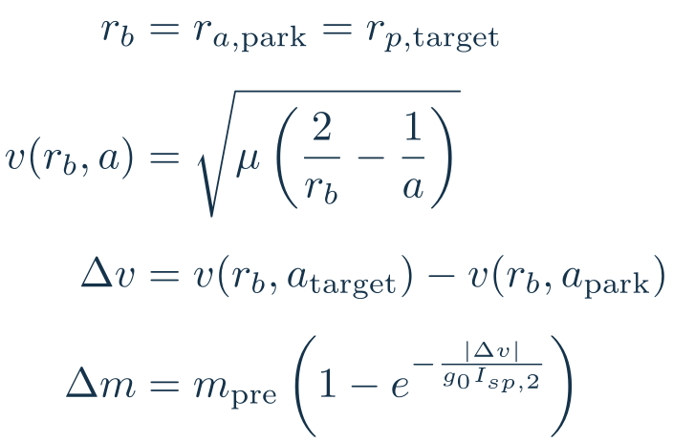
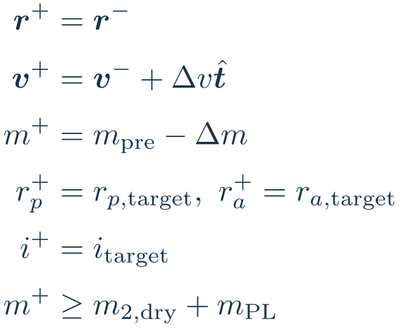
SES-2: parking orbit to final orbit
STATES (ECI FRAME, 7)
INPUTS
IMPULSIVE BURN MODEL
CONSTRAINTS AND TRANSITIONS
A tangential restart reaches the target apogee. Reserve calculation uses Isp₂ = 348 s.
Current formulation: impulsive state jump and propellant reserve. A finite burn requires the ECI thrust dynamics.
12
Notes:
Code propellant_mass_for_final_dv uses vis-viva at parking apogee and the rocket equation. The impulse magnitude is determined by the two orbits, not an additional independent optimized control. Direction is tangential; target inclination is already achieved. A finite burn would instead use the upper-stage ECI equations with thrust and throttle limits. Startup and boil-off are not modeled.
Source: https://github.com/pukmark/LaunchVehicleOptimization/tree/5295f20211b50467d81eac8f47408673b93e9190 . Current default-branch HEAD retrieved October 8, 2026, commit 5295f20 (gui update). Nominal Falcon 9, configuration 1, with unit dispersion factors and zero offsets. Parameter values: LV_Type_scaled.py lines 54–123 and derived initialization 144–151. Phase constraints: LV_Optimization_Type.py lines 125–324. Atmosphere: Atmosphere_Type.py. Values are optimizer inputs. Payload and target orbit remain mission-dependent.
LaTeX source:
\bm x_E=\begin{bmatrix}r_x&r_y&r_z&v_x&v_y&v_z&m\end{bmatrix}^{\mathsf T}
\bm u_{\mathrm{SES2}}=\Delta\bm v=\Delta v\,\hat{\bm t}
\begin{aligned}r_b&=r_{a,\mathrm{park}}=r_{p,\mathrm{target}}\\[4pt]v(r_b,a)&=\sqrt{\mu\left(\frac{2}{r_b}-\frac1a\right)}\\[4pt]\Delta v&=v(r_b,a_{\mathrm{target}})-v(r_b,a_{\mathrm{park}})\\[4pt]\Delta m&=m_{\mathrm{pre}}\left(1-e^{-\frac{|\Delta v|}{g_0I_{sp,2}}}\right)\end{aligned}
\begin{aligned}\bm r^+&=\bm r^-\\[2pt]\bm v^+&=\bm v^-+\Delta v\hat{\bm t}\\[2pt]m^+&=m_{\mathrm{pre}}-\Delta m\\[2pt]r_p^+&=r_{p,\mathrm{target}},\ r_a^+=r_{a,\mathrm{target}}\\[2pt]i^+&=i_{\mathrm{target}}\\[2pt]m^+&\geq m_{2,\mathrm{dry}}+m_{\mathrm{PL}}\end{aligned}

Slide 13

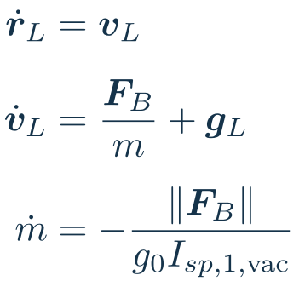
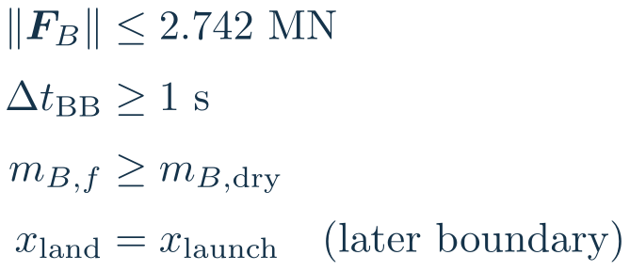
Recovery: RTLS boostback burn
STATES (LOCAL FRAME, 5)
INPUTS
EQUATIONS OF MOTION
CONSTRAINTS AND TRANSITIONS
Optimize a planar thrust vector and burn duration to make the RTLS landing feasible.
RTLS boostback uses 3-engine vacuum thrust (2.742 MN), Isp = 305 s. ASDS starts with coast.
13
Notes:
Code uses one thrust vector held over the boostback segment and integrates with substeps. No standalone boostback endpoint is prescribed: its exit state couples to the coast and landing boundaries. Final dry-mass condition is enforced at landing, rather than an explicit boostback path constraint; monotonic consumption makes it an implied lower bound earlier.
Source: https://github.com/pukmark/LaunchVehicleOptimization/tree/5295f20211b50467d81eac8f47408673b93e9190 . Current default-branch HEAD retrieved October 8, 2026, commit 5295f20 (gui update). Nominal Falcon 9, configuration 1, with unit dispersion factors and zero offsets. Parameter values: LV_Type_scaled.py lines 54–123 and derived initialization 144–151. Phase constraints: LV_Optimization_Type.py lines 125–324. Atmosphere: Atmosphere_Type.py. Values are optimizer inputs. Payload and target orbit remain mission-dependent.
LaTeX source:
\bm x_L=\begin{bmatrix}x&z&v_x&v_z&m\end{bmatrix}^{\mathsf T}
\bm u_{\mathrm{BB}}=\bm F_B=\begin{bmatrix}F_x&F_z\end{bmatrix}^{\mathsf T}
\begin{aligned}\dot{\bm r}_L&=\bm v_L\\[4pt]\dot{\bm v}_L&=\frac{\bm F_B}{m}+\bm g_L\\[4pt]\dot m&=-\frac{\|\bm F_B\|}{g_0I_{sp,1,\mathrm{vac}}}\end{aligned}
\begin{aligned}\|\bm F_B\|&\leq2.742\ \mathrm{MN}\\[2pt]\Delta t_{\mathrm{BB}}&\geq1\ \mathrm{s}\\[2pt]m_{B,f}&\geq m_{B,\mathrm{dry}}\\[2pt]x_{\mathrm{land}}&=x_{\mathrm{launch}}\quad\text{(later boundary)}\end{aligned}

Slide 14

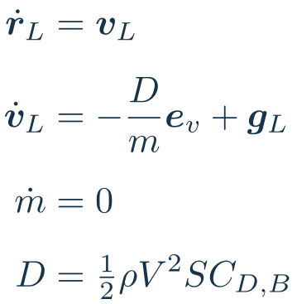
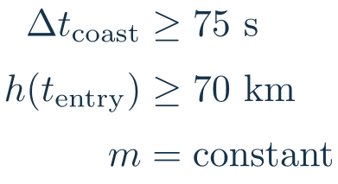
Recovery: ballistic coast before entry
STATES (LOCAL FRAME, 5)
INPUTS
EQUATIONS OF MOTION
CONSTRAINTS AND TRANSITIONS
Gravity and drag evolve the booster state with the engines off.
The entry start time is optimized subject to the altitude gate; it is not a fixed-altitude trigger.
14
Notes:
Code propagates a ballistic segment for an optimized duration >=75 s, then constrains its terminal altitude >=70 km. Dynamic-pressure and heat limits are not sampled explicitly during this pre-entry coast.
Source: https://github.com/pukmark/LaunchVehicleOptimization/tree/5295f20211b50467d81eac8f47408673b93e9190 . Current default-branch HEAD retrieved October 8, 2026, commit 5295f20 (gui update). Nominal Falcon 9, configuration 1, with unit dispersion factors and zero offsets. Parameter values: LV_Type_scaled.py lines 54–123 and derived initialization 144–151. Phase constraints: LV_Optimization_Type.py lines 125–324. Atmosphere: Atmosphere_Type.py. Values are optimizer inputs. Payload and target orbit remain mission-dependent.
LaTeX source:
\bm x_L=\begin{bmatrix}x&z&v_x&v_z&m\end{bmatrix}^{\mathsf T}
\bm u_{\mathrm{ballistic}}=\bm0
\begin{aligned}\dot{\bm r}_L&=\bm v_L\\[4pt]\dot{\bm v}_L&=-\frac{D}{m}\bm e_v+\bm g_L\\[4pt]\dot m&=0\\[4pt]D&=\tfrac12\rho V^2S C_{D,B}\end{aligned}
\begin{aligned}\Delta t_{\mathrm{coast}}&\geq75\ \mathrm{s}\\[2pt]h(t_{\mathrm{entry}})&\geq70\ \mathrm{km}\\[2pt]m&=\mathrm{constant}\end{aligned}

Slide 15

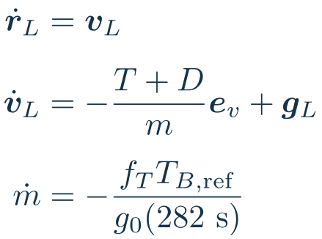
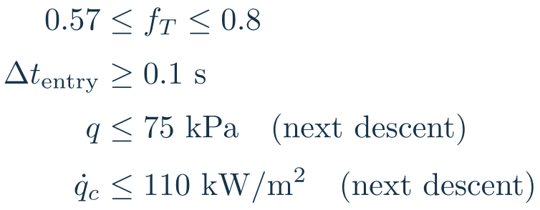
Recovery: entry burn
STATES (LOCAL FRAME, 5)
INPUTS
EQUATIONS OF MOTION
CONSTRAINTS AND TRANSITIONS
Thrust opposes velocity. A single throttle and burn duration set the post-entry state.
Three-engine reference thrust: 2.535 MN. Entry thrust range: 1.44495–2.028 MN.
15
Notes:
Code entry throttle bound is normalized by the configured recovery thrust scale, not full nine-engine ascent capacity. q and heat inequalities constrain the subsequent trajectory; this supplied code does not sample these loads within the entry-burn segment. T_B,ref=FirstStage_SL_Thrust/3=2.535 MN. Active return mass-flow uses Isp=282 s without atmospheric or throttle correction.
Source: https://github.com/pukmark/LaunchVehicleOptimization/tree/5295f20211b50467d81eac8f47408673b93e9190 . Current default-branch HEAD retrieved October 8, 2026, commit 5295f20 (gui update). Nominal Falcon 9, configuration 1, with unit dispersion factors and zero offsets. Parameter values: LV_Type_scaled.py lines 54–123 and derived initialization 144–151. Phase constraints: LV_Optimization_Type.py lines 125–324. Atmosphere: Atmosphere_Type.py. Values are optimizer inputs. Payload and target orbit remain mission-dependent.
LaTeX source:
\bm x_L=\begin{bmatrix}x&z&v_x&v_z&m\end{bmatrix}^{\mathsf T}
\bm u_{\mathrm{entry}}=f_T
\begin{aligned}\dot{\bm r}_L&=\bm v_L\\[4pt]\dot{\bm v}_L&=-\frac{T+D}{m}\bm e_v+\bm g_L\\[4pt]\dot m&=-\frac{f_T T_{B,\mathrm{ref}}}{g_0(282\ \mathrm{s})}\end{aligned}
\begin{aligned}0.57&\leq f_T\leq0.8\\[2pt]\Delta t_{\mathrm{entry}}&\geq0.1\ \mathrm{s}\\[2pt]q&\leq75\ \mathrm{kPa}\quad\text{(next descent)}\\[2pt]\dot q_c&\leq110\ \mathrm{kW/m^2}\quad\text{(next descent)}\end{aligned}

Slide 16

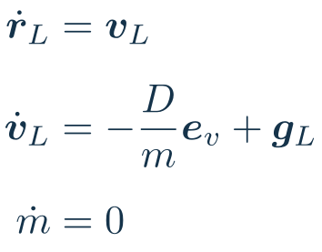
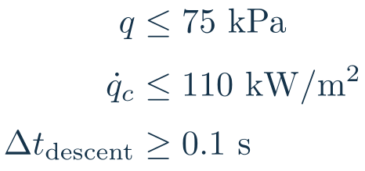
Recovery: atmospheric descent
STATES (LOCAL FRAME, 5)
INPUTS
EQUATIONS OF MOTION
CONSTRAINTS AND TRANSITIONS
After the entry burn, drag slows the booster while the optimizer selects the landing-burn start.
Landing ignition has no fixed altitude gate in this model. Terminal landing feasibility sets its timing.
16
Notes:
Code checks q and heat at 20 intermediate samples during post-entry coast before landing. This is discrete checking, not a continuous path guarantee. No horizontal lift control is present.
Source: https://github.com/pukmark/LaunchVehicleOptimization/tree/5295f20211b50467d81eac8f47408673b93e9190 . Current default-branch HEAD retrieved October 8, 2026, commit 5295f20 (gui update). Nominal Falcon 9, configuration 1, with unit dispersion factors and zero offsets. Parameter values: LV_Type_scaled.py lines 54–123 and derived initialization 144–151. Phase constraints: LV_Optimization_Type.py lines 125–324. Atmosphere: Atmosphere_Type.py. Values are optimizer inputs. Payload and target orbit remain mission-dependent.
LaTeX source:
\bm x_L=\begin{bmatrix}x&z&v_x&v_z&m\end{bmatrix}^{\mathsf T}
\bm u_{\mathrm{descent}}=\bm0
\begin{aligned}\dot{\bm r}_L&=\bm v_L\\[4pt]\dot{\bm v}_L&=-\frac{D}{m}\bm e_v+\bm g_L\\[4pt]\dot m&=0\end{aligned}
\begin{aligned}q&\leq75\ \mathrm{kPa}\\[2pt]\dot q_c&\leq110\ \mathrm{kW/m^2}\\[2pt]\Delta t_{\mathrm{descent}}&\geq0.1\ \mathrm{s}\end{aligned}

Slide 17

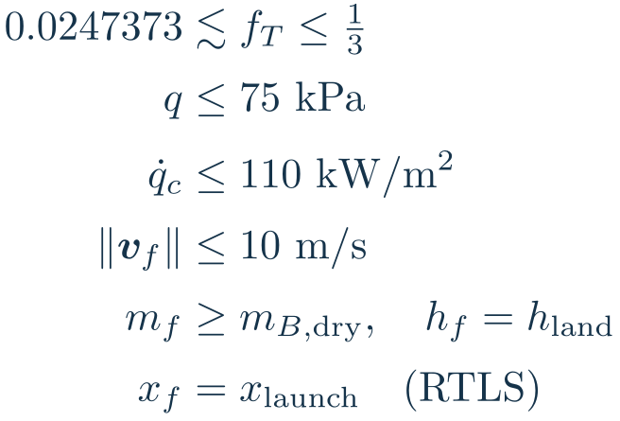
Recovery: landing burn
STATES (LOCAL FRAME, 5)
INPUTS
EQUATIONS OF MOTION
CONSTRAINTS AND TRANSITIONS
Optimize the throttle trajectory and landing duration to reach the surface at low speed.
Recovery reference: 2.535 MN. Landing thrust: approximately 62.709–845 kN. ASDS leaves downrange free.
17
Notes:
Code caps landing throttle at one third of recovery reference, rather than one third of full ascent thrust. Its lower bound is exactly 0.75*(1/3)*25600*g0/2535000=0.02473728878374703. This is the current optimizer formula. T_B,ref=2.535 MN and g0=9.7982854791873 m/s². The displayed rounded minimum is approximately 62.709 kN. Landing duration timestep >=0.1 s. Return load bounds are sampled at landing nodes. RTLS constrains local launch altitude; ASDS constrains geometric zero altitude. The 10 m/s bound is a simplified energy-feasibility endpoint, not an operational touchdown specification.
Source: https://github.com/pukmark/LaunchVehicleOptimization/tree/5295f20211b50467d81eac8f47408673b93e9190 . Current default-branch HEAD retrieved October 8, 2026, commit 5295f20 (gui update). Nominal Falcon 9, configuration 1, with unit dispersion factors and zero offsets. Parameter values: LV_Type_scaled.py lines 54–123 and derived initialization 144–151. Phase constraints: LV_Optimization_Type.py lines 125–324. Atmosphere: Atmosphere_Type.py. Values are optimizer inputs. Payload and target orbit remain mission-dependent.
LaTeX source:
\bm x_L=\begin{bmatrix}x&z&v_x&v_z&m\end{bmatrix}^{\mathsf T}
\bm u_{\mathrm{land}}(t)=f_T(t)
\begin{aligned}\dot{\bm r}_L&=\bm v_L\\[4pt]\dot{\bm v}_L&=-\frac{T+D}{m}\bm e_v+\bm g_L\\[4pt]\dot m&=-\frac{f_T T_{B,\mathrm{ref}}}{g_0(282\ \mathrm{s})}\end{aligned}
\begin{aligned}0.0247373&\lesssim f_T\leq\tfrac13\\[2pt]q&\leq75\ \mathrm{kPa}\\[2pt]\dot q_c&\leq110\ \mathrm{kW/m^2}\\[2pt]\|\bm v_f\|&\leq10\ \mathrm{m/s}\\[2pt]m_f&\geq m_{B,\mathrm{dry}},\quad h_f=h_{\mathrm{land}}\\[2pt]x_f&=x_{\mathrm{launch}}\quad\text{(RTLS)}\end{aligned}

Slide 18

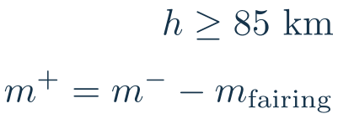
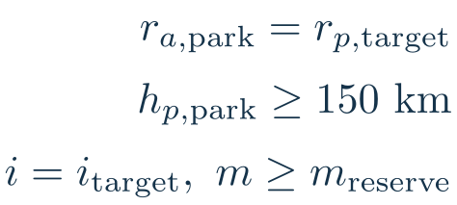
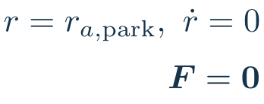
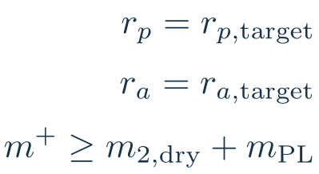
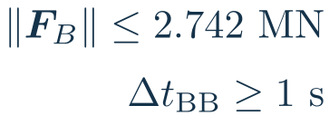
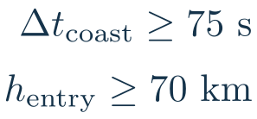
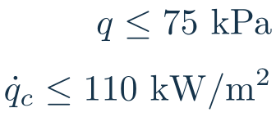
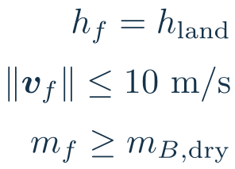
Flight logic and transition conditions
Initial vertical rise
Optimized ascent
Stage separation
UPPER STAGE • after separation
SES-1: fairing
SES-1: parking orbit
Coast to apogee
SES-2: final orbit
BOOSTER • RTLS uses boostback; ASDS starts with coast; EXP omits this branch
RTLS boostback
Coast to entry burn
Entry + descent
Landing burn
Nominal Falcon 9 • GitHub 5295f20 • SES-1 starts after 10 s coast • landing ignition time is optimized.
18
Notes:
The two branches evolve in parallel after separation. A gate is an admissibility condition, not necessarily an automatic state-triggered event. All phase durations are optimized except the 5 s initial rise and prescribed short coast after stage separation. Entry gate h>=70 km occurs after a coast >=75 s. Nominal fairing gate h>=85 km and fairing mass=1.9 t. SES1 follows a 10 s coast. Separation gate q<=0.5 kPa. SES2 is modeled analytically.
Source: https://github.com/pukmark/LaunchVehicleOptimization/tree/5295f20211b50467d81eac8f47408673b93e9190 . Current default-branch HEAD retrieved October 8, 2026, commit 5295f20 (gui update). Nominal Falcon 9, configuration 1, with unit dispersion factors and zero offsets. Parameter values: LV_Type_scaled.py lines 54–123 and derived initialization 144–151. Phase constraints: LV_Optimization_Type.py lines 125–324. Atmosphere: Atmosphere_Type.py. Values are optimizer inputs. Payload and target orbit remain mission-dependent.
LaTeX source:
t_0=5\ \mathrm{s}
q\leq30\ \mathrm{kPa},\quad |q\alpha|\leq5\ \mathrm{kPa\,rad}
q_{\mathrm{sep}}\leq0.5\ \mathrm{kPa};\ \text{split upper stage / booster}
\begin{aligned}h\geq85\ \mathrm{km}\\[2pt]m^+=m^--m_{\mathrm{fairing}}\end{aligned}
\begin{aligned}r_{a,\mathrm{park}}=r_{p,\mathrm{target}}\\[2pt]h_{p,\mathrm{park}}\geq150\ \mathrm{km}\\[2pt]i=i_{\mathrm{target}},\ m\geq m_{\mathrm{reserve}}\end{aligned}
\begin{aligned}r=r_{a,\mathrm{park}},\ \dot r=0\\[2pt]\bm F=\bm0\end{aligned}
\begin{aligned}r_p=r_{p,\mathrm{target}}\\[2pt]r_a=r_{a,\mathrm{target}}\\[2pt]m^+\geq m_{2,\mathrm{dry}}+m_{\mathrm{PL}}\end{aligned}
\begin{aligned}\|\bm F_B\|\leq2.742\ \mathrm{MN}\\[2pt]\Delta t_{\mathrm{BB}}\geq1\ \mathrm{s}\end{aligned}
\begin{aligned}\Delta t_{\mathrm{coast}}\geq75\ \mathrm{s}\\[2pt]h_{\mathrm{entry}}\geq70\ \mathrm{km}\end{aligned}
\begin{aligned}q\leq75\ \mathrm{kPa}\\[2pt]\dot q_c\leq110\ \mathrm{kW/m^2}\end{aligned}
\begin{aligned}h_f=h_{\mathrm{land}}\\[2pt]\|\bm v_f\|\leq10\ \mathrm{m/s}\\[2pt]m_f\geq m_{B,\mathrm{dry}}\end{aligned}

Slide 19
Summary
One optimization couples payload delivery
and booster recovery
CasADi and IPOPT solve the coupled trajectory problem.
The nonlinear formulation produces a local optimum.
Recovery propellant and flight constraints change
the ascent trajectory and achievable payload.
Falcon 9 provides a case study for comparing recovery modes
and evaluating sensitivity to vehicle parameters.
Scope: preliminary performance analysis with simplified recovery dynamics
19
Notes:
Summary of the current optimization architecture. No historical payload result is asserted as a result of this commit. Source: https://github.com/pukmark/LaunchVehicleOptimization/tree/5295f20211b50467d81eac8f47408673b93e9190 . Current default-branch HEAD retrieved October 8, 2026, commit 5295f20 (gui update). Nominal Falcon 9, configuration 1, with unit dispersion factors and zero offsets. Parameter values: LV_Type_scaled.py lines 54–123 and derived initialization 144–151. Phase constraints: LV_Optimization_Type.py lines 125–324. Atmosphere: Atmosphere_Type.py. Values are optimizer inputs. Payload and target orbit remain mission-dependent.

