Slide 1
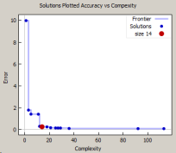
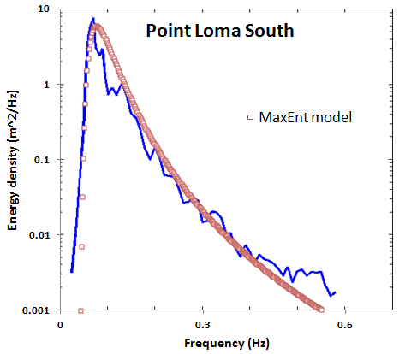

Semantic Context Architecture for Interoperability
Interactive
Mode
Automation
Mode
Remote Data
(buoys, stations)
information
criteria metrics
PSD, PDF
artifacts
Feedback
Interoperability
Query
Interface
Files
Model
select
FMU
FMI
VATR / Testbench
Semantic
Reasoner
Services
Web served
Param
select
ontology
rules / entailments
1. search
2. algorithms
3. generators
Knowledge
Interface
ABox
TBox
Kbase Model
Triple
Store
Data
terminology
Inference library
assertions
1. SWEET
2. geospatial
3. meta / ref
cite(Request) :-
http_parameters(Request, [name(Name, [])]),
findall(Title, find_title(Name,Title), List),
reply_html_page(title('Citations'),
[ h1(Name),
table(List) ]).
indexing, name spaces

