Slide 1
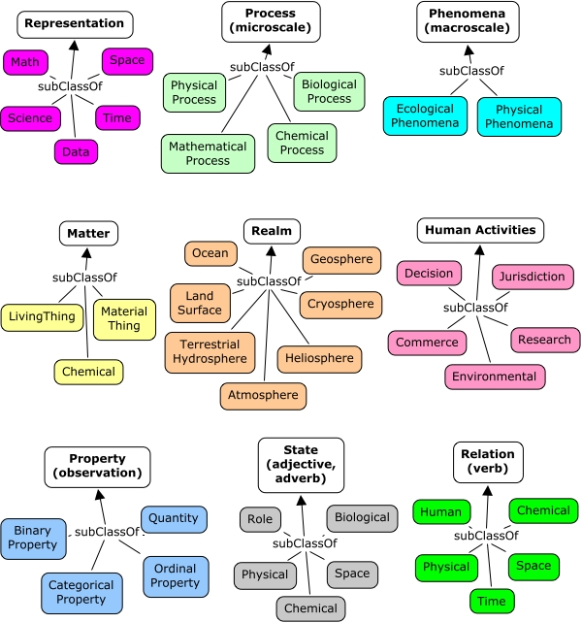

Applying an ontological classification strategy to stochastic models of the environment
  Simple, efficient while comprehensive
  A workflow-driven semantic web provides services
Ontology (SWEET)
Stochastic Modeling
Features of the land, sea and sky
influencing virtual designs
Probability Theory
  Maximum Entropy
Complexity Theory
Superstatistics
Information Theory
Fat-Tails and Fractals
apply
to design
Pattern Theory
Probability of Correctness
Notes:
DARPA asks for one great idea that we can glean from our work
From the proposal we had a bunch of novel elements that go into the one idea
-- The use of Probability Density Functions (PDF) to model sample spaces. These facilitate the characterization and modeling of natural phenomena that are prevalent in context modeling, including slope distribution, wind, rainfall, lakes, etc. Most of the models reduce to fairly simple analytical forms. For disordered systems and data containing uncertainty, techniques such as the Maximum Entropy Principle and superstatistics will be used, which have a more formal basis than the heuristic fractal models conventionally used. The sample size needed to reduce the variance of the statistics will be reduced by efficient applications of random sampling such as importance sampling.
- The application of metrics to describe context models. In particular, the multiscale entropy measure can be applied to temporal and spatial scales covering a wide dynamic range. What this tells us is the amount of disorder and uncertainty in the data, which is important as a quick characterization metric.
- Accounting for wear/tear/corrosion modeling. This would pull in particulate and ash models that feed into models for physical breakdown. Again, these models will often reduce to simple analytical forms.
-- Establishing and implementing an ontology-base for organizing models and techniques. Standardizing access protocols for context models.
-- Combining correlation functions with spectral representations to provide instances for the spatial and temporal domains of general system context.
-- Support for context modeling through internet-based data collection. This will provide means to leverage the vast amount of data available and reduce its dimensionality and scope by careful characterization and modeling.
Surprising how often simple probability density functions (PDF) can characterize the impact/ likelihood factors for various environmental behaviors
Doesn’t always need a theory (heuristics) but an explanation is useful.
Use established scientific criteria and ontological methods to help us derive and classify the models.

