Slide 1


AI-Powered Smart Sensor for Temperature and Humidity Monitoring
CSA1703-ARTIFICIAL INTELLIGENCE
Presented By:
K.Nithin Varma (192312272)
P.Dinesh Karthik (192525268)
G.Vinay(192312380)
Guided by:
DR.R.JEENA

Slide 2
INTRODUCTION
AI-Enabled Smart Monitoring: .Uses Artificial Intelligence to analyze temperature and humidity data. It improves monitoring accuracy by identifying patterns and trends.
Real-Time Monitoring: Continuously measures environmental conditions without interruption. This ensures timely detection of any changes.
IoT Connectivity: Transmits sensor data to the cloud through wireless communication. Users can monitor the system remotely from anywhere.
Predictive Analytics: Uses historical data to predict future temperature and humidity levels. This helps prevent potential environmental issues.

Slide 3
Problem Statement
Traditional temperature and humidity monitoring systems often require manual checking and provide limited analysis capabilities. They may fail to detect sudden environmental changes, leading to equipment damage, product loss, and inefficient resource management.
The need is for an AI-powered smart monitoring system that can continuously measure temperature and humidity, analyze data in real time, predict abnormal conditions, and provide instant alerts. Such a system can improve reliability, reduce human effort, and enable proactive environmental management in various applications.

Slide 4
Objectives
To develop an AI-powered IoT system for real-time temperature and humidity monitoring.
To collect and analyze environmental data using smart sensors.
To use AI algorithms for prediction and anomaly detection.
To provide instant alerts when environmental conditions exceed safe limits.
To enable remote monitoring through a web or mobile application.
To store and analyze historical data for better decision-making.

Slide 5
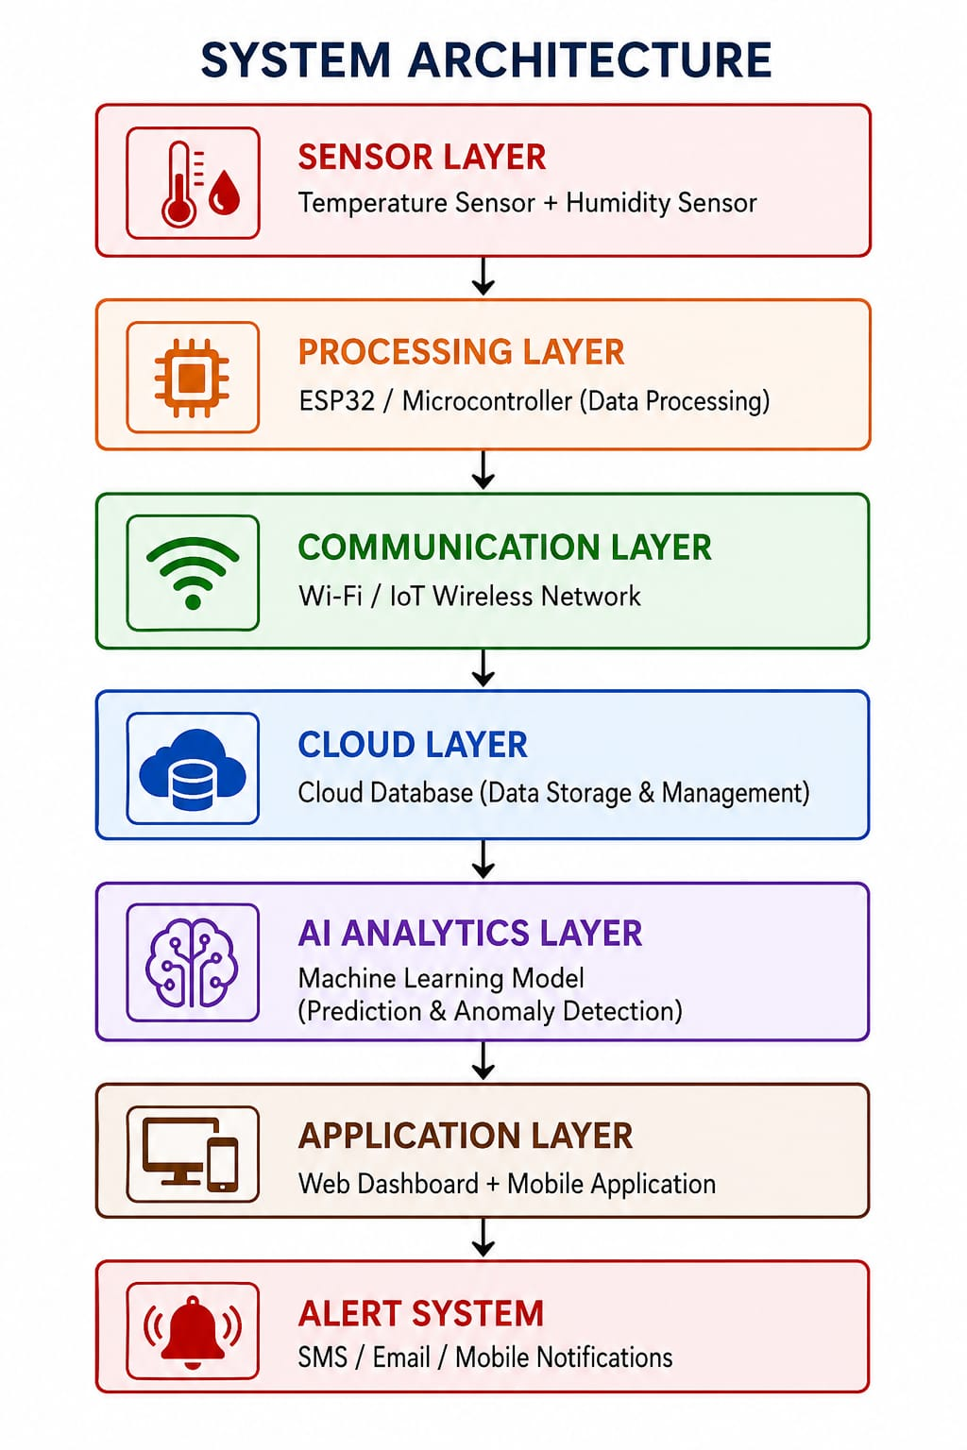
System Architecture

Slide 6
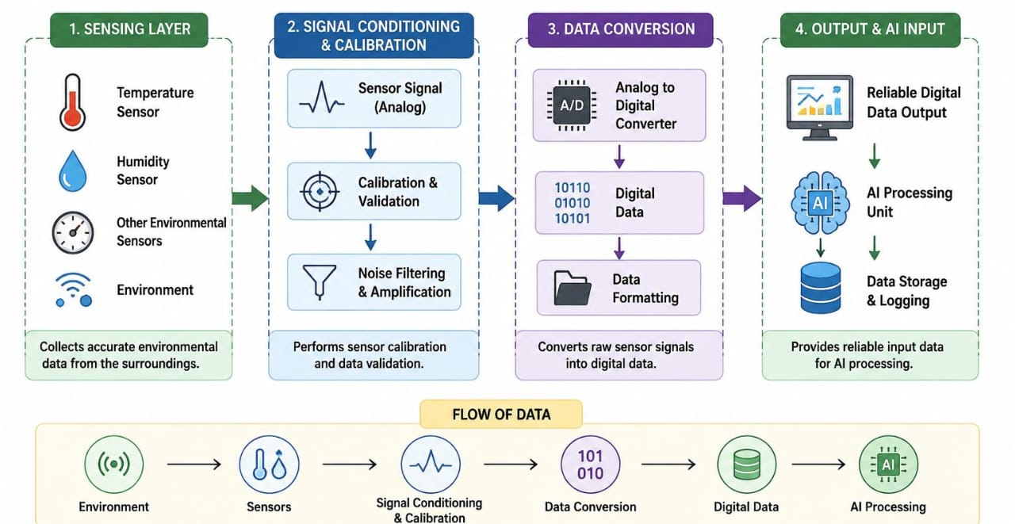
MODULE 1:- Intelligent Sensing and Data Acquisition Module
Purpose: Collects accurate environmental data from the surroundings.
Integrates temperature and humidity sensors for environmental measurement.
Performs sensor calibration and data validation.
Converts raw sensor signals into digital data.
Provides reliable input data for AI processing.

Slide 7
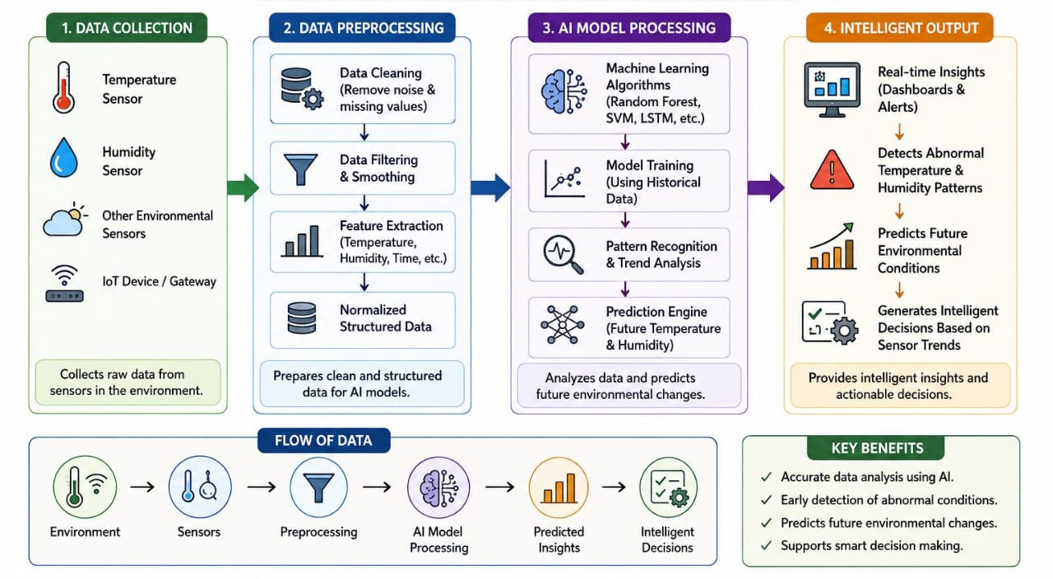
MODULE 2:- AI-Based Data Processing and Prediction
Purpose: Converts sensor data into intelligent insights.
Applies machine learning algorithms for data analysis.
Identifies abnormal temperature and humidity patterns.
Predicts future environmental changes using historical data.
Generates intelligent decisions based on sensor trends.

Slide 8
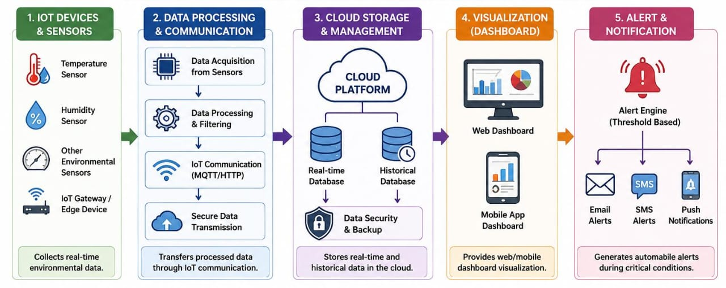
MODULE 3- IoT Cloud Monitoring and Alert
Purpose: Enables remote access and real-time response.
Transfers processed data through IoT communication.
Stores real-time and historical data in the cloud.
Provides web/mobile dashboard visualization.
Generates automatic alerts during critical conditions.

Slide 9
Advantages
Intelligent Environmental Prediction – Uses AI models to predict future temperature and humidity changes before problems occur.
Self-Learning Capability – Improves accuracy over time by learning from historical environmental data.
Proactive Monitoring – Detects risks early and enables preventive actions instead of only reacting to failures.
Smart Decision Support – Converts raw sensor data into meaningful insights for better system control.
Real-Time Anomaly Identification – Quickly recognizes unusual environmental patterns using AI-based analysis.

Slide 10
Future Scope
Advanced AI Models Integration – Future systems can use deep learning algorithms to improve prediction accuracy and environmental analysis.
Multi-Parameter Monitoring – Additional sensors can be integrated to monitor air quality, pressure, light intensity, gas levels, and other environmental factors.
Edge AI Processing – AI computation can be moved closer to the sensor using edge devices for faster response and reduced cloud dependency.
Smart Automation Integration – The system can automatically control devices such as fans, air conditioners, and ventilation systems based on environmental conditions.
Mobile Application Enhancement – Advanced mobile apps can provide real-time analytics, reports, and intelligent recommendations.

Slide 11
Results And Discussion
The AI-Powered Smart Sensor for Temperature and Humidity Monitoring successfully provides real-time environmental monitoring with accurate data collection and AI-based analysis.
Real-time temperature and humidity monitoring achieved.
Accurate sensor data collection and processing.
AI-based prediction and anomaly detection implemented.
Instant alerts generated during critical conditions.
Remote monitoring through dashboard enabled.

Slide 12
Conclusion
AI + IoT Integration – Combines intelligent analysis with smart sensing for advanced environmental monitoring.
Autonomous Operation – Reduces human involvement through automated monitoring and alert generation.
Future-Ready Architecture – Supports advanced AI models, additional sensors, and large-scale deployment.
Real-World Impact – Provides a practical solution for industries, agriculture, healthcare, and smart environments.

Slide 13
References
Arduino Official Documentation – For microcontroller programming and sensor interfacing concepts.
Espressif ESP32 Documentation – For ESP32 hardware, Wi-Fi communication, and IoT development.
DHT Sensor Library Documentation – For temperature and humidity sensor integration.
TensorFlow Official Documentation – For AI and machine learning model development.
Firebase Documentation – For cloud database and real-time data storage.
Internet of Things (IoT) – IEEE Xplore – Research papers related to IoT-based monitoring systems.
Machine Learning – SpringerLink – Research studies on AI-based prediction and anomaly detection.
Cloud Computing and IoT Research – ScienceDirect – Technical references for cloud-based smart monitoring systems.

Slide 14
