Slide 1
Lecture 3: Requirements Determination
Course ID: CSE471
Course Title: System Analysis and Design
Prepared by:
Dr. Muhammad Iqbal Hossain
Associate professor Department of Computer Science & Engineering BRAC University.

Slide 2
Objectives
■ Understand how to create a requirements definition.
■ Become familiar with requirements analysis techniques.
■ Understand when to use each requirements analysis technique.
■ Understand what and where to use REQUIREMENTS ANALYSIS STRATEGIES

Slide 3
Segment 1: Requirements Specification
Segment 2: Requirement Gathering Techniques and Interview
Segment 3: JOINT APPLICATION DESIGN (JAD)
Segment 4: Other Requirement Gathering Techniques

Slide 4
Key Ideas
The goal of the analysis phase is to truly understand the requirements of the new system and develop a system that addresses them.
The first challenge is collecting and integrating the information
The second challenge is finding the right people to participate.

Slide 5
Analysis Phase
This phase takes the general ideas in the system request and
refines them into a detailed requirements definition (this chapter),
functional models
structural models and
behavioral models
This becomes the system proposal
Includes revised project management deliverables,
feasibility analysis and
workplan

Slide 6
Requirement Specification
A statement of what
the system must do or
characteristics it must have
Written from business person perspective – business requirement
Later requirements become more technical – system requirement

Slide 7
Functional vs. Nonfunctional
A functional requirement relates directly to a process the system has to perform or information it needs to contain.
Nonfunctional requirements refer to behavioral properties that the system must have, such as performance and usability.

Slide 8
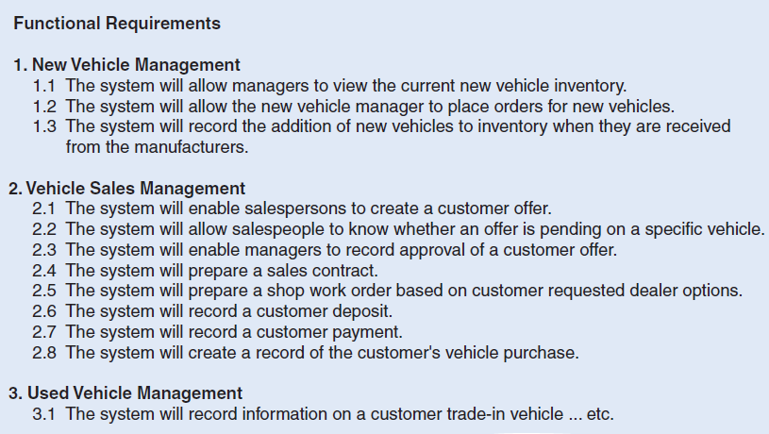
Functional Requirements example

Slide 9
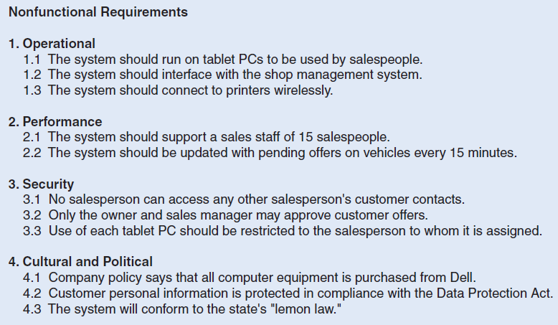
Nonfunctional Requirements example

Slide 10
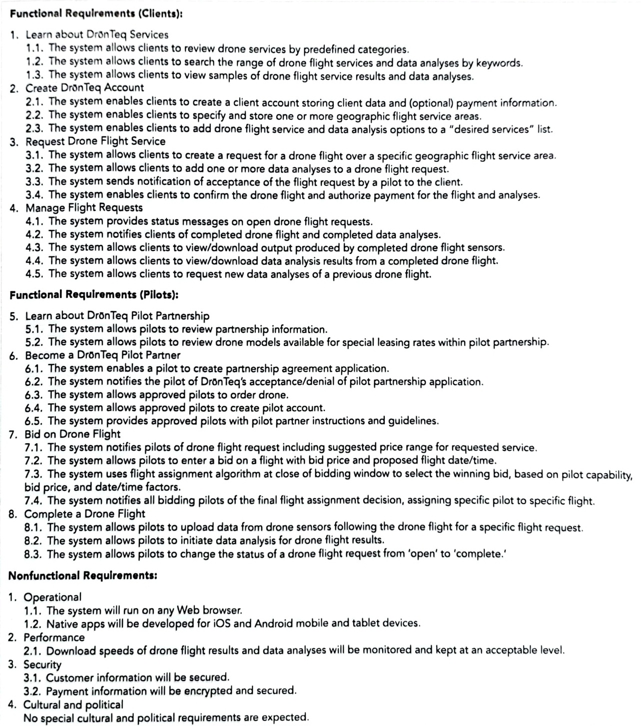

Slide 11
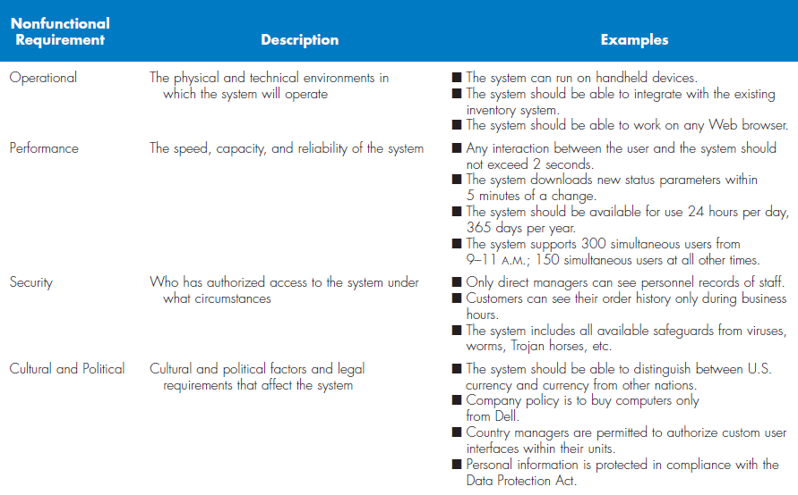
Types of Nonfunctional Requirements

Slide 12
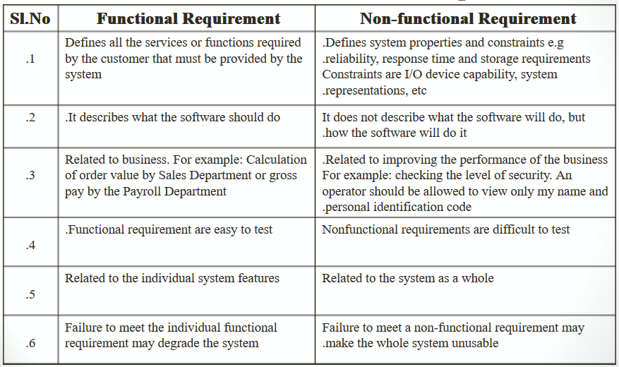

Slide 13
Segment 2
REQUIREMENTS ANALYSIS STRATEGIES

Slide 14
Requirement Gathering Techniques
An analyst search for requirements using a variety of techniques
Make sure that the current business processes and the needs for the new system are well understood before moving into design.
Five most commonly used requirements elicitation techniques:
Interviews
JAD sessions
Questionnaires
Document analysis
Observation.

Slide 15
Problem Analysis
Ask users to identify problems and solutions
Improvements tend to be small and incremental
Rarely finds improvements with significant business value

Slide 16
Root Cause Analysis
Users are not asked for solutions, but for:
A list of (prioritized) problems.
All possible root causes for those problems.
Analysts investigate each root cause to find:
Solutions for the highest priority problems.
Root causes that are common to multiple problems.

Slide 17
Duration Analysis
Calculate time needed for each process step
Calculate time needed for overall process
Compare the two – a large difference indicates a badly fragmented process
Potential solutions:
Process integration – change the process to use fewer people, each with broader responsibilities
Parallelization – change the process so that individual step are performed simultaneously

Slide 18
Activity-Based Costing
Calculate cost of each process step
Consider both direct and indirect costs
Identify most costly steps and focus improvement efforts on them

Slide 19
Benchmarking
Studying how other organizations perform the same business process
Informal benchmarking
Common for customer-facing processes
Interact with other business’ processes as if you are a customer

Slide 20
Technology Analysis
Analysts list important and interesting technologies
Managers list important and interesting technologies
The group identifies how each might be applied to the business and how the business might benefit

Slide 21
Activity Elimination
Identify what would happen if each organizational activity were eliminated
Use “force-fit” to test all possibilities

Slide 22
Comparing Analysis Techniques
Potential business value
Project cost
Breadth of analysis
Risk

Slide 23
Thank you

