Slide 1
INTELLIGENCE

Slide 2
Are you smart?

Slide 3
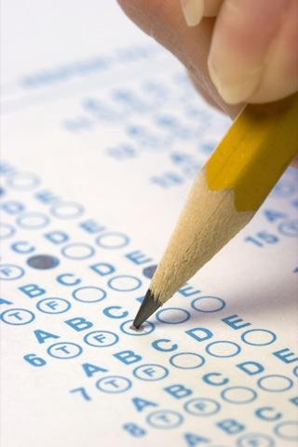
“Definition” of Intelligence
Intelligence tests are a series of questions and other exercises which attempt to assess people’s mental abilities in a way that generates a numerical score, so that one person can be compared to another.
Intelligence can be defined as “whatever intelligence tests measure.”
Your college entrance test measures how good you are at scoring well on that test.
Notes:
Click to reveal bullets.
It is hard to argue with this definition of intelligence other than to point out that it’s pretty much a tautology (a circular reasoning statement that really doesn’t say much). However, the text goes out on a limb and puts a little meaning into the concept (next slide).

Slide 4

Definition of Intelligence: Beyond the Test?
The text defines intelligence,
whether it’s math ability or a rainforest dweller’s understanding of plants, as the ability to learn from experience, solve problems, and use knowledge to adapt to new situations.
Notes:
No animation
Note that this definition from the text makes reference to knowledge, and correlates with it, but is focused on ability, especially adaptability. Not surprisingly, psychologists tend to define “intelligence” in a way that allows psychologists to fit the definition.
The picture from the text is meant to represent the “understanding of plants.”

Slide 5
Intelligence: Single or Multiple?
Is intelligence one general ability or several specific abilities?
Charles Spearman | general intelligence [g]
Louis Thurstone | 7 linked clusters of abilities
Howard Gardner | 8 intelligences
Robert Sternberg | 3 intelligences
Creativity and intelligence | 5 components
Emotional intelligence | 4 components
Notes:
No animation.

Slide 6

Multiple Intelligences
The “savant syndrome” refers to having isolated “islands” of high ability amidst a sea of below-average cognitive and social functioning.
Howard Gardner’s Multiple Intelligences
Howard Gardner (b. 1943) noted that different people have intelligence/ability in different areas.
Research and factor analysis suggests that there may be a correlation among these intelligences.
Notes:
Stephen Wiltshire (b. 1974) is limited in his social and overall cognitive skills by autism, but has extraordinary visual memory. Wiltshire was able to draw this picture of the Tokyo skyline from memory after a 30-minute helicopter ride and a view from the top of a skyscraper. The existence of the savant syndrome suggests that intelligence can exist in parts.
Click to reveal Howard Gardner’s Multiple Intelligences.
Narrative linking to above: “Howard Gardner feels that even discounting the “savant syndrome,” different people have different strengths.” Acknowledging all of these abilities means honoring strengths and success in areas other than verbal and math ability.

Slide 7
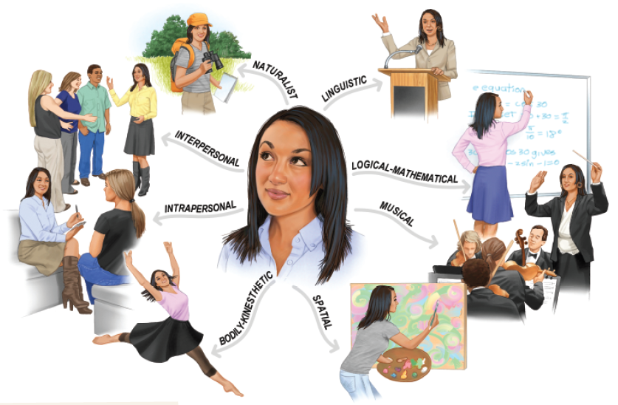
Howard Gardner’s Eight Intelligences
Notes:
No animation.
In case a student asks, Howard Gardner has considered adding “moral” intelligence and “spiritual”/”existential” intelligence to his list, but does not consider them to have adequate empirical support.

Slide 8
Video

Slide 9
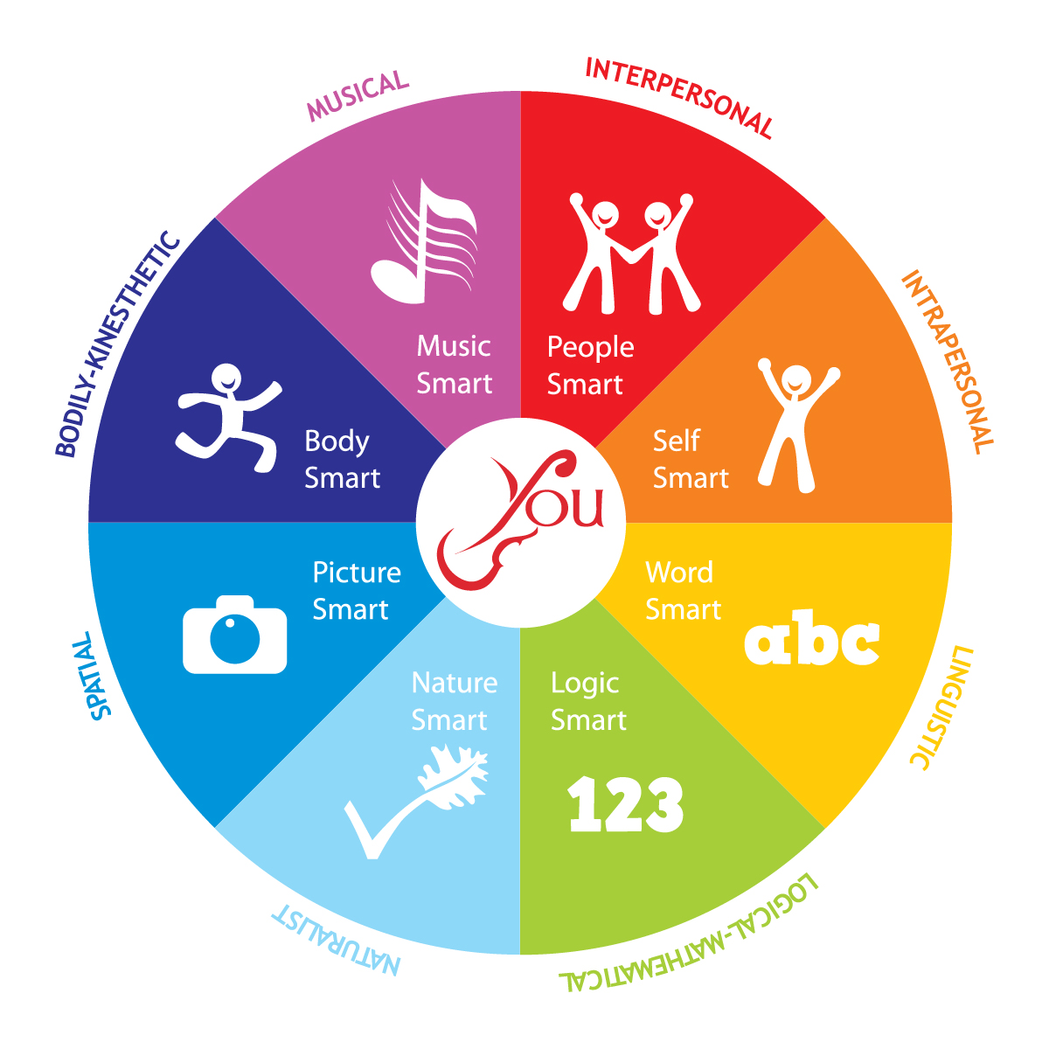

Slide 10

VERBAL/LINGUIST
Thinks and learns through written and spoken words ; has the ability to memorize facts, enjoys reading, debates on current issues, explains a situation/problem, creates TV advertisements /poem/story/role play/drama, compiles and tells jokes, learns a foreign language, keeps a personal journal.

Slide 11

MUSICAL/RHYTHMIC
Recognizes tonal patterns and environmental sounds, learns through rhyme, rhythm and repetition, plays musical instrument, makes simple musical instruments, reduces stress through music, leads physical exercise to music, teaches dance steps.

Slide 12

LOGICAL /MATHEMATICAL
Deals with numbers, solves math problems, recognizes abstract patterns, defines an event/situation logically, compares contrast ideas, defines patterns in history, follows instructions, creates computer programs, analyses similarities/differences.

Slide 13

VISUAL/SPATIAL
Thinks in and visualizes images/pictures, has the ability to create graphic designs, communities with diagrams and graphics, graphs result of a survey, creates posters, draw maps, makes clay maps/buildings/figures, illustrates dance steps, draw from different perspectives.

Slide 14

INTERPERSONAL
Learns and operates one-to –one, through group relationships, plans and arranges social events, enjoys participation, Coaches peers and /or younger children, teaches cooperative games, discusses/debates controversial issues, analysis group relationships, depends on all of the other intelligences.

Slide 15

INTRAPERSONAL
Enjoys and learns through self-reflection, works alone, keeps a personal journal or feelings diary, analyzes historical personalities, writes on personal learning experiences, analyzes thinking patterns,
understands group dynamics, has an awareness of inner spiritual realities.

Slide 16

BODY/KINESTHETIC
Learns through physical movement and body wisdom, practices physical exercises, learns dances of different cultures, illustrates geometrical figures, conducts hands-on-experiments, acts out scenes from stories and plays, designs role plays, prepares food or snacks, learns alphabet through physical movement, has a sense of knowing through body memory.

Slide 17

NATURALIST
Pays attention to natures, loves nature, recognizes and classifies plants and animals, shows interest to know about the elements of nature, draws nature, takes care of plans, likes nature related poems/stories, collects leaves/flowers/fruits/shells, likes to discuss about nature, likes to know about under ground things.

Slide 18
Video: How MI works in combination.

Slide 19
Social and Emotional Intelligence
Social intelligence refers to the ability to understand and navigate social situations.
Emotional intelligence
involves processing and managing the emotional component of those social situations, including one’s own emotions.
Notes:
Automatic animation.
Note that these definitions link emotional intelligence to social intelligence. The four components of emotional intelligence on the next slide also correlate with social success. This means that other emotional skills, such as modulating extreme emotions (e.g. staying mentally healthy) are less central to this definition, except as they relate to social success.

Slide 20

 Emotional Intelligence :-
The ability to perceive emotion, integrate emotion to facilitate thought, understand emotions and to regulate emotions to promote personal growth."
- Salovey and Mayer.

Slide 21
Components of
Emotional Intelligence
Benefits of
Emotional Intelligence
People with high emotional intelligence often have other beneficial traits, such as the ability to delay gratification while pursuing long-term goals.
The level of emotional intelligence, including the skill of reading the emotions of others, correlates with success in career and other social situations.
Perceiving emotions
Recognizing emotions in facial expressions, stories, and even in music
Understanding emotions
Being able to see blended emotions, and to predict emotional states and changes in self and others
Modulating and expressing emotions in various situations
Managing emotions
Using emotions
Using emotions as fuel and motivation for creative, adaptive thinking
Notes:
Click to reveal more about each component.
Introducing this slide: “emotional intelligence can be defined by four components identified on a test by Mayer, Salovey, and Caruso (2002, 2008):”
In this case, “modulating” means not allowing emotions get out of control; having one’s emotions be a connective rather than a disruptive force in social situations.
Click to reveal sidebar.
The second bullet point relates to the struggles of people on the autism spectrum who have difficulty in this area and sometimes in all areas of emotional intelligence, even if overall intelligence test scores are in the normal range.

Slide 22
Video

Slide 23

 Developing emotional intelligence helps us to recognize, contain, and effectively communicate our emotions, as well as recognize the emotions of other people. These abilities have been proven to surpass high cognitive intelligence in predicting success in all types of relationships at home, and in all other areas of our lives.

Slide 24
 EI develops over time and that it can be improved through training, programming, and therapy.

Slide 25
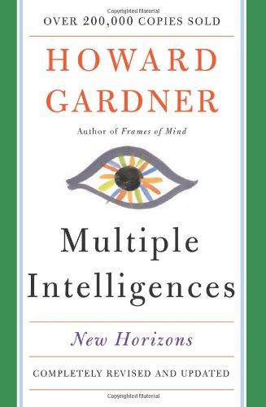
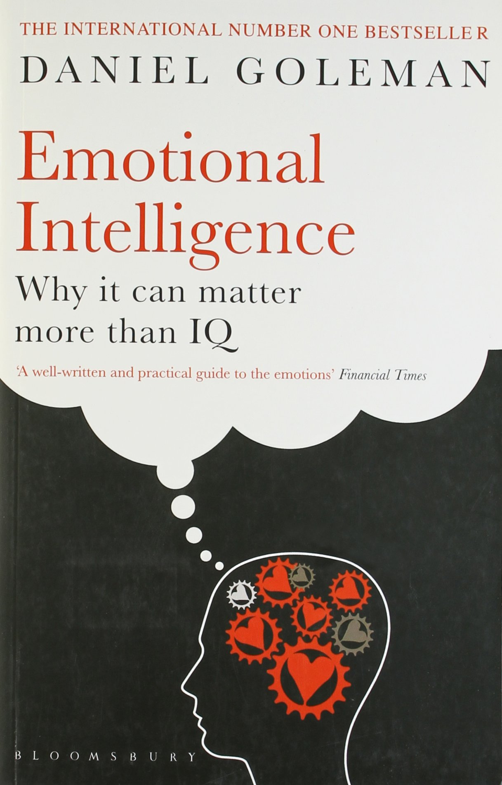

Slide 26
