Slide 1
Overview: Topics in this Chapter
What do we mean by “learning”?
Learning is the process of acquiring new and relatively enduring information or behaviors.
Definitions
Classical conditioning
Operant conditioning
Biological and cognitive components of learning
Observational learning
Notes:
Click to reveal definition of learning.
This chapter focuses on the changes in behavior. The next chapter on memory will help us understand how we fill our minds with factual knowledge.
Even focusing on behavior, humans are different than other animals. More of our behavior is learned, rather than instinctual.
Why “relatively enduring”? If you’re walking and I am in your way, you may change your behavior (walk around me), but that new behavior will not now endure.

Slide 2
Activity
Think of your favorite learning experience so far in your life?
What was the process of the learning?

Slide 3
How does learning happen other than through language/words?
We learn from experience:
We learn by association:
when we learn to predict events we already like or don’t like by noticing other events or sensations that happen first.
when our actions have consequences.
when we watch what other people do.
when two stimuli (events or sensations) tend to occur together or in sequence.
when actions become associated with pleasant or aversive results.
when two pieces of information are linked.
Notes:
Click to reveal bullets under each heading.
Instructor: see if students can identify which forms of conditioning are being referred to in points 1-3 of either column, before going on to the next slide for the answers.

Slide 4
Types of Learning
Classical conditioning: learning to link two stimuli in a way that helps us anticipate an event to which we have a reaction
Operant conditioning: changing behavior choices in response to consequences
Cognitive learning: acquiring new behaviors and information through observation and information, rather than by direct experience
Notes:
Automatic animation.
There are millions of sensory neurons and millions of motor neurons, but BILLIONS of interneurons.

Slide 5

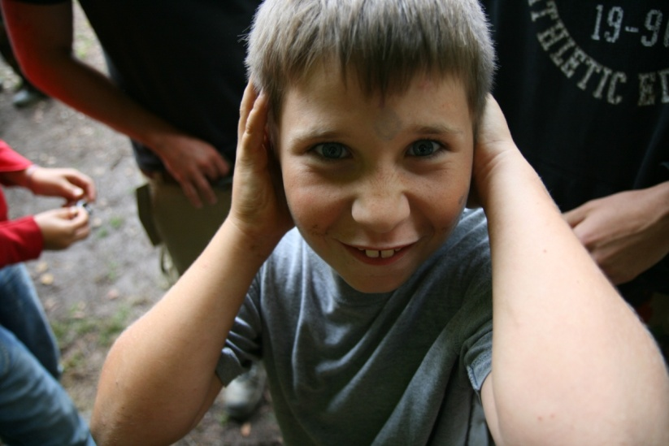
Associative Learning:
Classical Conditioning
Stimulus 1: See lightning
How it works: after repeated exposure to two stimuli occurring in sequence, we associate those stimuli with each other.
Result: our natural response to one stimulus now can be triggered by the new, predictive stimulus.
Stimulus 2: Hear thunder
Here, our response to thunder becomes associated with lightning.
After Repetition
Stimulus: See lightning
Response: Cover ears to avoid sound
Notes:
Click to start animated example (let it play out).
Instructor: another example of classical conditioning in which we learn from experience occurs when conditioning helps us associate “BEEEP” with an approaching car. The BEEP sound soon is as alarming as the car. Without this learning, cars might run us over.
Another example of classical conditioning: military service personnel who hear a mortar launch sound “thoom” followed by a violent explosion nearby may learn to associate those two stimuli. As a result, at fireworks, even when they know there is no danger, the launch of fireworks sometimes still triggers a “duck and cover” reaction.

Slide 6
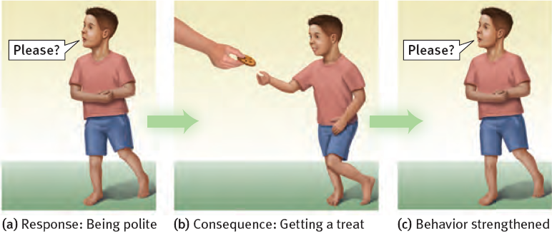
Associative Learning: Operant Conditioning
Child associates his “response” (behavior) with consequences.
Child learns to repeat behaviors (saying “please”) which were followed by desirable results (cookie).
Child learns to avoid behaviors (yelling “gimme!”) which were followed by undesirable results (scolding or loss of dessert).
Notes:
No animation.

Slide 7
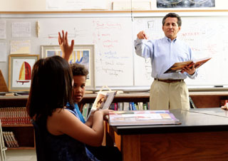
Cognitive Learning
Cognitive learning refers to acquiring new behaviors and information mentally, rather than by direct experience.
Cognitive learning occurs:
by observing events and the behavior of others.
by using language to acquire information about events experienced by others.
Notes:
No animation.

Slide 8
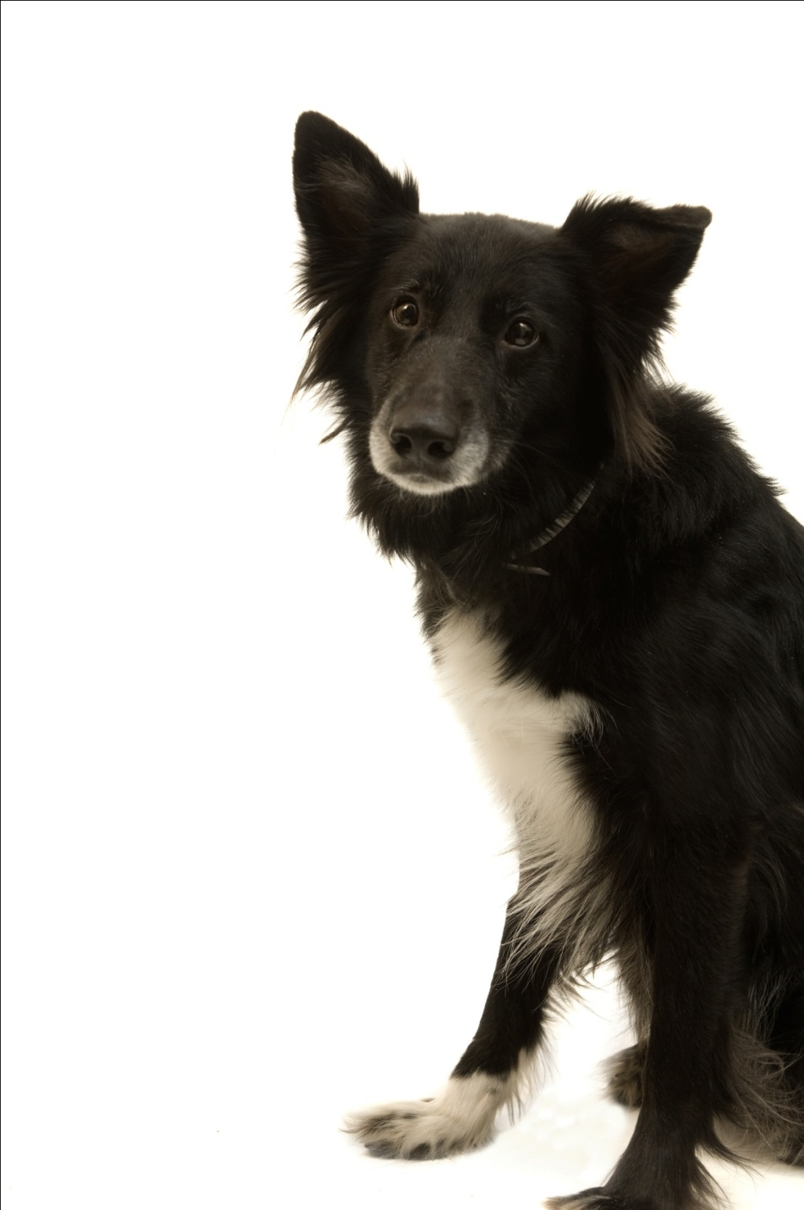
Ivan Pavlov’s Discovery
While studying salivation in dogs, Ivan Pavlov found that salivation from eating food was eventually triggered by what should have been neutral stimuli such as:
just seeing the food.
seeing the dish.
seeing the person who brought the food.
just hearing that person’s footsteps.
Notes:
Click to reveal bullets.
Instructor, you can add verbally:
“The dog had learned that these stimuli predicted the arrival food. These neutral stimuli had become conditioned stimuli.”
Ivan Pavlov then performed controlled experiments yielding much of the knowledge about conditioning still used today.

Slide 9
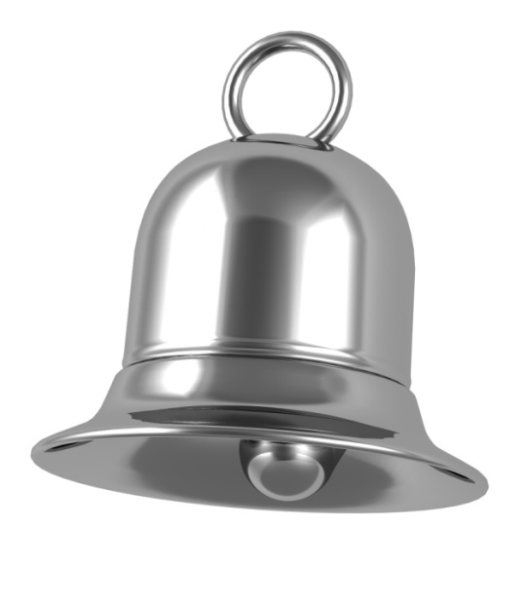
Before Conditioning
Neutral stimulus:
a stimulus which does not trigger a response
Neutral
stimulus (NS)
No response
Notes:
Click to start animation.

Slide 10
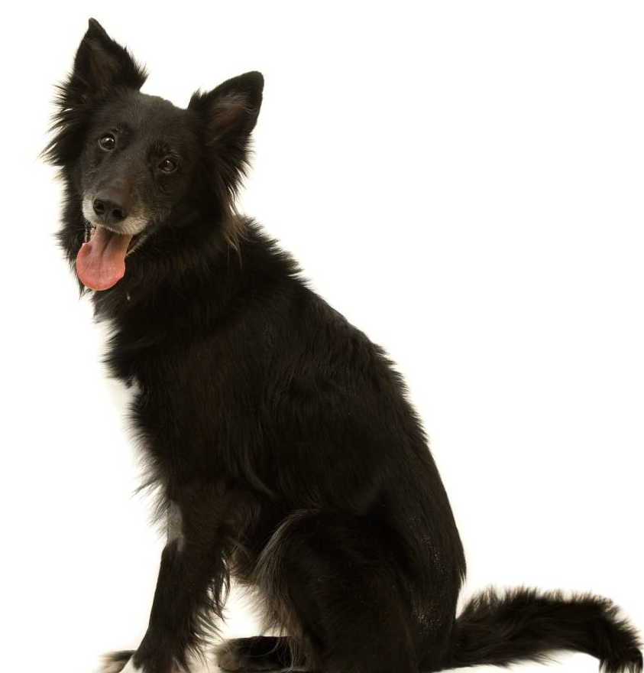
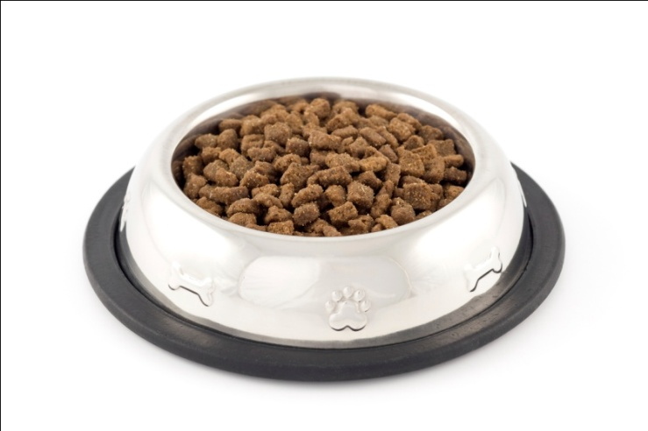
Before Conditioning
Unconditioned stimulus and response:
a stimulus which triggers a response naturally,
before/without any conditioning
Unconditioned response (UR):
dog salivates
Unconditioned
stimulus (US): yummy dog food
Notes:
Click to start animation.
Ivan Pavlov’s dogs exhibited salivation (UR) in response to food (US).

Slide 11
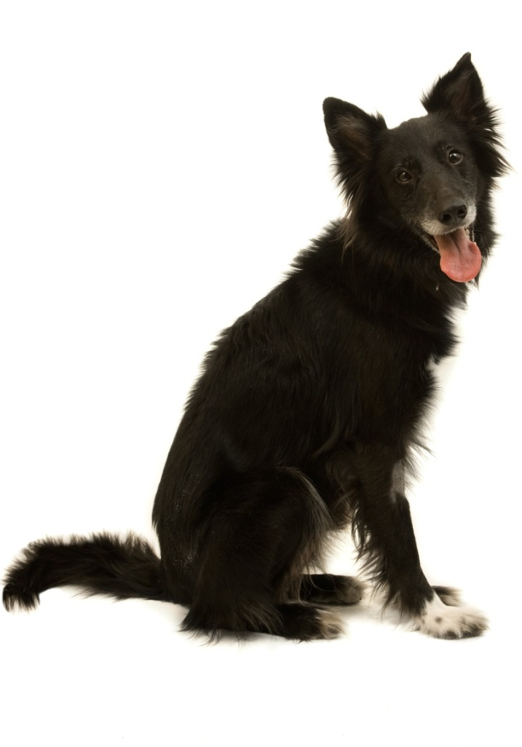


During Conditioning
The bell/tone (N.S.) is repeatedly presented with the food (U.S.).
Neutral
stimulus (NS)
Unconditioned response (UR):
dog salivates
Unconditioned
stimulus (US)
Notes:
Click to start animation.
Ivan Pavlov then presented a tone (NS) just before presenting the food (US).
APA Learning Goal 1: Knowledge Base of Psychology

Slide 12
After Conditioning
The dog begins to salivate upon hearing the tone (neutral stimulus becomes conditioned stimulus).
Did you follow the changes?
The UR and the CR are the same response, triggered by different events.
The difference is whether conditioning was necessary for the response to happen.
The NS and the CS are the same stimulus.
The difference is whether the stimulus triggers the conditioned response.
Conditioned response:
dog salivates
Conditioned (formerly neutral)
stimulus
Notes:
Click to start animation. Click again to show recap.
After a few pairings, the NS (tone) became a CS, and it was able to produce a CR (salivation) by itself.

Slide 13



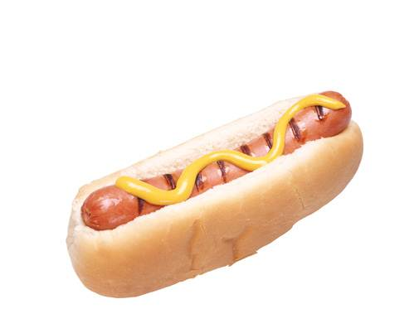
Find the US, UR, NS, CS, CR in the following:
Your romantic partner always uses the same shampoo. Soon, the smell of that shampoo makes you feel happy.
The door to your house squeaks loudly when you open it. Soon, your dog begins wagging its tail when the door squeaks.
The nurse says, “This won’t hurt a bit,” just before stabbing you with a needle. The next time you hear “This won’t hurt,” you cringe in fear.
You have a meal at a fast food restaurant that causes food poisoning. The next time you see a sign for that restaurant, you feel nauseated.
Notes:
No animation.

Slide 14
Generalization and Discrimination Please notice the narrow, psychological definition .
Ivan Pavlov conditioned dogs to drool when rubbed; they then also drooled when scratched.
Ivan Pavlov conditioned dogs to drool at bells of a certain pitch; slightly different pitches did not trigger drooling.
Generalization refers to the tendency to have conditioned responses triggered by related stimuli.
Discrimination refers to the learned ability to only respond to a specific stimuli, preventing generalization.
MORE stuff makes you drool.
LESS stuff makes you drool.
Notes:
Click to show generalization and then discrimination sequences.
There are possible evolutionary values for each of these aspects of conditioning.
Generalization: if a leopard roars and then bites you, it might help you survive if you avoid other large cats who roar, and maybe the ones who growl too. 🡪 Abused children have been found to generally fear any angry face.
You also can apply your associations to related situations. If you get hurt by a Colt 45, watch out for ALL guns
Discrimination: if hearing your mother’s voice comes right before getting fed, it might help you to survive if you recognize and distinguish your mother’s voice from among a group of people. 🡪 Therapy can help anxious people stop having fears triggered by safe stimuli.
You learn to react only when it’s appropriate. For example you fear guns, but not someone pointing a finger at you, and you don’t develop an aversion to ALL food.

Slide 15
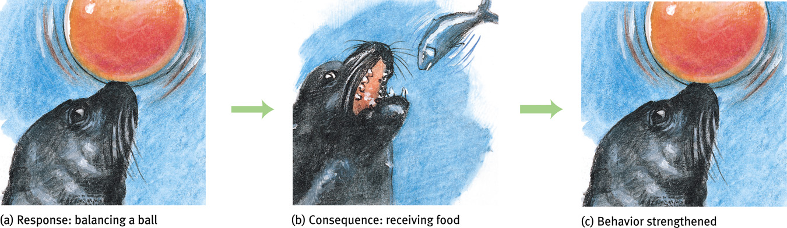
Operant Conditioning
Operant conditioning involves adjusting to the consequences of our behaviors, so we can easily learn to do more of what works, and less of what doesn’t work. Examples 🡪
We may smile more at work after this repeatedly gets us bigger tips.
We learn how to ride a bike using the strategies that don’t make us crash.
How it works:
An act of chosen behavior (a “response”) is followed by a reward or punitive feedback from the environment.
Results:
Reinforced behavior is more likely to be tried again.
Punished behavior is less likely to be chosen in the future.
Response: balancing a ball
Consequence: receiving food
Behavior strengthened
Notes:
Click to reveal bullets and example.
Instructor: the word “strengthened” is used here to refer to making the behavior happen more frequently, more intensely, or in the case of the seals, more accurately and reliably.

Slide 16
Classical conditioning:
Operant and Classical Conditioning are Different Forms of Associative Learning
Operant conditioning:
involves respondent behavior, reflexive, automatic reactions such as fear or craving
these reactions to unconditioned stimuli (US) become associated with neutral (then🡪conditioned) stimuli
involves operant behavior, chosen behaviors which “operate” on the environment
these behaviors become associated with consequences which punish (decrease) or reinforce (increase) the operant behavior
There is a contrast in the process of conditioning.
The experimental (neutral) stimulus repeatedly precedes the respondent behavior, and eventually triggers that behavior.
The experimental (consequence) stimulus repeatedly follows the operant behavior, and eventually punishes or reinforces that behavior.
Notes:
Click to reveal all bullets.

Slide 17
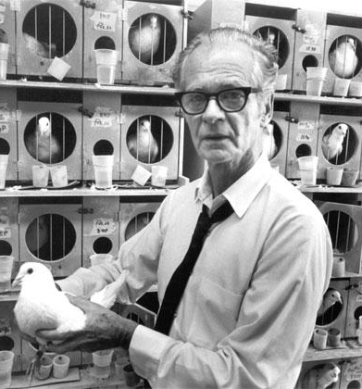
B.F. Skinner: Behavioral Control
B. F. Skinner saw potential for exploring and using Edward Thorndike’s principles much more broadly. He wondered:
how can we more carefully measure the effect of consequences on chosen behavior?
what else can creatures be taught to do by controlling consequences?
what happens when we change the timing of reinforcement?
B.F. Skinner trained pigeons to play ping pong, and guide a video game missile.
Notes:
Click to reveal bullets.
B.F. Skinner, unlike John B. Watson, did not go into advertising to use his ideas. Instead, Skinner envisioned societies where desired behaviors were deliberately shaped with reinforcement. Skinner is well known for his books Walden Two (1948) and Beyond Freedom and Dignity (1971).

Slide 18
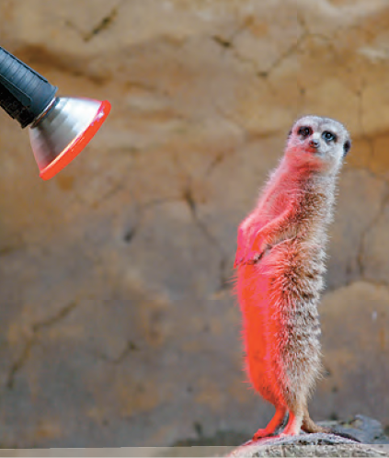
Reinforcement
Reinforcement refers to any feedback from the environment that makes a behavior more likely to recur.
Positive (adding) reinforcement: adding something desirable (e.g., warmth)
Negative (taking away) reinforcement: ending something unpleasant (e.g., the cold)
This meerkat has just completed a task out in the cold
For the meerkat, this warm light is desirable.
Notes:
Click to reveal bullets.
You can give students a preview of upcoming concepts by pointing out that taking the warm light away from the meerkat could be used as a punishment (a negative punishment, because it’s taking something away).

Slide 19
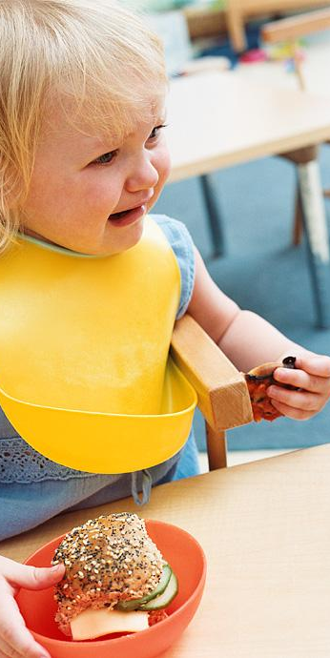
A cycle of mutual reinforcement
Children who have a temper tantrum when they are frustrated may get positively reinforced for this behavior when parents occasionally respond by giving in to a child’s demands.
Result: stronger, more frequent tantrums
Parents who occasionally give in to tantrums may get positively reinforced when the child responds by ending the tantrum.
Result: parents giving-in behavior is strengthened (giving in sooner and more often)
Notes:
Click to reveal bullets.

Slide 20
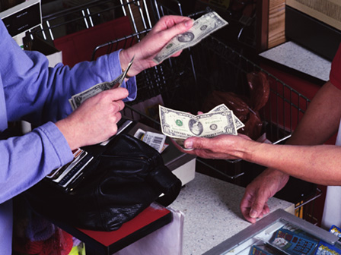
Why we might work for money
If we repeatedly introduce a neutral stimulus before a reinforcer, this stimulus acquires the power to be used as a reinforcer.
A primary reinforcer is a stimulus that meets a basic need or otherwise is intrinsically desirable, such as food, fun, attention, or power.
A secondary/conditioned reinforcer is a stimulus, such as a rectangle of paper with numbers on it (money) which has become associated with a primary reinforcer (money buys food, builds power).
Notes:
Click to reveal bullets.
Instructor: you could ask the class, “what learning process allows money to serve as a reinforcer when it’s just a fancy piece of paper (cash or check) or numbers on a screen?”
Students might provide various “correct” answers:
1. higher order conditioning
2. classical conditioning, if the pay is presented along with other benefits, OR during the process at a store when holding cash immediately predicts getting something we already like
3. operant conditioning, when earning a lot of cash later gets reinforced by the things money can buy
4. cognitive learning, when we use our rational ability to plan and make predictions to understand that the money represents the ability to get things we want

Slide 21
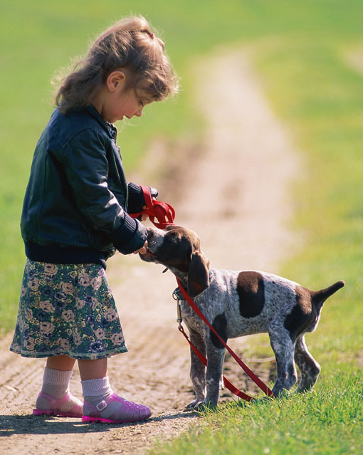
A Human Talent: Responding to Delayed Reinforcers
If you give a dog a treat ten minutes after they did a trick, you’ll be reinforcing whatever they did right before the treat (sniffing?). Dogs respond to immediate reinforcement.
Humans have the ability to link a consequence to a behavior even if they aren’t linked sequentially in time. The piece of paper (money) can be a delayed reinforcer, paid a month later, yet still reinforcing if we link it to our performance.
Delaying gratification, a skill related to impulse control, enables longer-term goal setting.
Notes:
Click to reveal bullets.

Slide 22
Operant Effect: Punishment
Punishments have the opposite effects of reinforcement. These consequences make the target behavior less likely to occur in the future.
+ Positive Punishment
You ADD something unpleasant/aversive (ex: spank the child)
- Negative Punishment
You TAKE AWAY something pleasant/ desired (ex: no TV time, no attention)--MINUS is the “negative” here
🡪Positive does not mean “good” or “desirable” and negative does not mean “bad” or “undesirable.”
Notes:
Click to reveal bullets.

Slide 23
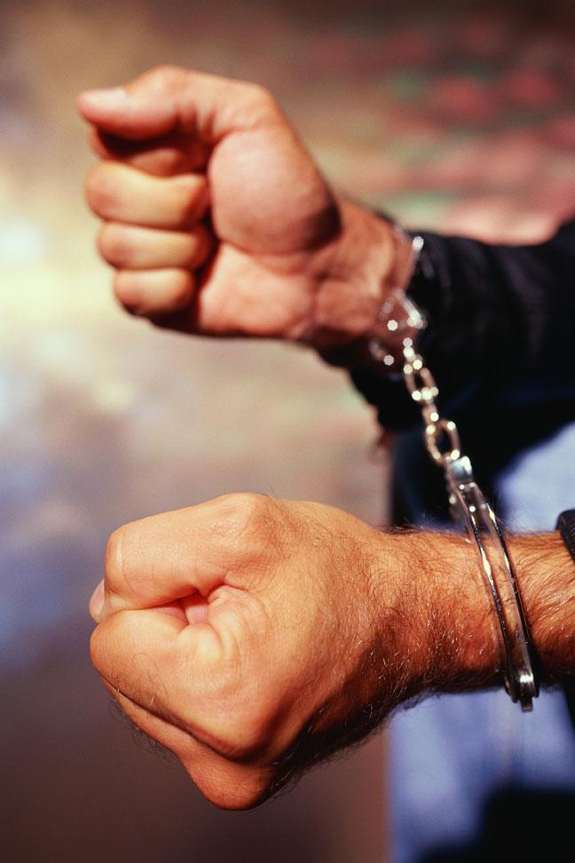
When is punishment effective?
Punishment works best in natural settings when we encounter punishing consequences from actions such as reaching into a fire; in that case, operant conditioning helps us to avoid dangers.
Punishment is effective when we try to artificially create punishing consequences for other’s choices; these work best when consequences happen as they do in nature.
🡪Severity of punishments is not as helpful as making the punishments immediate and certain.
Notes:
Click to reveal bullets.
Instructor: an overall answer to the question in the slide title might be that punishment works best when it approximates the way we naturally encounter immediate consequences (less well when the only consequence we encounter is a distant, delayed, possible threat).
You can ask students, testing both their reading and their thinking: “Does the final sentence suggest any changes to our criminal justice system?” The text reviews an example of how drunk driving was reduced not by harsh sentencing, but by better patrolling (more certainty of consequences) and by arresting people right away (more immediate consequences). Another study applied this insight to traffic enforcement. Immediate feedback, even signs showing your speed, work better to reduce traffic violations than punishments that were more severe but delayed and inconsistent.

Slide 24
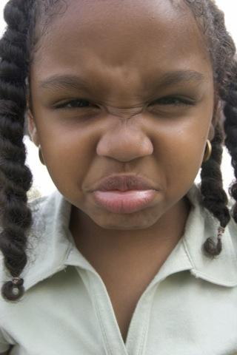
Applying operant conditioning to parenting Problems with Physical Punishment
Punished behaviors may restart when the punishment is over; learning is not lasting.
Instead of learning behaviors, the child may learn to discriminate among situations, and avoid those in which punishment might occur.
Instead of behaviors, the child might learn an attitude of fear or hatred, which can interfere with learning. This can generalize to a fear/hatred of all adults or many settings.
Physical punishment models aggression and control as a method of dealing with problems.
Notes:
Click to reveal bullets.
Instructor: you can point out to students that these points, especially the first three, are not reasons why physical punishment is morally wrong. Instead, they are reasons why physical punishment doesn’t work well as an operant conditioning technique. The fourth/last point is also an example of ineffectiveness if (presumably) the parent is trying to teach prosocial behavior.

Slide 25

Don’t think about the beach
Don’t think about the waves, the sand, the towels and sunscreen, the sailboats and surfboards. Don’t think about the beach.
Are you obeying the instruction? Would you obey this instruction more if you were punished for thinking about the beach?
Notes:
Let the automatic animation play out.

Slide 26
Problem:
Punishing focuses on what NOT to do, which does not guide people to a desired behavior.
Even if undesirable behaviors do stop, another problem behavior may emerge that serves the same purpose, especially if no replacement behaviors are taught and reinforced.
Lesson:
In order to teach desired behavior, reinforce what’s right more often than punishing what’s wrong.
Notes:
Click to reveal lesson.
Instructor: see if students can think of examples of lessons their parents tried to teach them that were in the form of “Don’t…” Then see if the students can restate the lesson in a form of what they SHOULD do. For example, “don’t run across the street without looking” might become “look both ways before you cross the street.”

Slide 27
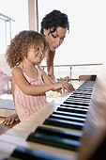
More effective forms of operant conditioning The Power of Rephrasing
Positive punishment: “You’re playing video games instead of practicing the piano, so I am justified in YELLING at you.”
Negative punishment: “You’re avoiding practicing, so I’m turning off your game.”
Negative reinforcement: “I will stop staring at you and bugging you as soon as I see that you are practicing.”
Positive reinforcement: “After you practice, we’ll play a game!”
Notes:
Click to reveal bullets.

Slide 28
Summary: Types of Consequences
Adding stimuli | Subtract stimuli | Outcome
Positive + Reinforcement (You get candy) | Negative –Reinforcement (I stop yelling) | Strengthens target behavior (You do chores)
Positive + Punishment (You get spanked) | Negative –Punishment (No cell phone) | Reduces target behavior (cursing)
= uses desirable stimuli
= uses unpleasant stimuli
Notes:
No animation.

