Slide 1
PSY 421
Summer 2018
Faculty Member:
Shami Suhrid
Psychosocial Counselor and Lecturer
Counseling Unit
BRAC University

Slide 2

Motivation:
Does motivation work in humans by way of drives, incentives, and optimizing arousal, or by following a hierarchy of motives?
Some strong human drives we will examine include:
  hunger, with an application to obesity.
  belonging, relating to ostracism and networking.
  Work motivation and organizational psychology
Notes:
Click to reveal bullets.

Slide 3

Motivation
Motivation refers to a need or desire that energizes behavior and directs it towards a goal.
For example, Aron Ralston found the motivation to cut off his own arm when trapped on a cliff in Utah in 2003.
What motivated him to do this? Hunger? The drive to survive? The drive to reproduce?
Notes:
Click to reveal bullets.
The drive to survive might seem more obvious, but see if students can guess why the drive to reproduce is listed here. Ralston, after thinking he had no way to survive, had a dream of a one-armed man picking up a young boy. Maybe this stirred up his desire to live to be a father someday. [His first child, Leo, was born in 2010.]

Slide 4
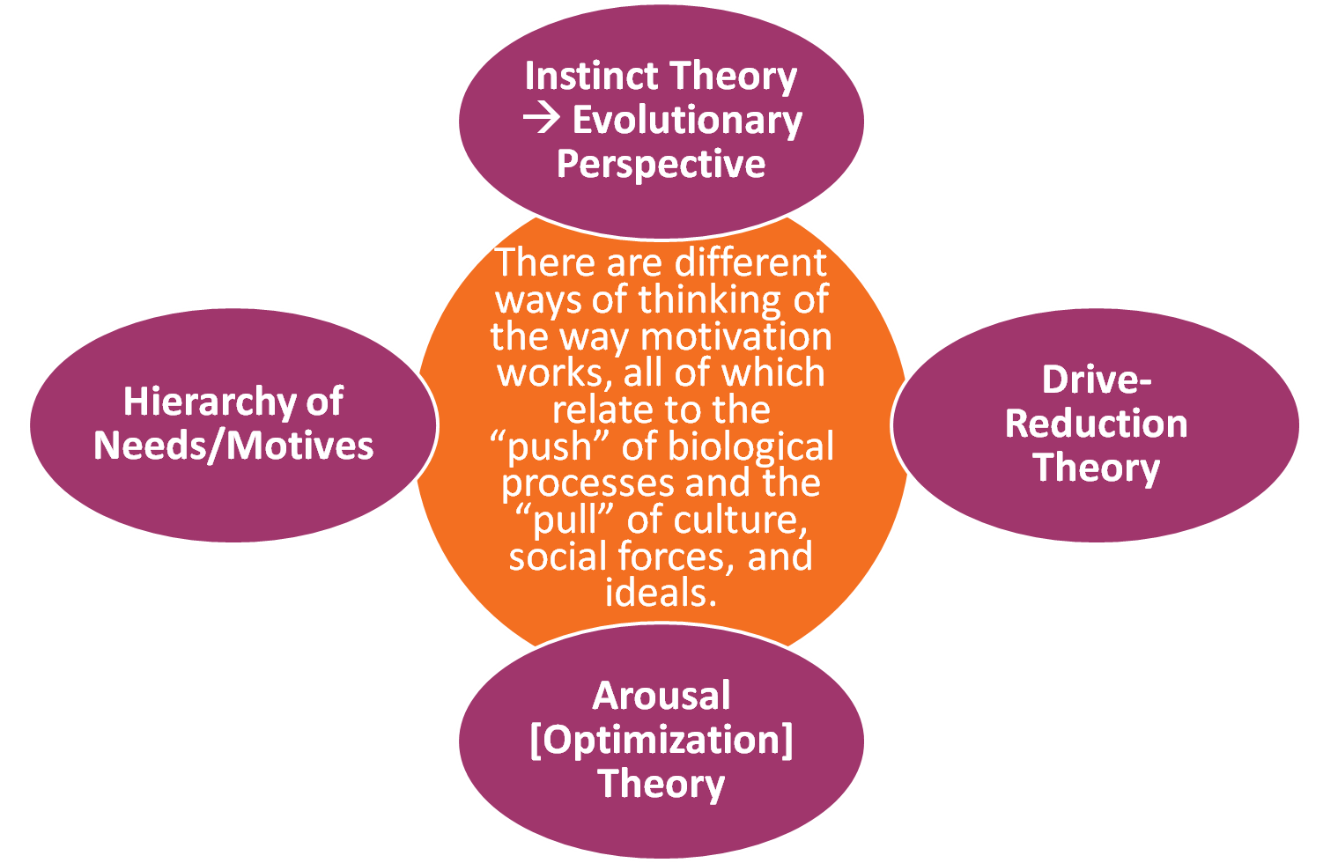
Perspectives on Motivation
Notes:
No animation.

Slide 5
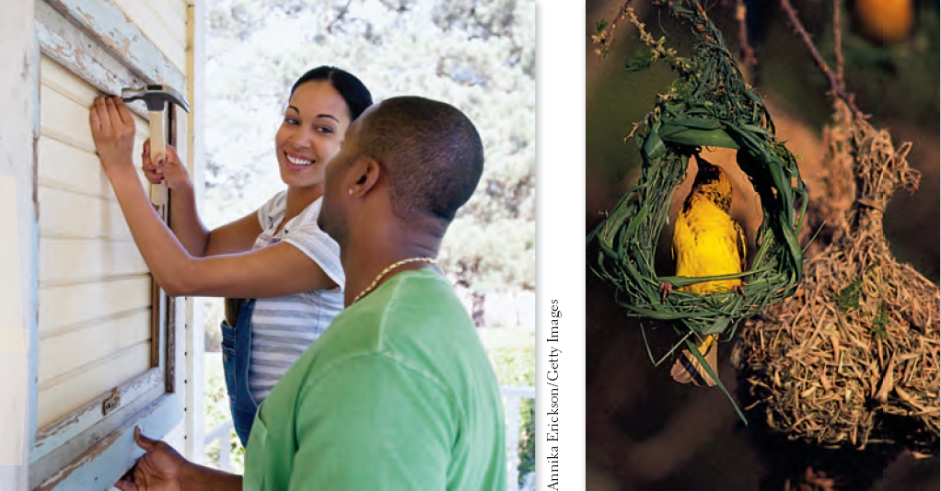
Do Instincts Direct Human Behavior?
An instinct is a fixed (rigid and predictable) pattern of behavior that is not acquired by learning and is likely to be rooted in genes and the body.
Human “nesting” behavior
Instinctual nesting
Notes:
No animation.
Humans may have a general nesting “instinct,” but the specific behavior is less predictable. The bird can only build one kind of nest, but humans may decorate a baby’s room in a variety of ways, or use this general “instinct” to simply buy and repair a home.

Slide 6
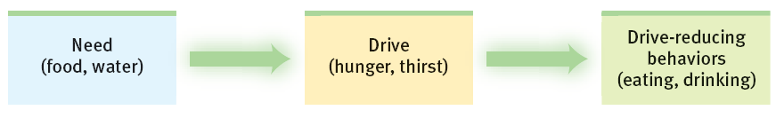
Drive Reduction
  A drive is an aroused/tense state related to a physical need such as hunger or thirst.
  Drive-reduction theory refers to the idea that humans are motivated to reduce these drives, such as eating to reduce the feeling of hunger. This restores homeostasis, a steady internal state.
Notes:
Click to reveal bullets and example.

Slide 7
Drives “Push” and Incentives “Pull”
Drives are based on inner needs and can be seen as a force “pushing” from inside of us.
Incentives are external stimuli that either appeal to our needs or trigger our aversive feelings, and can be used to “pull” us in our actions.
For example:
we have a drive to have food, or money we can exchange for food.
employers can use the prospect of a raise in (or elimination of) salary as an incentive for us to follow employer goals and policies.
Notes:
Automatic animation for first half. Click to reveal example.

Slide 8
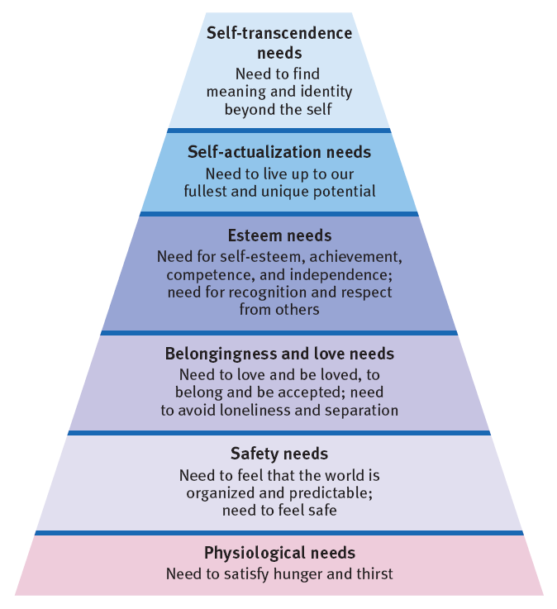
Hierarchy of Needs/Motives
In 1943, Abraham Maslow proposed that humans strive to ensure that basic needs are satisfied before they find motivation to pursue goals that are higher on this hierarchy.
Notes:
No animation.

Slide 9
Violating the Hierarchy?
Do hunger strikers and mystics feel secure enough in meeting their needs that they can do without food temporarily to pursue a higher goal?
Soldiers sacrifice safety, but could they be seen as fighting for safety, both indirectly (protecting the country) and directly (defeating the people shooting at them)?
Notes:
No animation.

Slide 10
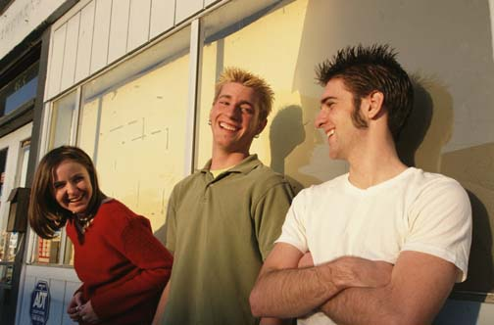
Another Motivation: “To Belong”
What do people need besides food and sex?
Aristotle: friends
Alfred Adler: community
In Middle English, to be wretched [wrecche] means to “be without kin nearby”
Roy Baumeister, Mark Leary, and Abraham Maslow:
“To Belong.”
Belonging refers to being connected to others; part of a group or family or community.
Notes:
Click to reveal bullets and definition.

Slide 11
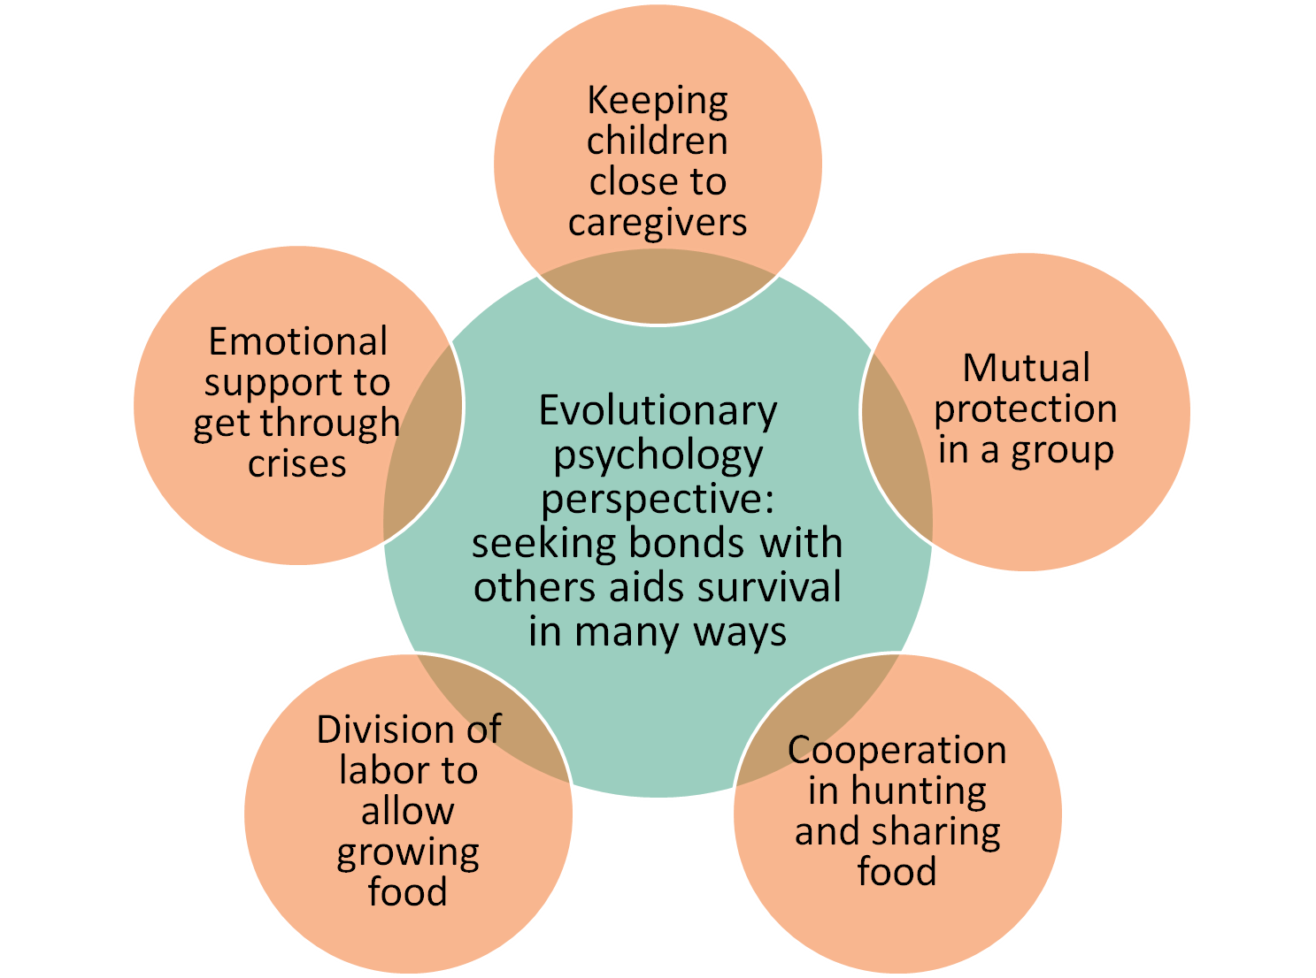
Why do we have a need to belong?
Notes:
No animation.

Slide 12
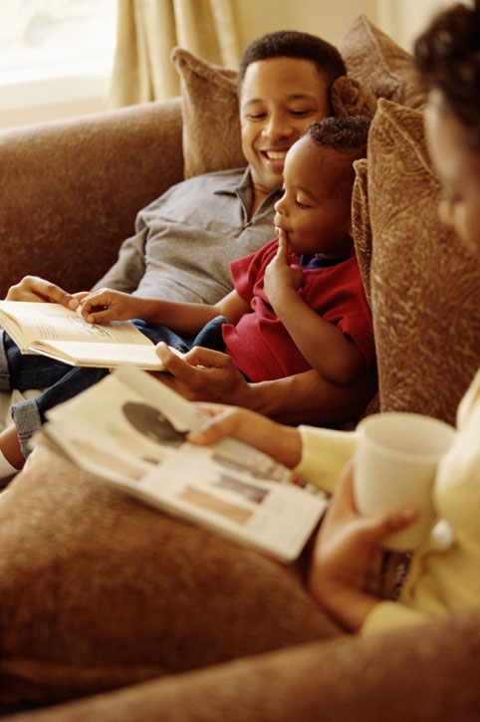
Balancing Bonding with Other Needs
The need to bond with others is so strong that we can feel lost without close relationships.
However, we also seem to need autonomy and a sense of personal competence/efficacy.
There a tension between “me” and “us,” but these goals can work together.
→ Belonging builds self-esteem, and prepares us for confident autonomy.
Notes:
Click to reveal bullets.

Slide 13
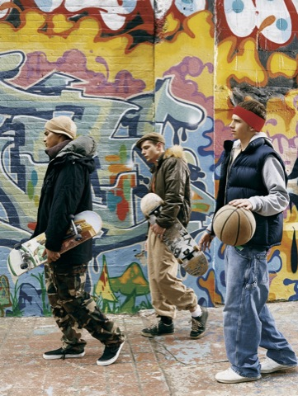
The Need to Belong Leads to:
loyalty to friends, teams, groups, and families.
However, the need to belong also leads to:
changing our appearance to win acceptance.
staying in abusive relationships.
joining gangs, nationalist groups, and violent organizations.
Notes:
Click to reveal text box.
Abusive relationships typically undermine our autonomy and our sense of self-efficacy/competence. Ironically, this makes us less likely to leave an abusive relationship.

Slide 14

Disrupted Bonds, New Beginnings
Children repeatedly moved away from primary caretakers in childhood may have difficulty forming deep attachments in adulthood.
People losing a loved one or moving away from a hometown can feel grief.
Being ostracized, cut off from social contact or excluded, can lead to real physical pain.
  →And yet people can find resilience and relief from pain by building social connections.
Notes:
Click to reveal bullets.

Slide 15
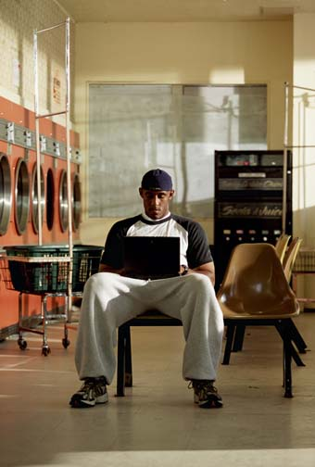
Social Networking =
Social Connection?
Connecting online can be seen as taking turns reading brief words about each other, or as an experience of connection and/or belonging.
Portrayal of one’s self online is often close to one’s actual sense of self.
Use of social networking can become a compulsion, sacrificing face-to-face interaction and in-depth conversation.
Notes:
Click to reveal bullets.
Regarding the face-to-face interaction: I suggest pointing out here that something called “Facebook” may have reduced our exposure to both faces and books.

