Slide 1
Problem Statement 2: User Query on Stack Overflow
ATP coders

Slide 2
Team details
Name of the College:
gates institute of engineering and technology
Team Name:
ATP coders
City:
Anantapur, Andhra Pradesh.
Total team members:
4
Problem statement:
User Query on Stack Overflow

Slide 3

My self
Full name : Pula.Sai Gana Sandeep
Gender: Male
E-mail: ganasandeepsai@gmail.com deepupula@gmail.com
Phone: 7799228879
Currently Pursuing: Under Graduate
Engineering Branch: COMPUTER SCIENCE ENGINEERING
Semester: 3
Aggregate % UG: 77
12th Marks % : 90
10th Marks %: 83
Role in team work: Coder, analyser.
Expertise area: Bug detection, Rectification of errors, task analyser, keen knowledge upon programing, communication skills etc..

Slide 4
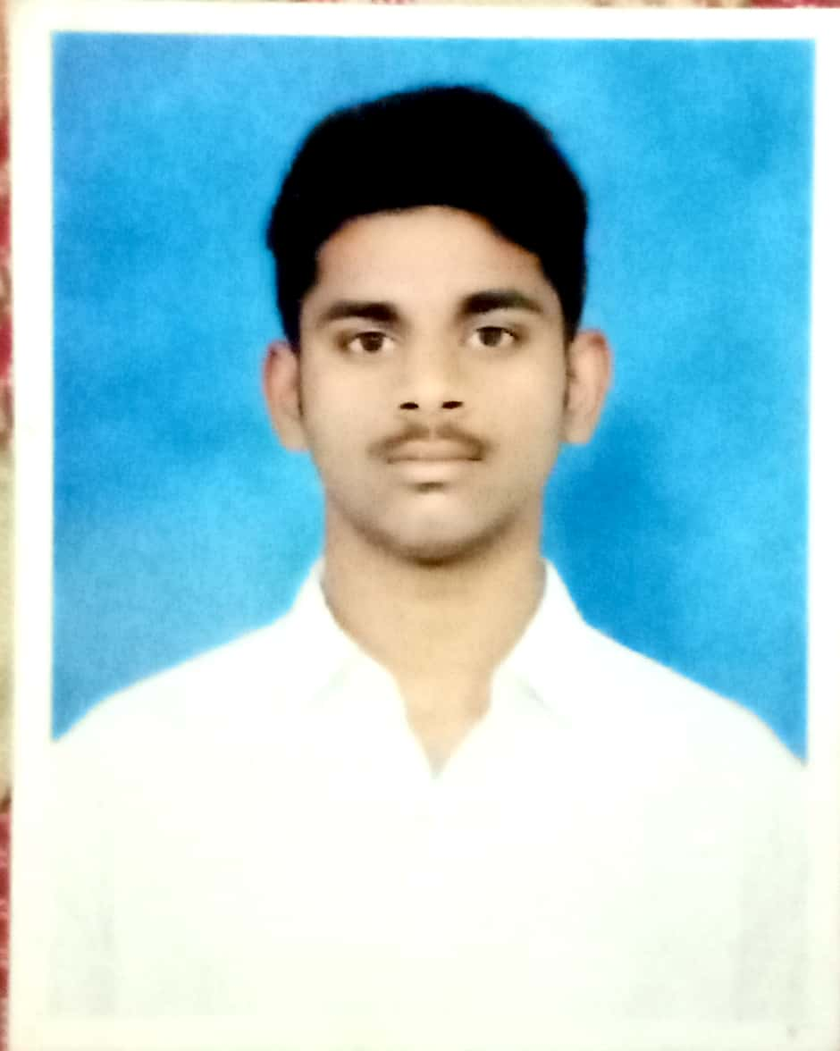
Team members
Full name : k.venkata varun
Gender: Male
E-mail: venkatavarun3@gmail.com
Phone: 9573959461
Currently Pursuing: Under Graduate
Engineering Branch: COMPUTER SCIENCE ENGINEERING
Semester: 3
Aggregate % UG: 70
Role in team work: Analyser, Documentation.
Expertise area: task analyser, programing, communication skills etc..

Slide 5
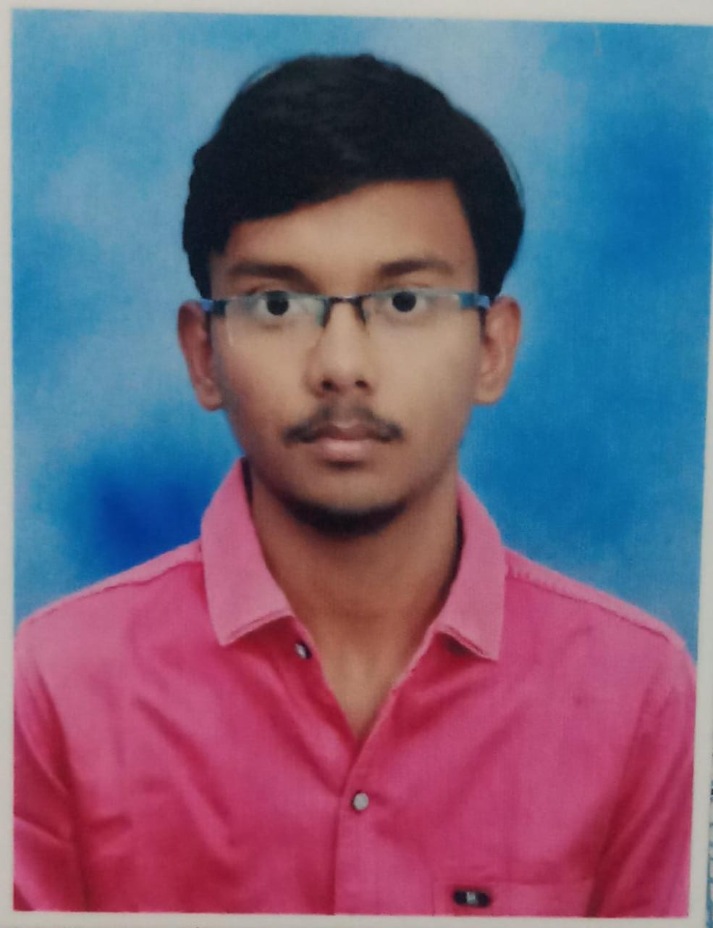
Team members
Full name : shaiksha vali shaik
Gender: Male
E-mail: shaikshavali2204@gmail.com
Phone:8247212132
Currently Pursuing: Under Graduate
Engineering Branch: COMPUTER SCIENCE ENGINEERING
Semester: 3
Aggregate % UG: 70
Role in team work: Schedule manager, flow charts designer, Documentation.
Expertise area: programing, communication skills etc..

Slide 6

Team details
Full name : p.sreekanth reddy
Gender: Male
E-mail: psreekanth934@gmail.com
Phone: 8074627417
Currently Pursuing: Under Graduate
Engineering Branch: COMPUTER SCIENCE ENGINEERING
Semester: 3
Aggregate % UG: 56
Role in team work: flow charts designer, Documentation, schedule manager.
Expertise area: communications etc..

Slide 7
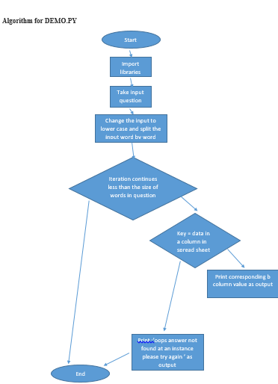
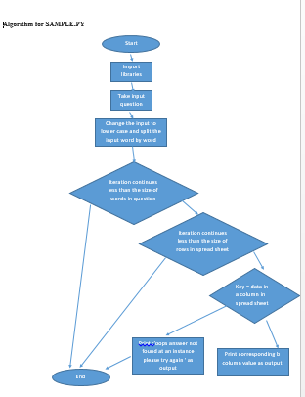
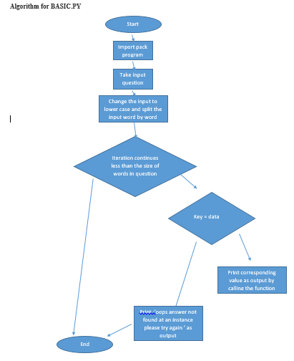
Flow charts

Slide 8
Actual concept
Based on min+max/2 formula
By comparing size of word among question and key word in excel database we use min+max/2 formula based upon data structures.
Algorithm:
if ( string length of word in question= string length of word in excel )
perform mid=min+max/2 formula
if ( word match is true )
print the output of corresponding keyword in excel
else alter min value and max values as per data structure concepts

Slide 9
If ( key >= min ) min = mid else ( key <= max) max = mid
min
max
Key word | Key word | Key word | Key word | Key word | Key word | Key word
Data | Data | Data | Data | Data | Data | data
Note: this is not implemented as soon as we get shortlisted we will submit the entire project

Slide 10
Tools used
Pycharm:
I'm in the unique position of asking over 100 industry experts the following question on my Talk Python To Me podcast. "When you write some Python code, what editor do you open up?" While the answers vary, it is frequently PyCharm. The reasons the guests give are usually the same reasons I've been a PyCharm advocate for years.
PyCharm deeply understands your project, not just individual files
Refactoring is a breeze across an entire project
The built-in SQL tooling is amazing
Autocomplete works better than any other editor, by far
That's just a few reasons I open PyCharm daily to build my web properties and manage the software that runs my business.

Slide 11
Will be going to use further
Anaconda: Anaconda is a free and open-source distribution of the Python and R programming languages for scientific computing, that aims to simplify package management and deployment. Package versions are managed by the package management system conda
Pandas: In computer programming, pandas is a software library written for the Python programming language for data manipulation and analysis. In particular, it offers data structures and operations for manipulating numerical tables and time series. It is free software released under the three-clause BSD license.

Slide 12
Thankyou…

