Slide 1
Harold Pulcher
pulcher@pulcher.biz
https://github.com/pulcher/AzurePlay

Slide 2
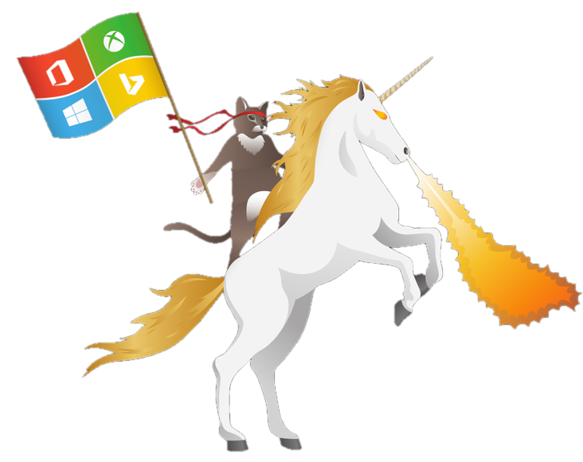

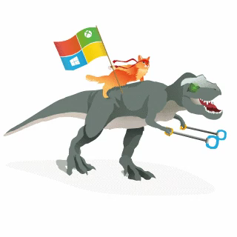

https://www.meetup.com/Hackster-DFW/
https://insider.windows.com/
http://improving.com

Slide 3
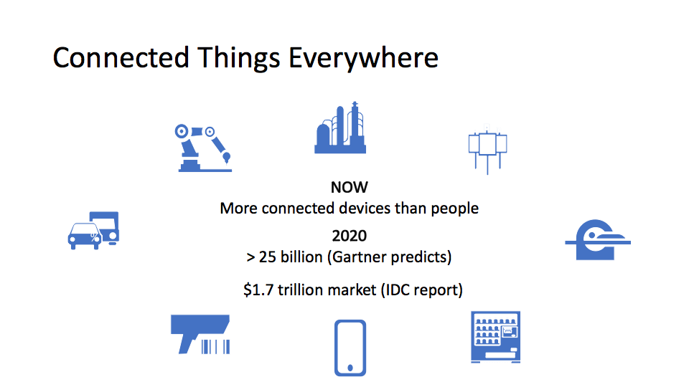

Slide 4
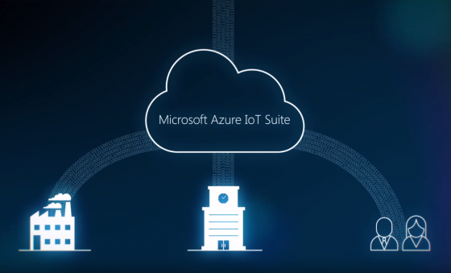
A fully managed service that enables reliable and secure bidirectional communications between millions of IoT devices and a solution back end.

Slide 5
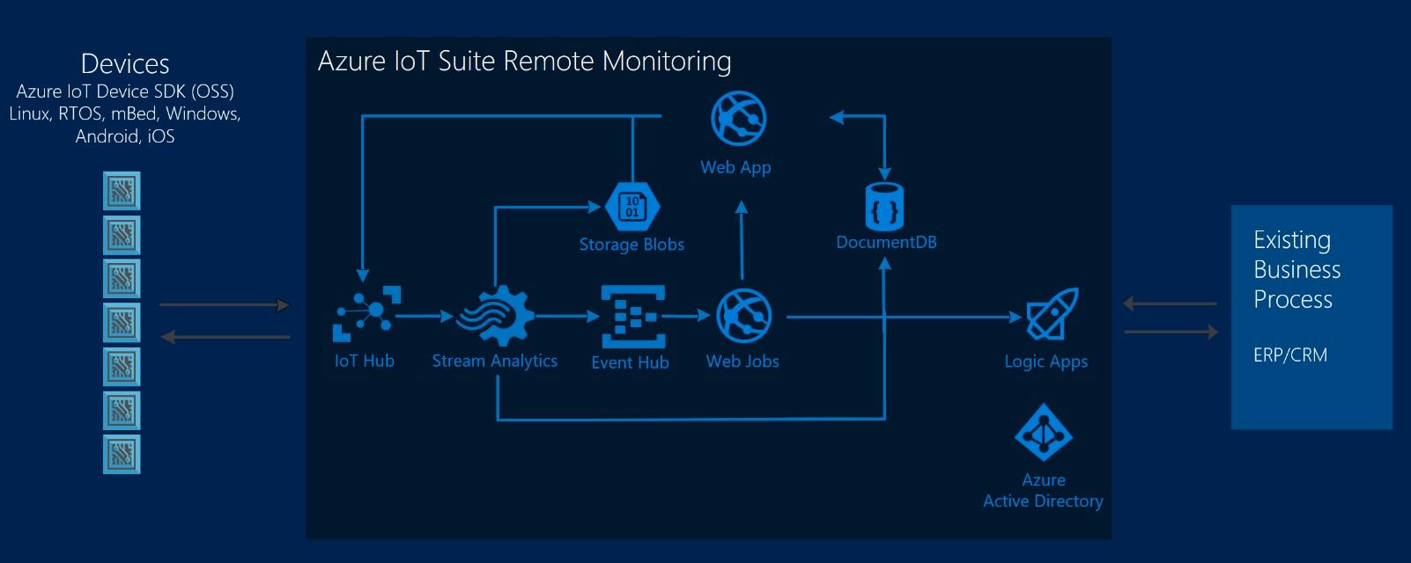
So what can I do with stuff?

Slide 6
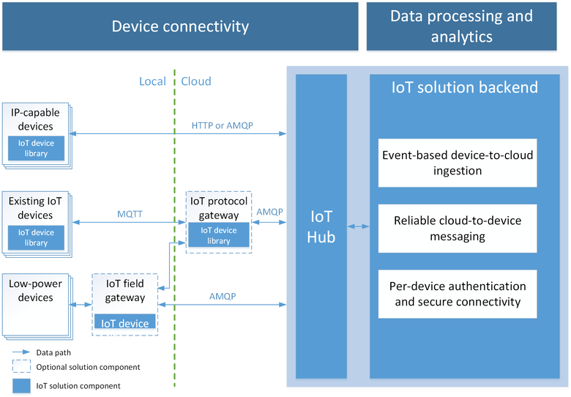
It starts with the Azure IoT Hub

Slide 7

So how do these things connect again?
AMQP
MQTT
HTTPS

Slide 8
Can I use just any old language on any device?
C#
Node.js
Objective C
Swift
Java
Javascript
C <- The sexy isn’t dead yet!
Arduino(MKR1000, Photon, etc)
Minnowboard Max
Intel Edison
Raspberry Pi 2/3/0
Freescale FRDM K64
Asus TinkerBoard
Arrow DragonBoard
Your Computer
https://azure.microsoft.com/en-us/develop/iot/get-started/

Slide 9
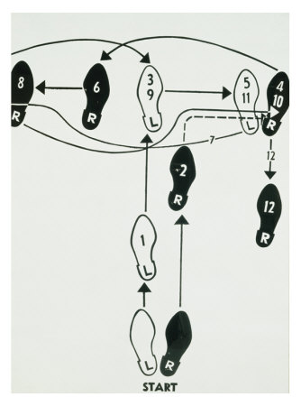
Basic Steps
Get an Azure account
Setup an IoT hub
Grab some credentials
Code up a sender, a receiver, and a device if you have it.

Slide 10
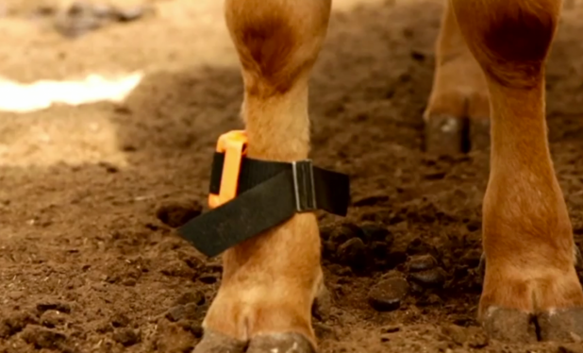
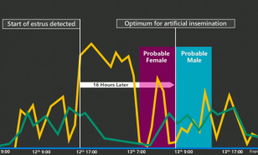
Connected Cow
http://www.youtube.com/embed/oY0mxwySaSo?autoplay=1

Slide 11
Links
Main site: https://azure.microsoft.com/en-us/services/iot-hub/
Dev Guide: https://azure.microsoft.com/en-us/documentation/articles/iot-hub-devguide/
Azure Fridays: https://azure.microsoft.com/en-us/documentation/videos/azure-friday/
Elio Damaggio’s video: https://azure.microsoft.com/en-us/documentation/videos/azurecon-2015-overview-of-azure-iot-hub/
Oliver Bloch’s AzureCon video: https://azure.microsoft.com/en-us/documentation/videos/azurecon-2015-connect-your-iot-devices-with-azure-iot-client-libraries/

Slide 12
Device Explorer: https://github.com/Azure/azure-iot-sdks/blob/master/tools/DeviceExplorer/doc/how_to_use_device_explorer.md
White Papers: https://microsoft.github.io/techcasestudies/#technology=IoT
My examples and slides: https://github.com/pulcher/AzurePlay

