Slide 1

Trust me, Event Hubs are really cool!
Harold Pulcher
pulcher@pulcher.biz
http://pulcher.biz
https://github.com/pulcher/AzurePlay

Slide 2


Slide 3
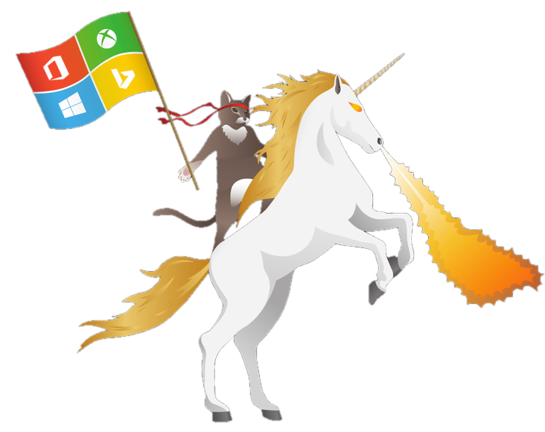
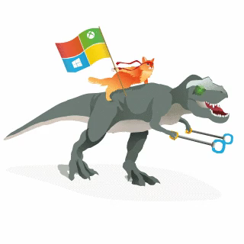
Become a Windows Insider!
https://insider.windows.com/

Slide 4

Need to collect a ton of data
Need to collect data from a ton of devices
Need to collect data on my mobile app that is killin' it!
My new IoT device has to log somewhere.
I care about the order of things.
Shipping logs around and merging

Slide 5

How does this fit?
Part of the Azure Service Bus offering.
Designed for high speed input/ouput.
Queues and Topics are too heavy and not really fast enough.
Based on AMQP and open source standard

Slide 6
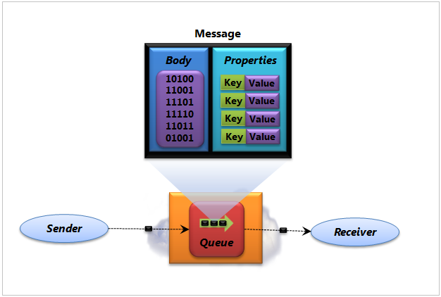
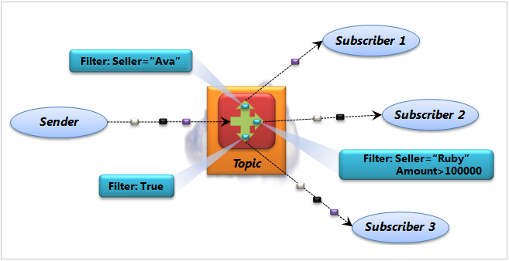
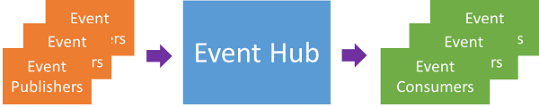
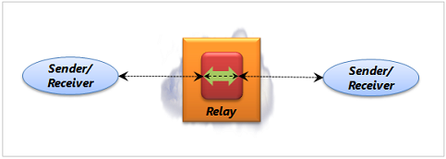
Service Bus

Slide 7

Open standards?
What is AMQP
How long has it been around
Who else uses this stuff?
What platforms are supported?
SwiftMQ, a JMS, AMQP 1.0 and AMQP 0.9.1 broker (free and commercial) and a free AMQP 1.0 client.
Windows Azure Service Bus, Microsoft's cloud-based messaging service
Apache Qpid
Apache ActiveMQ
Apache Apollo
RabbitMQ
IBM MQ Light

Slide 8

Cool, any limits?
1 day retention
Ingres: 1MBps or a 1000 events per second.
Egres: 2 MBps
Maximum size of a single event: 256KB

Slide 9
Can I get more?
Single up to 20 units
A single partition can do 1 unit
You should not have more units than you have partitions(consumers).
Set it on your config page.
Anything over 20 and you have to call Microsoft

Slide 10
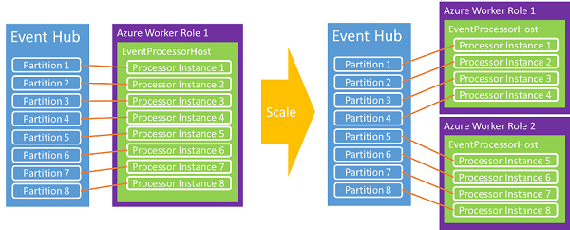
What’s a partition?

Slide 11
What’s the cost?

Slide 12

Hey lets make something!
Azure Account
Visual Studio 2013 community or better

Slide 13
Creating an Event Hub
Depends on how many you want reading
Maximum 32
How many days to retain
Don’t use the Root, create a reader and writer
Create a storage account for partition reader coordination. The processor needs this.

Slide 14
Demo Time

Slide 15
Links
Sign up: http://azure.microsoft.com/en-us/services/event-hubs/
Overview: https://azure.microsoft.com/en-us/documentation/articles/event-hubs-overview/
AMQP: https://en.wikipedia.org/wiki/Advanced_Message_Queuing_Protocol
Service Bus Explorer: https://github.com/paolosalvatori/ServiceBusExplorer

Slide 16
Dan Rosonova: https://channel9.msdn.com/Shows/Azure-Friday/Azure-Service-Bus-Event-Hubs-101-with-Dan-Rosanova
Dan Rosanova: https://channel9.msdn.com/Shows/Azure-Friday/Scaling-out-Azure-Service-Bus-Event-Hubs-102-with-Dan-Rosanova
Elio Damaggio: https://azure.microsoft.com/en-in/documentation/articles/event-hubs-csharp-ephcs-getstarted/
My example: https://github.com/pulcher/AzurePlay

