Slide 1

My Users Posted What?
Harold Pulcher (MVP)
@haroldpulcher
pulcher@pulcher.biz
https://www.youtube.com/user/hpulcher
http://bit.ly/cm-presentation

Slide 2


Slide 3

Become a Windows Insider
https://insider.windows.com/

Slide 4
Ok, really what are we talking about today?
Machine-assisted Content Moderation at Scale with Content Moderator
Notes:
This is part of Cognitive Services, but it goes where most of the other services don’t go.
It generates insight from your content. This is in preview so there are only about 6-8 api’s so far.

Slide 5
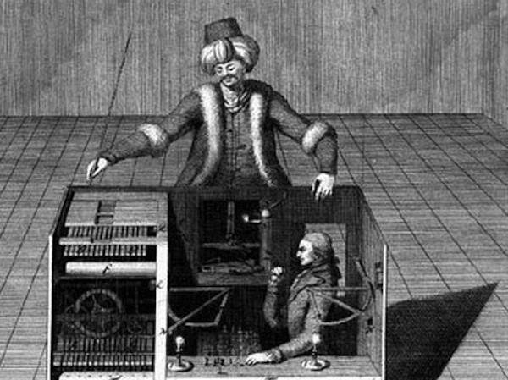
So who can use should use this thing?
Online marketplaces/e-Commerce
Social Media/messaging platforms
Enterprises with documents and user content
Gaming sites with user communities
Media companies that aggregate content
Content Moderation service providers!!!!
Notes:
Online marketplaces: Online reviews, anywhere you can make a comment
Social Media: Facebook, “My space”, Instagram, etc… Whatever the cool kids are using today…
Any place where users can upload images or content. Chats,
A lot of those moderators may be “Mechanical Turks”

Slide 6
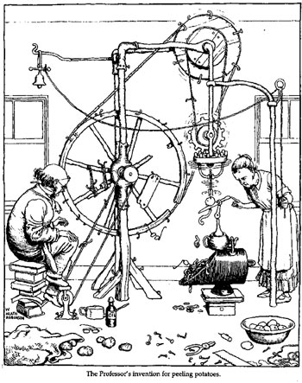
What sorts of problems does this thing help solve?
Brand and customer risks from illegal, inappropriate, and fraudulent content
High direct and indirect costs of traditional content moderation
Significant costs for applying AI & machine learning.
Lack of flexible and scalable tools
Hard to integrate with other business or service providers
Notes:
Not just the cost of having people look at the stuff. Think of the “Health” of these people.
There are ton of costs in training of models and applying machine learning.
Us software folks haven’t really paid very much attention to this stuff. For myself, I do lots of importing/exporting of excel spreadsheet. I would’ve thought we had figured that out by now. ☺
Most of this is bolt on afterwards sorts of stuff, or cobbled together bits of software that really were not meant to work together.

Slide 7
So how can the Content Moderator help?
Broad coverage across images, text and videos
Dramatically lower content moderation costs
Easy-to-integrate, flexible APIs
Built-in human-in-the-loop review tools
Speed and scale of AI on the Azure cloud.

Slide 8
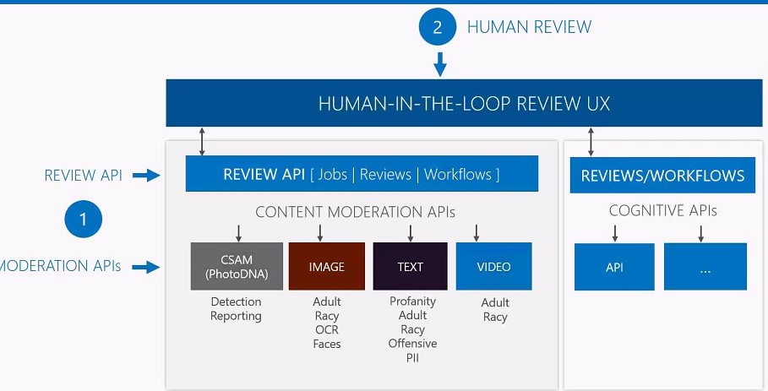
So what do I get with this Content Moderator?
Notes:
Create your own. JSON in a request will create a review.
CSAM (PhotoDNA) free to law enforcement. Being used all of the world to help find missing kids. You have to apply to be able to use this.
PII == Personal Identifying Information.

Slide 9
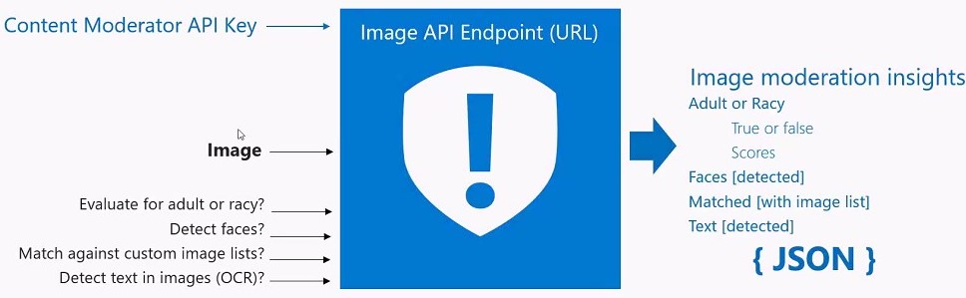
So how do these things work?
Notes:
Takes an API key, some input image, text, or video, maybe some settings if you like. And emits Content Moderation Insights. Which include Classification label, a classification score, and some very specific insights in a JSON object.

Slide 10
Lets see a demo already!!!!!
Notes:
Pull up visual studio and the image moderation.

Slide 11
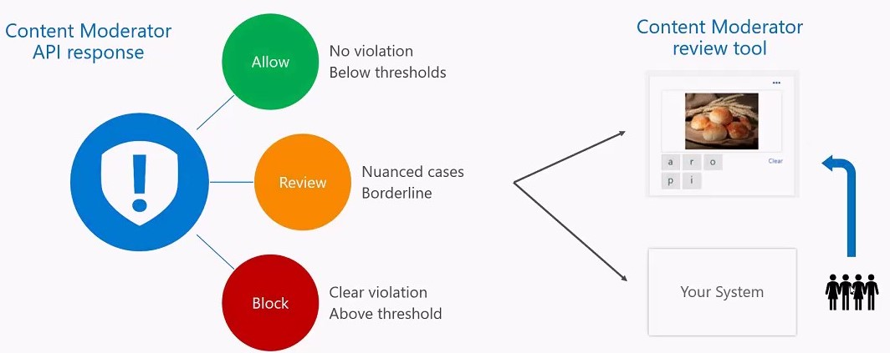
So we moderated stuff. Now what do we do with it?

Slide 12
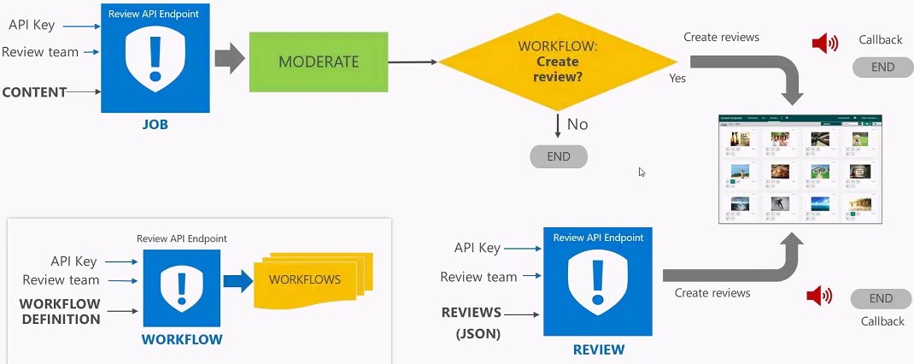
So how does the review stuff work?

Slide 13
Yo! Show off the cool stuff!
Notes:
Pull up visual studio and the image moderation.

Slide 14
Main Azure Link: https://azure.microsoft.com/en-us/services/cognitive-services/content-moderator/
Getting Started: https://docs.microsoft.com/en-us/azure/cognitive-services/content-moderator/quick-start
Facebook Integration: https://docs.microsoft.com/en-us/azure/cognitive-services/content-moderator/facebook-post-moderation

